Slide 1




Paper ID - 432
Improving Transformer-Based Underwater Semantic Segmentation Through Domain-Specific Fine-Tuning
Santosh Anand and Dr. Lalengmawia Chhangte
National Institute of Technology Mizoram, India
4th International Conference on Artificial Intelligence, Computing Technologies, Internet of Things (IoT) and Data Analytics (AICTA 2026),
October 2-3, 2026, NIT Silchar
Notes:
Good morning everyone. I'm presenting our work on improving transformer-based segmentation for underwater images through domain-specific fine-tuning.

Slide 2
Presentation Outline
Introduction
Performance Measures
01
05
Background
Results and Analysis
02
06
Proposed Work
Conclusion and Future Scope
03
07
Dataset Description
References
04
08
4th International Conference on Artificial Intelligence, Computing Technologies, Internet of Things (IoT) and Data Analytics (AICTA 2026),
October 2-3, 2026, NIT Silchar
Notes:
Quick roadmap: the problem, related work, our approach, the dataset, the metrics, the results, and what we conclude.

Slide 3
Introduction
Can domain-specific fine-tuning close the gap between terrestrial pretraining and underwater imagery?
WHY UNDERWATER SCENES ARE HARD
Light is absorbed and scattered, so colors wash out and contrast drops
Uneven lighting and floating particles blur object edges and fine detail
Popular models are pretrained on land-based images
Direct transfer to underwater scenes performs poorly
WHAT THIS PAPER DOES
Evaluates SegFormer and Mask2Former on underwater images as-is
Fine-tunes both on the SUIM dataset
Measures the gain with IoU, Dice and Pixel Accuracy
Compares pretrained and fine-tuned models side by side
4th International Conference on Artificial Intelligence, Computing Technologies, Internet of Things (IoT) and Data Analytics (AICTA 2026),
October 2-3, 2026, NIT Silchar
Notes:
Underwater images suffer from absorption, scattering, uneven light and blur. Models pretrained on land images struggle here. Our question is simple: how much does fine-tuning on underwater data help SegFormer and Mask2Former?

Slide 4
Background
CNN era
FCN, U-Net, DeepLab [5-7]
Strong dense prediction, but convolutions are local and miss long-range context.
Transformers
Vision Transformer [8]
Self-attention captures global relationships across the whole image.
SegFormer and Mask2Former
[2] [3]
Hierarchical encoder with a light MLP decoder; masked attention in a unified mask-classification design.
Underwater work
SUIM [4], UWSegFormer [13] and others
Dataset, enhancement-first pipelines and quality-attention models aimed at underwater degradation.
1
2
3
4
The gap: strong transformer models are trained on terrestrial data, so how well they cope with underwater degradation still has to be measured and adapted.
4th International Conference on Artificial Intelligence, Computing Technologies, Internet of Things (IoT) and Data Analytics (AICTA 2026),
October 2-3, 2026, NIT Silchar
Notes:
CNN-based methods such as FCN, U-Net and DeepLab were strong but local. Transformers brought global context. SegFormer and Mask2Former are two leading designs. Underwater-specific work exists, but we wanted a clean before-and-after view of plain fine-tuning.

Slide 5
Proposed Work
SUIM data
Images + masks resized to 256 x 256
>
Pretrained model
SegFormer-B2, Mask2Former Swin-S
>
New head
Final layer set to 8 SUIM classes
>
Fine-tune
AdamW, batch 8, 10 epochs
>
Evaluate
IoU, Dice, Pixel Accuracy
SEGFORMER-B2
Hierarchical encoder + lightweight MLP decoder
ADE20K-pretrained, 27.4M trainable parameters
Pixel-wise cross-entropy loss
Learning rate 6e-5
MASK2FORMER (SWIN-SMALL)
Masked attention with learned queries, 68.7M parameters
Loss: BCE + Dice (weight 5 each) + classification (weight 2)
Bipartite matching of queries to ground truth
Learning rate 1e-5
4th International Conference on Artificial Intelligence, Computing Technologies, Internet of Things (IoT) and Data Analytics (AICTA 2026),
October 2-3, 2026, NIT Silchar
Notes:
Both models start from pretrained weights. We swap the final layer to eight SUIM classes and fine-tune for ten epochs with AdamW. SegFormer uses cross-entropy; Mask2Former uses a mask loss with BCE and Dice plus a classification loss.

Slide 6
Dataset Description
1,500+
images
8
semantic classes
256 x 256
input size
70:15:15
train / valid / test
SUIM OBJECT CATEGORIES
HOW IT WAS PREPARED
Collected during underwater exploration and human-robot studies
Pixel-level masks annotated by trained annotators
Color-coded masks converted to class indices 0-7
Fish (vertebrates)
Reefs (invertebrates)
Aquatic plants
Wrecks / ruins
Human divers
Robots
Sea-floor
4th International Conference on Artificial Intelligence, Computing Technologies, Internet of Things (IoT) and Data Analytics (AICTA 2026),
October 2-3, 2026, NIT Silchar
Notes:
We use SUIM: over 1,500 images with pixel-level labels for fish, reefs, plants, wrecks, divers, robots and sea-floor. Images are resized to 256 by 256 and split 70-15-15. The color masks are converted to class indices.

Slide 7
Performance Measures
Intersection over Union
Dice Score
Pixel Accuracy
IoU = |P ∩ G| / |P ∪ G|
Dice = 2|P ∩ G| / (|P| + |G|)
PA = correct pixels / all pixels
Overlap between predicted and true regions, relative to their union.
Also rewards overlap, but counts it twice, so it is gentler on small regions.
Share of pixels given the right label; large classes can dominate it.
P = predicted mask, G = ground truth. Training loss: cross-entropy (SegFormer); BCE + Dice + classification (Mask2Former).
4th International Conference on Artificial Intelligence, Computing Technologies, Internet of Things (IoT) and Data Analytics (AICTA 2026),
October 2-3, 2026, NIT Silchar
Notes:
We report IoU, Dice and pixel accuracy. IoU and Dice measure region overlap; pixel accuracy is the fraction of correctly labeled pixels.

Slide 8
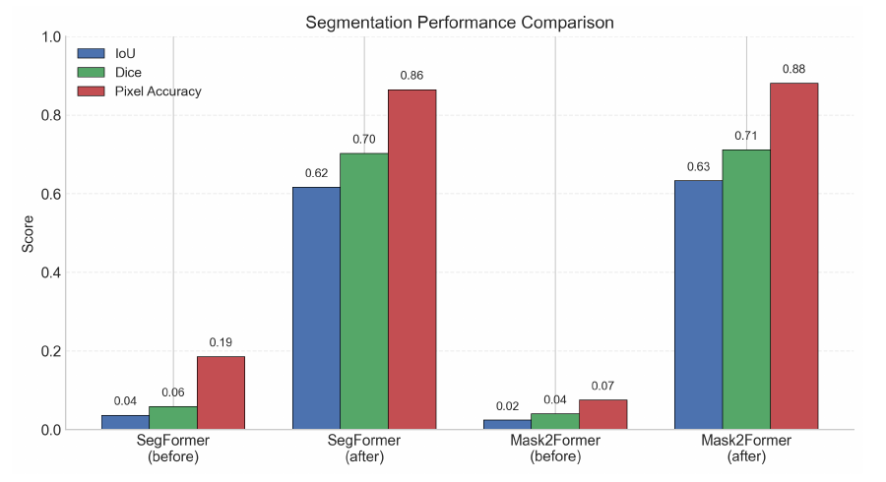
Results and Analysis
Model | IoU | Dice Score | Pixel Accuracy | Training Time
SegFormer (before) | 0.0362 | 0.0580 | 0.1854 | -
SegFormer (after) | 0.6163 | 0.7023 | 0.8646 | 350 min
Mask2Former (before) | 0.0236 | 0.0398 | 0.0747 | -
Mask2Former (after) | 0.6326 | 0.7110 | 0.8808 | 70 min
WHAT STANDS OUT
IoU jumps from 0.036 to 0.616 (SegFormer) and 0.024 to 0.633 (Mask2Former)
Mask2Former ends slightly ahead on every metric
It converges in about 70 min versus 350 min for SegFormer
Larger model (68.7M vs 27.4M parameters), same ~0.9 s inference
4th International Conference on Artificial Intelligence, Computing Technologies, Internet of Things (IoT) and Data Analytics (AICTA 2026),
October 2-3, 2026, NIT Silchar
Notes:
Before fine-tuning both models are essentially unusable: IoU around 0.03. After fine-tuning, IoU is about 0.62 for SegFormer and 0.63 for Mask2Former. Mask2Former is slightly better and trained in 70 minutes versus 350 for SegFormer.

Slide 9
Conclusion & Future Scope
CONCLUSION
Fine-tuning on SUIM lifts both models from near-failure to usable underwater segmentation
Gains appear across IoU, Dice and pixel accuracy
Adapting pretrained transformers narrows the domain-shift gap and improves semantic consistency
FUTURE SCOPE
Extend the approach to datasets from multiple domains
Evaluate with a range of foundation models to look for further gains
0.036 → 0.616
SegFormer IoU
0.024 → 0.633
Mask2Former IoU
70 vs 350 min
Mask2Former vs SegFormer training
4th International Conference on Artificial Intelligence, Computing Technologies, Internet of Things (IoT) and Data Analytics (AICTA 2026),
October 2-3, 2026, NIT Silchar
Notes:
Domain adaptation is what makes these models work underwater. Next we want to test on multiple domains and with foundation models. Thank you, I'm happy to take questions.

Slide 10
References
[1] A. Vaswani et al., Attention is all you need, NeurIPS (NIPS’17), 2017.
[2] E. Xie et al., SegFormer: Simple and efficient design for semantic segmentation with transformers, NeurIPS 34, 2021, pp. 12077–12090.
[3] B. Cheng et al., Mask2Former for video instance segmentation, arXiv:2112.10764, 2021.
[4] M.J. Islam et al., Semantic segmentation of underwater imagery: Dataset and benchmark, IROS 2020, pp. 1769–1776.
[5] J. Long, E. Shelhamer, T. Darrell, Fully convolutional networks for semantic segmentation, CVPR 2015, pp. 3431–3440.
[6] Z. Su et al., An improved U-Net method for the semantic segmentation of remote sensing images, Applied Intelligence 52(3), 2022, pp. 3276–3288.
[7] L.-C. Chen et al., DeepLab: Semantic image segmentation with deep convolutional nets, atrous convolution, and fully connected CRFs, IEEE TPAMI 40(4), 2018, pp. 834–848.
[8] A. Dosovitskiy et al., An image is worth 16x16 words: Transformers for image recognition at scale, arXiv:2010.11929, 2021.
[9] C. Li et al., An underwater image enhancement benchmark dataset and beyond, IEEE TIP 29, 2020, pp. 4376–4389.
[10] F. Liu, M. Fang, Semantic segmentation of underwater images based on improved DeepLab, J. Mar. Sci. Eng. 8(3), 2020.
[11] J. Wang et al., SPPF-CGA: Marine garbage detection and image enhancement in turbid and high-dynamic underwater environments, J. Ocean Univ. China 24, 2025, pp. 1301–1314.
[12] Z. Liu et al., Swin Transformer: Hierarchical vision transformer using shifted windows, ICCV 2021, pp. 10012–10022.
[13] X. Zuo et al., Improving underwater semantic segmentation with underwater image quality attention and multi-scale aggregation attention, Pattern Anal. Appl. 28(2), 2025.
4th International Conference on Artificial Intelligence, Computing Technologies, Internet of Things (IoT) and Data Analytics (AICTA 2026),
October 2-3, 2026, NIT Silchar
Notes:
References, as listed in the paper.

