Slide 1


Hands On Building an Ontology
Training in Semantics and Ontology Development
Wednesday October 28, 2015

Slide 2
Thoughts
Make the colors same as Protégé (have to do blue/green for relation)
[Done. --DC]
Make relation second
[Done. --DC]
Add the classes and relations to the spreadsheet

Slide 3
Five Important Distinctions
Instance
Value
Relation
Class
Taxonomy

Slide 4
Instance (aka Individual)
Instance
Value
Relation
Class
Taxonomy
Instance
Things with independent existence
“British Petroleum”
“MV Sirius Star”
“Houston, TX”
Typically have many complex relationships

Slide 5
Value (literal)
Instance
Value
Relation
Class
Taxonomy
Value
Descriptive text, number, or date
“It was a dark and stormy night..
$45.10
.03
8/25/2015
Technically literals, but best to think of what they represent
Identifiers
Labels
Names
Categories

Slide 6
Relation (Relationship / Property)
Instance
Value
Relation
Class
Taxonomy
Relation
Connects two instances
“BP” “owns” “Cherry Point, WA refinery”
Or associates an instance with a value
“Shardin Oil Field” “firstProductionDate” “5/26/1908”

Slide 7
Class
Instance
Value
Relation
Class
Taxonomy
Class
Sets of things with similar properties (ie. a kind of thing)
“Pipeline”
“Organization”
Typically all instances of a given class have the same properties (relationships), but different values
Subclass (e.g., “Oil Company” is a subclass of “Organization”) is a subset with different properties

Slide 8
Taxonomy (Term, Category)
Instance
Value
Relation
Class
Taxonomy
Taxonomy
Label, used to categorize other things
“Delivered”
“Bankrupt”
“FOB”
May be hierarchical, but this aspect overrated
Does not have complex relationships on its own

Slide 9
Remove the PRS slides
Too specific to Platts

Slide 10
PRS

Slide 11
PRS *** be nice to put the blue and purple on here too

Slide 12
Protégé is…
Free, open source
Ontology editor
Knowledge acquisition system.
Protégé provides a graphic user interface to define ontologies.
Includes deductive classifiers to
Validate that models are consistent
To infer new information based on the analysis of an ontology

Slide 13
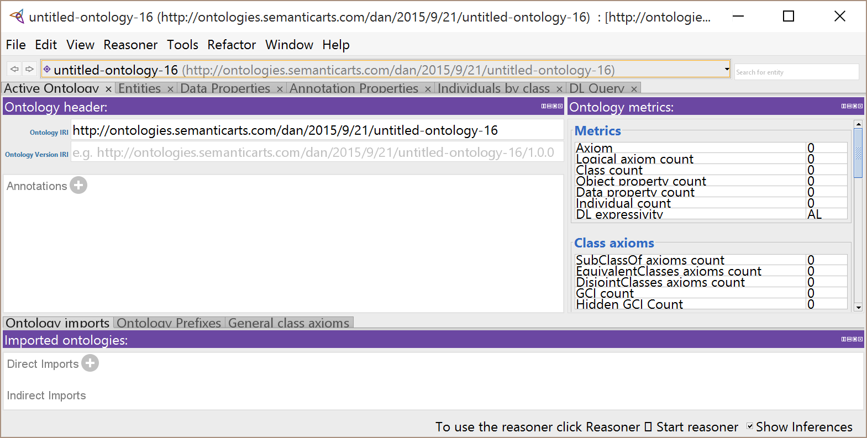
Protégé Check in
Everyone have Protégé installed, working?

Slide 14
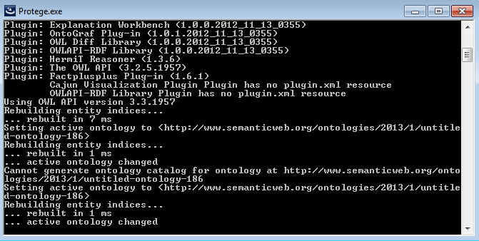
Elsewhere on your desktop
If you ever need to kill a running instance of Protégé, closing this window will do it.
Occasionally there are useful clues in here if something is going wrong.

Slide 15
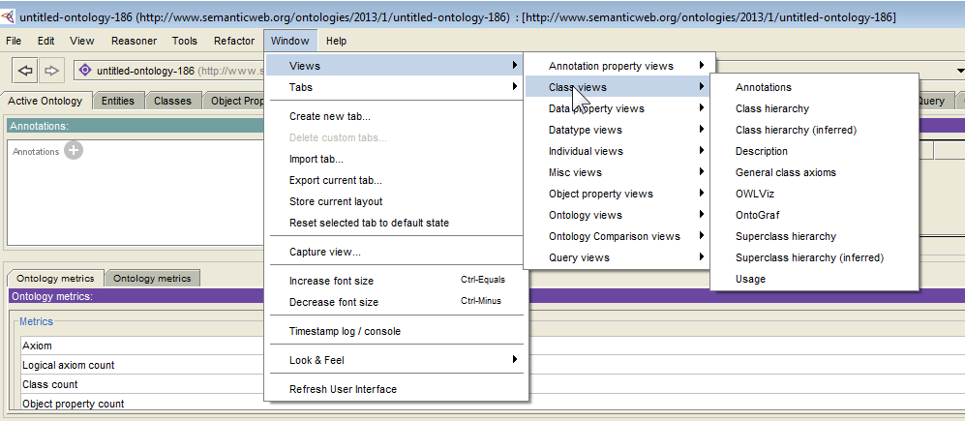
Protégé Quick Tour
Protégé is a view-based Interactive Editor.
There are about 50 different views (panes) of an ontology.
The tabs have some useful preconfigured views.
But you can always add any of the views under Windows/Views to any window as we’ll demonstrate now.

Slide 16
Longer quick tour
Teeny-tiny font?
Window -> Tabs
Check these: Active Ontology, Classes, Object Properties, Data Properties, Individuals by class, SPARQL Query. (Others may be unchecked)
The Annotations frame
The Usage frame

Slide 17
Back to the ontology…
We are going to name our ontology
Since this ontology we are creating has never before existed (many similar ones have but not this one), we get naming rights
I will let you borrow our namespace for the purpose, so you won’t be “URI squatting”

Slide 18
Rethink how we name the ontology
And its relationship to the namespace
Still causing confusion

Slide 19
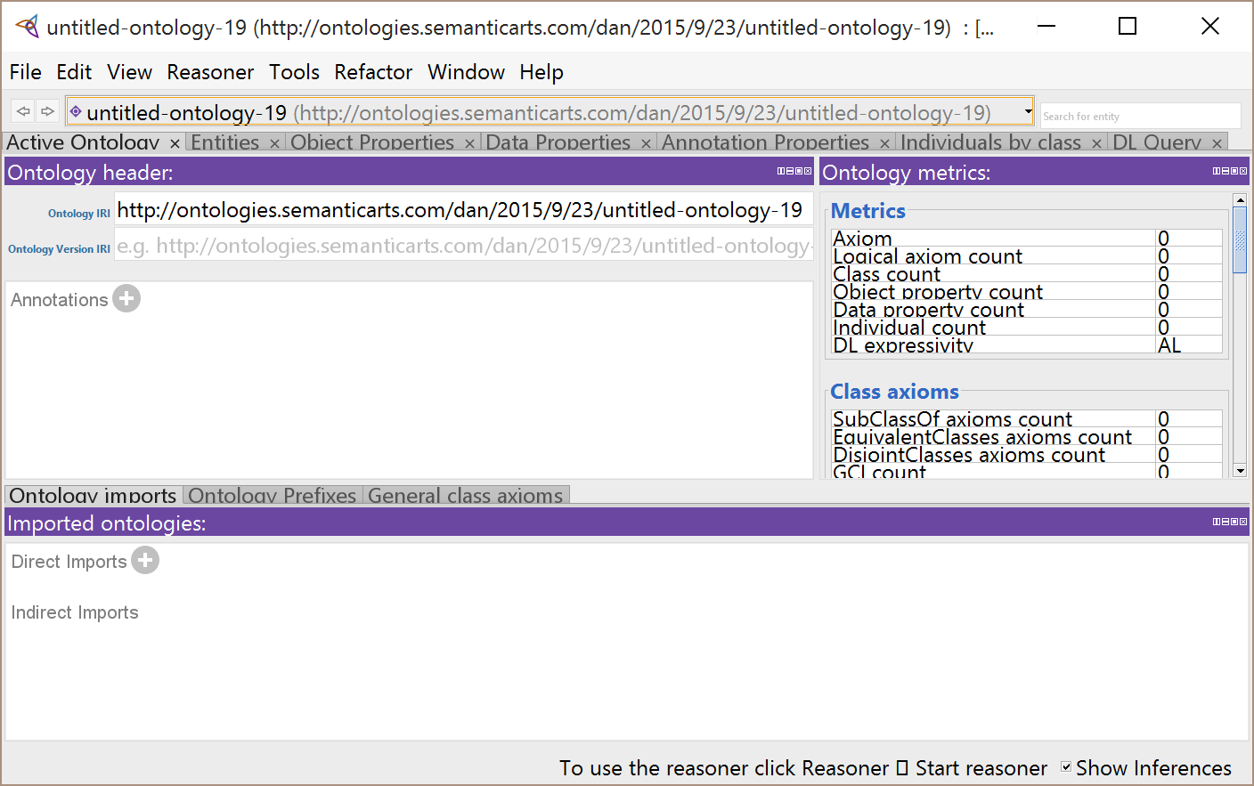
Naming your ontology
The default name appears here.
We will change it to:
Type the new URI here.
http://ontologies.semanticarts.com/DBBO/onto1

Slide 20
Looking at the text file
Let’s wait til they’ve added some stuff
It makes the difference between XML and TTL more obvious
Done. Slides moved. [dc]

Slide 21
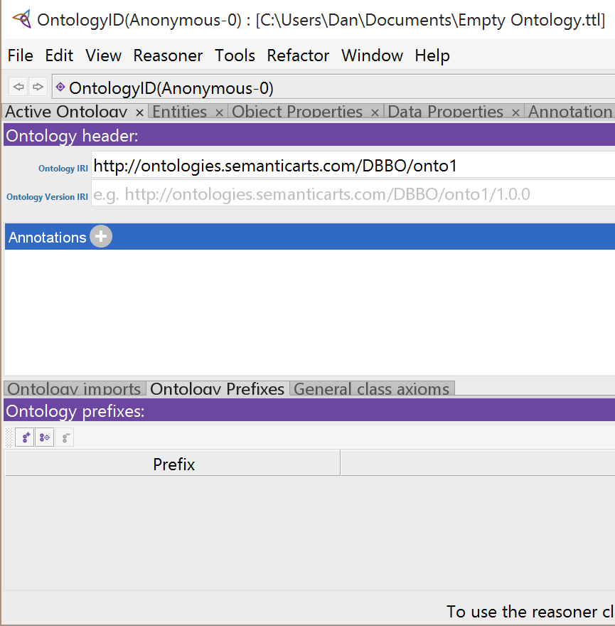
Create a Qname for your Namespace
Click on the Ontology Prefixes tab
And then the first icon, which if you hovered over it would say “add prefix mapping”

Slide 22
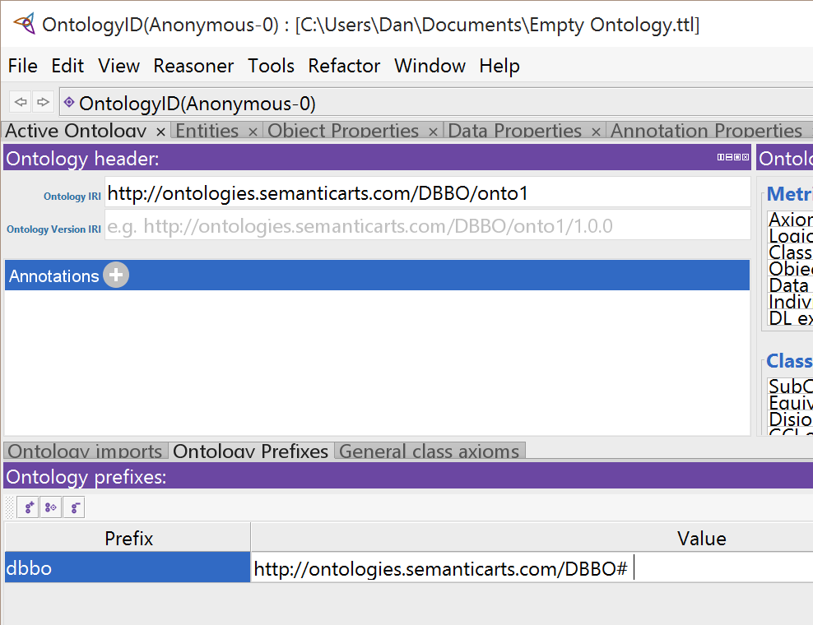
Create a Qname for your Namespace
Double click a field so you can enter data.
In the first field, type “dbbo”
In the second field, type the namespace (which is not the same as the name of our ontology)
(Note: you have to hit a carriage return after entering these fields)

Slide 23
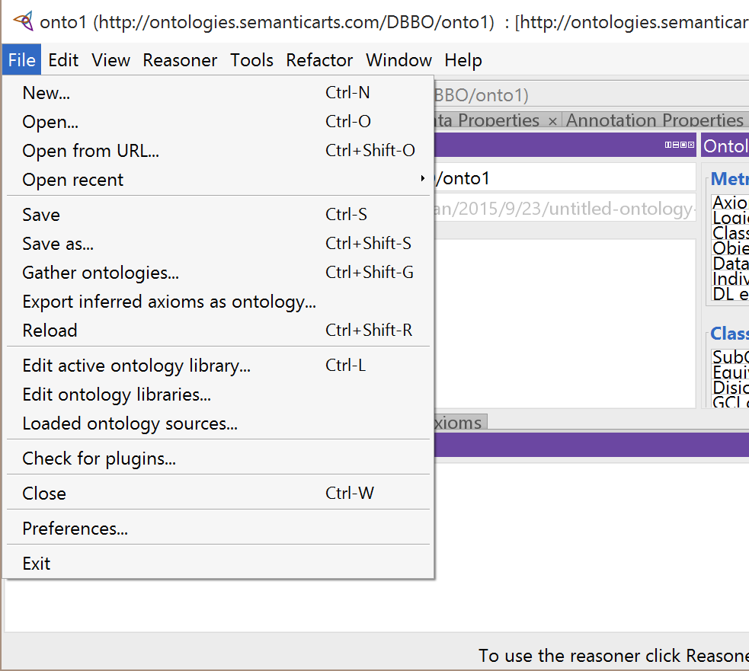
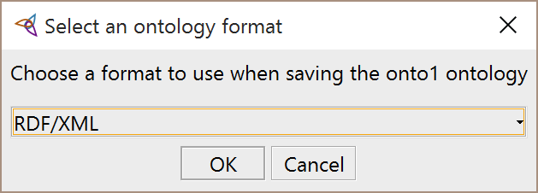
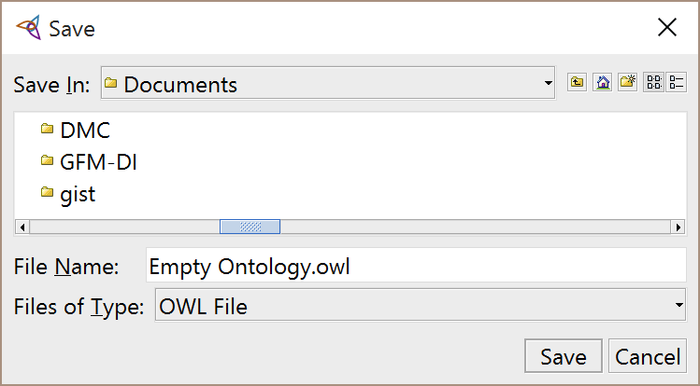
Save this (empty) ontology
RDF/XML is the format within which the ontology will be serialized and saved.
Put it in a directory you can find again, and give it a name you will recognize.
NOTE: the filename need not be the same as the ontology name

Slide 24
Note:
So far all we have is an empty ontology
Let’s put something in it

Slide 25
Recall, In Semantics, All Data is Expressed as Triples
These are also called “assertions,”
To “assert” that Vela owns a particular tanker ship, we could make this assertion:
dbbo:_vela
dbbo:owns
dbbo:_SiriusStar
subject
predicate
object
We call these three parts of the assertion.

Slide 26
Individuals
Individuals (like Vela and the Sirius Star) are actual “in the world” instances; they are not types or classes.
dbbo:_vela
dbbo:owns
dbbo:_SiriusStar
individual
individual

Slide 27
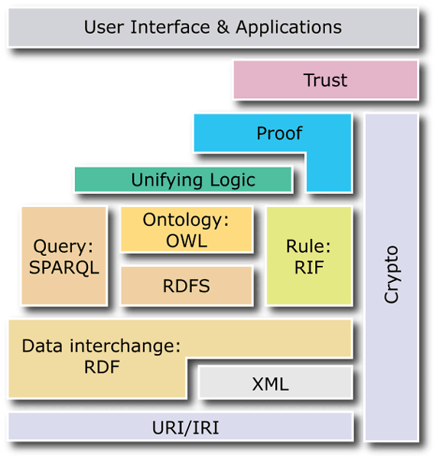
We didn’t mention
Each part of the triple has an identifier

Slide 28
Redo example with 007

Slide 29
Useful Global Identifiers
All systems create identifiers for the many things they need to identify
The traditional approach is to create a primary key on a table

Slide 30
There are problems with this approach
These numbers only mean anything in the context of:
This database
This table
This column

Slide 31
This is one reason existing systems are complex
If you want to get information from multiple different tables
You have to write a query that “joins” the tables
… WHERE Cust.CID = Companies.Comp AND Cust.CID = Stocks.Key and Cust.CID = Securities.ID….

Slide 32
This is one reason existing systems are complex
A human has to know all the metadata in order to construct this join for each use
This join only works between tables in the same database

Slide 33
We need global identifiers
GUIDs
May be globally unique, but not globally resolvable
What will you do when someone sends you a message with this in it?
{21EC2020-3AEA-1069-A2DD-08002B30309D}

Slide 34
Semantic Technology Finesses this with the “URI”
This identifier is truly global
It means the same thing, regardless of the database or document it is part of
cusip:02209S103
=
http://cusip.com/reg#02209S103
In turn, this yields information that can be “joined” without relying on humans or metadata

Slide 35
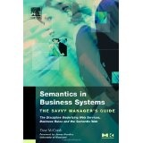
Using URIs (similar to URLs) as identifiers
Gives us truly global unique IDs
That can be looked up, if needed
http://isbn10.isbn.org/books#1558609172
Namespace
Fragment
This is the key to “self-assembling structures”

Slide 36
Semantic Identifiers
This buys you three things:
Human- and machine-readable and -understandable information
Humans can look up to resolve
Self-assembly (we’ll see later)

Slide 37
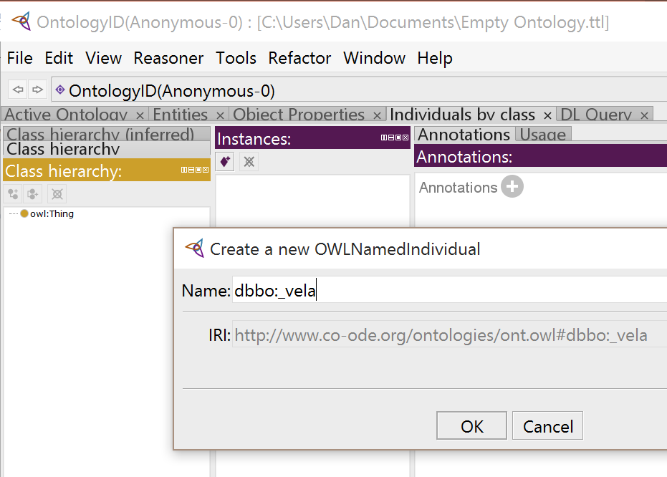
Let’s create an individual
Click the Individuals tab.
Select the Magenta diamond to create an individual.
There is not a uniform practice for naming individuals.
If you have individuals, classes and properties in the same namespace, a leading underscore is a good way to ensure you don’t create an accidental synonym.

Slide 38
Create some more individuals
Let’s create:
_vela
_osg
_SiriusStar
_AriesStar
_Aframax
_velaFleet
_osgFleet
_houston
_brentCrudeOil
_harrisCounty
_texas
_usa
_padd3
_portArthur
_jeffersonCounty
_northAmerica
You may make as many additional individuals as you want.

Slide 39
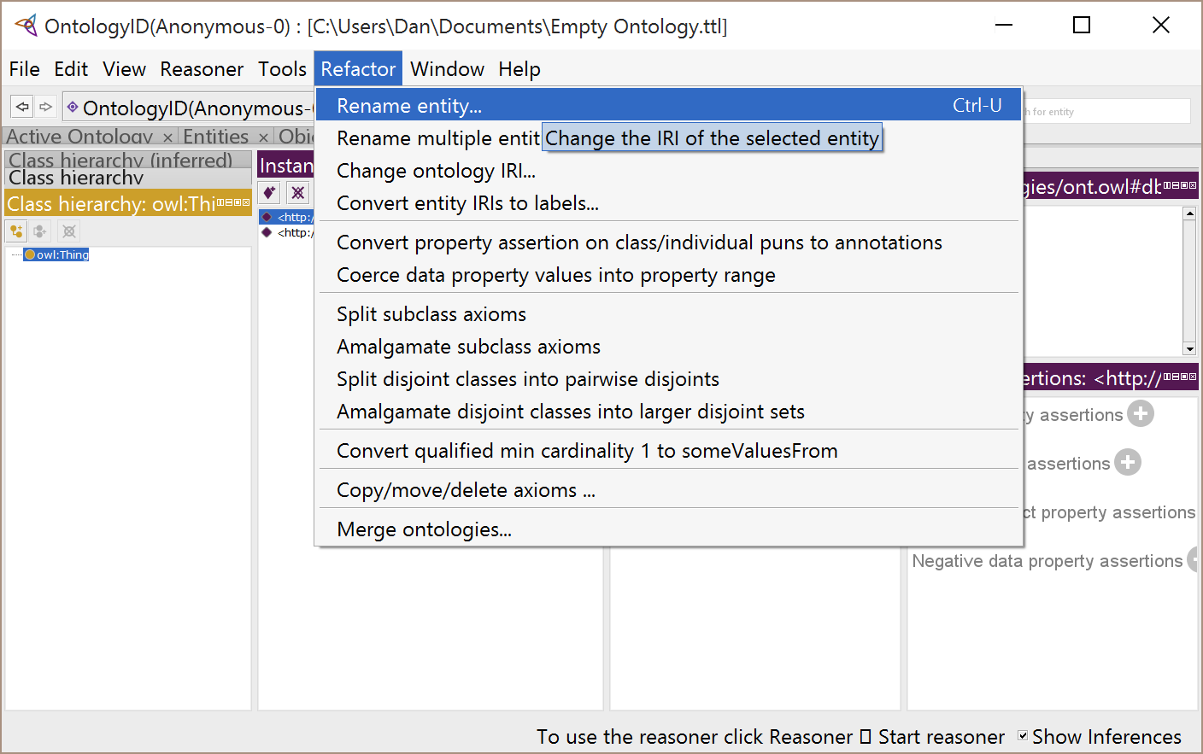
Just in case… (correcting errors)
To make corrections, open the very non-intuitively named “Refactor” menu

Slide 40
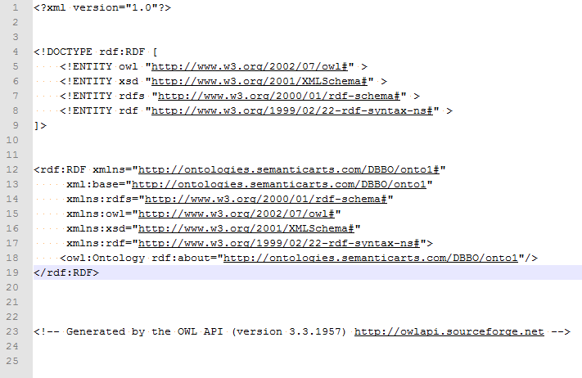
Let’s look at this ontology in a text editor
Formatted this way because we chose XML as our serializing language
These are the standard short prefixes (qnames) for namespaces that get used a lot
This is mostly boiler plate, with one line we added

Slide 41
Let’s look at this ontology in a text editor
Plus, it gets repeated twice as the base and the default
Here is where the actual name of the ontology is

Slide 42
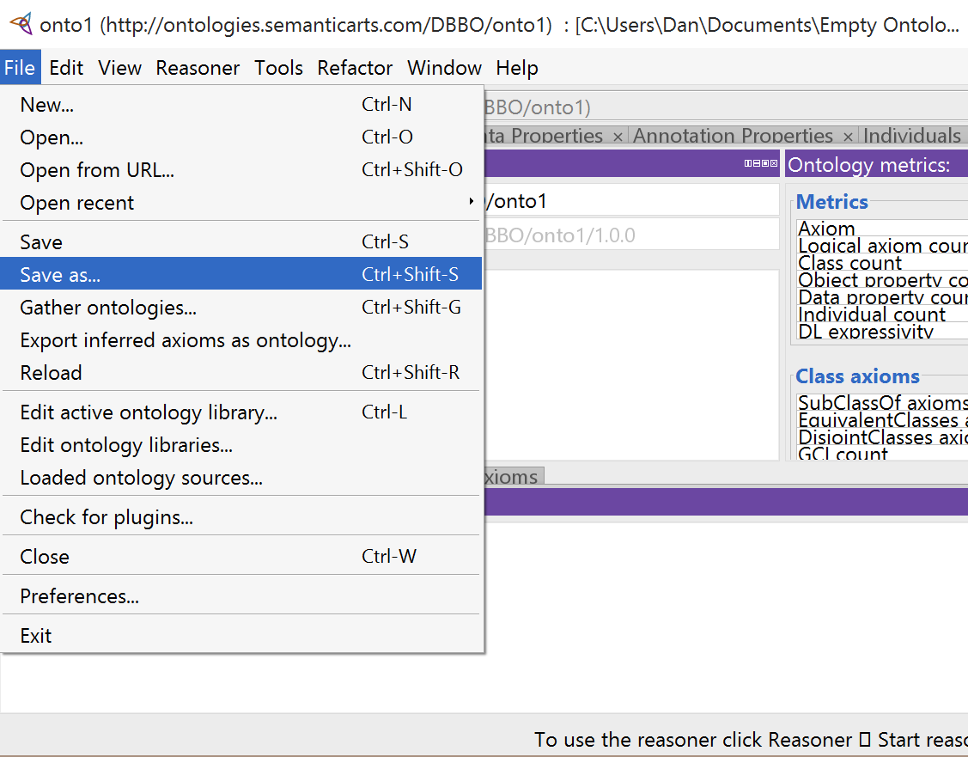
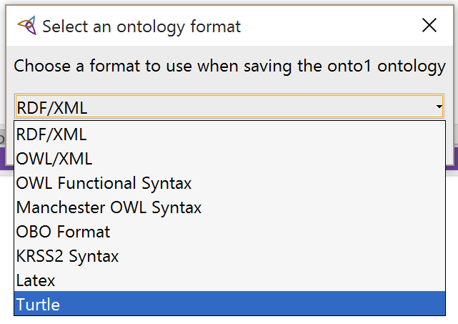
Go back and re-save it but this time pick a different format (Turtle)
Ontology name and file path
Use the suffix “.ttl” for the new saved file
e.g., “Empty Ontology.ttl”

Slide 43
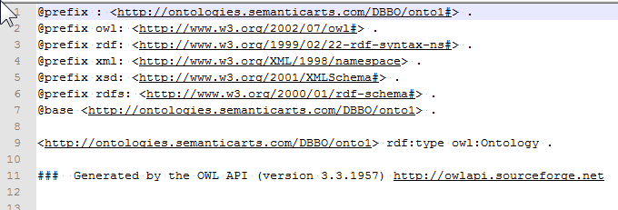
Turtle gives us a simpler to read file
These are the standard short prefixes (qnames) for namespaces that get used a lot

Slide 44
Turtle gives us a simpler to read file
Plus it gets repeated twice as the base and the default
Here is where the actual name of the ontology is

Slide 45
This is the RDF level of the cake

Slide 46
Any fact can be expressed as a triple
Or a bunch of triples
As we’ll see later.

Slide 47
Individuals without Class (no disrespect intended)
In traditional systems, the schema (table or class) must exist before a row or instance can be created.
But we have just created a bunch of individuals without concern about what they are in the real world
Later in the seminar, we will create classes into which these individuals may (but do not have to be) included

Slide 48
Save Classes for RDFS day
Done. Moved the two class creation slides to Day 2 p.m.

Slide 49
Properties in OWL
Properties are defined in order to be the predicate in an assertion
Assertions come in two types:
Those that connect two “Individuals” (URI to URI)
dbbo:_vela
dbbo:owns
dbbo:_SiriusStar
Those that supply literal information about an “Individual”
dbbo:_vela
dbbo:name
“Vela International Marine”

Slide 50
URIs/IRIs
But URIs do far more than provide a better identifier
They make possible “self-assembling data structures”

Slide 51
Triples, built on URIs, allow self-assembling data structures
These triples …
…self-assemble into a graph structure without the need for metadata or “joins”
dbbo:_vela
dbbo:owns
dbbo:_SiriusStar
"Vela International Marine"
dbbo:_vela
dbbo:owns
dbbo:_AriesStar
dbbo:name
dbbo:_vela
dbbo:owns
dbbo:_SiriusStar
dbbo:_vela
dbbo:name
dbbo:owns
"Vela International Marine"
dbbo:_AriesStar
dbbo:_SiriusStar
dbbo:in
dbbo:_Fleet2
dbbo:in
dbbo:_Fleet2

Slide 52
Let’s Visualize this Process
Lets say we the following triples were harvested from completely different sources
CUSIP: Identifier for a Financial Securities
cusip:filedBy
cusip:02209S
cusip:02209S103
cusip:02209S
cusip:name
“Altria”
cusip:02209S
foaf:name
“Phillip Morris”
cusip:02209S103
cusip:underwrittenBy
cusip:123456

Slide 53
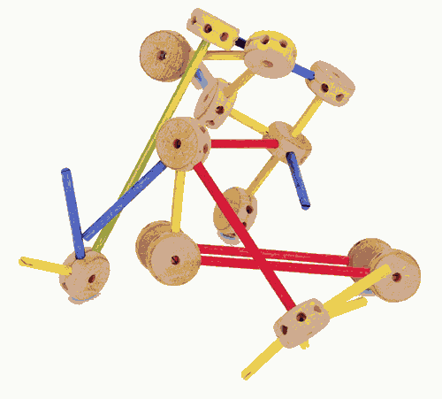
Graphs instead of tables

Slide 54
Metadata discussion later
Moved metadata slides to Day 2 p.m.

Slide 55
Properties must be declared…
…before you can use them in an assertion.
Because the assertions come in two varieties, so do the properties:
“Object Properties” which are used to connect Individuals (URIs) to other Individuals.
“Datatype Properties” which are used to connect individuals to literals.
For the remainder of this course we’ll use this drawing convention when we draw properties.
Object Property
Datatype Property

Slide 56
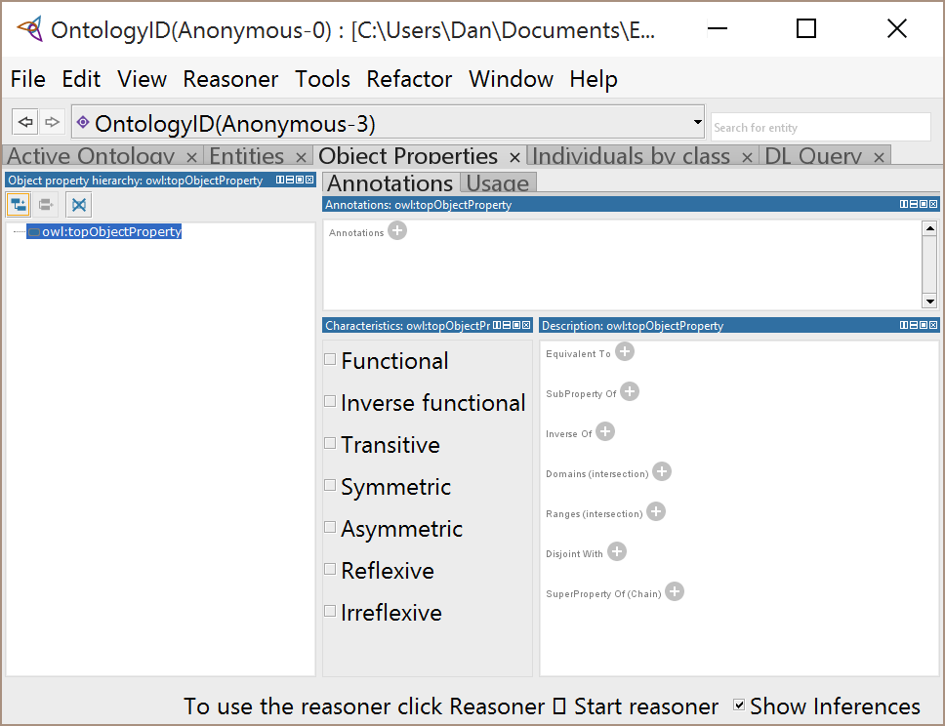

Let’s define one, then use it
Click on the Object Property tab.
Select “owl:topProperty”
Select the icon “add sub property”

Slide 57
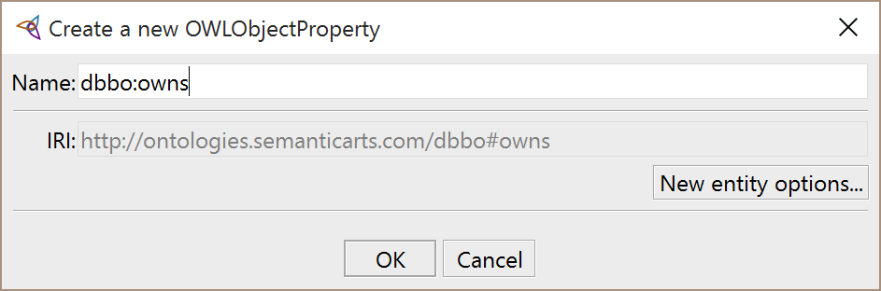
Add the property
Don’t forget the namespace.
After you’ve created :owns, go back and add these properties:
belongsTo,
memberIn,
geoOccupies,
geoDirectlyContainedIn,
operator,
suitableToMove,
governedBy,
categorizedBy
Note that by convention, property names are camelCase, with an initial lower case.

Slide 58
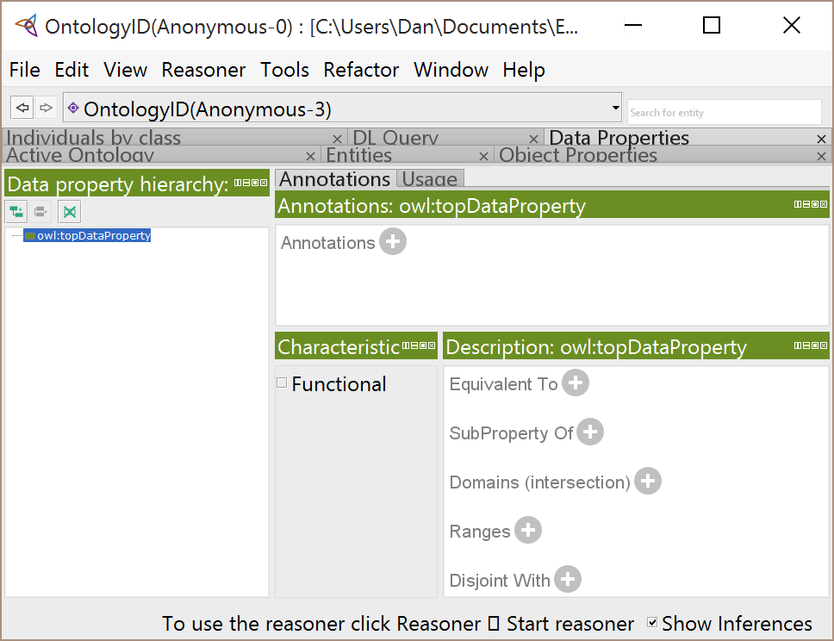
Do the same for the Datatype Properties
Click on the Data Properties tab.
Select “owl:topDataProperty”
Select the icon “add sub property”

Slide 59
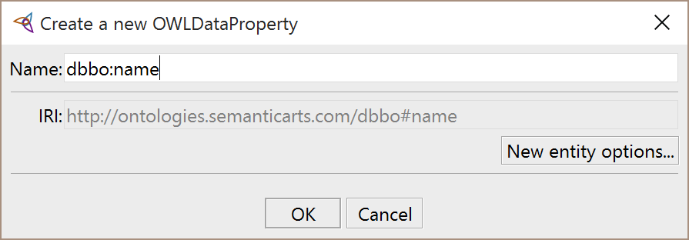
Add datatype properties
Add
name
imoNumber
hullIdentifier
fleetName

Slide 60
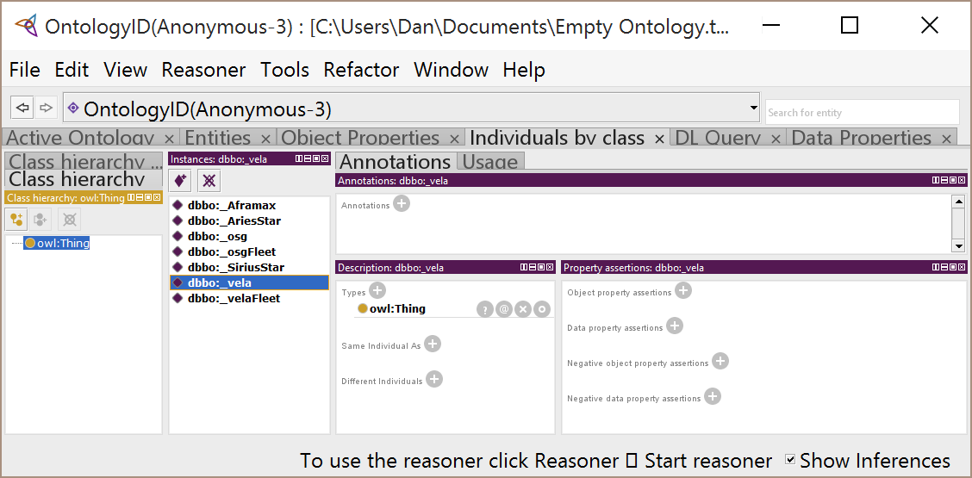
Now we’ll make some object assertions
Select the Individuals tab.
Select the individual to be the subject of your triples.
Click on the plus sign next to Object Property Assertions.

Slide 61
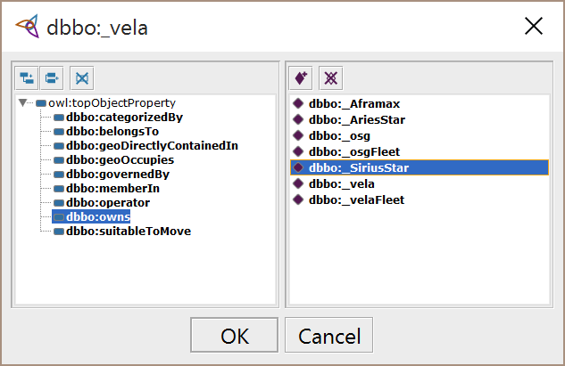
Select your predicate and object
(You may need to click the little triangle to the left of owl:topObjectProperty to see all the object properties.)
Select the property you want for the predicate (owns).
Select the individual you want as the assertion’s object.
Click OK.

Slide 62

You’ve now created this triple
dbbo:_vela
dbbo:owns
dbbo:_SiriusStar
Create several more for “muscle memory”
:_SiriusStar :geoOccupies :_Houston
:_houston :geoDirectlyContainedIn :_harrisCounty
:_harrisCounty :geoDirectlyContainedIn :_texas
:_texas :geoDirectlyContainedIn :_usa
:_texas :geoDirectlyContainedIn :_padd3
:_usa :geoDirectlyContainedIn :_northAmerica
:_padd3 :geoDirectlyContainedIn :_usa
:_portArthur :geoDirectlyContainedIn :_jeffersonCounty
:_jeffersonCounty :geoDirectlyContainedIn :_texas
:_vela :owns :_AriesStar
:_osg :owns :_Aframax
:_Aframax :memberIn :_osgFleet
:_SiriusStar :memberIn :_velaFleet

Slide 63
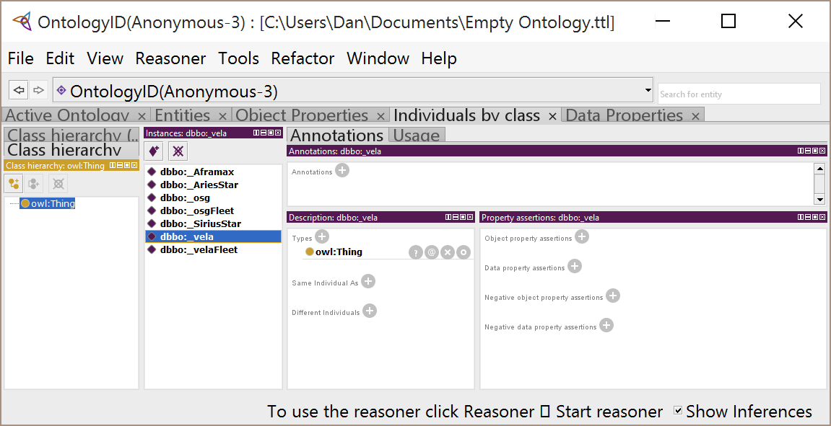
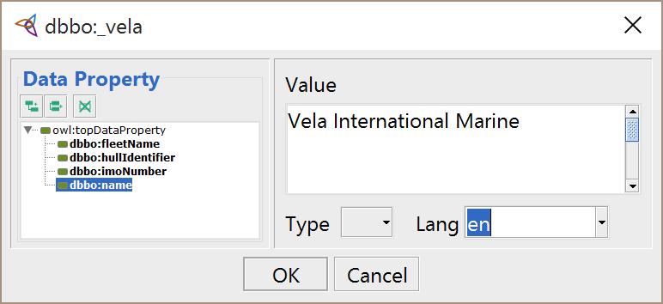
Create some datatype assertions
Select the individual to be the subject of your triple.
Click on the Data property assertions plus sign.
Select the property you want (name).
Enter the literal value.
Indicating the language (“en” = English) is a good practice.
Click OK.

Slide 64
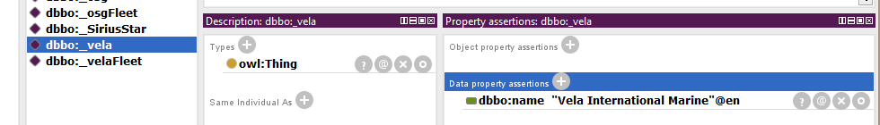
You’ve created
dbbo:_vela
dbbo:name
“Vela International Marine”
Load up
organizations with names,
vehicles with imoNumbers and hullIdentifiers,
and give the fleets names.

Slide 65
Break

Slide 66
Once we’ve assembled a graph…
We can use the assembled information to infer additional information.
Inference is the ability to derive new information from existing data and knowledge.
In general, many types of inference are possible.
Interpolation, regression, and the results of algorithms could be thought of as forms of inference.
But here, we’ll focus on inference that can be drawn from triples and results in new triples.

Slide 67
Reasoner or Inference Engine
In Semantics, a Reasoner or an Inference Engine (the two terms are interchangeable) is a software program that runs over a set of triples (an ontology) and, using rules in the ontology, can construct new triples.
It can also prove that some triples cannot possibly exist.
In the Enterprise, the reasoner is often server-based and near the triple store.
Most ontology editors (including Protégé) have at least one inference engine built in, and others potentially available.

Slide 68
Our first inference
Properties are directional.
Both the property’s definition and its use as a predicate in an assertion are directional.
:hasParent
:hasParent
:_addie
:_dave
:hasParent
The same as
:_dave
:_addie
Not the same as
:_addie
:_dave
:hasParent

Slide 69
Implied relation
But there is an implied relationship going the other way:
:hasParent
:hasChild
:hasParent
:_addie
:_dave
:hasChild
It is called the inverse, and it’s ours for the naming.

Slide 70
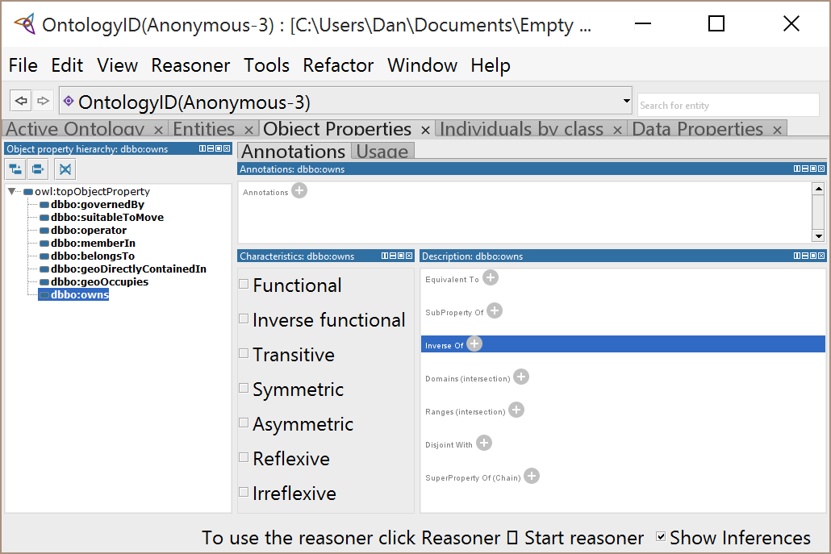
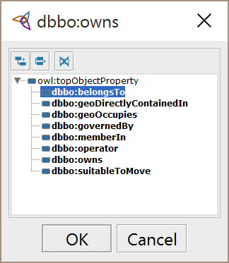
We’re going to create an Inverse Property
Click on the Object Properties tab.
Select dbbo:owns
Click on the plus sign beside “Inverse Of”
Select dbbo:belongsTo
Click OK

Slide 71
What we’re doing
In a traditional relational system, you may be used to the idea that all properties are bi-directional
Organization
Vehicle
owns/ belongsTo

Slide 72
What we’re doing
In semantic tech, predicates are directional.
We can make them bi-directional when we want to….
dbbo:_vela
dbbo:owns
dbbo:_SiriusStar
:owns
:belongsTo
dbbo:belongsTo
dbbo:_vela
dbbo:_SiriusStar

Slide 73
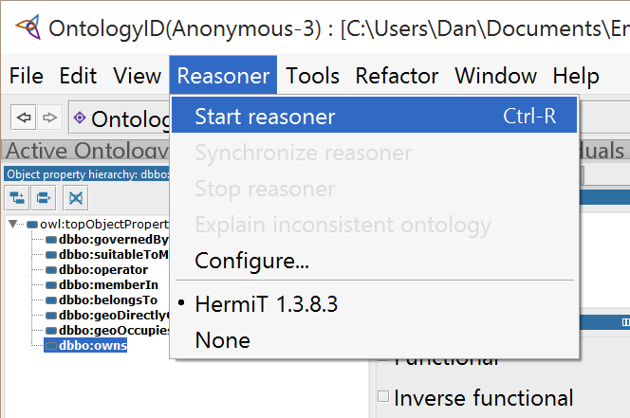

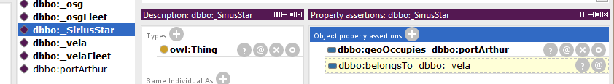
Running the Reasoner in Protégé
You can also do CTL-R to start the Reasoner
Protégé displays inferred assertions in dashed, highlighted boxes

Slide 74
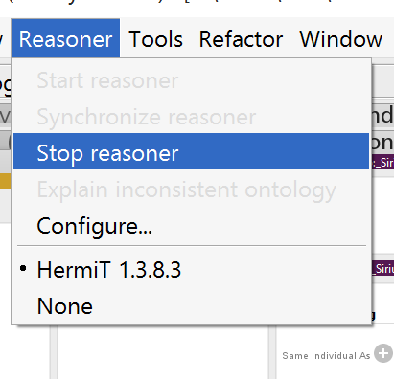
Discarding inferences
Stopping the Reasoner will erase the inferences from memory

Slide 75
Creating information
We’ve created, through inference, another triple
dbbo:_vela
dbbo:owns
dbbo:_SiriusStar
dbbo :_SiriusStar
dbbo:belongsTo
dbbo:_vela
More succinctly
dbbo:_vela
dbbo:owns
dbbo:_SiriusStar
dbbo:belongsTo

Slide 76
As we said…
In semantic tech, predicates are directional.
We can make them bi-directional when we want to….
dbbo:_vela
dbbo:owns
dbbo:_SiriusStar
:owns
:belongsTo
dbbo:belongsTo
dbbo:_vela
dbbo:_SiriusStar
But this begs the question: when do we want to?

Slide 77
Some implications
Properties needn’t be bi-directional
You don’t need to declare an inverse at the time you define a property
You can have many inverses for one property
You can declare inverses to properties you inherit
Declaring inverses greatly increases the number of triples in your triple store when you run the reasoner

Slide 78
Add in example of ownedBy

Slide 79
Maybe drop the sparql bit
Agreed. Following slide tweaked; SPARQL slide deleted [dc]

Slide 80
Do you need an inverse?
If we want to find who owns _SiriusStar
dbbo:_vela
dbbo:owns
dbbo:_SiriusStar
At first you might think we need an inverse property…
…but in a query, you can just reverse the order in which the items are reported.
This gives the appearance of an inverse.

Slide 81
Datatype properties cannot have inverses
If inverses were allowed on datatype properties...
age
:age
:_addie
“24”
?
…that would effectively make a triple with a literal as the subject, which isn’t allowed.
“24”
:_addie

Slide 82
When to have inverses
If you think it would make it a lot easier for consumers of your data to write queries; or
If you need to use the inverse name in a class restriction (we’ll get to that later)
Bottom line: we’ve gone from reflexively adding them all the time to rarely defining them

Slide 83
Property Characteristics
Transitivity
By saying that a property is transitive, we are:
changing its meaning
changing the inferences that are sanctioned
changing how we use it
Later, we will introduce other characteristics of properties.

Slide 84
Concept: Transitivity
Transitivity is a characteristic of some object properties that works like transitivity in math.
We all know that IF A>B and B>C, THEN A>C
When a property has this pattern, we say it is transitive. So “>” is transitive.
Examples: “locatedIn”, “physicalPartOf”
Counter Examples: “hasParent”, “owns”

Slide 85
Subproperties
:hasAncestor
:hasAncestor
:_dave
:hasParent
:_john
:hasParent
Subproperties are used when participation in one property implies participation in another.
e.g., hasParent and hasAncestor
hasParent implies hasAncestor
Notes:
85
85

Slide 86
Subproperties
:hasAncestor
:hasAncestor
:_dave
:hasParent
:_john
:hasParent
:hasAncestor
:_dave
:hasParent
:_john
:hasParent
:_daves
Grandpa
:hasParent
?
X
Q: does the implication go the other way? i.e. does hasAncestor imply hasParent?
Notes:
86
86

Slide 87
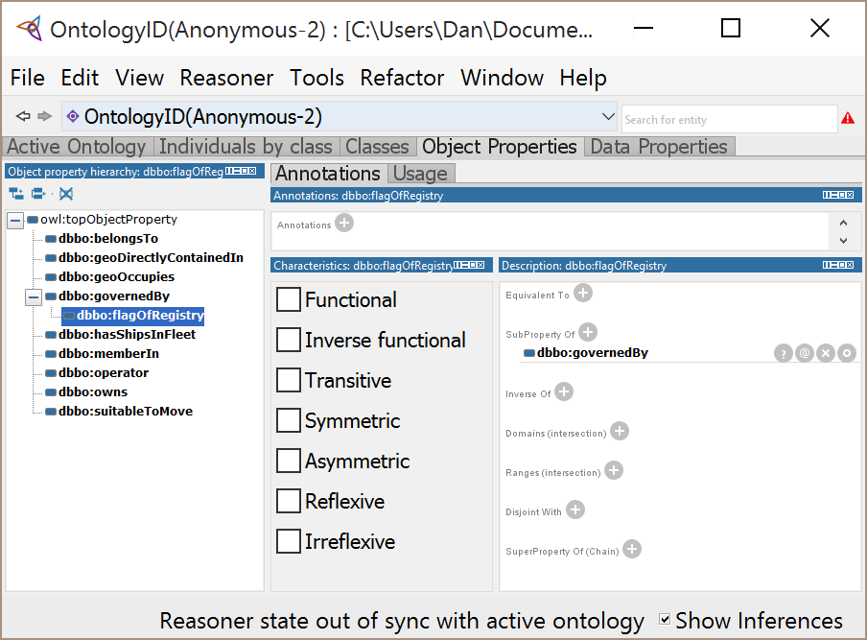
Create an object subproperty in Protégé
3 Different Methods
Create as a subproperty in the Object Property frame
Create, then declare as a subproperty in the Description frame
Create, then Drag’n’Drop

Slide 88
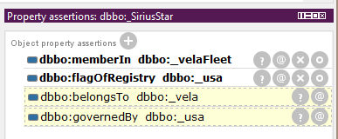
Subproperty inference
The reasoner knows to infer the super-property (:governedBy) applies to the _SiriusStar because of the subproperty (:flagOfRegistry)

Slide 89
Transitive
This is what is going on with transitive
[T]
TBox
:locatedIn
:locatedIn
ABox
:locatedIn
:locatedIn
:locatedIn
:sa
:FC
:CO
:USA
:locatedIn
:locatedIn

Slide 90
Transitive Pattern
+transitive
The direct assembly is a nice hierarchy. It would get lost in all the other links.
hasPart
:hasPart
:hasPart
:hasPart
:hasPart
:hasPart
:_engine
:hasPart
:_distr
:hasPart
:_points
:_car
:hasPart
:hasPart
Notes:
90
90

Slide 91
Transitive Pattern
+transitive
hasPart
Do this instead.
Best of all worlds.
hasDirectPart
:hasPart
:hasPart
:hasPart
:hasPart
:hasDirectPart
:_engine
:hasDirectPart
:_distr
:hasDirectPart
:_points
:_car
:hasPart
:hasPart
Notes:
91
91

Slide 92
Transitive Pattern
+transitive
hasAncestor
The indirect inferred link
hasParent
The direct asserted link
Combines transitivity and subproperty
Whenever you use transitive properties, use this classic pattern

Slide 93
Transitive Pattern: Another Example
+transitive
hasPart
The indirect inferred link
hasDirectPart
The direct asserted link
Why make the transitive property the parent of a separate direct property?
Why not just have one property that is transitive?
+transitive
hasPart

Slide 94
Create a transitive property in Protege
Create the property dbbo:geoLocatedIn
Click the “Transitive” box
Select the dbbo:geoDirectlyContainedIn property and make it a subproperty of :geoLocatedIn
Now apply it:
:_portArthur :geoDirectlyContainedIn :_jeffersonCounty
:_jeffersonCounty :geoDirectlyContainedIn :_texas
:_texas :geoDirectlyContainedIn :_usa
:_usa :geoDirectlyContainedIn :_northAmerica
:_portArthur :geoDirectlyContainedIn :_padd3
:_texas :geoDirectlyContainedIn :_padd3
:_padd3 :geoDirectlyContainedIn :_usa
Run the reasoner

Slide 95
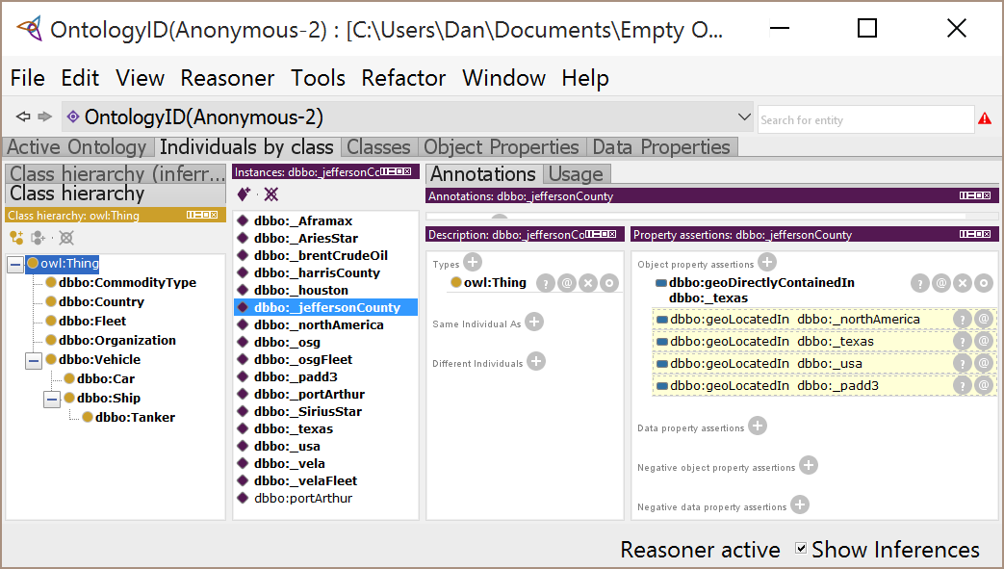
Do the reasoner for transitive
We see that Jefferson County is in PADD-III, even though it was never explicitly stated to be so.

Slide 96
Equivalent Properties
Like classes, if two properties were subs of each other, they would be equivalent.
That is, asserting one would imply the other, and vice versa.
When would you want this?

Slide 97
Equivalent Properties
:locatedIn
:geoContainedIn
:geoContainedIn
:locatedIn
:locatedIn
:_texas
:geoContainedIn
:_usa
:geoContainedIn
:locatedIn
:_texas
:usa

Slide 98
Equivalent Properties
In your own ontology, you typically wouldn't create two properties for the same thing, but this happens all the time when you combine two ontologies. You will find that other ontologists have used a different term for what is the really the same property.
:locatedIn
:geoContainedIn
:locatedIn
:fc
:geoContainedIn
:CO
:geoContainedIn
:locatedIn
:CO
:usa

Slide 99
Symmetric Properties
:hasParent
Remember Inverses?
The property going the other way
:hasChild
:hasBorderWith
When a property always goes both ways, it is called “symmetric”.
A symmetric property is its own inverse.
:hasBorderWith
:us
:hasBorderWith
:ca
:hasBorderWith

Slide 100
Making Distinctions only when Needed
You can distinguish borrower from lender if you need to (e.g. using SPARQL)
If you don’t, you can just ask about the parties; you get that for free from sub-property inference.
Then it occurs to you that one individual can’t be the borrower and lender on the same loan.
This is where we need “disjoint properties”

Slide 101
Disjoint Properties
X
hasBorrower
hasLender
If someone is a borrower on a given loan, they cannot also be the lender, and vice versa
:hasLender
The inference engine knows as soon as you make the borrower assertion (and run reasoner) that that loan cannot have jones as a lender.
X
:loan1
:jones
:hasBorrower

Slide 102
Disjoint Properties
Disjoint Object Properties
If two object properties are disjoint, no pair of individuals can be related by both properties, i.e., they are pair-wise incompatible.
Disjoint Datatype Properties
If two datatype properties are disjoint, no individual can have same value for both properties.

Slide 103
Asymmetric Properties
:hasChild
When a property never goes both ways, it is called “asymmetric”.
An asymmetric property is disjoint with its inverse.
:hasChild
X
We’ll talk about disjoint properties shortly
:bob
:hasChild
:bill
X
:hasChild

Slide 104
Properties Distinctions
Let’s say you were doing a loan system.
You would probably create something like “hasParty” (to the loan contracts).
hasParty
hasBorrower
hasLender
After a while, you’d realize that you have to distinguish the borrower from the lender.

Slide 105
Another kind of inference
Super Properties (also called Property Chains) are a very specific way to infer the existence of a new triple from the existence of existing triples.

Slide 106
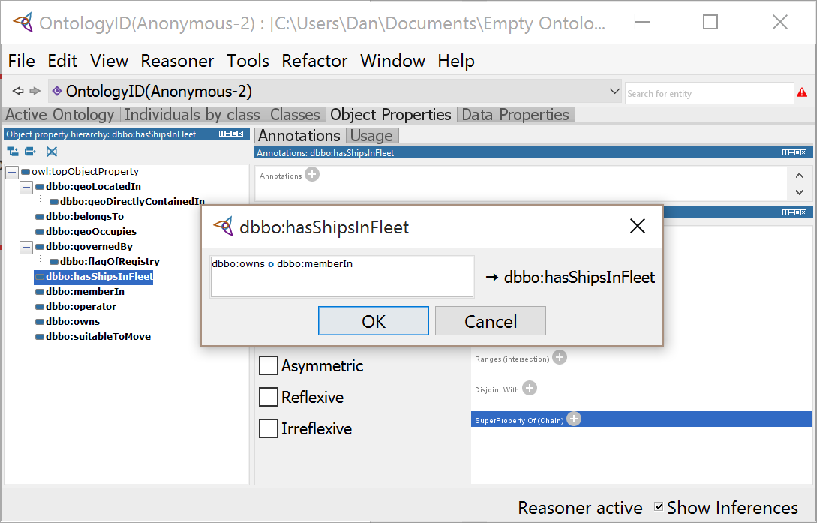
Property Chain exercise
Define a new property, say dbbo:hasShipsInFleet
Click on SuperProperty Of (Chains)
Enter:
“dbbo:owns o dbbo:memberIn”
(NOTE: the syntax used will vary between ontology tools.)
Click OK

Slide 107
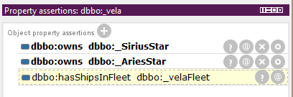
Run inferences
Ensure you have the following assertions:
:_vela :owns :_SiriusStar
:_SiriusStar :memberIn :_velaFleet
Run the reasoner
Look at the assertions frame for :_vela

Slide 108
Data and Metadata
Let’s pause and reflect.
We are essentially adding metadata (hasShipsInFleet is a new property) to a data base with existing data that was created before this part of the metadata.
And yet, it’s okay to do that.
We will have more about this tomorrow

Slide 109
Wrap up ― Inference
Inference is a process for deriving new information in the form of triples from existing triples.
Inference can be done by querying with SPARQL or by using the OWL inference engine directly.
These inferred triples are available to [many] SPARQL engines.
The advantage of using inference over querying is that inference is available to all the consumers of the information, whereas with a query, they have to know to execute it.
However (as we’ll see), there are some things you can do with queries that you can’t do with inference.

Slide 110
Wrap up ― Chains and Transitivity
We’ve looked at two simple forms of OWL inference.
Transitivity
Inferring assertions between individuals that are connected by the same property, through any number of jumps.
Property Chains:
Inferring an assertion between two individuals based on the discovery of a path between them of conforming assertions.
The chain can be of an arbitrary, but fixed, length.

Slide 111
Recap (1/2)
Properties are first-class objects
They have their own characteristics: e.g. transitive, (a)symmetric
We can relate properties to other properties
They can participate in sub-property hierarchies e.g. hasParent is subproperty of hasAncestor
They can be set to be equivalent to one another e.g. when merging disparate data sources
They can be set to be disjoint from one another e.g. borrower disjoint from lender
It works just like it does for classes

Slide 112
Recap (2/2)
Properties can be re-used in Restrictions e.g. owns House and owns Vehicle
This dramatically reduces the need to make up lots of new properties that only differ in their domain or range…
… which in turn eliminates one of the major sources of complexity in enterprise software.
This is Fantastic!

