Slide 1
Ontology Examples

Slide 2
Motivation
To clarify intended uses of ontology concepts
Domains and ranges (actual and intended) give important clues
Seeing real examples makes it so much easier

Slide 3
Example Examples: Operators Ontology
Operators Ontology
Originated 10+ years ago as part of product specifications
For specifying the acceptable range of the value for some characteristic.
Several years later was separated out from the specification ontology to be used for version dependencies
Here are two examples of using the operators ontology

Slide 4
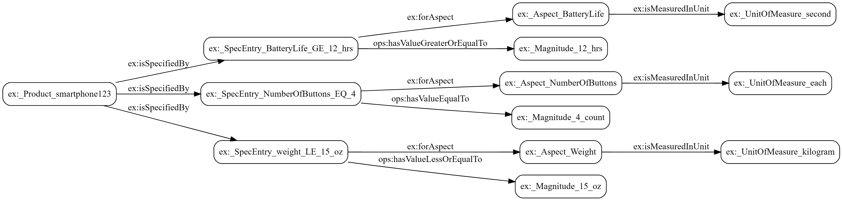
Product Specifications
A smart phone must have
GE 12 hrs battery life
weight LE 15 oz
exactly 4 buttons

Slide 5
Version Dependencies
The semantic version number for the disease taxonomy is 6.3.0.
This version depends on
the version of the disease ontology being between 3.1.0 and 4.0.0
the version of gist core being between 12.1.0 and 13.0.0

Slide 6
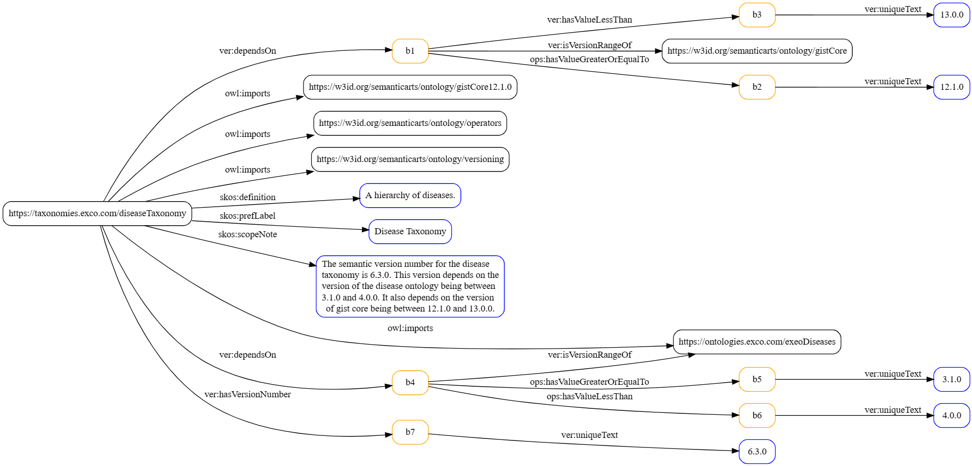
Version Dependencies

Slide 7
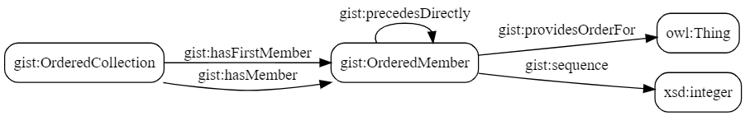
Ordered Collections
John and Jane are competing in two races.
In one race, John comes in first and Jane second.
In the other race Jane comes in first and John second.
We need two ordered collections, one for each finishing order.
Triple patterns

Slide 8
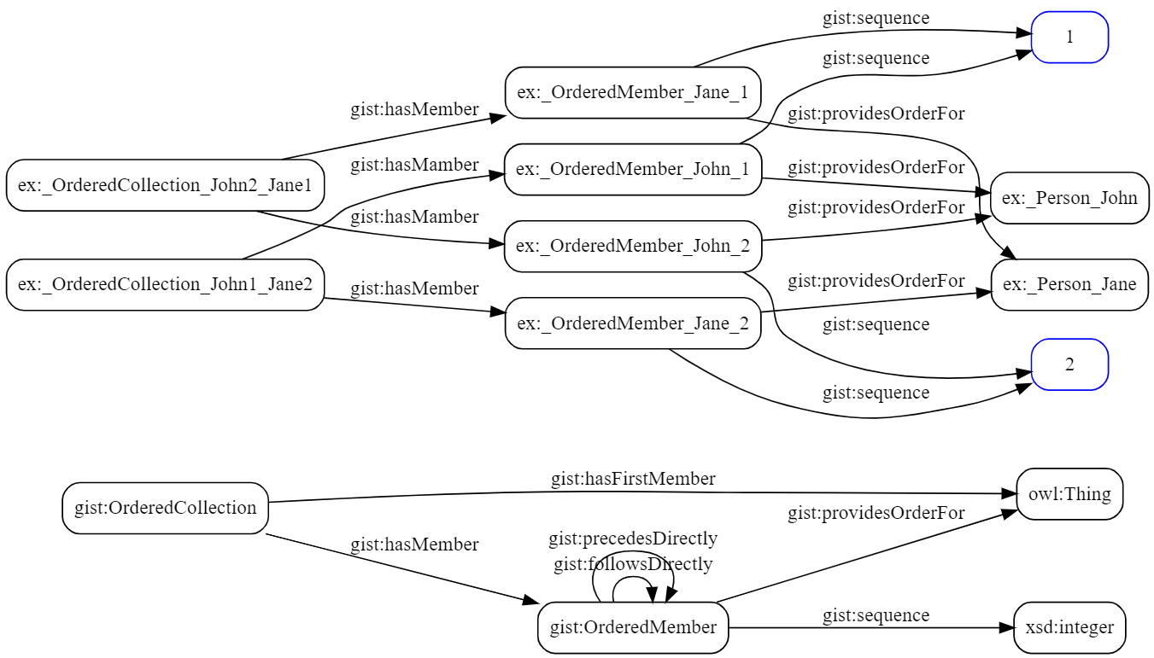
Two Ordered Collections (as Arrays)
Triple patterns

Slide 9
Two Ordered Collections (as Linked Lists)
Triple patterns

Slide 10
A New Wrinkle
John and Jane are competing in two races.
Winners are ordered by both finish time and by 1st 10 meters time.
There are four orderings: 2 races, 2 aspects each.
Race 1: John comes in first and Jane comes in second for both aspects (finish and 1st 10m) Race 2: For the finish time, again it is John first and Jane 2nd. But the order is reversed for the first 10m time.

Slide 11
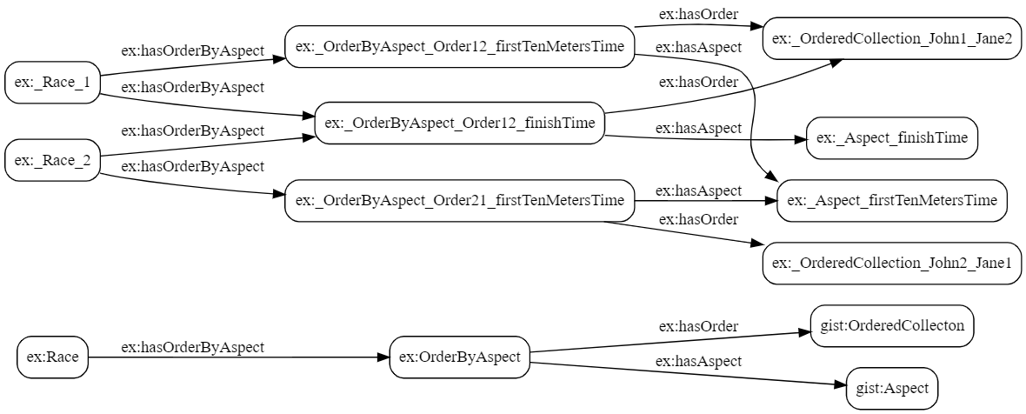
Ordered Collections
John and Jane are competing in two races.
Winners are ordered by both finish time and by 1st 10 meters time.
There are four orderings: 2 races, 2 aspects each.
Race 1: John comes in first and Jane comes in second for both aspects (finish and 1st 10m) Race 2: For the finish time, again it is John first and Jane 2nd. But the order is reversed for the first 10m time.
Two orderings collapse into one,
same people, same order, same aspect
Needs to be expanded
From before
More
Triple patterns

Slide 12
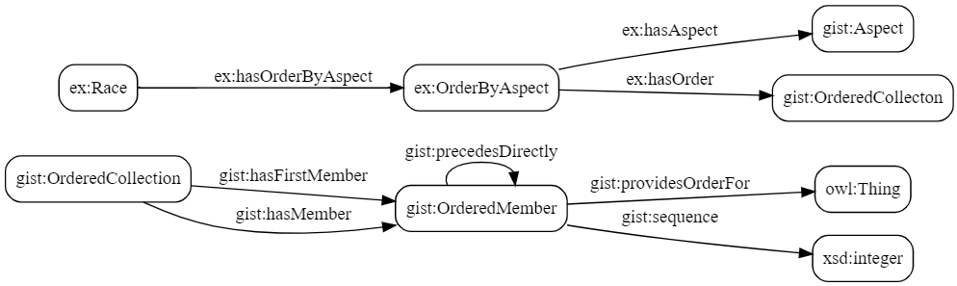
Combined Triple Patterns

Slide 13
Conventions – Suggestions and Questions
Separate folder for examples
File naming convention
examplesProductSpec.ttl
examplesVersionDependency.ttl
gistExamplesOrderedCollections.ttl
Show triple patterns as well as data examples
Namespaces:
ex: <http://example.com/examples/>
Do we need to explicitly import gist?
What about stand-alone ontologies like operators and versioning.
will not import gist
will recreate some gist concepts in ex: namespace
ex:Magnitude & ex:Aspect
ex:hasUnitOfMeasure

Slide 14
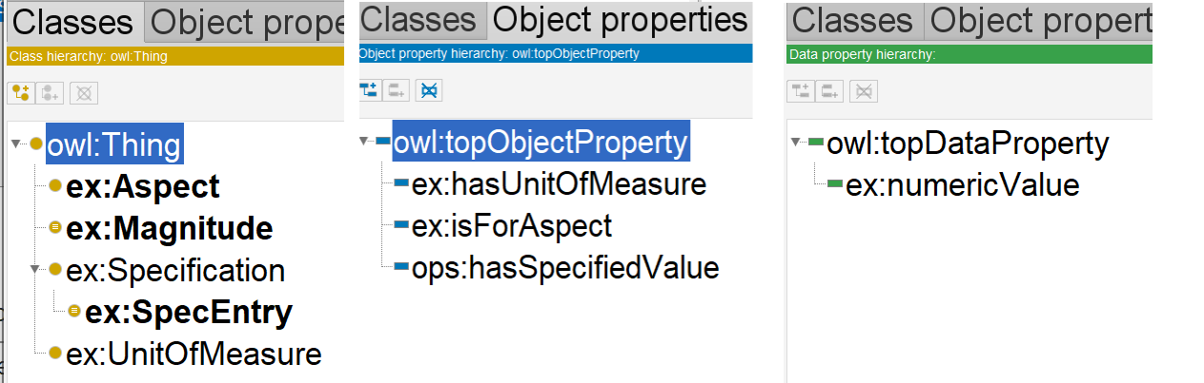
Product Spec Examples in Protege

Slide 15
Gist Examples – Class Perspective
Identifiers
Category / Class pattern
Taxonomies of Categories
Unit and Magnitudes
Aspect & Specifications
Addresses
Content: authoring, date published, topic etc.
Sensors / Controllers / Actuator
Geo stuff / occupies
Collections & ORderedCollections
Commitments, Contracts & Obligations
Accounts and Transactions
Events
Temporal Relations

Slide 16
Gist Examples – Property Perspective
comesFrom/goesTo place
conformsTo
contributesTo
hasPart
hasParticipant
hasPhysicalLocation
isAbout
isBasedOn
occursIn

