Slide 1



WorkingGenius.com | © Copyright 2023 The Table Group, Inc.

Slide 2

The Working Genius Model

Slide 3


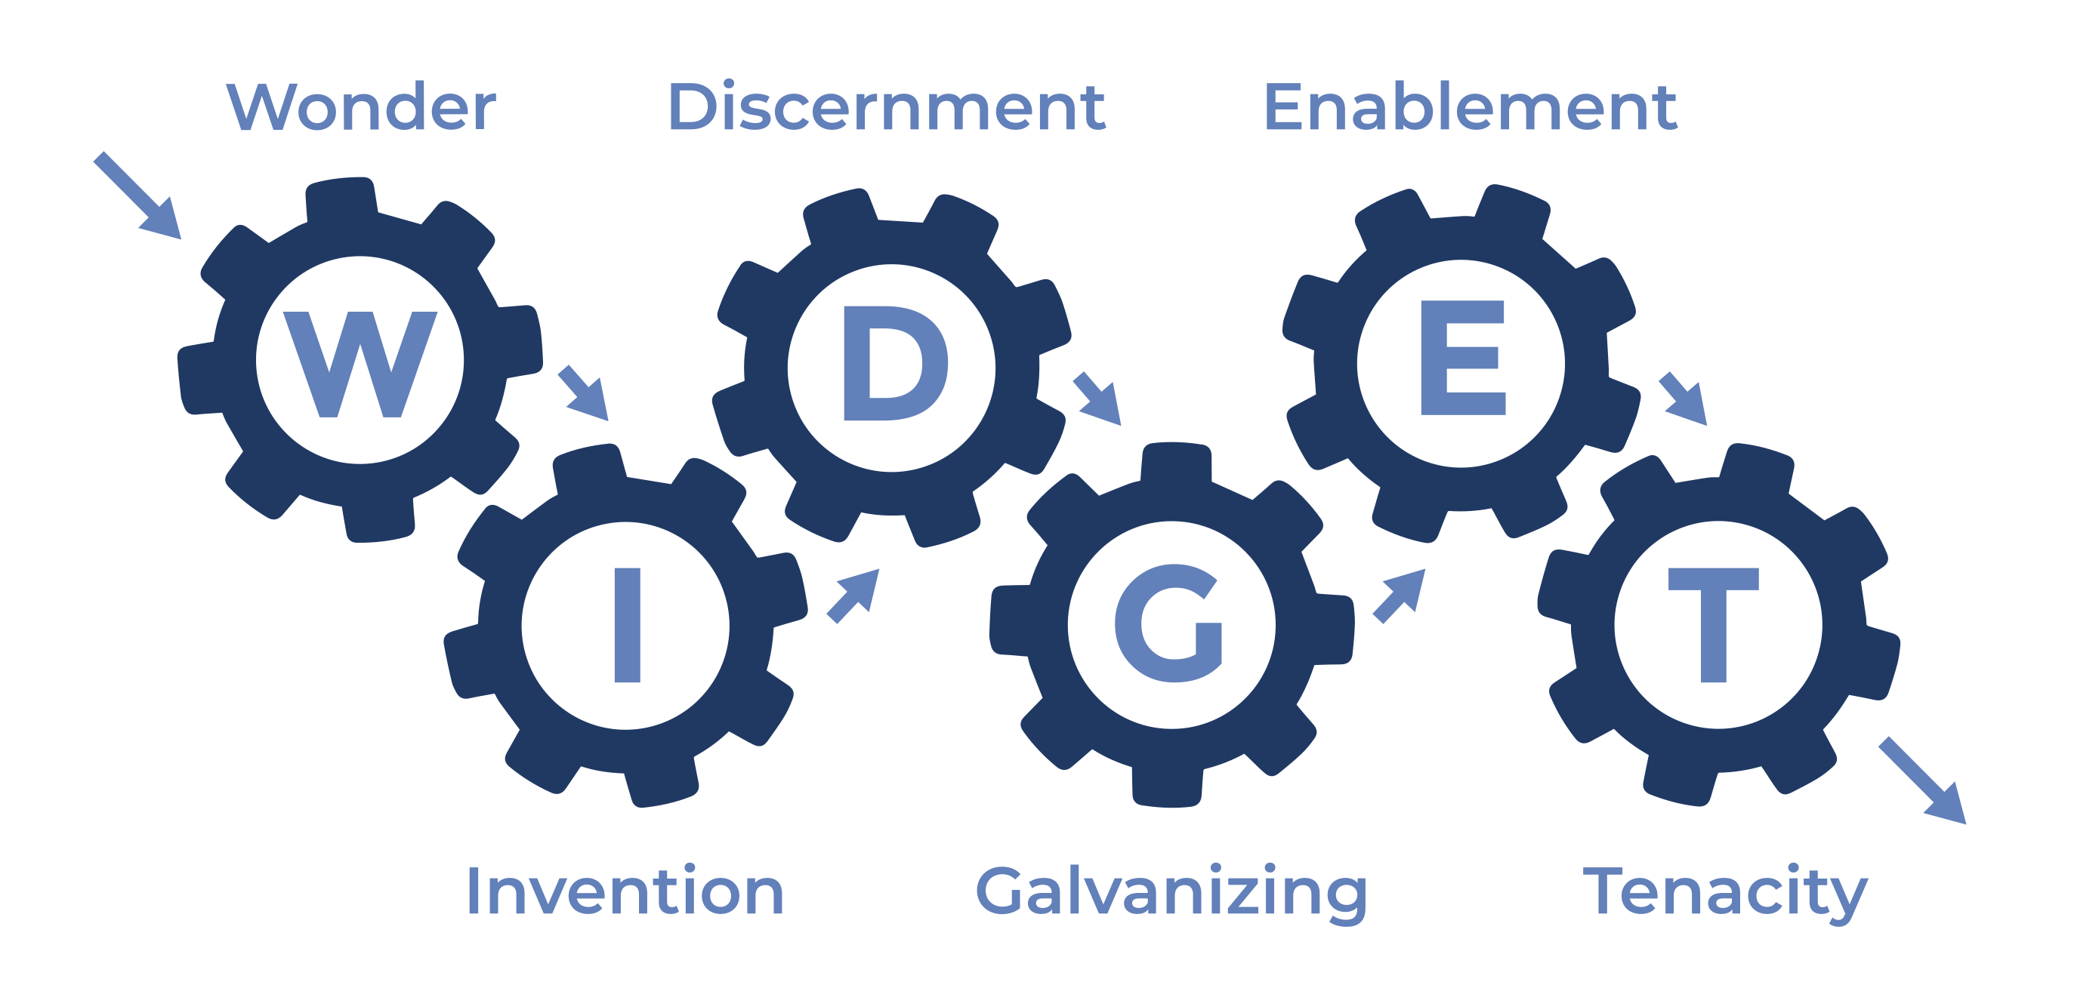

Slide 4

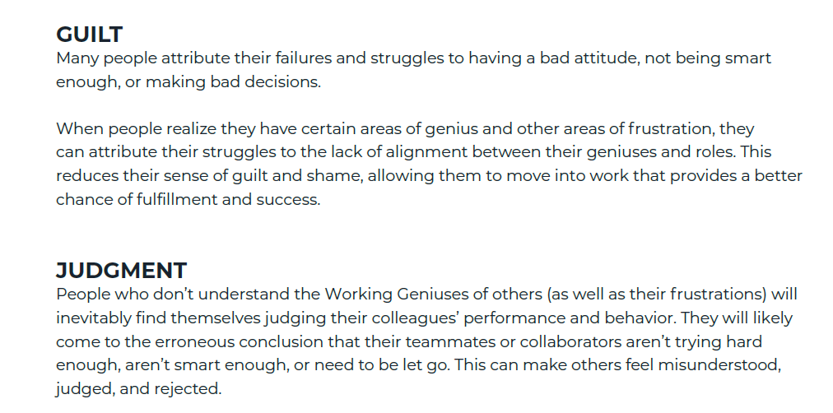


Guilt and Judgment
Self
Others –
Fundamental
Attribution Error

Slide 5
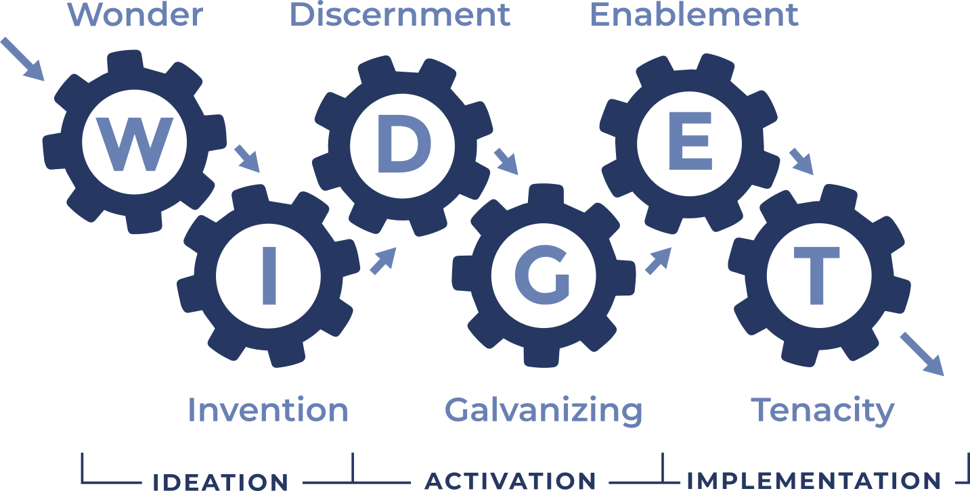
Three Stages of Work

Slide 6
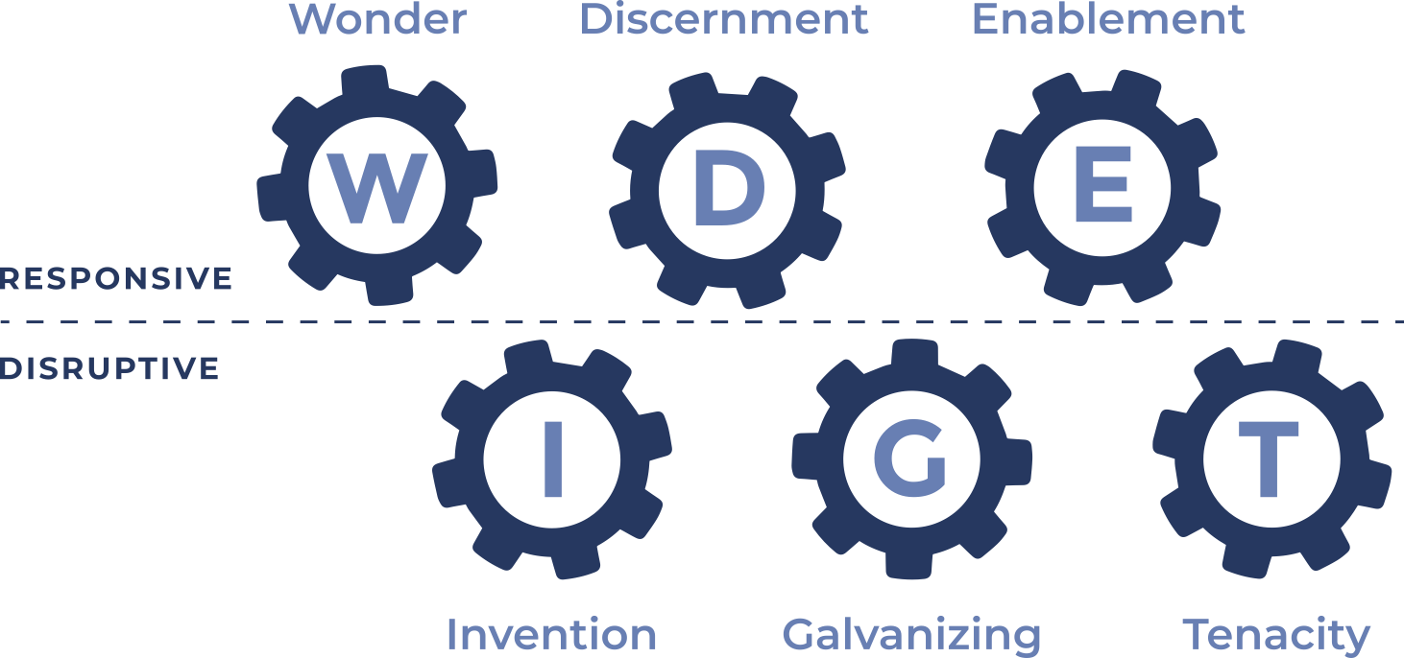
Responsive vs Disruptive

Slide 7
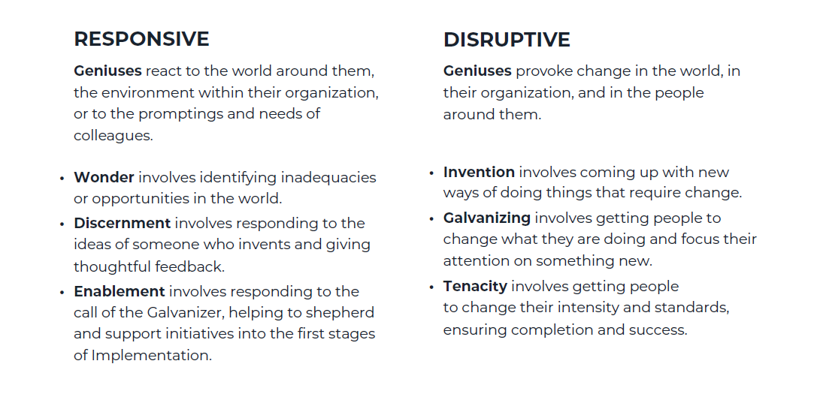
Responsive vs Disruptive

Slide 8
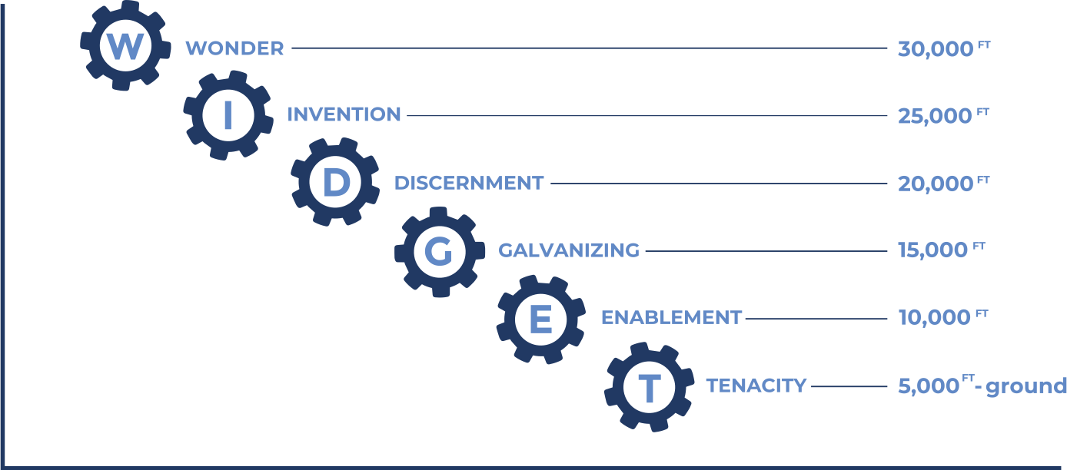
The Altitude of Geniuses

Slide 9
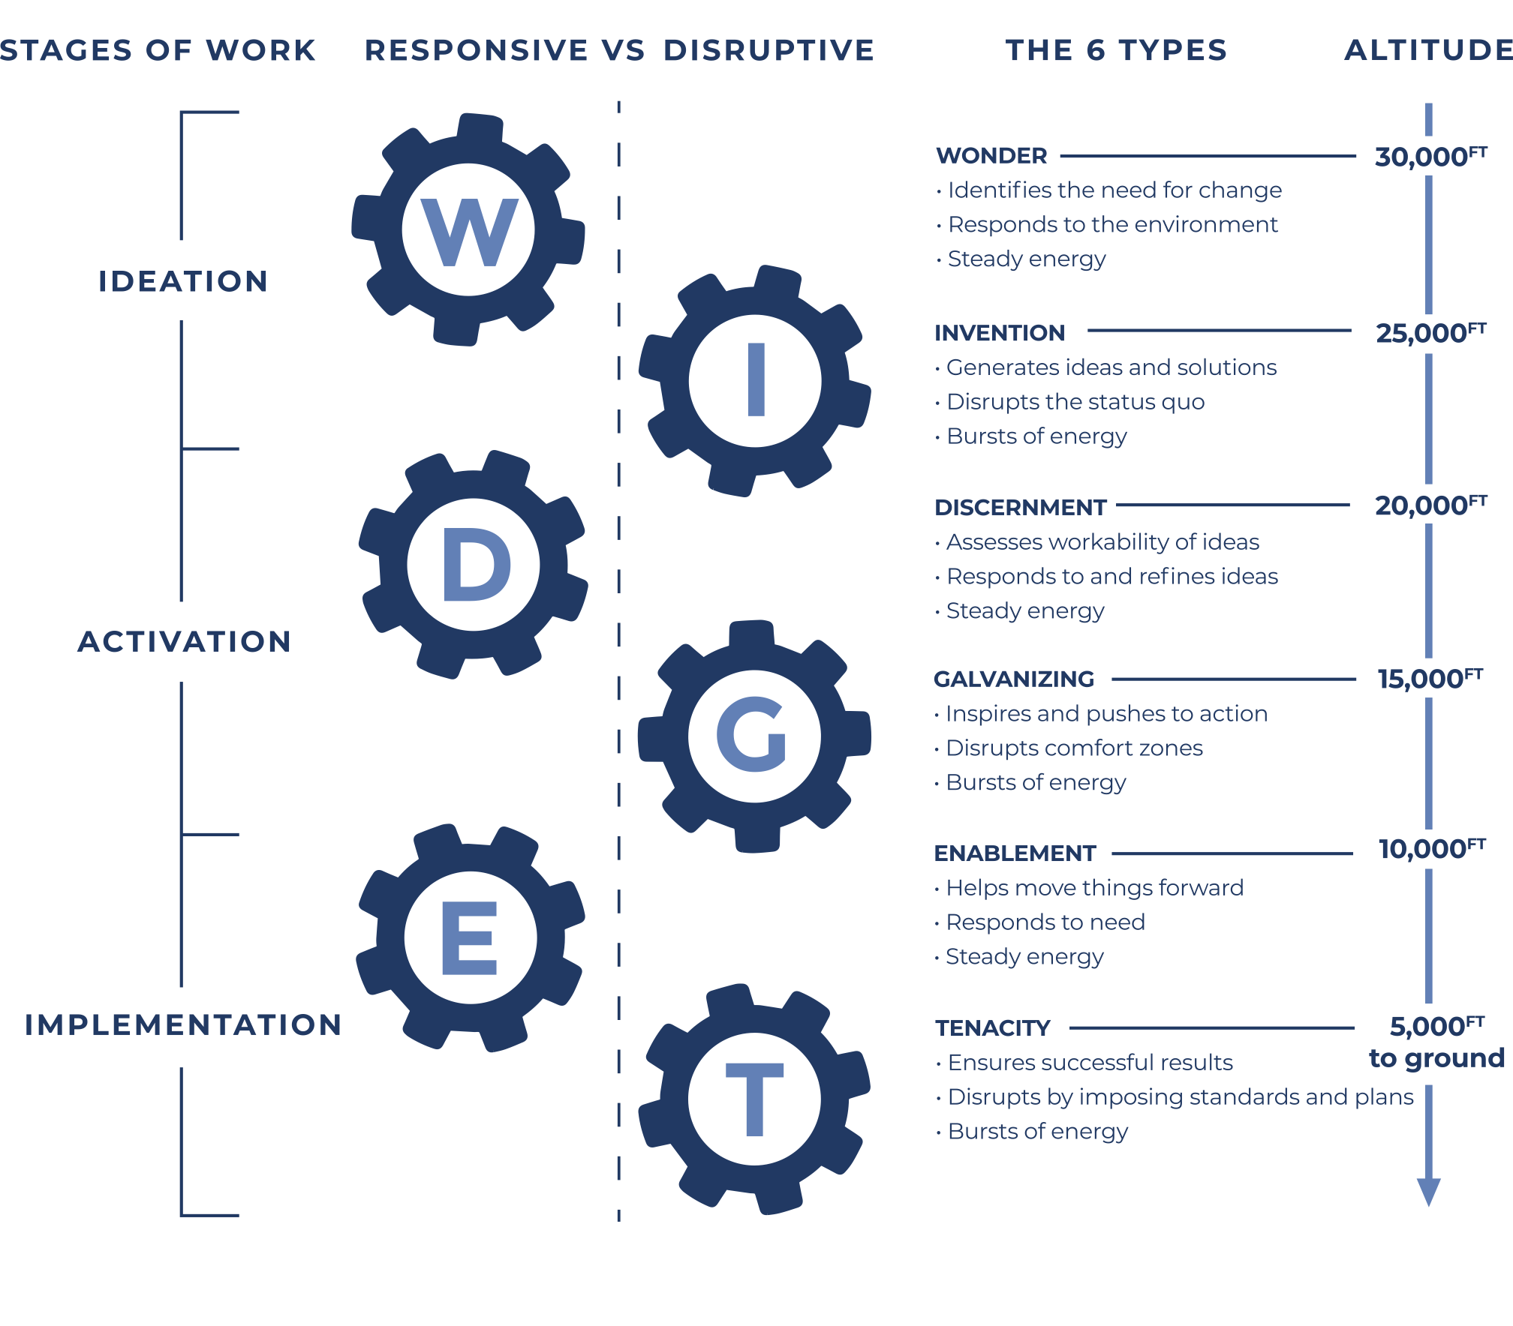
All-In-One
Model

Slide 10
Working Genius Profile

Slide 11

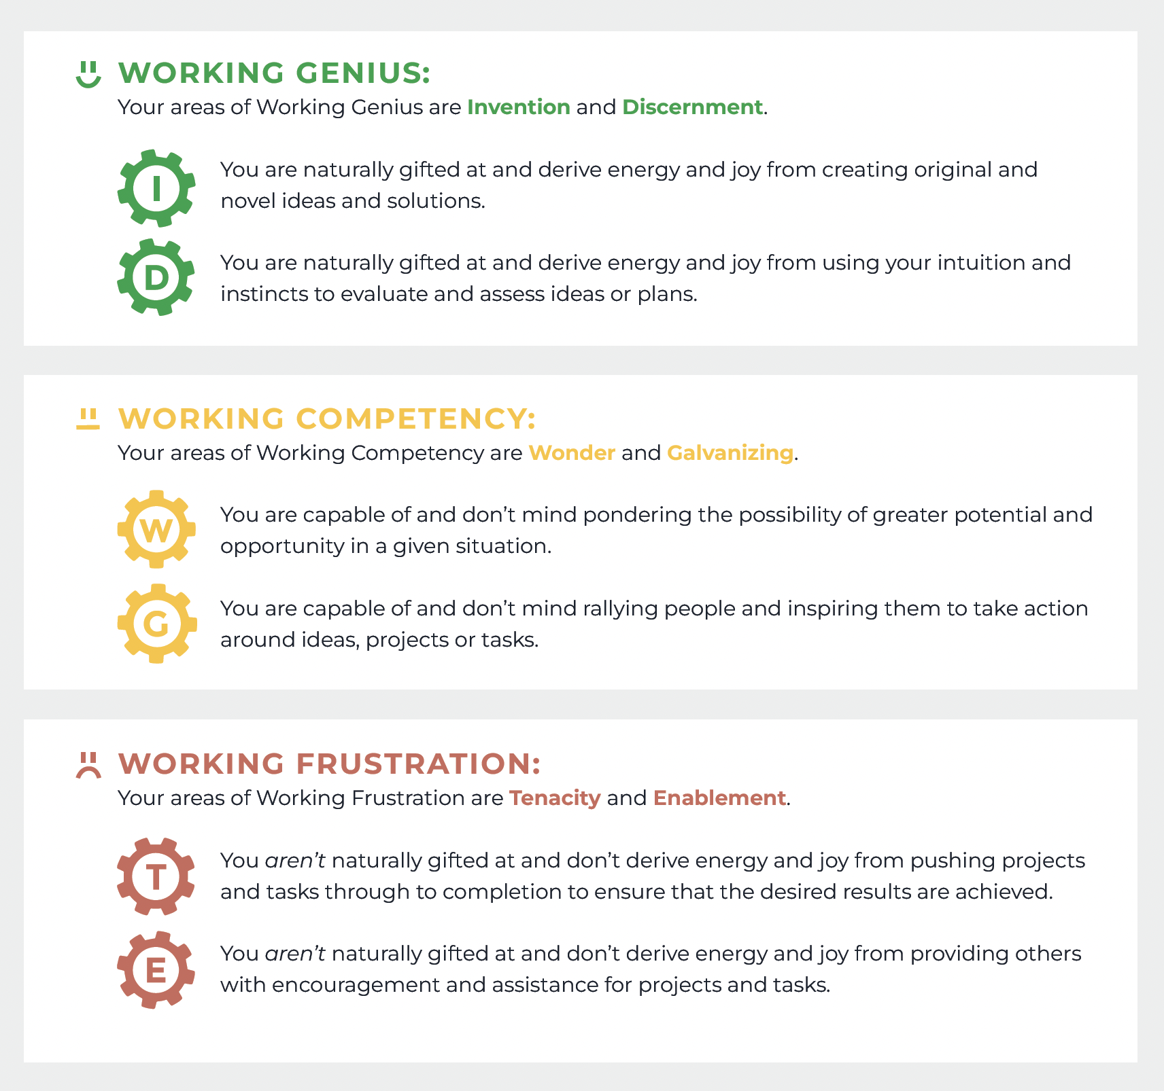



Individual Profiles
Working Genius
Working Competency
Working Frustration

Slide 12

Group Discussion
Does the Profile Report resonate with you?
How do your Geniuses play out in your work?
Do you see where your Frustrations show up?

Slide 13
Team Map

Slide 14
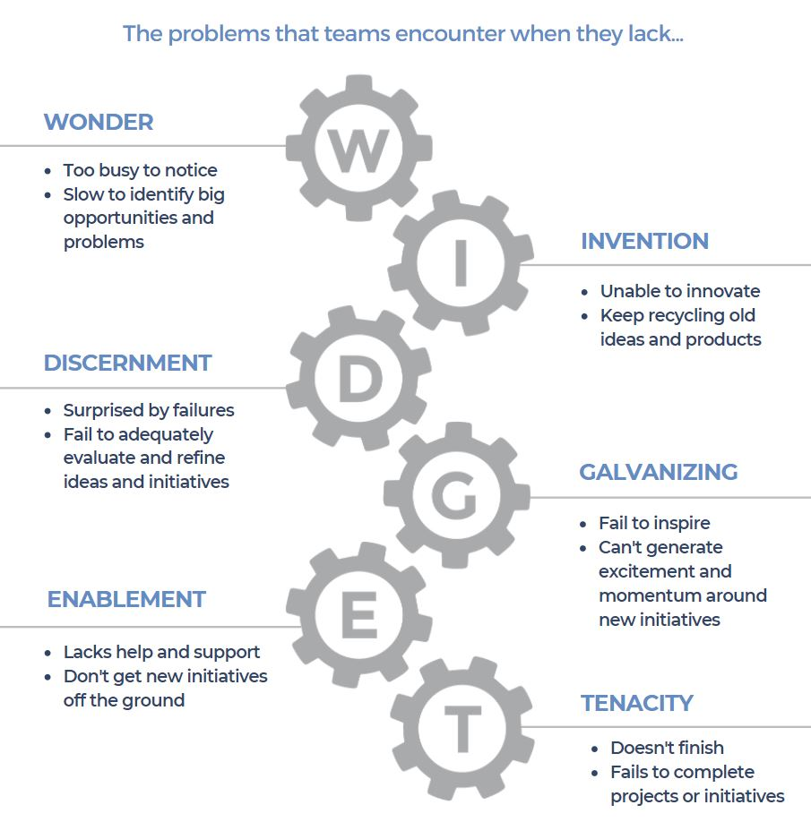
Team Gap
Analysis

Slide 15

Reading a Team Map
Things to consider when reading your Team Map:
What are the team’s strengths based on Genius groupings?
What are the team’s weaknesses or underrepresented Geniuses?
Now that everyone’s geniuses are represented visually on the map, is there a need to adjust or rethink roles?
Who is the leader?

Slide 16
Team Maps

Slide 17
The Genius of Meetings

Slide 18
Productive Meetings
Brainstorm or Offsite
Solutions Oriented or Ad Hoc Strategic
Rally and Tactical or Weekly Staff Meeting
Task Oriented or Daily Standup

Slide 19
Team Commitments
Based on what you’ve learned, what’s one thing the team can do differently to have more productive meetings?
Based on your individual Geniuses and Frustrations, what’s one thing you can each do to help the team have more productive meetings?

Slide 20
Takeaways
What are your top three takeaways from today?

Slide 21
Closing Thoughts

Slide 22
Thank You!

