Slide 1
LLMs, Agents, GraphRAG, and Semantic Arts
Brett Heffelfinger
Notes:
Time crunch, leave questions to the end
Note your question & slide number at the top right corner
Goal: bring everyone here to at least the same base level of understanding about these technologies
Some may know way more than what I’ll talk about, others may not
1 math adjacent slide, a few flow-charts/high level architecture flows

Slide 2
Outline/Agenda
Understand Large Language Models and how they work
Understand RAG and how it works
Understand Agents and how they work
Understand GraphRAG and how it works
Understand the potential places of Semantic Arts within an LLM architecture

Slide 3
What is a Large Language Model?
A Large Language Model (LLM) is, at its core, a machine learning model to process language.
LLMs are trained on large bodies of text and use statistics to predict sequential responses.
Once the model is trained, the model is used in instances of a “context window” (most commonly, one conversation with ChatGPT).
Within a “context window”, responses can be directed by “prompts” and instructions.
Typically, there’s a complex background instruction for the model you’re interacting with, for example: “You are a helpful LLM called GPT-4o. You must be polite and respond to user requests to the best of your ability without hallucinating.”

Slide 4
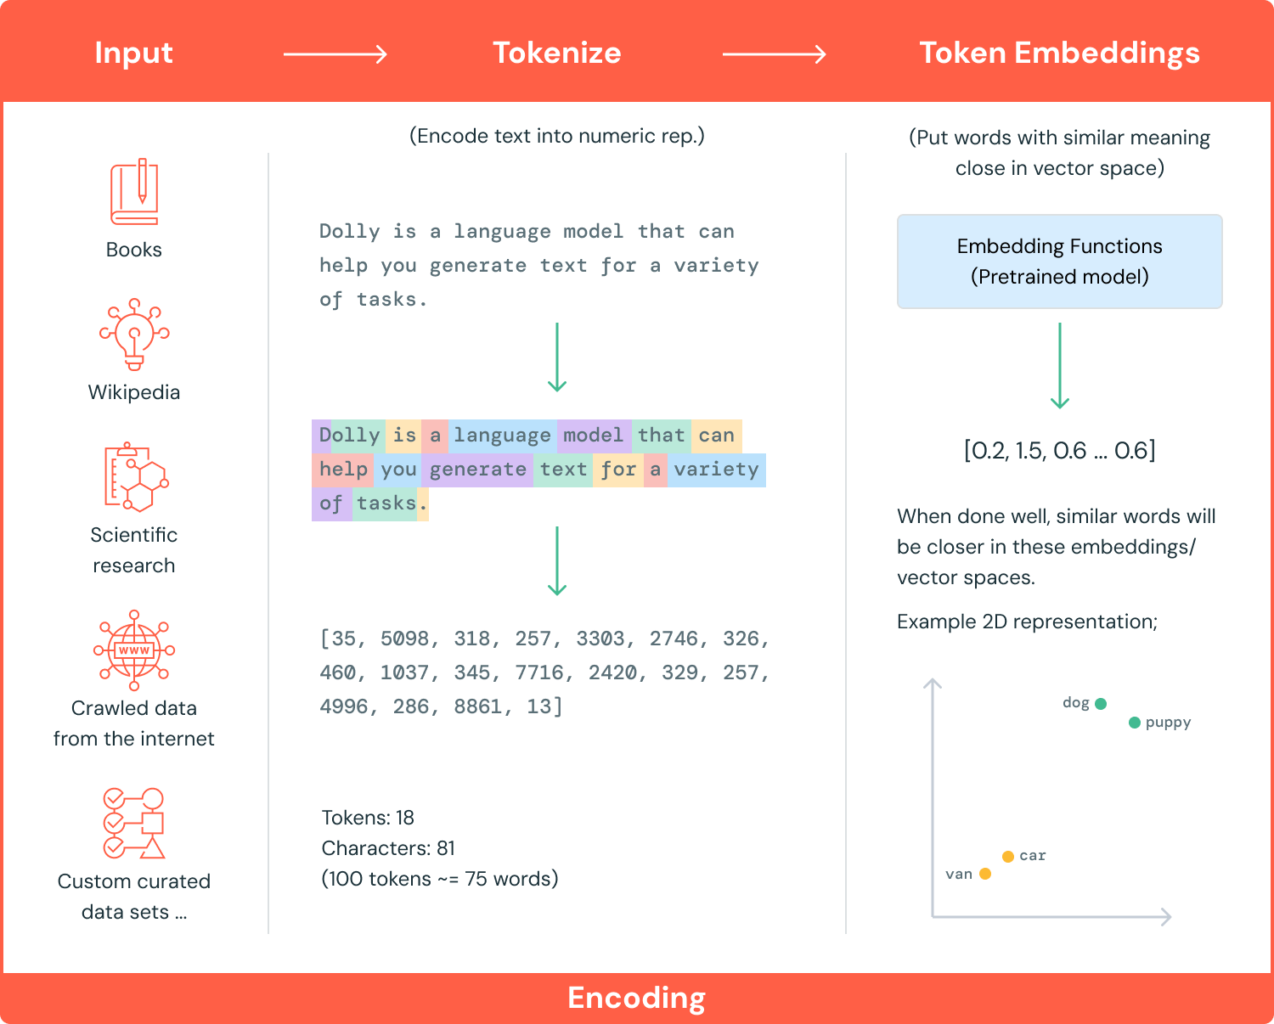
Notes:
Source: https://www.databricks.com/glossary/large-language-models-llm

Slide 5
What is RAG?
Retrieval Augmented Generation is a method to:
Retrieve text relevant to a part of a context window by comparing the vector space of the context window to some set of text resources.
Augment the prompt by adding retrieved information to the context window.
Generate a higher-accuracy response based on the augmented information.
This dramatically reduces the possibility of hallucination but doesn’t eliminate it - LLMs are still inherently random.

Slide 6
RAG Example
If I ask a basic LLM (with no extra features) the question: “What is my name?” – The model will be unable to answer accurately or will give a guess.
Let’s have a file called myname.txt in a vector database, that contains the sentence “My name is Brett and I work at Semantic Arts as an Ontologist.”
The phrase “What is my name?” and “My name is Brett” will be similar in vector space, and a RAG method will pick up the file or text snippet and add it as additional context.

Slide 7
RAG Example (cont.)
LLM Response:
It looks like your name is Brett, from the information that’s available to me. You also work at Semantic Arts as an Ontologist.
Augmented Prompt:
What is my name?
This document may be able to help answer my question: {text from myname.txt}
RAG Methodology
User Prompt:
What is my name?
Vector Database
Note: The “augmentation” is typically coded as part of the LLM workflow (like a formatted string that’s appended to the initial prompt).
myname.txt
My name is Brett and I work at Semantic Arts as an Ontologist.

Slide 8
What is an Agent?
From NVIDIA: “a system that can use an LLM to reason through a problem, create a plan to solve the problem, and execute the plan with the help of a set of tools”
Key example:
An LLM may give an accurate response for simple math (like 2+2=4) – Those characters appear enough together to be statistically likely in that pattern.
For more complicated questions, like calculating key takeaways from a data table of monthly sales, an LLM will try to predict what comes next – it isn’t calculating anything.
Real-world example: Fluree Sense Pipeline
Notes:
Quote source: https://developer.nvidia.com/blog/introduction-to-llm-agents/

Slide 9
A Simpler Example than Fluree Sense
Our RAG-enabled LLM was trained on millions of documents and has access to a document store with additional context.
All of these documents are historical and are not being updated anymore, with limited additions to the corpus.
We set up a LLM chat bot for our company to help manage document retrieval and other daily operations.
One employee wants to know what the weather is going to be like at the Summit, so asks the question: “What is the weather forecast for Fort Collins next week?”
Answers will be based on the historical records (if found in the documents), but not the live forecast (which probably exists somewhere on the internet).
Notes:
Langchain/Python Agent Tutorial: https://python.langchain.com/docs/tutorials/agents/

Slide 10
A Simpler Example than Fluree Sense
Augmented Prompt:
What is the weather forecast for Fort Collins next week?
This information was retrieved from {tool source}: {agent-retrieved weather forecast}
This document text may be able to help answer my question: {text from RAG}
User Prompt:
What is the weather forecast for Fort Collins next week?
Orchestration Layer (Langchain, etc.)
RAG Methodology
Agent Toolset
(Weather API, SPARQL Generator, etc.)
LLM Response
Notes:
Langchain/Python Agent Tutorial: https://python.langchain.com/docs/tutorials/agents/

Slide 11
Putting it all together: What is GraphRAG?
GraphRAG is RAG with the addition of a knowledge graph that’s available to the LLM corpus.
Some architectures add both structured data and unstructured data embeddings to the knowledge graph and some leave the unstructured embeddings out.
There are a number of different methods for implementing this retrieval from base vector embedding to agentic architectures.
Vector embedding indexes the graph and uses vector similarity to a user prompt to find a starting point in the graph.
Agentic architectures can use multiple retrieval methods as tools for gathering information related to a user prompt.
For example: One could use vector search to determine a starting point of a graph, then pass that starting point to a query generator for getting more information from traversing nearby nodes.
Notes:
Demystifying GraphRAG
Talking with Irina: originally, GraphRAG was talking about how to use an LLM to make a graph and “communities” of context from data (and this is a terrible idea without a backbone)
Now: information retrieval utilizing a knowledge graph as a core data structure
Neo4J’s article is fairly good at talking about the abstracts of GraphRAG: https://neo4j.com/blog/genai/what-is-graphrag/

Slide 12
Examples of GraphRAG Retrievers
Vector (Embedding), Fulltext, Spatial, or other Search Indexes: Using index searches with information from the user question to determine starting points in the graph for further exploration.
Neighborhood Traversal: Access direct or indirect neighbors of a node to put a piece of information into context.
Path Traversals: Find paths between starting entities, expand relationships to their neighborhood, and retrieve additional related documents, claims, and other entities.
Global Queries: Using pre-computed, cross-topic summarization and other global representations of insights to answer general questions (see Microsoft’s GraphRAG with Query Focused Summarization).
Query Templates: Use case-specific queries for categories of questions are provided by a domain expert, can have the same starting points but explore different sub-graphs, and can be selected by categorizing questions.
Dynamic Query Generation: A (fine-tuned) LLM generates a query from the user question and the graph schema description to answer specific and structural questions.
Agentic Traversal: Using different retrievers, an LLM selects and executes them in a planned sequence to collect all information to answer the question.
Graph Embedding Retrievers: Using embeddings to represent the “essence” of a node’s neighborhood and allow fuzzy topological search by matching candidate embeddings.
Notes:
Source: https://neo4j.com/blog/genai/what-is-graphrag/
Note: I changed “Dynamic Cipher Generation” to “Dynamic Query Generation” as the methodology is not exclusive to Cipher, it can be done with SPARQL, SQL, or other query languages as well.

Slide 13
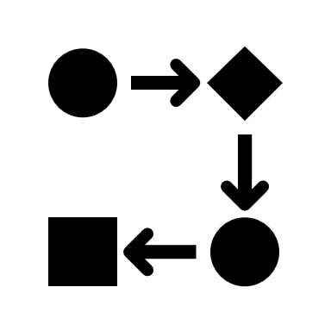



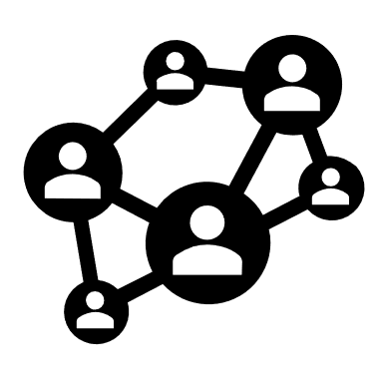






A High-Level GraphRAG/Agentic Architecture
GraphRAG
Ontology
Do I know enough information to respond to the user?
Legacy Systems
User Prompt
Toolset Decision
Orchestration
System
UI
Knowledge Graph
LLM Response
Unstructured
Documents
External APIs,
Custom Functions,
etc.

Slide 14
Where do we fit in?
GraphRAG
Ontology
Do I know enough information to respond to the user?
Legacy Systems
User Prompt
Toolset Decision
Orchestration
System
UI
Knowledge Graph
LLM Response
Unstructured
Documents
External APIs,
Custom Functions,
etc.

Slide 15
Q&A/Discussion

