Slide 1

Data-Centric Accounting
Semantic Arts Summit
May 1, 2025
Dave McComb & Cheryl Dunn

Slide 2
Basics of Data-Centric Accounting
Three Phases: DCA 1, DCA 2, and DCA 3
All phases share these concepts:
Financial activity is directly driven by business events
Immutable data at rest
Accounting policy is machine executable
Debits and credits are no longer needed or useful
Journals, Journal entries, and posting are no longer needed
Closing goes from a process to a state change
Financial reporting is model-driven
All financial reports contain their own lineage and provenance

Slide 3
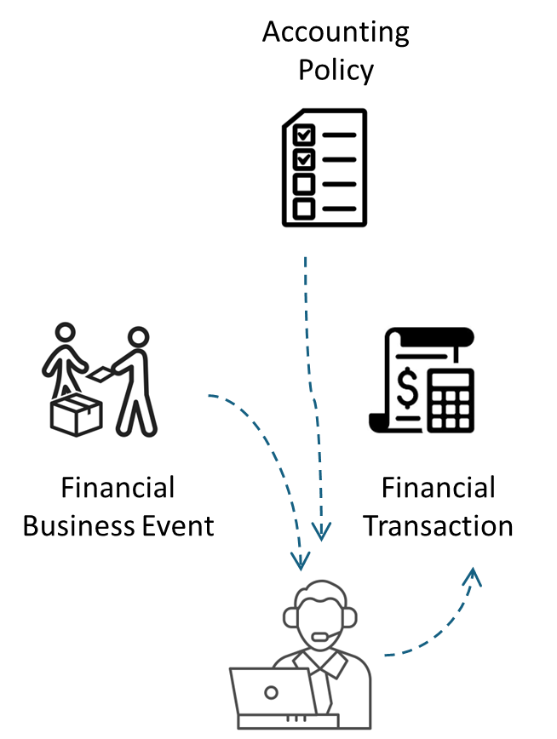
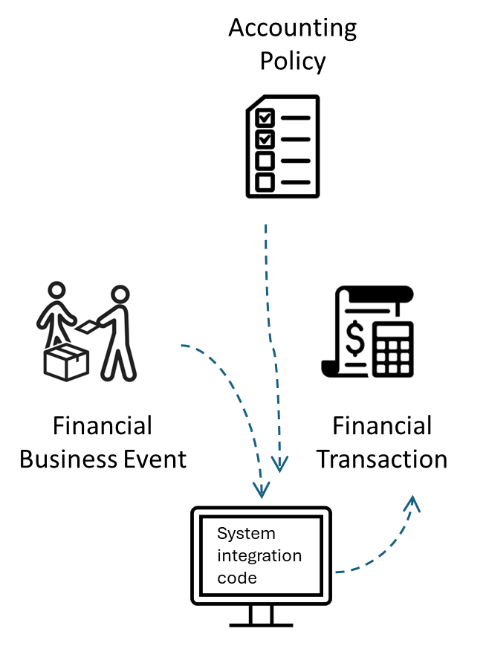
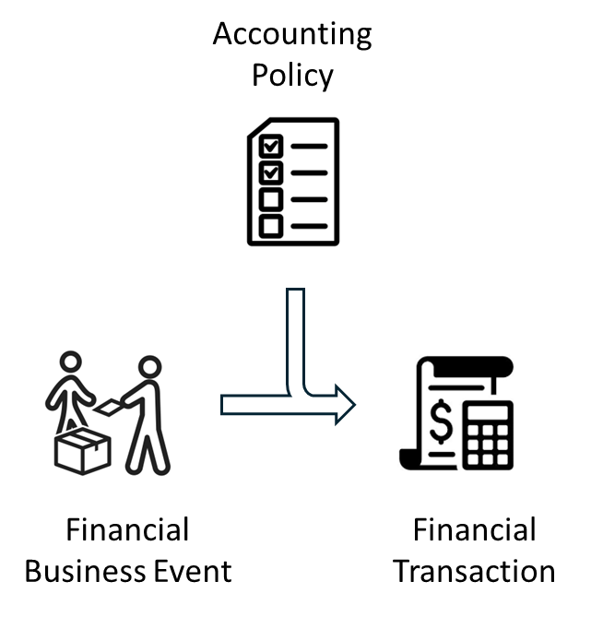
Financial Activity Driven by Business Events
Current systems do
This: Or This:
Data-Centric Accounting will do
This:
A simple graph, event type, and intention will automatically create financial transactions

Slide 4
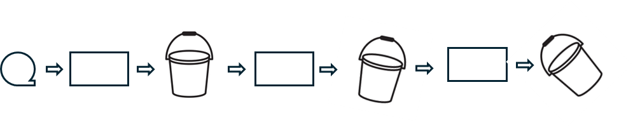
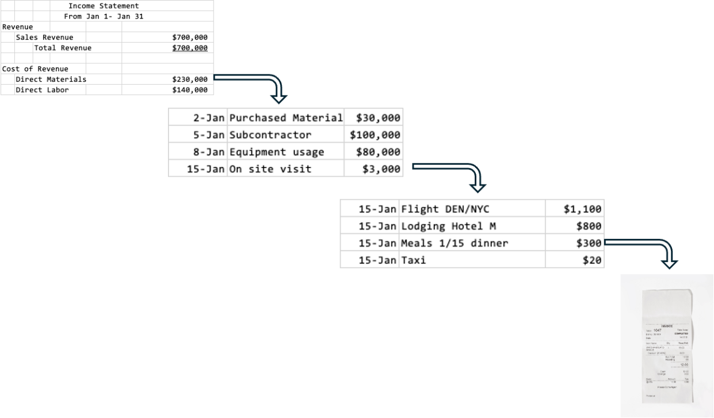
Immutable Data at Rest
Current Systems – Provenance is lost in the “bucket brigade”
Data-Centric Accounting Systems will keep complete provenance for all financial business events

Slide 5
Machine Executable Accounting Policy
Accounting includes many policies that should and can be machine executable.
Inventory Costing
Depreciation

Slide 6
Machine Executable Accounting Policy
Labor Costing

Slide 7
No More Debits and Credits

Slide 8
No More Journals, Journal Entries, or Posting
Event details will be captured wherever in the organization the event took place
The DCA system knows which business events lead to financial activity and will add the financial information (valuation, recognition, and classification) to the event

Slide 9
Closing as a State Change, not a Process
The books are always closed so no closing process is needed
Minimal delay between events’ occurrences and their capture in the books

Slide 10
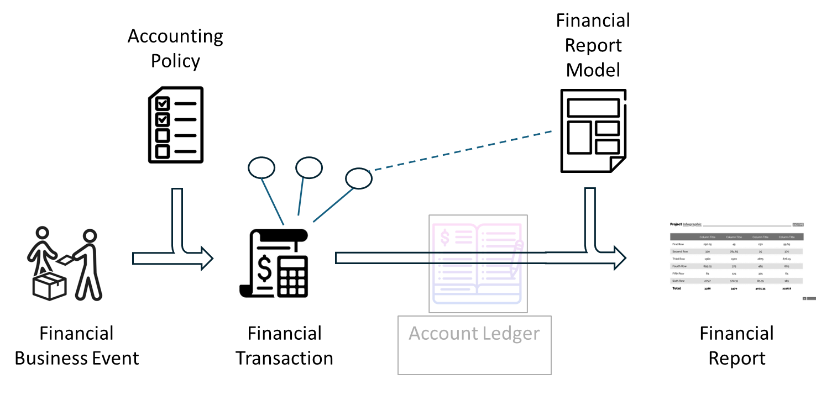
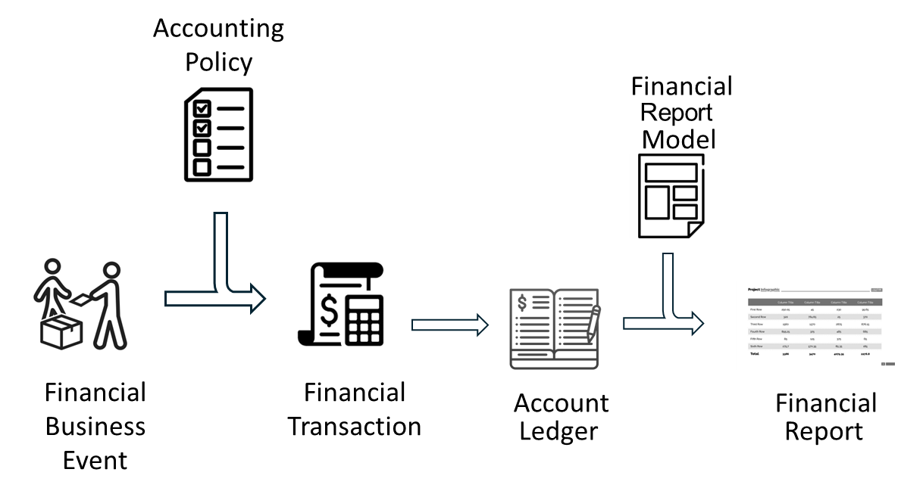
Model-driven Financial Reporting
Traditional Model-Driven Financial Reporting
Model-Driven Financial Reporting Without Ledgers

Slide 11
DCA 1: Data Centric Accounting, Transactionally
KEEPS
DISCARDS
Chart of accounts with general ledger accounts
Posting financial transactions at moments in time
Debits and credits
Journals
Closing process
ADDS
Event-Driven

Slide 12
Event-Driven
Simplest set of financial business events
Order goods or services
Pay for goods or services
Receive goods or services
Sell goods or services
Deliver goods or services
Receive payment for goods or services
Some companies will also have a “Make goods” event, but not all will, so we focus on the six above, which all companies will have.

Slide 13
Primitive Event Considerations
Is it singular or composite?
E.g. buying something with a credit card
Creates and fulfills merchant’s obligation to deliver goods to you
Creates and fulfills your obligation to pay the merchant for those goods
Actually, it transfers your obligation to pay the merchant to the credit card company, thereby creating an obligation for the credit card company to pay the merchant
Also creates an obligation for you to pay the credit card company
Does it involve an obligation or a right?
Does it involve goods and services or money?
Is it a commitment or a fulfillment of a previous commitment?
If the event seems different from our initial set of 6? Look for semantic similarity – e.g. payroll is buying labor for cash

Slide 14
Asset – a present right of an entity to an economic benefit (FASB Conceptual Framework)
Ownership Rights – full ownership consists of all of these:
Possession – the right to move something
Right to Use or Access – also called usufructous rights – right to use and benefit from a property without the right to change or transfer it
Right to Economic Benefit
Exclusivity – right to prevent others from using, e.g., having control of physical items or having intellectual property protections such as copyrights, patents, trademarks, etc.
Right to transfer (sell)
Right to modify
Right to consume or destroy
Ability to Control
Right to Pledge

Slide 15
Intention
Why someone initiated a transaction
E.g. is that chocolate they ordered raw material, for the tour room, or for the executive lounge?
The intention determines how the chocolate should be classified on financial statements
The person who initiated the transaction is the best qualified to classify it
Possible intentions (not exclusive)
Material for production (raw materials inventory)
Material for resale (merchandise inventory)
Operating expense
Sale in normal course of business
Sale of fixed asset (not recorded as sales, but may generate gains or losses)

Slide 16
Policy-Driven Recognition
First two columns drive the rest of the results
If we know the intention and event type, we know whether to recognize the event and what account to charge it to.
Last two columns determine timing and valuation issues
Likely will be only several dozen (at most a few hundred) rows – won’t need the thousands of accounts typical in medium-sized companies.

Slide 17
Equity Accounts as Counterparty Accounts
Equity is made up of
Contributed Capital (amounts received from owners)
Common Stock
Preferred Stock
Retained Earnings (cumulative amount of income earned by company less any dividends paid to its owners throughout the company’s existence)
Treasury Stock (amounts paid back to owners by the company to buy back shares of its own stock – Treasury Stock reduces overall Equity)
Equity represents the (theoretical) claim owners have against the assets of the company
They only really have a claim if the company liquidates
And then even after liabilities are paid, the actual liquidation value of assets may not have been sufficient to pay the owners anything.

Slide 18
Why DCA 1 instead of going right to DCA 2?
To convert existing system, we must bring in legacy data that requires preservation of General Ledger (GL) accounts.
DCA 1 reduces the number of GL accounts, but still allows them. In DCA 2 we will eliminate account numbers and the GL itself.
Implementers will get a baseline of instantaneous financial reporting that is well worth the minor changes made to that point.

Slide 19
DCA 2 – Data-Centric Accounting Directly from Commitments
KEEPS
DISCARDS
Single-organization perspective
Chart of accounts with general ledger accounts
Posting financial transactions at moments in time
ADDS
On-demand time periods for financial reports, e.g. daily or weekly income statements
Full integration of commitment management, improving ability to control spending
Capture of relationships between events reduces amount of information to capture with each event.

Slide 20
Rights and Obligations
One entity’s right is another entity’s obligation
E.g., the mortgagee’s obligation to make payments is also the mortgage holder’s right to receive those payments
Rights are generally assets and obligations are generally liabilities (debt)

Slide 21
Long-Running Business Transactions
May take years or decades to complete
For example, a 30-year mortgage is a transaction that will have a duration of 30 years if both parties adhere to the original loan schedule.
Operating a bridge or recovering an ore body are also LDBTs.

Slide 22
Long-Running Commitments
May or may not show up in traditional financial statements
They only show up if one side of the overall commitment agreement has been partially fulfilled.
If Company 1 ordered something from Company 2 and Company 2 agreed to provide it by a given date, but Company 1 has not given Company 2 any cash yet, and Company 2 hasn’t yet shipped anything yet, traditional financial statements won’t reflect anything.
If company 1 has paid and company 2 hasn’t shipped, company 1 will record Prepaid Expense (and company 2 will record unearned revenue, which is a liability).
If company 2 has shipped and company 1 hasn’t paid, company 1 will record Accounts Payable (and company 2 will record Accounts Receivable)
With DCA 2, Company 1 records the order as a “soft asset” called something like “due-in, goods & services” and as a “soft liability” called something like “due-out, cash”
Company 2 records the order as a “soft asset” called “due-in, cash” and a “soft liability” called something like “due-out, goods & services”

Slide 23
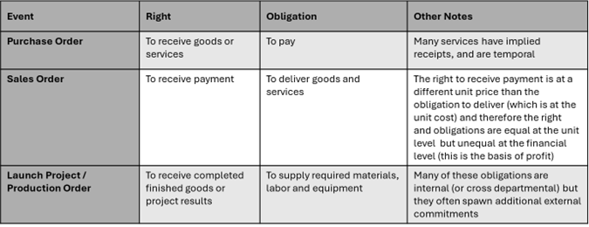
The Most Common Originating Events

Slide 24
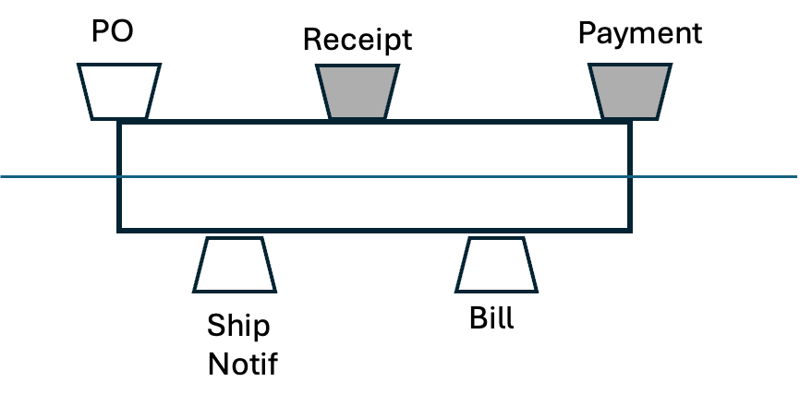
Core Events: Procure to Pay (P2P)
Our company
Our counterparty

Slide 25
Intention
Why someone initiated a transaction
E.g. is that chocolate they ordered raw material, for the tour room, or for the executive lounge?
The intention determines how the chocolate should be classified on financial statements
The person who initiated the transaction is the best qualified to classify it
Possible intentions (not exclusive)
Material for production (raw materials inventory)
Material for resale (merchandise inventory)
Operating expense
Sale in normal course of business
Sale of fixed asset (not recorded as sales, but may generate gains or losses)

Slide 26
Core Events: Procure to Pay (P2P)
P2P Events | Enterprise has Obligation/Right | Event involves Goods-Service / Money | Event is a Commitment /Fulfillment
Purchase Order (PO) this is a DCA2 event | Both | Both | Commitment
Ship Notification | Obligation | Goods / Services | Updated Commitment
Receipt (receive goods or service) | Right | Goods/Service | Fulfillment
Bill (receive request to pay) | Obligation | Money | Updated Commitment
Payment (send payment) | Obligation | Money | Fulfillment

Slide 27
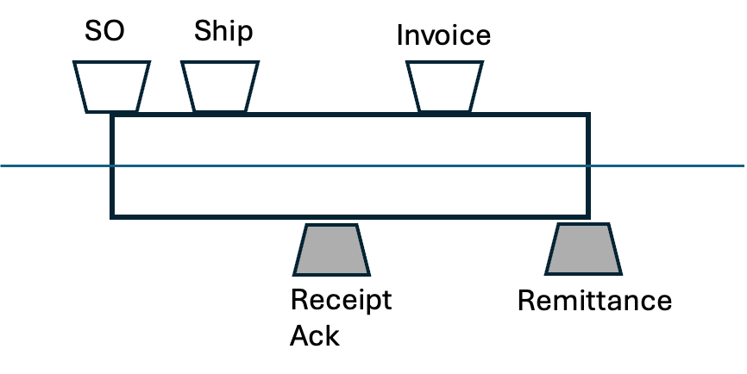
Core Events: Order to Cash (O2C)
Our company
Our counterparty

Slide 28
Core Events: Order to Cash (O2C)

Slide 29
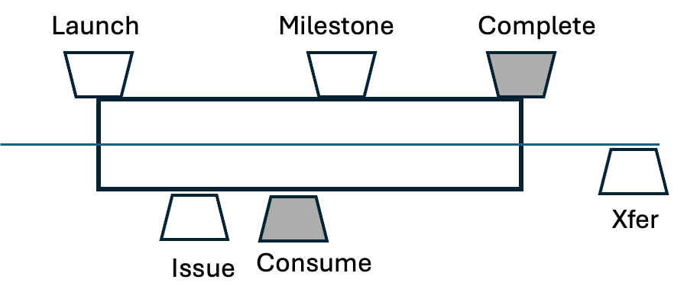
Core Events: Make
Originating portion of our company
Receiving portion of our company

Slide 30
Core Events: Make

Slide 31
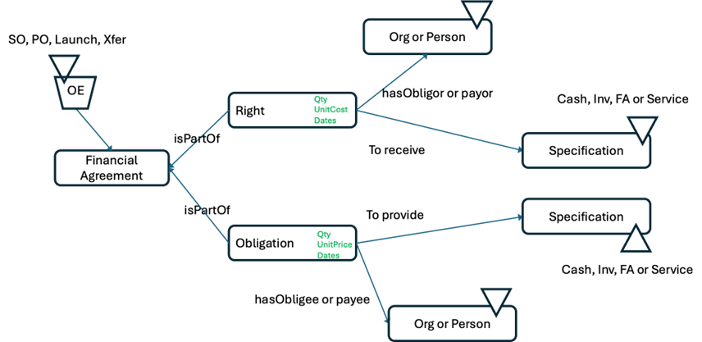
Counterparties

Slide 32
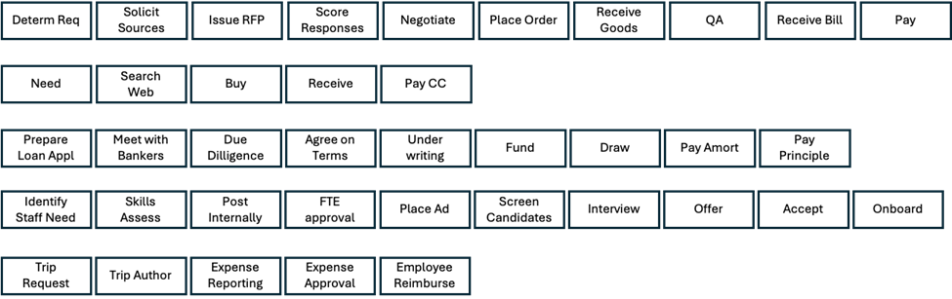
Different Workflows may have Similar Commitments

Slide 33
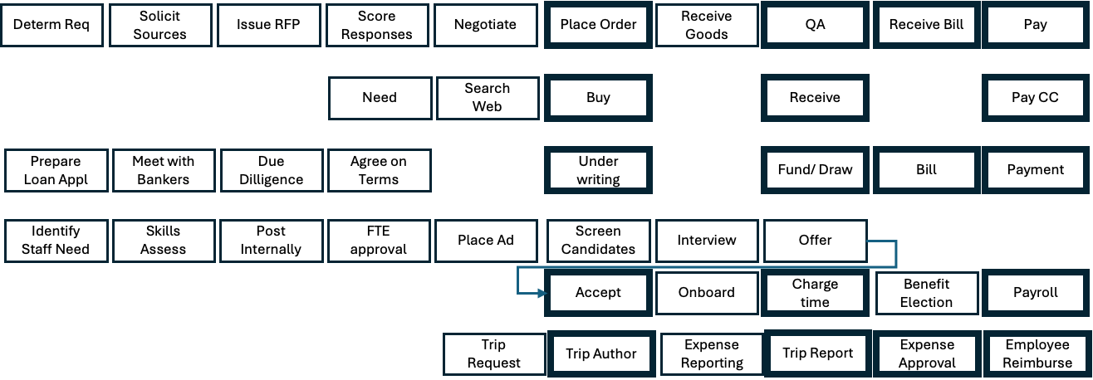
Different Workflows Aligned By Similar Commitments

Slide 34
Accounting Policy in DCA 2 (policy choice made at time of committing event)
Driven by Financial Agreement type, whether the goods are to be immediately consumed (intension), and the event type

Slide 35
Balance Sheet with Commitments

Slide 36
Income Statement with Commitments

Slide 37
Accounting Policy in DCA 2 (policy choice made at time of committing event)
Driven by Financial Agreement type, whether the goods are to be immediately consumed (intension), and the event type

Slide 38
DCA 3 – Data-Centric Accounting in the Multi-Organizational World
KEEPS
DISCARDS
Single-organization perspective
ADDS
Multi-organization perspective

Slide 39
Wait, What does that even mean, and why would it be important?!
Conglomerates
Supply chains
Smart contract participants (blockchain may help)

Slide 40
What has to change?
All terms and concepts that communicate a single entity’s perspective on a transaction
e.g. Sale Order, Sale, Purchase Order, Purchase
Must instead use aperspectival terms such as “Exchange of Goods for Cash” or “Exchange of Service for Cash”

Slide 41
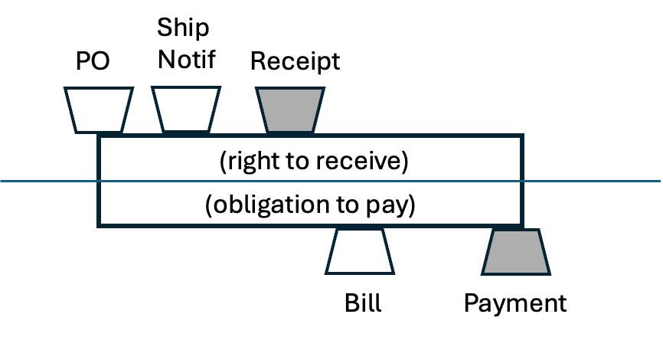
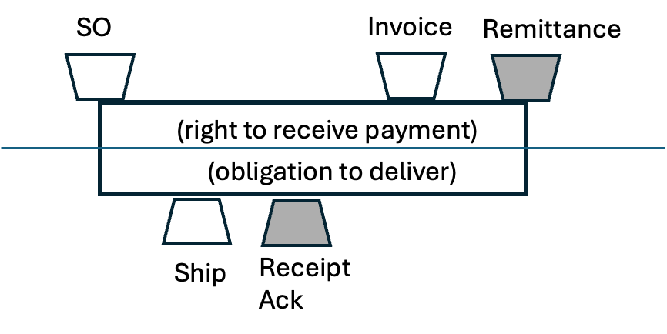
One entity’s Purchase Order IS another entity’s Sale Order

Slide 42
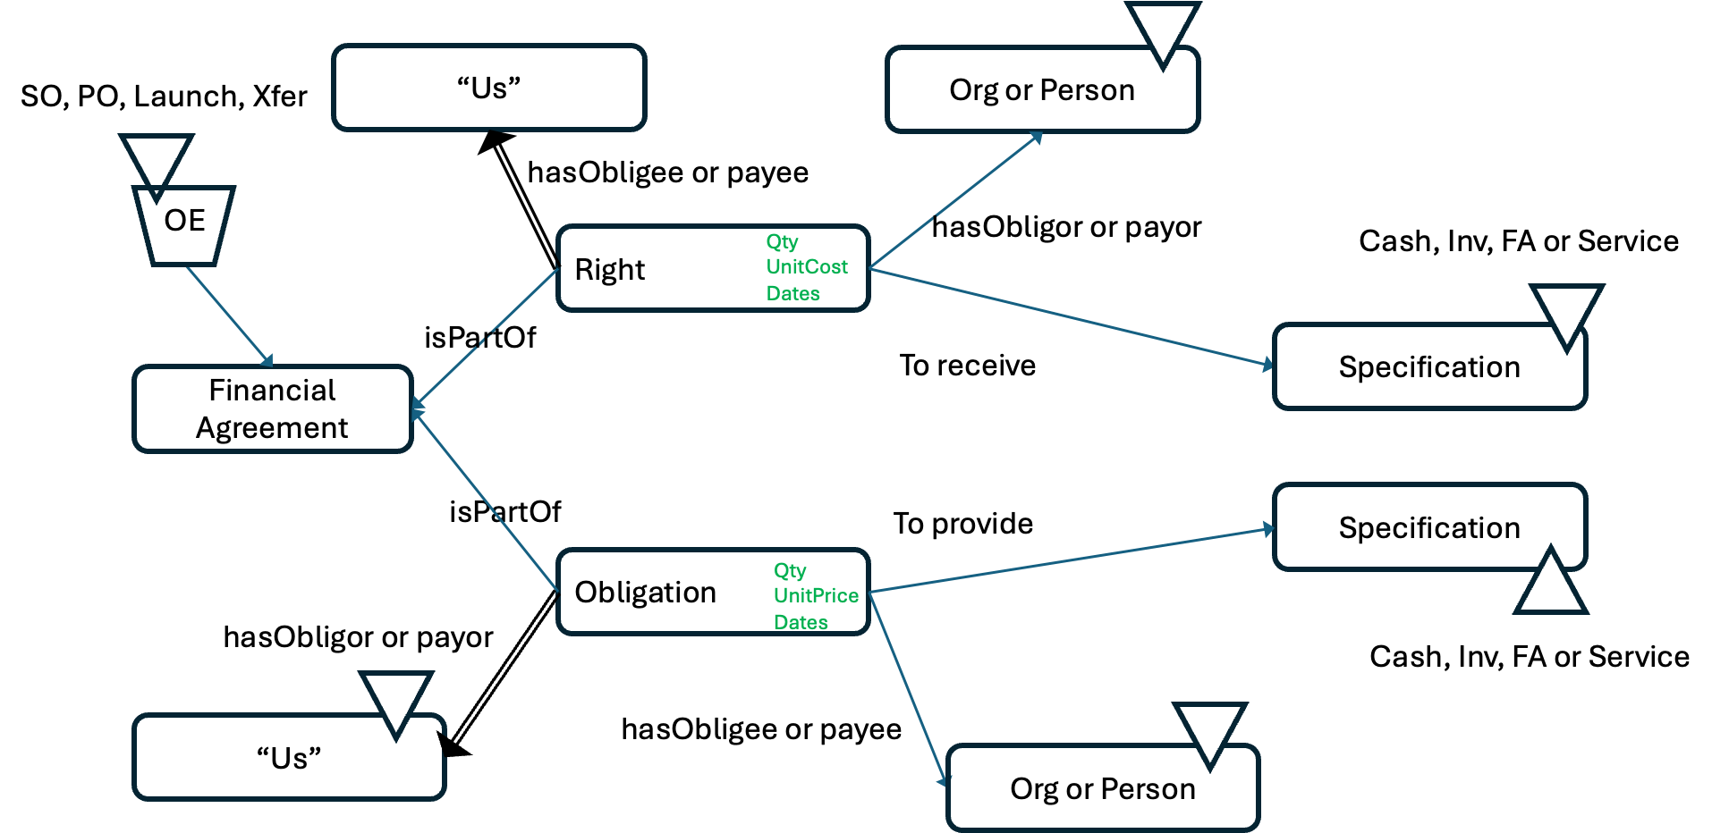
Putting ourselves in our obligations

Slide 43
Challenges with DCA 3
Different systems that aren’t interoperable
Different data representations
Different communication protocols
Different meanings of concepts
Different identifiers for the same things
E.g., trying to match up buyer and seller product numbers, etc.

Slide 44

Questions?

