Slide 1

Developing Vendor Partnerships & Lead Gen
May 1, 2025
Steve Case & Joaquin Melara

Slide 2
Short Agenda:
Why Partners?
Updates on Partner engagement
How it aligns with SA Marketing Strategy?
More on the Marketing/Sales Pipeline generation …
Q&A at the end

Slide 3









Slide 4
Why Partner?
Synergies Exist
Seeking to capture similar semantic based business cases
Synergies between SA and Product Vendors:
Explicitly stated - sell licenses and DO NOT want professional services business.
Vendors bring similar messaging, and solution sets
Vendors bring extensive marketing materials, mature websites, sales staff and partner relationship managers to generate leads and complement long sell cycles to educate prospects
Deliver W3C standard capabilities to resolve business challenges whereby traditional data practices fall short
What SA offers that’s valuable in partnering
Proven and predictable implementation services with 25 years and over 100 projects!
Think BIG /Start Small methodology that aligns with Land & Expand sales strategy for domain extendibility
Apprenticeship type model in ontology build leveraging upper level ‘gist’ to show incremental value “real” client data to demonstrate business impact
Semantic Sustainability – Stickiness & Adoption.
VENDOR GOAL: license growth beyond a single use case
SA GOAL: Domain expansion and Data-Centric enterprise momentum

Slide 5
So, why is it not working … a few theories
SA’s explicit decision to maintain “honest broker” position and alignment with W3C standards, not proprietary tools
SA does not re-sell their products. Vendors prefer to partner with organizations that will bring new clients to them
Vendors may not trust that we will support their approach and proprietary tools that promote vendor lock-in
Motivations may not be in clear, tight alignment:
Vendors Goal: Sell licensing
SA goal: To implement semantic standards based, data-centric architecture that supports ontology driven decisioning with an enterprise, “real world” perspective
CONCLUSION: Develop more hyper-focused partnering offerings that combine product and services to address a specific business problem and expand relationship with successful delivery

Slide 6
Partnership Journey

Slide 7
M365 Connector Offer Development SharePoint 365 with SA professional services https://graphwise.ai/microsoft-365-integration/ - Addressing the findability challenges (faceted taxonomies, semantic search) - Better search capabilities and improved collaboration - Semantic framework to connect data silos – greater accuracy and faster retrieval with enriched metadata - Specific scoping, milestone, and level of effort - TBD - Delivers value within a 3-month period with a goal of achieving an expedient executive win
Outcomes to date …
Developed a Generic Capabilities Statement for Partnerships. Baseline document describing SA:
Relationship, Data-Centric Journey, Implementation focus, Industry Disciplines, Pricing Service Packages (different levels of effort – strategic and execution)
Only North America partner for implementation
Training is completed and experimentation with existing clients and internal to serve as testing ground.
Next steps: Announce formal partnership, create LinkedIn post, joint streaming series event or webinar, market directly to SharePoint Admin, support Graphwise lead gen activities as an implementation partner.

Slide 8
Partnership Journey

Slide 9
eCTD Drug Submission Offer Development CMC data subsets – Fluree products w/ SA services https://acrobat.adobe.com/id/urn:aaid:sc:VA6C2:1dd1d554-7397-415e-b596-2caefc8533f0 - Demonstrate value of semantic KG’s in producing regulatory filing documents - Use of gistPharma & Fluree Sense conversion tool to map table doc’s into a semantic model with traditional AI - SA to extend ontology w/ SME’s for customer specific harmonization, terminology tagging, and model representation - Delivers value with a dynamic eCTD Word template, populated with live data and in-scope of the data sources. - A Drug Manufacturing Asset in the form of a KG allowing users to query and retrieve information across compounds, operational process, batches, recipes and analytical tests/equipment
Outcomes to date …
Development of a 90-day clearly documented offering that includes:
Scope of Work, Fluree & SA contributions, proposal inputs and solution outputs, client expectations
Time boxed, prescriptive offering w/ pricing
Promotional 1-page document – outlines the challenge, joint solution, anticipated results, and how to get started
“Live” LinkedIn streaming event completed between Eliud (Fluree), Doug Beeson and Irina Filitovich (SA)
Next steps: Present at KGC 2025 part of Master Class session – Tuesday, May 6. https://www.knowledgegraph.tech/
Attend KGC 2025 with Fluree & SA in booth partnership – Promote social & KG networking evening on May 6th, https://bit.ly/4jiZzgC
Announce formal partnership, create LinkedIn post, market directly to Regulatory and CMC pharma leadership, and explore further lead gen activities from BioIT 2025 conference and Life Sciences & Healthcare audience at KGC.

Slide 10
Partnership Journey

Slide 11

Next-Gen Cyber Security Offer Development - Cyber Security standards bodies (NIST, DEFEND, MITRE, CCO …) modeled into an ontological representation (Ryan). - Extend and map data for GraphRAG demonstration of the inner workings for query generation (Jans) - Specific scoping, milestone, and level of effort - TBD - INTENT - Delivers value within a 3-month period with a goal of achieving an expedient executive win
Outcomes to date …
Demo - LinkedIn streaming series video explaining the challenge, use of ontology models coupled with standards, and embedding of NLP and GraphRAG capabilities
Promotional via a TicTok style, 3-minute video entry at KGC 2025
Next steps: More thought and analysis on scope of work, Franz & SA contributions, proposal inputs and solution outputs, client expectations, and pricing for a time boxed, prescriptive offering
Deeper discussion with FBI, DIOWG, John Beverly, and other security communities of interest to capture alignment in addressing a targeted security challenge with a tightly scoped offering.

Slide 12
Joaquin for more on Marketing Execution

Slide 13
The Assertion
Formal partnerships with Tool and Graph Vendors:
Bundle proven solutions for faster sales.​
Tap into partner marketing and sales channels.
Unlock targeted customer pipelines for specific industries or use cases

Slide 14

What does a Pipeline Typically Look Like?

Slide 15

What is the Relationship between Marketing and Sales?

Slide 16
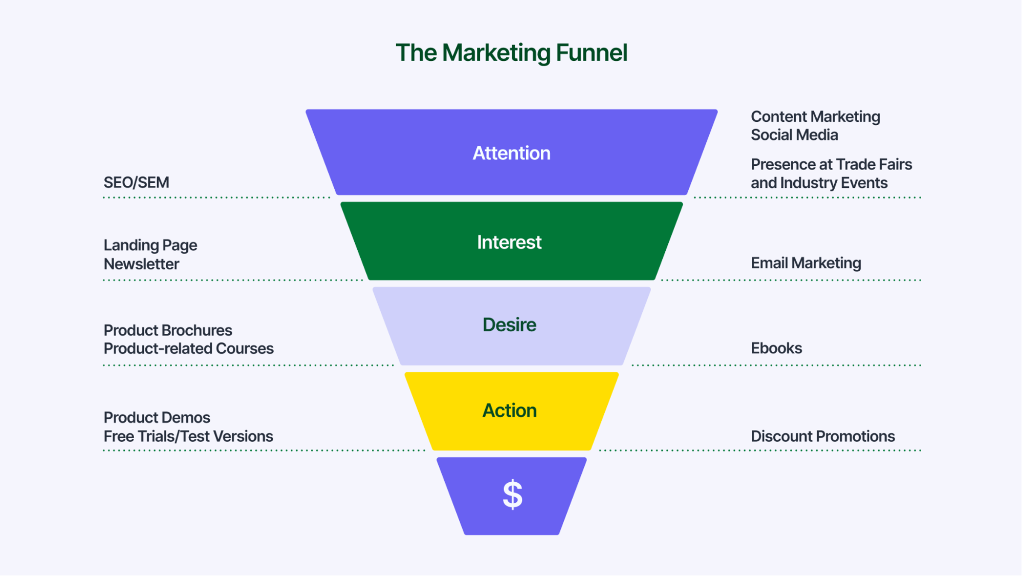
What does a Marketing Funnel Look Like?

Slide 17
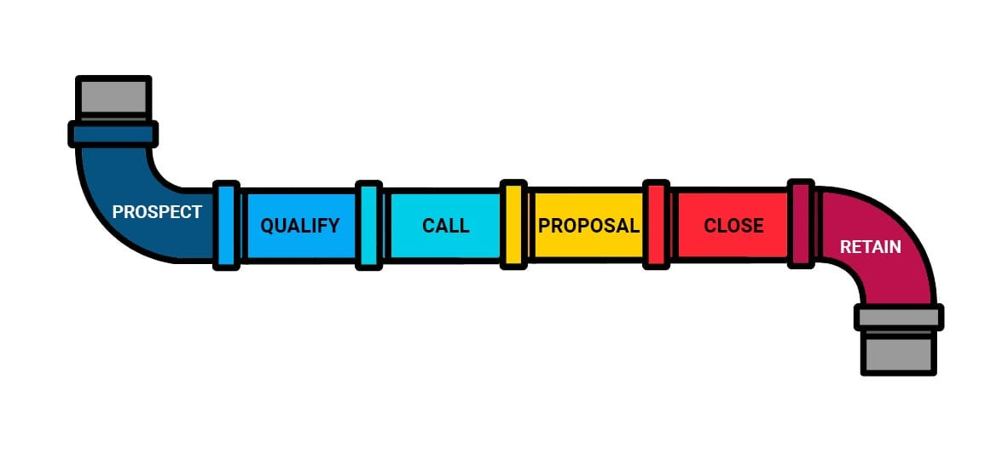
What does a Sales Pipeline Look Like?

Slide 18
What does Our Sales Pipeline Look Like?
Warm Lead
Sponsor Identified
Opportunity Discussed
Exploratory Proposal
Converged Proposal
Contract Negotiated
Contract Signed
Project Started

Slide 19
Warm Lead
DEFINITION:
We have captured the contact and expressed desire to engage via an email or form. PRIORITY:
Education
Filtering

Slide 20
Sponsor Identified
DEFINITION:
We need to find the person with money who can cut a check. It’s not a quick process to get to identify a sponsor. There are still conversations around solutions here, including:
Requesting additional info
White papers
Share examples of previous projects in industry
PRIORITY:
Education

Slide 21
Opportunity Discussed
DEFINITION:
An opportunity discussed during the warm lead identification leads us to have more meaningful discussion on what they are seeking to accomplish. PRIORITY:
Start creating a rough proposal
Access to SMEs
Access to data

Slide 22
Exploratory Proposal
DEFINITION:
We create a proposal, show deliverables, costs, milestones, and a timetable. PRIORITY:
Draft a project plan to determine a potential start date.

Slide 23
Converged Proposal
DEFINITION:
We deliver a presentation from SA’s perspective on how we would deliver a solution and benefits to the client. PRIORITY:
Determine process of approval
Completed mutual NDA
Completed a master SLA
Plotted access to SME & Data sources

Slide 24
Contract Negotiated
DEFINITION:
We produce a formal contract from a Statement of Work template including the notes and previous engagements. PRIORITY:
Onboarding the SA representatives to the client.
Security protocol
Client screening
Getting secured access to certain client data / systems
Getting secured access to SMEs

Slide 25
Contract Signed
DEFINITION:
We kick start the project into production by assigning a lead ontologist as the point of contact with the client. PRIORITY:
Lead ontologist begins setting expectations via a deck to provide a clear set of expectations with the client
A cadence is set with SMEs, and other client representatives

Slide 26
Project Started
DEFINITION:
We build and bill around the Statement of Work.
PRIORITY:
Complete work as it is described and promised.
Scan the environment to see what subsequent work may be tied in as a potential adjacent area of expansion.

Slide 27
What might an Offer + Partner Sales Pipeline look like?
Warm Lead
Sponsor Identified
Converged Proposal
Contract Negotiated
Contract Signed
Project Started

Slide 28
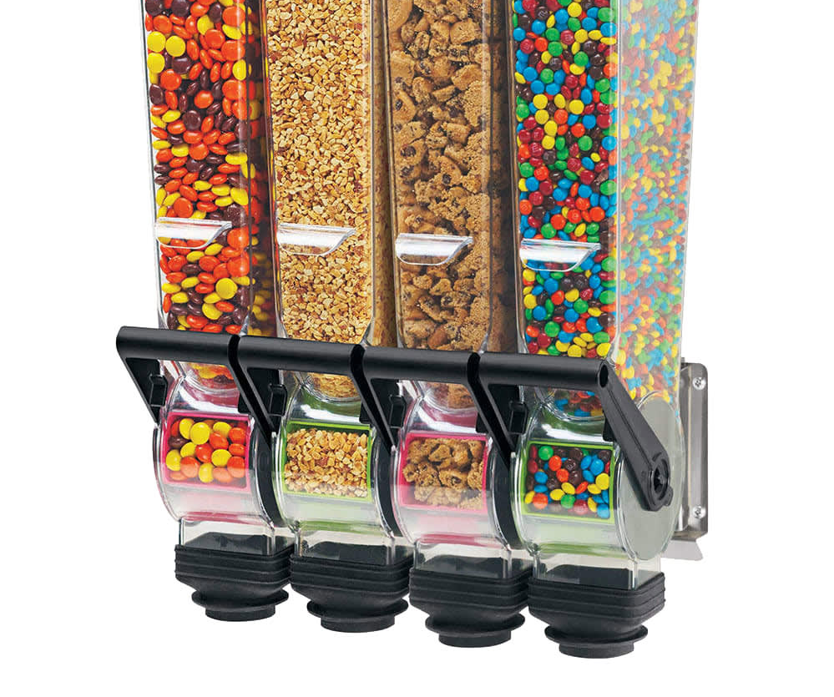
Each Offer-Based Partnership Creates a new Customer Acquisition Channel

Slide 29

But... Nothing in Life is FREE

Slide 30
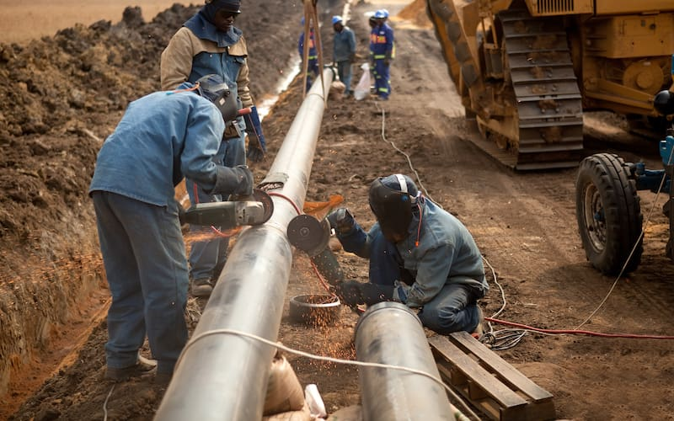
Building Partnerships Requires Co-Operation

Slide 31
Each Partnership Requires Maintenance

Slide 32

Each Deal Requires (Varying) Time + Effort

Slide 33
This can Get Hairy if NOT Organized...

Slide 34
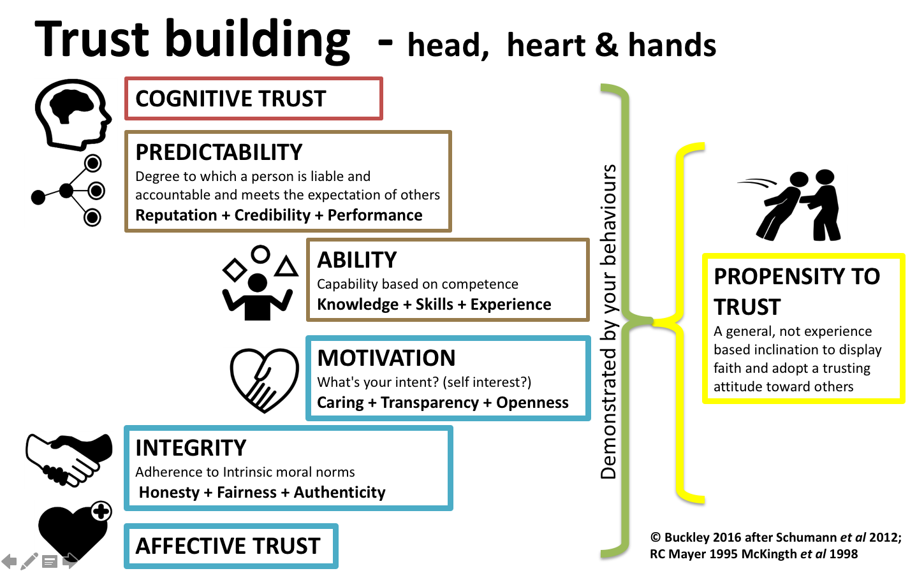
Partnerships are a Consequence of Trust

Slide 35
We Need Clear Parameters and Procedures
Establish a Mutual Offering around a Use Case
Operate Offering through a Consistent Sales Process
Communicate Regularly and Effectively
Deliver on Promises and Action Items
Gather Social Proof and Testimonials

Slide 36
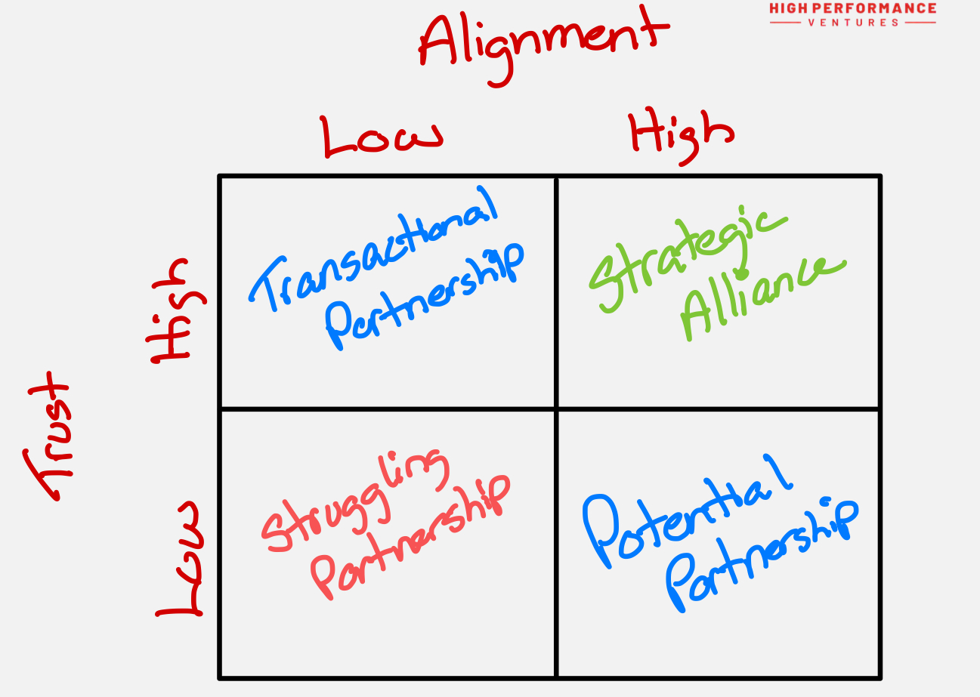
Not all Partnerships are the Same

Slide 37
Partnership Offerings Need to be Codified
MATURE: We have conducted a real-world project that may be reversed engineered to create a potential offer. Needs work.
PROMISING: A potential value proposition has been identified and needs to be wrapped around a past project, brought into a demonstration, or prototype.
GO-TO MARKET READY: We have clearly established a joint value proposition and operational alignment around shared objectives.

Slide 38
Go-To Market Ready
Graphwise
Fluree

Slide 39
Mature
Stardog
RDFox

Slide 40
Promising
Franz, Inc
TopQuadrant
University of Buffalo
CyberSecurity Foundry
Data.World
Relational AI
metaphacts

Slide 41
4 Steps to Making an Offer
Select a Use Case (Past or Promising)
Scope definement as part of core offering
Plot designated responsibilities between partners
Desired outcome and required qualificaitons

Slide 42
What does it take to Develop an Offer?
By working backward from a past project, a known issue within a client’s organization, or a promising area of interest, we can formulate a hypothesis about what makes an offer attractive.
The first exercise to undergo is how this offer has occurred spontaneously in the past following the marketing and sales pipeline to document the patterns emerged.

Slide 43
What does it take to Develop an Offer?
In order of priority, we need to match the sales pipeline pattern:
What were the compentecy questions?
What kind of data sources are required?
What was the parti? Is there documentation to reference or produce?
We want to look at the different stages of a proposal's development to walk through the logical steps of what a client would deem to be a valuable reflection of their problem / solution.
What was the initial opportunity discussed?
What was the exploratory proposal look like?
What was the converged proposal look like?
What was included

Slide 44
What does it take to Develop an Offer?
We want to find outDo we have any records on the kind of tech stack the client was working with?
Do we have any records on what the ontology model looks like?
Do we have any records on what the taxonomy looked like?
Do we have any

