Slide 1
Electrowinning Process for Copper
Group 2
Solomon Ahedor 1981322
Christian Mills 1983822
Kingsley Sarpong 1985722
Christian Oduro 7279521
Bettina Shika Gemegah 1983122
Lordina Erskine 1982922
Rashid Abdul Sumaila 1985822
Emmanuel Kyei Sarfo 1985522
Kelvin Nana Adjei 7278821
Supervisor: Ing. Henry Agbe

Slide 2
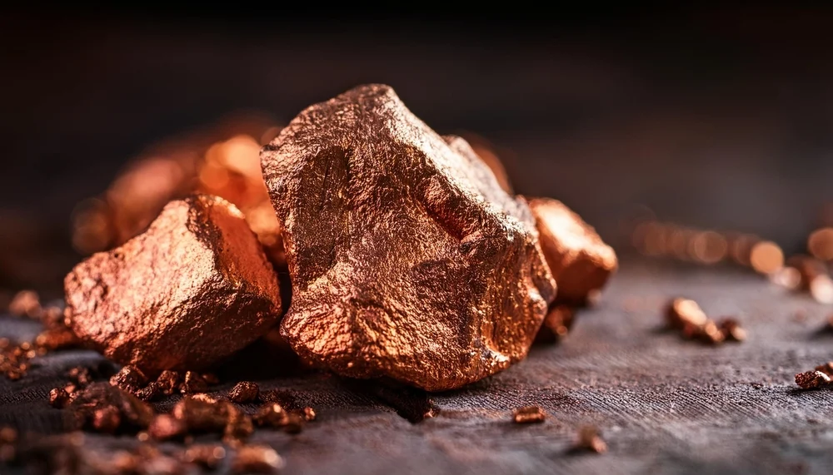
Content
Introduction
Electrochemical Principles
Electrowinning vs. Electrorefining
Electrowinning Cell Design
Overall Process Flow
Typical Operating Parameters
Operating Challenges & Advances
Cathode Harvesting & Quality
Industrial Plant Case Studies
Recent Advances & Future Outlook
Environmental & Economic Significance
Conclusion

Slide 3
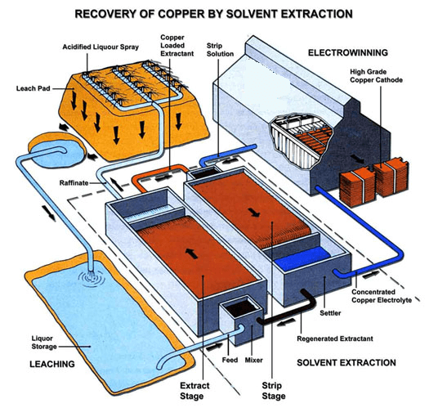
Introduction
Copper electrowinning (EW) recovers metallic copper from a purified sulfate solution by passing a DC current between an insoluble anode and a cathode.
Final step of the hydrometallurgical route (Solvent Extraction-EW), treating oxide and low-grade ores.
SX-EW accounts for about 20% of global copper production.
Operates in a complementary role to conventional smelter-refineries.

Slide 4
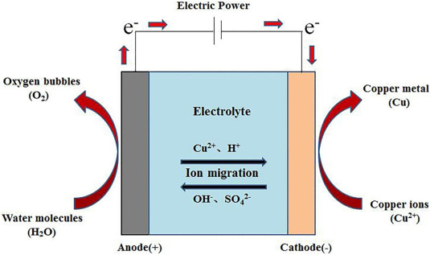
Electrochemical Principles
Cathode Reaction:
Cu²⁺ + 2e⁻ → Cu⁰ (E° = +0.34 V)
Anode Reaction:
H₂O → ½O₂ + 2H⁺ + 2e⁻ (E° = -1.23 V)
The overall cell reaction is thermodynamically unfavorable, requiring applied voltage.
Mass deposited is governed by Faraday's laws of electrolysis.
Current efficiency is typically 88–95% due to parasitic reactions (e.g., ferric ion reduction).

Slide 5
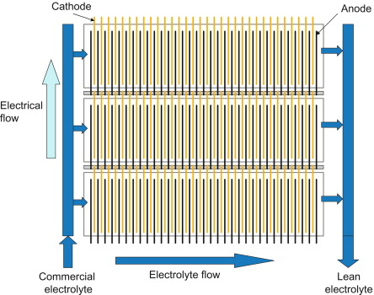
Electrowinning Cell Design
Tanks are typically polymer concrete, electrically isolated.
Alternating flat rectangular anodes and cathodes are suspended vertically.
Anodes: Lead-calcium-tin/antimony alloys or dimensionally stable coated titanium.
Cathodes: copper starter sheets, permanent stainless-steel blanks.
Cobalt sulfate suppresses anode corrosion.
Guar gum promotes smooth deposits.

Slide 6
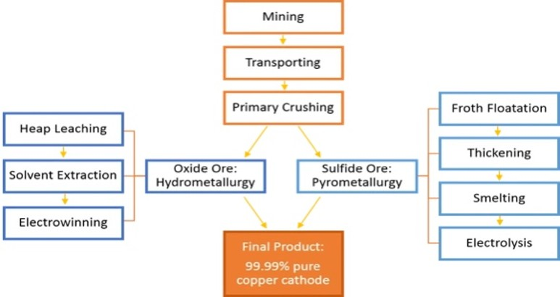
Overall Process Flow
Leaching:
Oxide ores irrigated with dilute H₂SO₄ to produce a pregnant leach solution (PLS).
Solvent Extraction (SX):
Organic extractant selectively binds copper, leaving impurities in raffinate. Copper is then stripped into a pure, concentrated electrolyte.
Electrowinning (EW):
Electrolyte is fed to the tankhouse. Copper deposits on cathodes and spent electrolyte returns to SX.

Slide 7
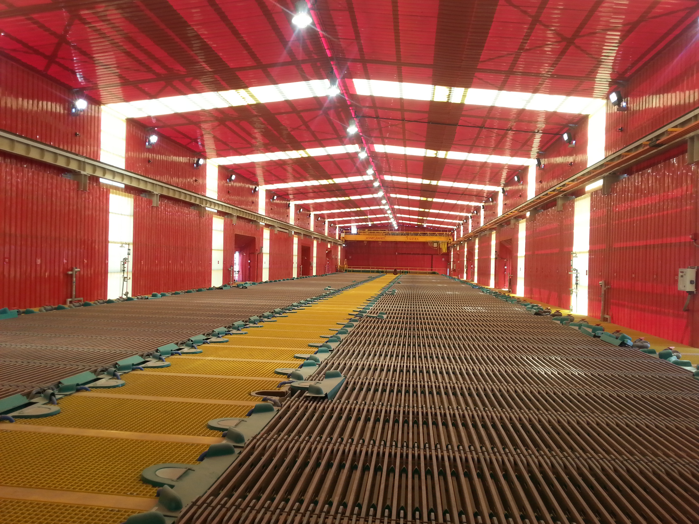
Typical Operating Parameters
Cu²⁺ concentration: 35 - 45 g/L
H₂SO₄ concentration: 150 - 180 g/L
Electrolyte temperature: 40 - 50 °C
Current density: 160 - 370 A/m²
Cell voltage: 2.0 - 2.2 V per cell
Current efficiency: 88 - 95%
Specific energy consumption: 1,800 - 2,000 kWh/t Cu
Deposition cycle: 5 - 9 days

Slide 8
Operating Challenges & Advances
Iron Impurities:
Fe³⁺ migration causes current-efficiency loss.
Acid Mist:
Oxygen bubbles entrain corrosive electrolyte. Controlled using floating balls, mats or chemical suppressants (e.g., fluorochemicals, glycyrrhizin).
Advances:
Permanent stainless-steel cathodes, robotic stripping machines and alternative anode reactions (ferrous/ferric or sulfur-dioxide-depolarised) to lower cell voltage.

Slide 9
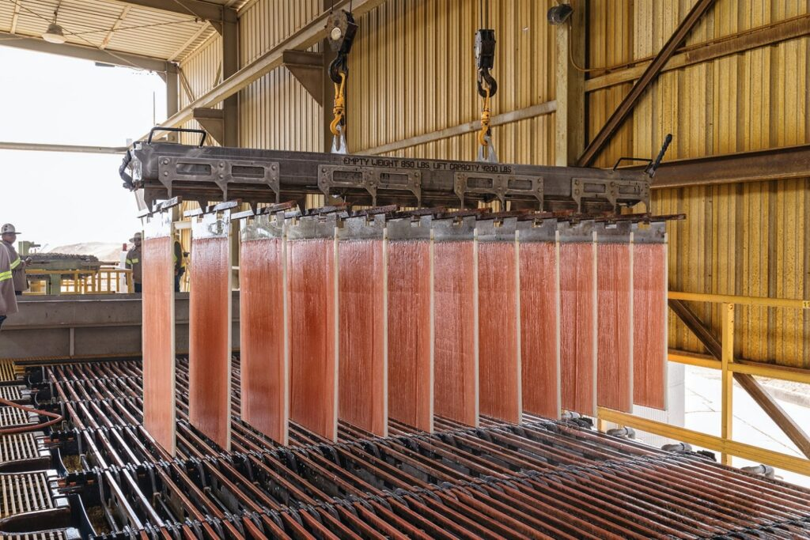
Cathode Harvesting and Product Quality
Deposition Cycle:
Harvested after 5 to 9 days (6-12 mm thick, 40-60 kg per sheet)
Stripping:
Mechanical stripping machines peel copper from permanent stainless-steel blanks
Washing:
Hot water wash (70-80°C) to remove residual acid and sulfate salts
Quality:
LME Grade A purity (>99.99% Cu)
Impurity Limits:
S ≤ 5 ppm, Pb ≤ 2 ppm, Fe ≤ 2 ppm

Slide 10
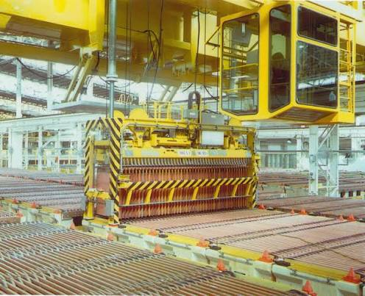
Industrial Plant Case Studies
Cerro Verde, Peru:
Latin America's first commercial SX-EW plant
Expanded capacity to 48,000 tonnes/year at 250 A/m²
Optimized to 368 A/m², doubling throughput while maintaining Grade A quality
KCM Tankhouse, Zambia:
Key controls: acid tenor, organic entrainment, cobalt sulfate and thiourea dosing
Achieves 92% current efficiency with automated desludging

Slide 11
Recent Advances and Future Outlook
Low-Voltage Anode Reactions:
Ferrous/ferric or SO2-depolarized anodes can lower voltage below 1.5 V, yielding 30-40% energy savings
MMO DSA Anodes:
Catalytic coatings on titanium lower overpotential and eliminate lead sludge
Robotics & Automation:
Robotic crane harvesting, AI-driven dosing and automated short-circuit laser scanning
Ultra-High Current Density:
Optimized fluid dynamics enable operation at 450 A/m²

Slide 12
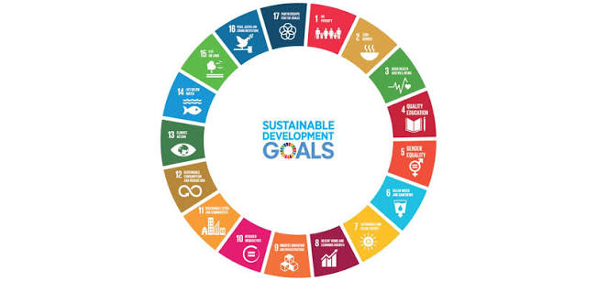
Environmental and Economic Significance
Sustainable Pathway:
Zero direct greenhouse gas emissions during the electrolysis process
Resource Efficiency:
Enables economic processing of low-grade oxide ores and e-waste
Energy Consumption:
Highly energy intensive (1,800 to 2,000 kWh/tonne Cu)
Future Shift:
Industry is transitioning towards renewable sources (solar/hydro) to lower indirect carbon footprint

Slide 13
Conclusion
Electrowinning remains a vital process for converting copper leach solutions into high-purity cathode metal
Modern plants achieve over 94% current efficiency by integrating permanent stainless-steel cathodes and optimized additives
The technology is continuously advancing towards lower-overpotential anodes and fully automated tankhouse operations

Slide 14
THANK YOU

