Slide 1
Multimodal Bengali Book Genre Classification Using Transformer-based Model
Presented By
Syed Ahmad Reza
ID : 1904016
Supervised By
Annesha Das
Assistant Professor,
Dept. of CSE, CUET
Course Code: CSE-400
Course Title: Project and Thesis
Notes:
1
*

Slide 2
Contents
Introduction
Motivation
Objectives
Application
Challenges
Related Work
Dataset Development Steps
Proposed Methodology
Reference

Slide 3
Introduction
Bengali Book Genre Classification: An automated model that will classify Bengali books by genre based on cover image and text summaries.
Genre : The term "genre" refers to the specific categories or classes that the system will identify. The system is designed to classify Bengali books into 7 distinct genres:
উপন্যাস (Novel)
ইতিহাস ও ঐতিহ্য (History & Heritage)
গণিত, বিজ্ঞান ও প্রযুক্তি (Mathematics, Science & Technology)
ছড়া, কবিতা ও আবৃত্তি (Poetry & Recitation)
থ্রিলার (Thriller)
ধর্মীয় (Religious)
প্রবন্ধ (Essay)

Slide 4
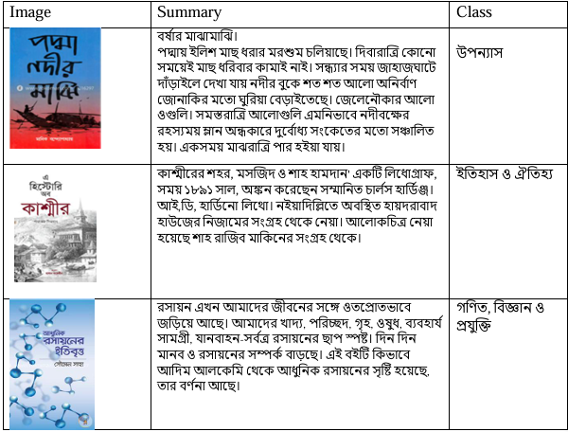
Introduction(Cont.)
Figure 1 : Visual and textual data for classifying the book into 3 categories

Slide 5
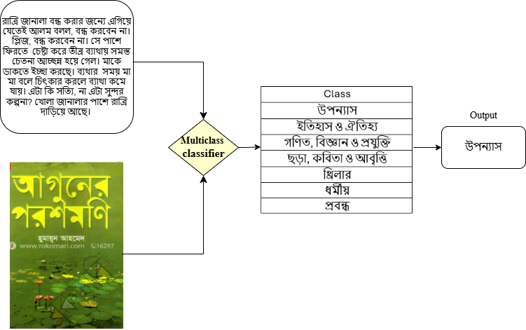
Introduction (Cont.)
Figure 2 : Overview of multiclass book genre classification system

Slide 6
Motivation
There is a lack of a Bengali multimodal dataset, highlighting the need for new data collection.
Limited research on genre classification in Bengali literature by implementing a multimodal system.
Combining both visual and textual information, the model can classify genres more accurately.
Automatic categorization of books by genre make digital books easier to locate and access.

Slide 7
Objectives
To build a model that classifies Bengali books into genres by utilizing both cover images and text summaries, improving the accuracy of genre detection.
To create a multi-class Bengali book dataset that includes both cover images and summaries, along with their respective genre labels.
To develop a state-of-the-art Transformer models for processing both image and text data.

Slide 8
Related work
Empirical Text Analysis [1] (A. Afroze et al.)
Used Nine different classes
Collected 12925 dataset from Rokomari
Used different Machine learning algorithm and BERT,RNN,LSTM deep learning model
Accuracy 77% for title dataset
Limitations:
Only textual modality.
Low accuracy for title dataset.

Slide 9
Related Work(Cont.)
Book Genre classification based on title [2] (Ozsarfati et al.)
Used 32 distinct genre
Used 207,575 samples from Amazon Library
Applied RNN, LSTM, BiLSTM, GRU and different machine-learning algorithms
Accuracy is 65.58% for title-based classification
Limitations:
Low accuracy.
Based on English Language.
Unimodal, based on title only.

Slide 10
Related work(Cont.)
Deep multi-modal networks for book genre classification based on its cover [3] (Kundu et al.)
Dataset is based on 57,000 samples
Number of genre is 32
Used algorithm LSTM, RNN, ImageNet, ResNet, MobileNet, InceptionNet, VGGNet
Accuracy 77.7%
Limitations:
Applicable only to the English language
Low accuracy

Slide 11
Dataset Development Steps
Figure 3 : Dataset Development Process
Data sources : Rokomari
https://www.rokomari.com/book

Slide 12
Challenges
Lack of Existing Bengali Datasets:
There is a shortage of Multimodal Bengali datasets that include both cover images and text summaries along with genre labels, requiring the creation of a new dataset from scratch.
//bangla language er sentence structure
Difficulty in model building:
Combining information from both images and text into a single model

Slide 13
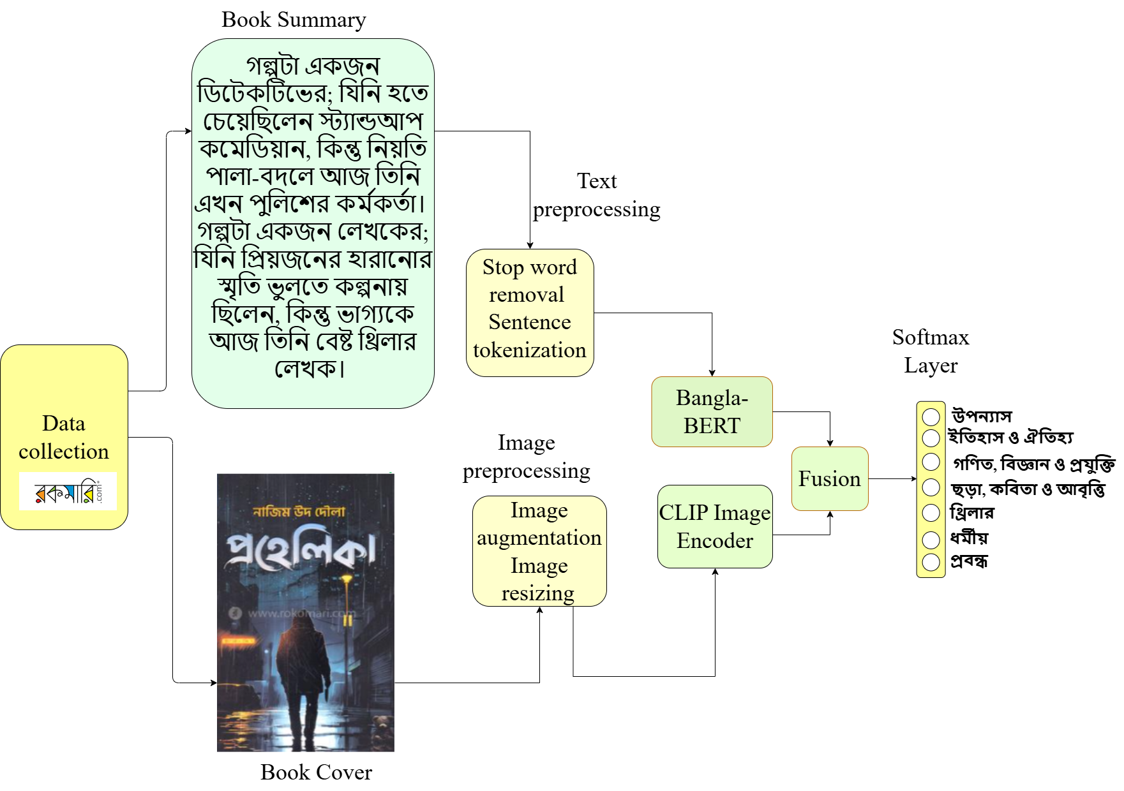
Proposed Methodology
Figure 4 : Schematic diagram of multiclass book genre classification system

Slide 14
Conclusion
A multimodal dataset will be developed for multiclass Bengali book genre classification
Several transformer-based models and fusion techniques will be implemented to develop a reliable system for classifying book into different genres
A multimodal framework will be developed for multiclass Bengali book genre classification

Slide 15
References (3 reference)
[1]A. Afroze, K. Dutta, S. Sadik, S. Khanam, R. Rab and M. A. Rahim, ‘Empirical text analysis for identifying the genres of Bengali literary work,’ Journal of Advances in Information Technology, vol. 15, no. 5, 2024 (cit. on pp. 3, 6).
[2]E.Ozsarfati,E.Sahin,C.J.SaulandA.Yilmaz,‘Book genre classification based on titles with comparative machine learning algorithms,’ in 2019 IEEE 4th International Conference on Computer and Communication Systems (ICCCS), IEEE,2019, pp. 14–20 (cit. on pp. 3, 6).
[3]B. K. Iwana, S. T. R. Rizvi, S. Ahmed, A. Dengel and S. Uchida, ‘Judging a
book by its cover,’ arXiv preprint arXiv:1610.09204, 2016 (cit. on pp. 2, 5, 6).
[4]C. Kundu and L. Zheng, ‘Deep multi-modal networks for book genre classification based on its cover,’ arXiv preprint arXiv:2011.07658, 2020 (cit. on pp. 5,6).

