Slide 1
State of the Pandemic
Dr. Rochelle P. Walensky

Slide 2
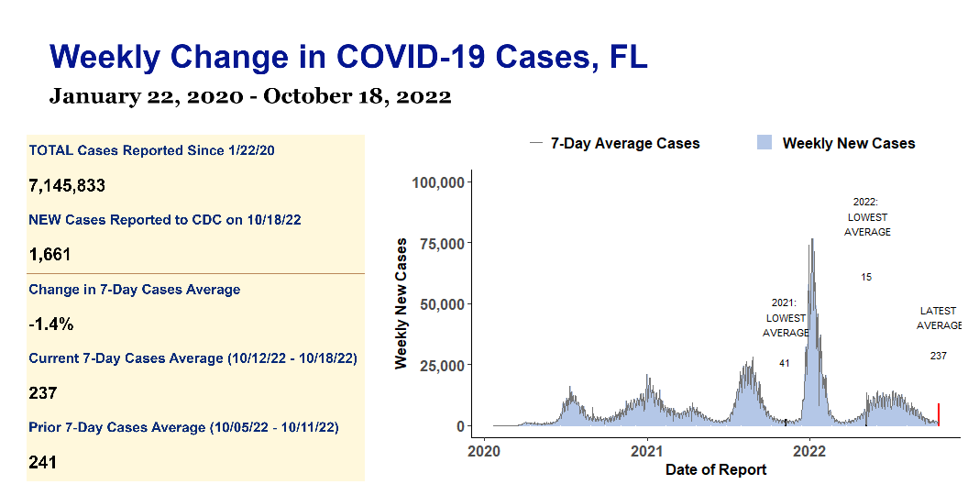

Slide 3
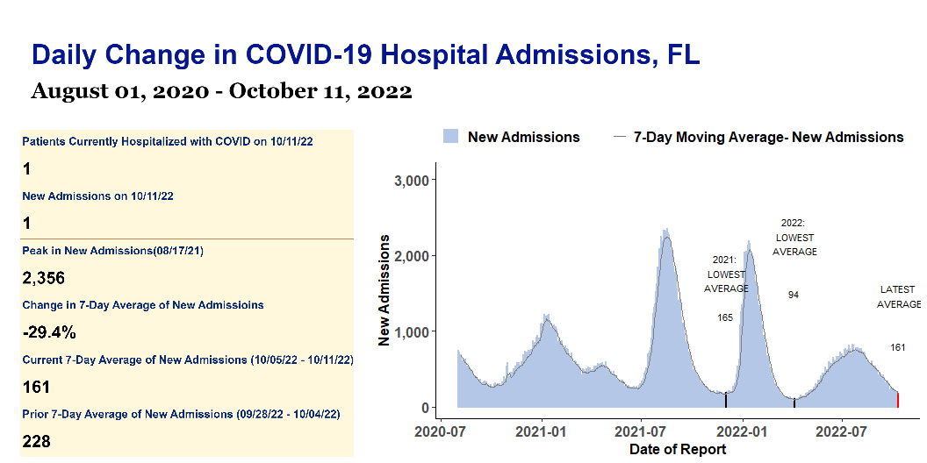

Slide 4
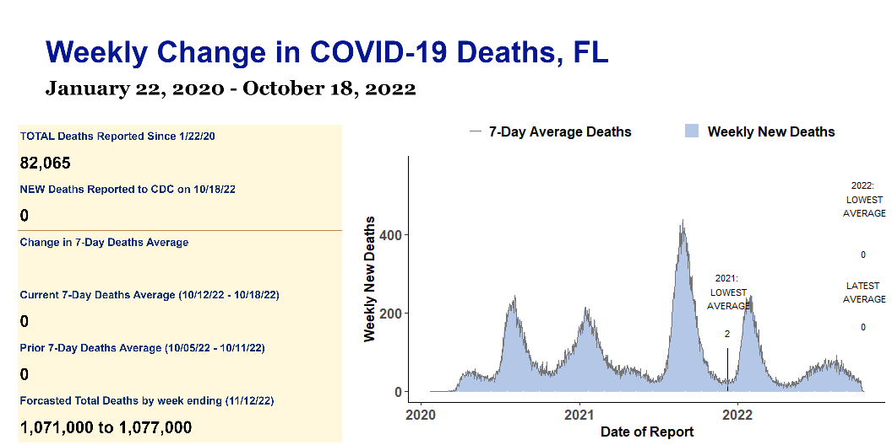

Slide 5
FL Weekly COVID Report
Key Metrics | Key Metrics | Key Metrics | Key Metrics | Key Metrics
indicator | Total to date | Most recent week | 7-Day average | Period-on-period change
Cases | 7,145,833 | 1,661 | 237 | -1.4%
Hospital Admissions | 494,931 | 1,125 | 161 | -29.4%
Deaths | 82,065 | 0 | 0
Test Positivity | 12.6% | N/A | 6.6% | -10.8%

