Slide 1
State of the Pandemic
Dr. Rochelle P. Walensky

Slide 2
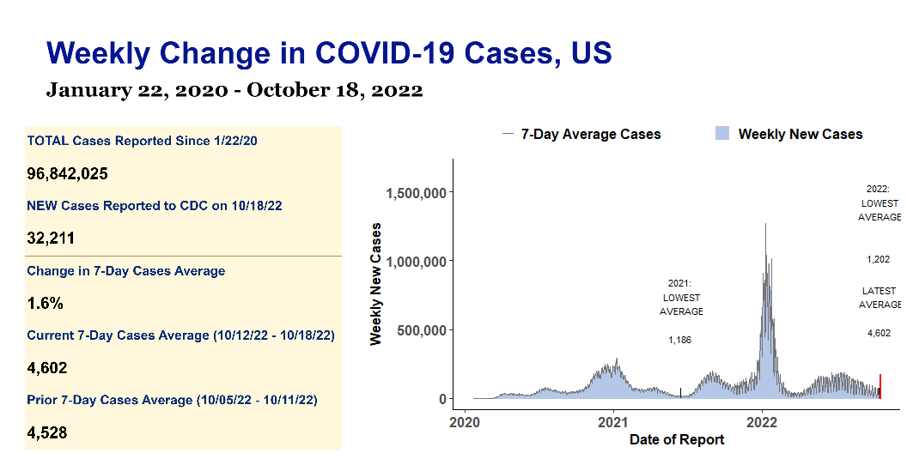

Slide 3
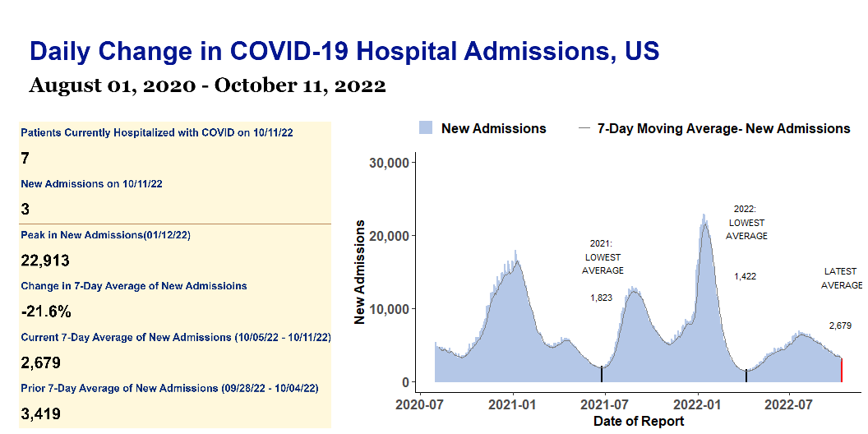

Slide 4
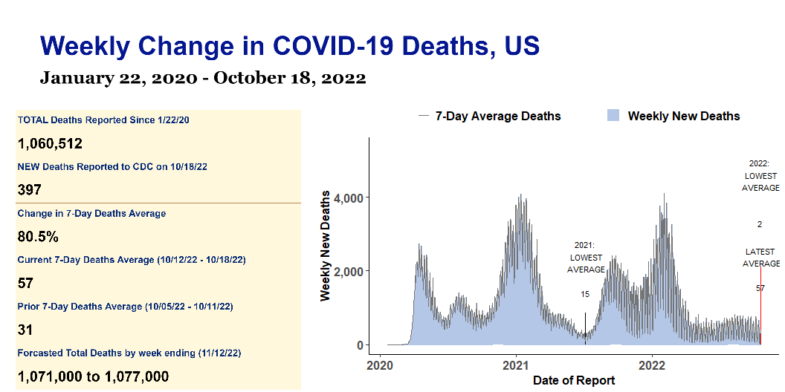

Slide 5
US Weekly COVID Report
Key Metrics | Key Metrics | Key Metrics | Key Metrics | Key Metrics
indicator | Total to date | Most recent week | 7-Day average | Period-on-period change
Cases | 96,842,025 | 32,211 | 4,602 | 1.6%
Hospital Admissions | 5,395,984 | 18,752 | 2,679 | -21.6%
Deaths | 1,060,512 | 397 | 57 | 80.5%
Test Positivity | 9.5% | N/A | 8.6% | 2.7%

