Slide 1
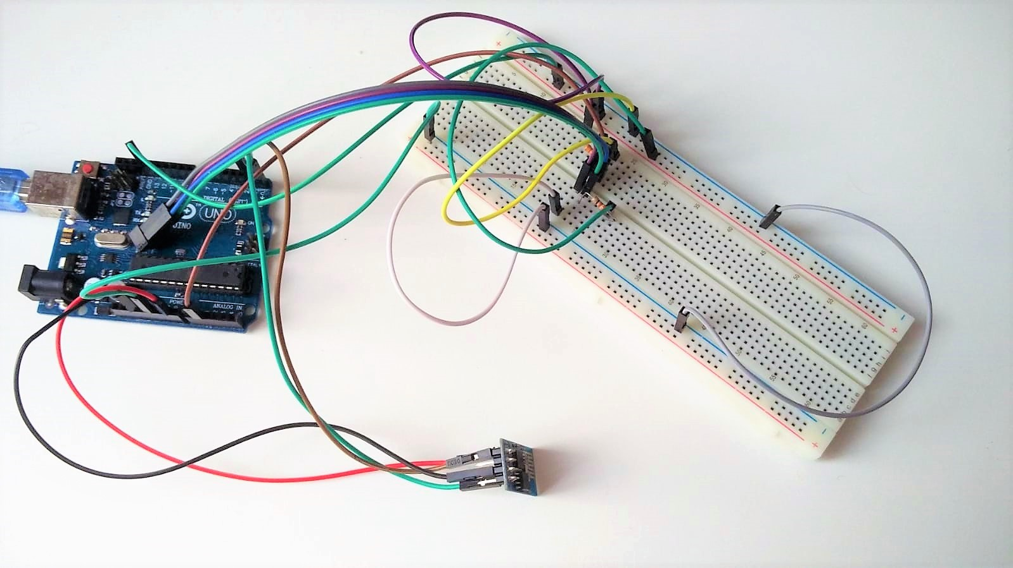
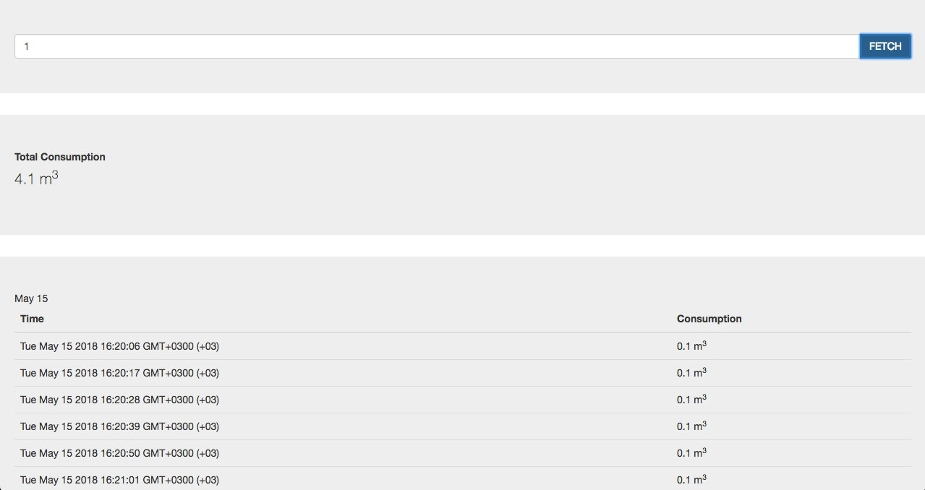
Smart Meter
Team members:
Semih Ersahin
Mert Saricaoglu
Sabahattin Orasen
Solution:
One reflective optical sensor was placed on top of the water meter above the last digit of the odometer
Connected to Bluemix using MQTT and WiFi
Cloud controller translating the readings to cubic meter
Reporting water usage on our custom made UI
Problem: University wanting to know the precise water usage (i.e., cubic meter) with less human interaction
Technologies: Arduino, CNY70 Reflective Optical Sensor, ESP8266, Node-Red, IBM Bluemix, etc.
CmpE 490 IoT Course Final Project, 2018 Spring, Bogazici University Computer Engineering Department

