Slide 1
REVERSE ENGINEERING:ADVERTISEMENT
-R.SABANA

Slide 2
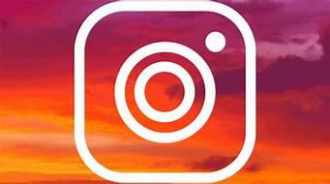
INSTAGRAM
Instagram is a social networking app made for sharing photos and videos from a smartphone

Slide 3
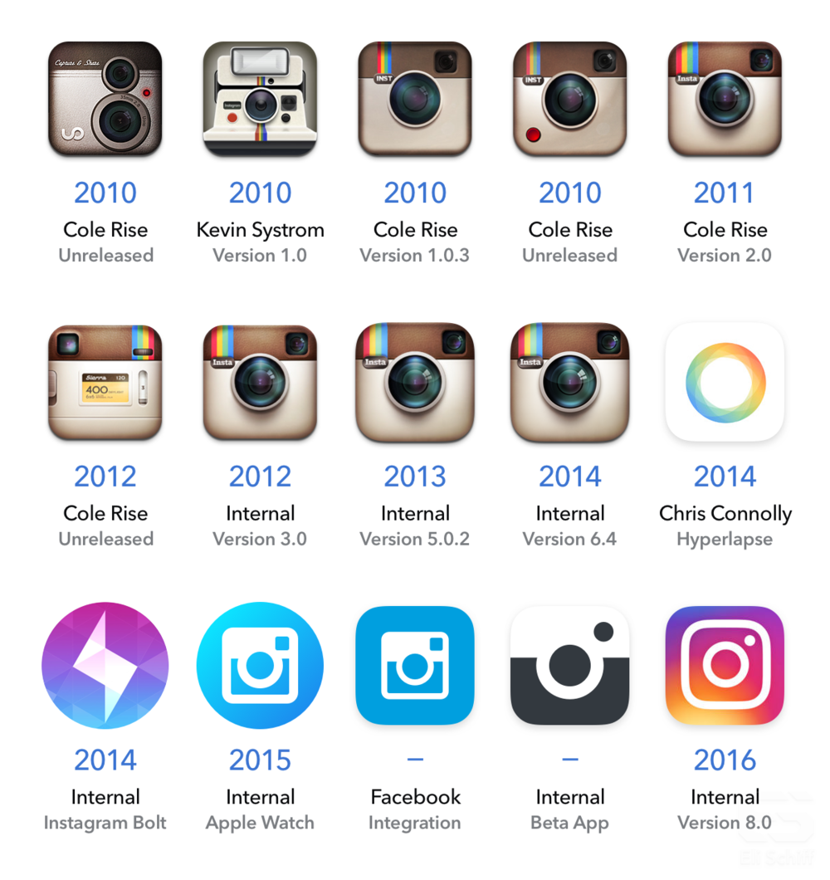
HISTORY OF INSTAGRAM
LIFE CYCLE

Slide 4
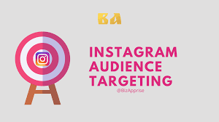
TEENAGERS
FEMALE TEENAGERS

Slide 5
SURVEY
A SURVEY IS BEING CONDUCTED THROUGH TEENAGERS,YOUNG ADULT,MIDDLE ADULT AND OLD PEOPLE
FROM THIS SURVEY WE CONCLUDE THAT TEENAGERS HAVE BEEN USING INSTAGRAM MORE THAN OTHERS
THE NEXT HIGHEST USERS ARE YOUNG ADULT FOLLOWED BY MIDDLE ADULT
THE VERY LEAST USERS OF INSTAGRAM IS OLD PEOPLE

Slide 6
HYPOTHESIS TESTING
1)TEST PERFORMED:ONE WAY ANOVA
2)Y-USERS(CONTINUOUS)
X-AGE GROUP(DISCRETE)
3)THE P-VALUE OF TESTING IS 0.700344 WHICH IS HIGHER THAN THE ALPHA 0.05=IT ACCEPTS HYPOTHESIS
4)There is no difference before and after L.D in acceptance X doesn’t affect Y

Slide 7
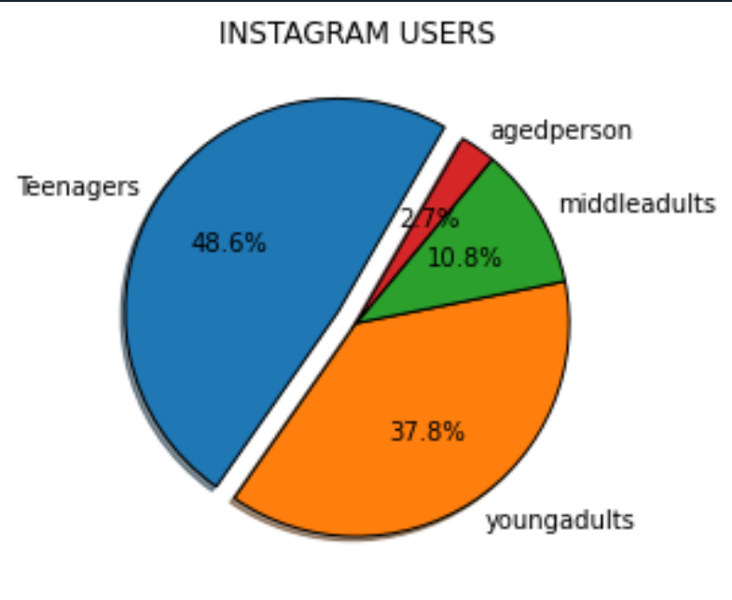
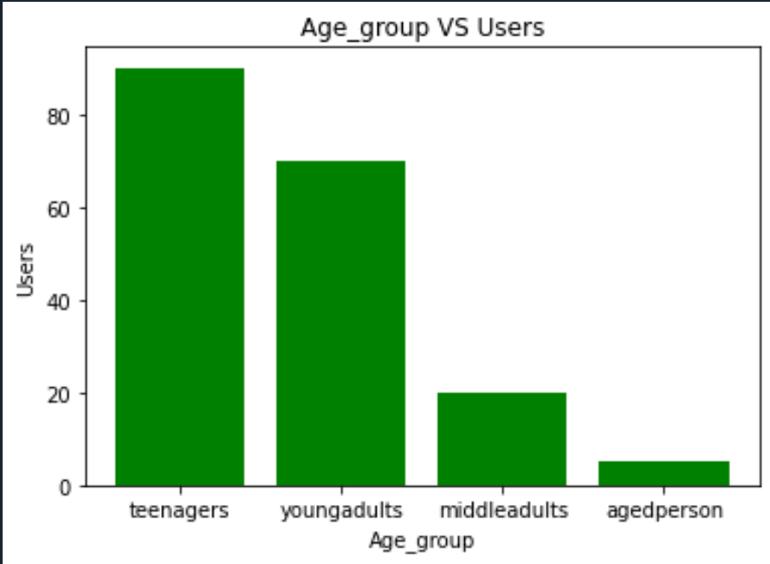

Slide 8
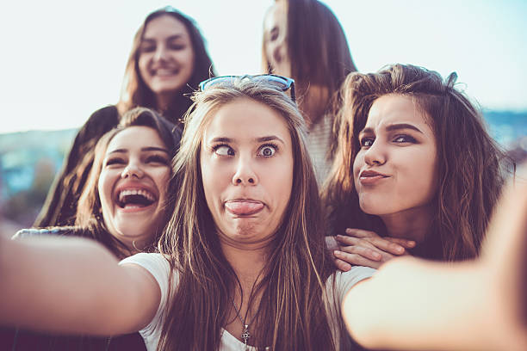
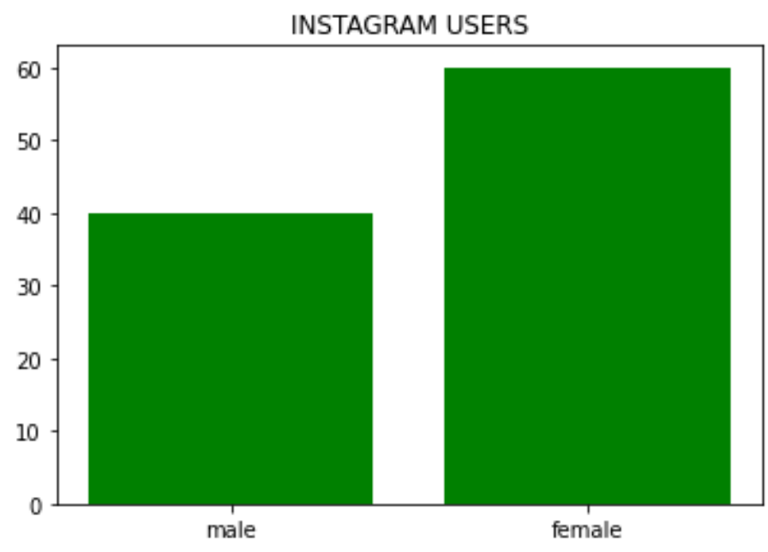
INFERENCE
FROM THE GRAPH AND DATA WE INFER THAT:
TEENAGERS HAVE A LOT OF INTEREST IN USING INSTAGRAM
FROM THE TEENAGERS,THE FEMALE TEENAGERS HAVE A LOT OF INTEREST IN USING INSTAGRAM

Slide 9
RESULT
WE CAN CONCLUDE THAT H0 IS TRUE AND TEENAGERS ARE MORE INTERESTED(i.e,)FEMALE TEENAGERS
SO THE ADVERTISEMENT IS CREATED MOSTLY FOR TEENAGERS RATHER THAN OTHERS

