Slide 1
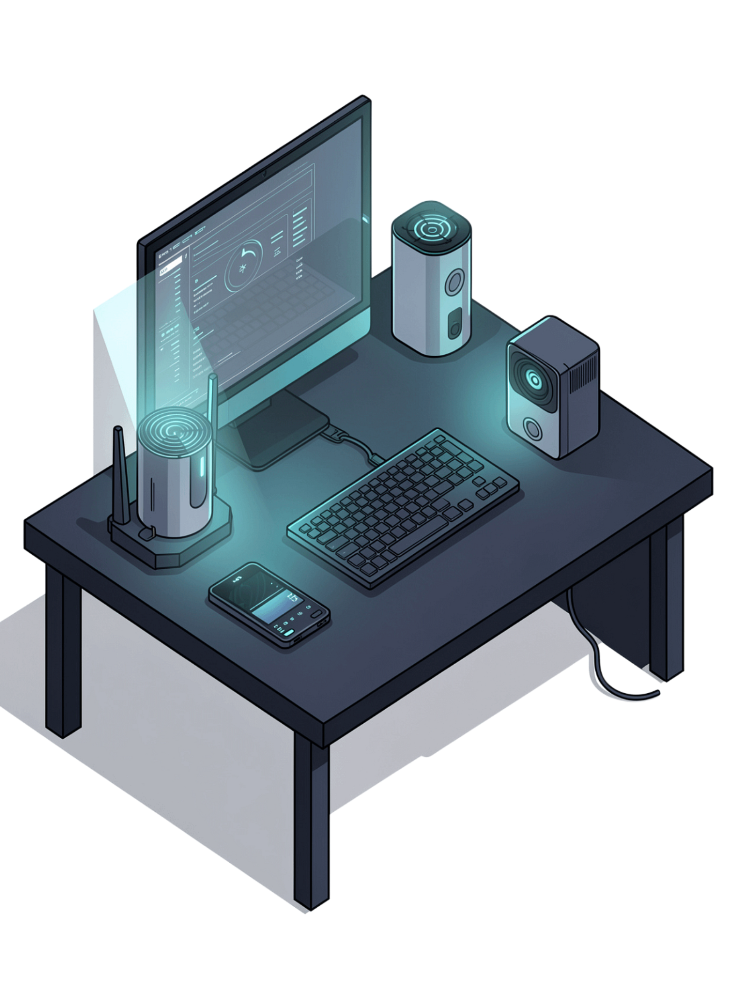
Voice-Controlled IoT System with ESP32 & Relays
Smart Home Automation using Speech Recognition & Wi-Fi

Slide 2
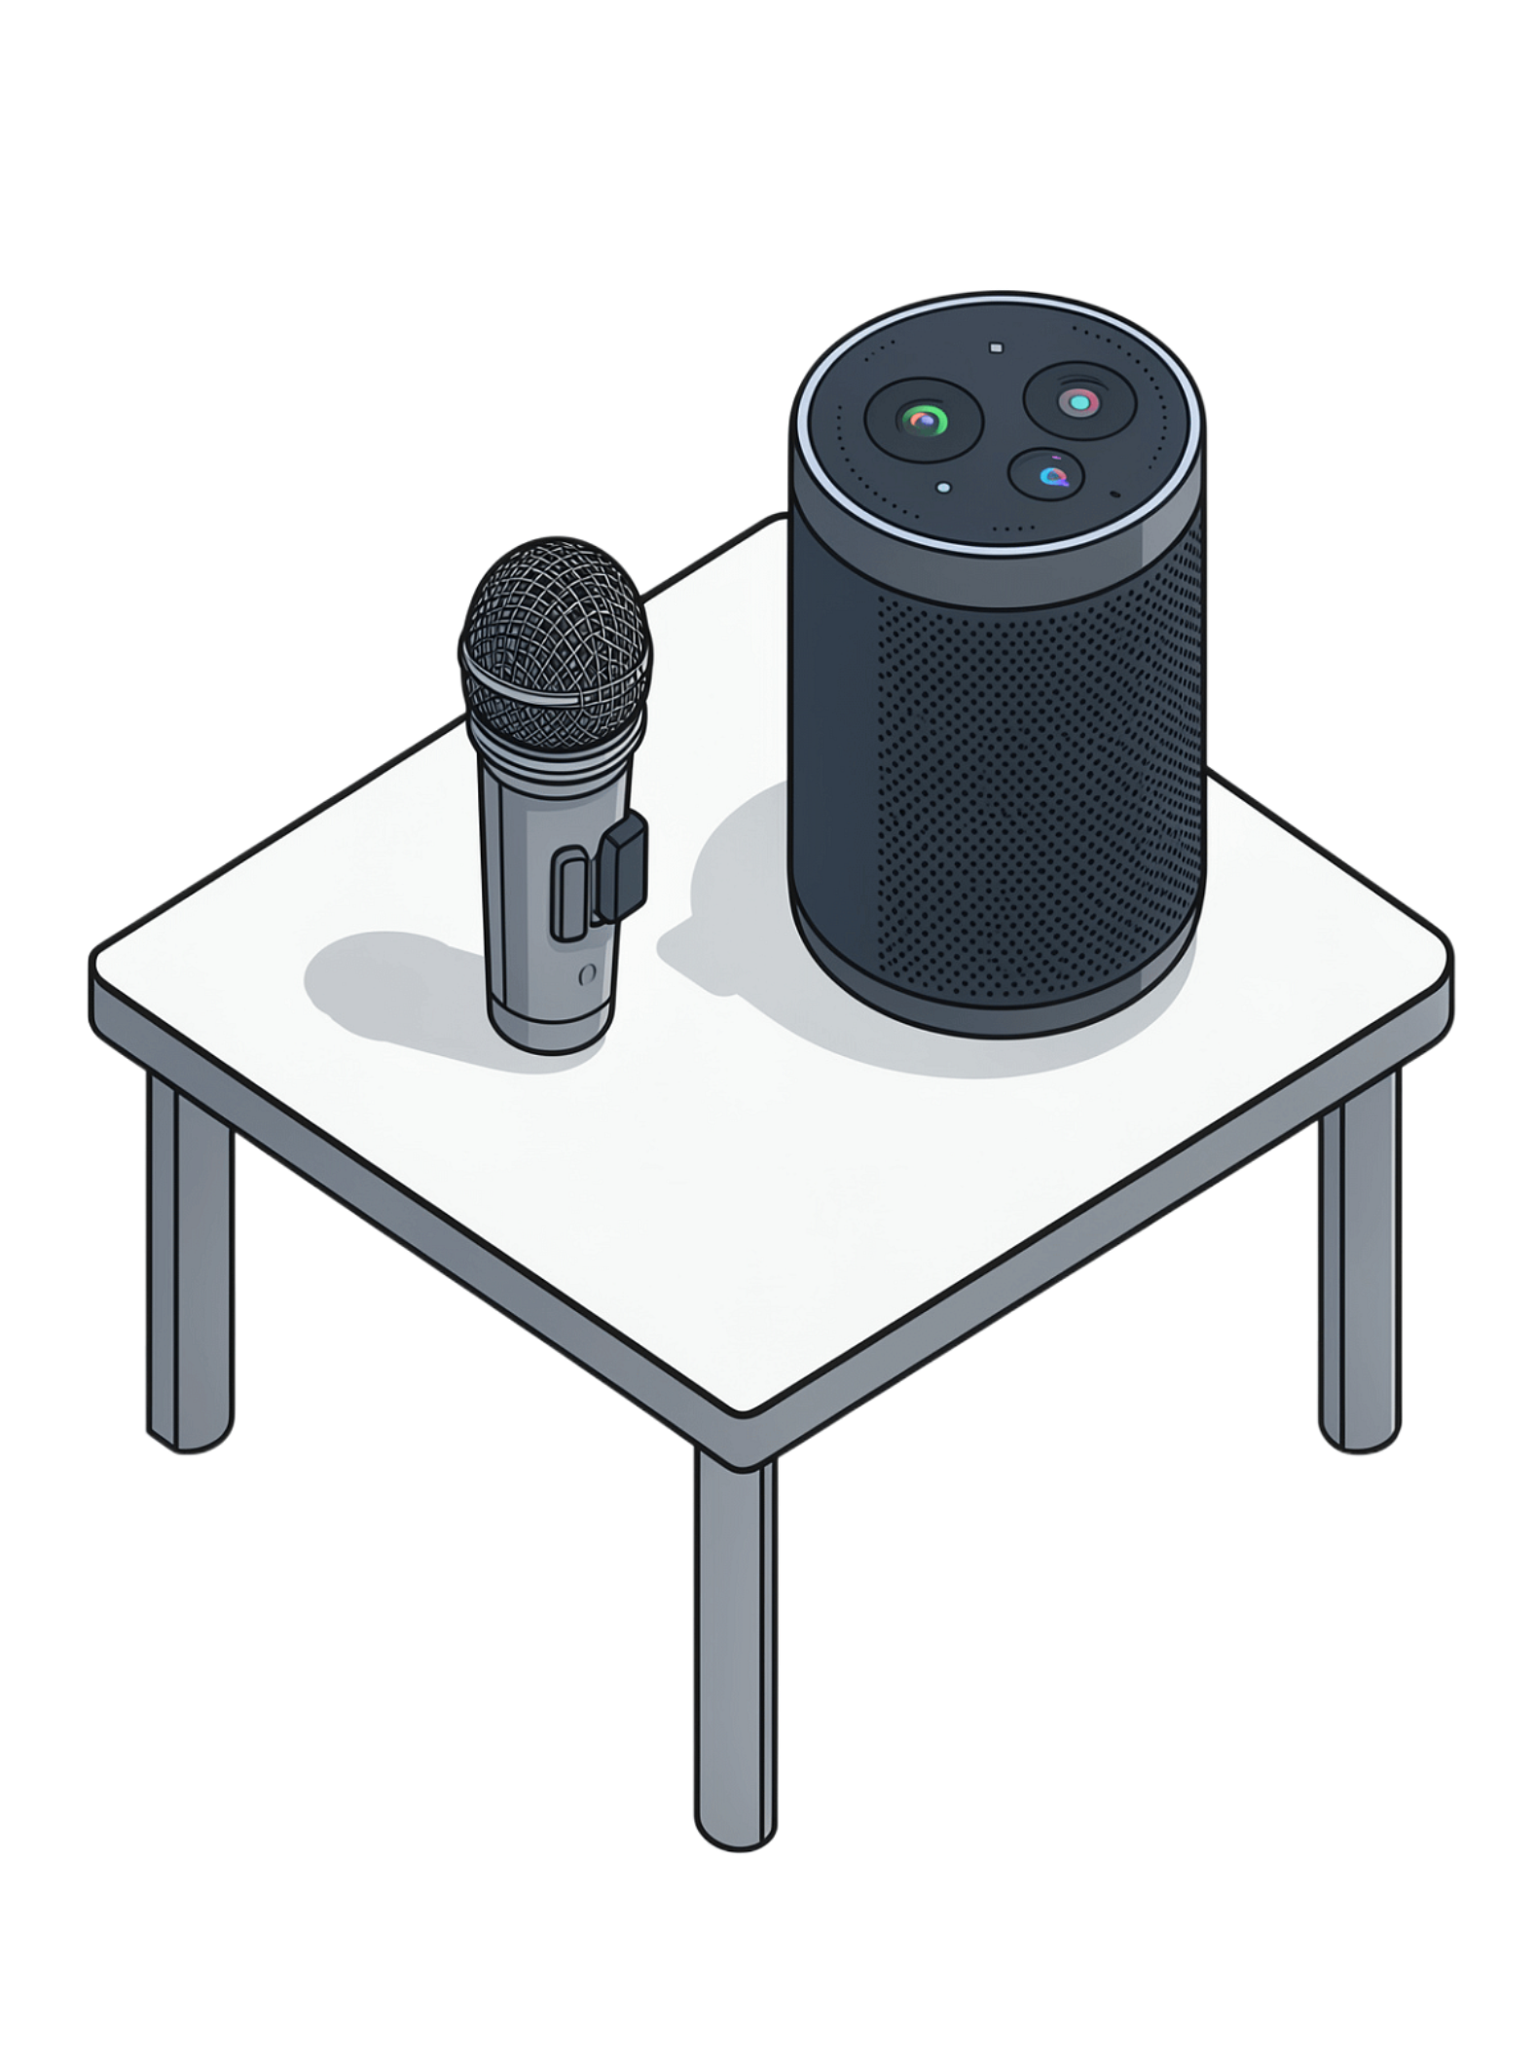
Introduction
IoT & Smart Control
IoT enables smart control of appliances via internet & automation
Project Integration
This project integrates ESP32 microcontroller, 2-channel relay, and Python voice recognition
Goal
Control lights/appliances using simple voice commands

Slide 3




Core Components
ESP32
Relay Module (2-channel)
Wi-Fi enabled microcontroller at the heart of the system
Switches electrical appliances safely
Python SpeechRecognition
Wi-Fi Communication
Listens to voice commands via microphone
Python sends HTTP requests to ESP32

Slide 4
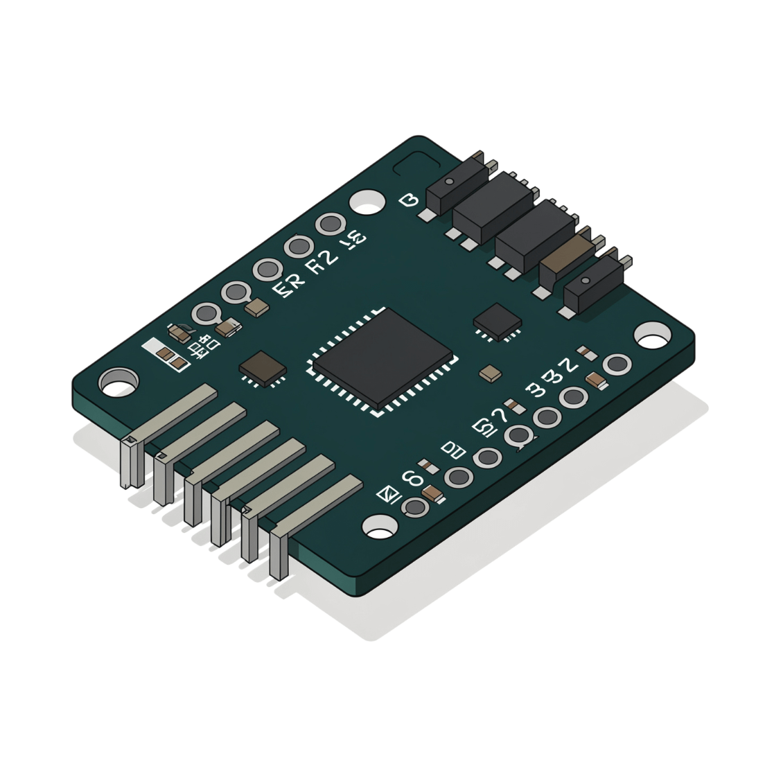
ESP32 Role
Hosts a web server with /on and /off endpoints
Receives commands from Python script
Controls relay pins (GPIO 26 & 27)
Provides real-time feedback ("Lights ON" / "Lights OFF")

Slide 5

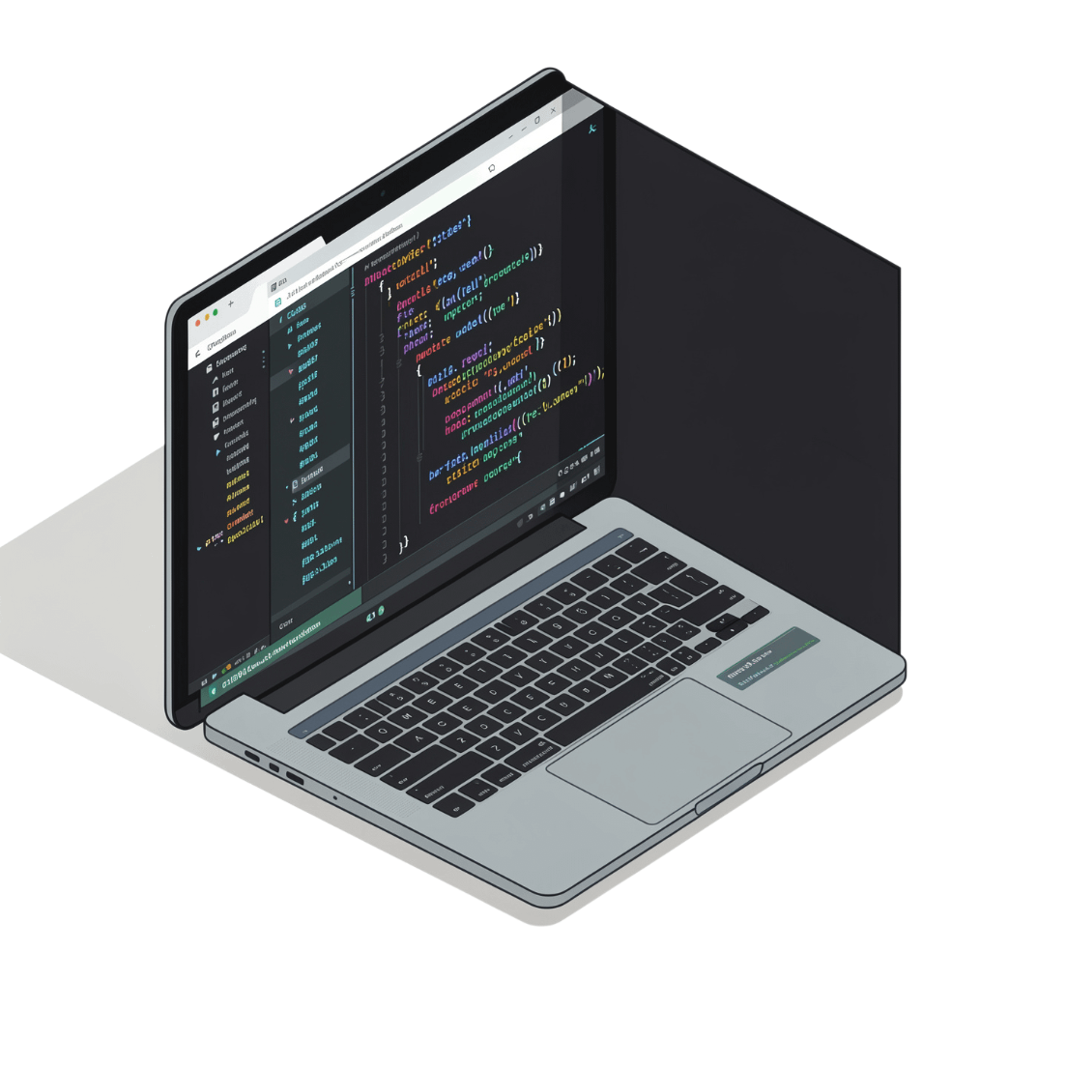

Python Role
Voice Capture
Keyword Recognition
Uses SpeechRecognition + PyAudio to capture voice input
Recognizes keywords: "turn on", "light on", "turn off", "light off"
HTTP Request
Voice-to-Action Bridge
Sends HTTP request to ESP32 server (/on or /off)
Acts as the voice-to-action bridge between user and hardware

Slide 6
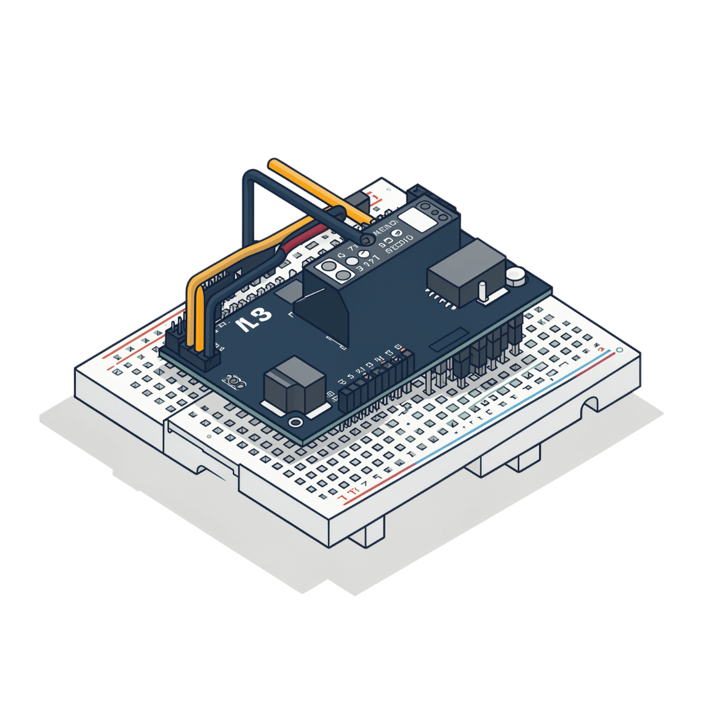

Circuit Design
ESP32 connected to relay module
Relay channels wired to appliances (e.g., light bulb)
Common ground between ESP32 & relay
Wi-Fi ensures wireless control
All high-voltage wiring should be handled with proper insulation and safety precautions.

Slide 7
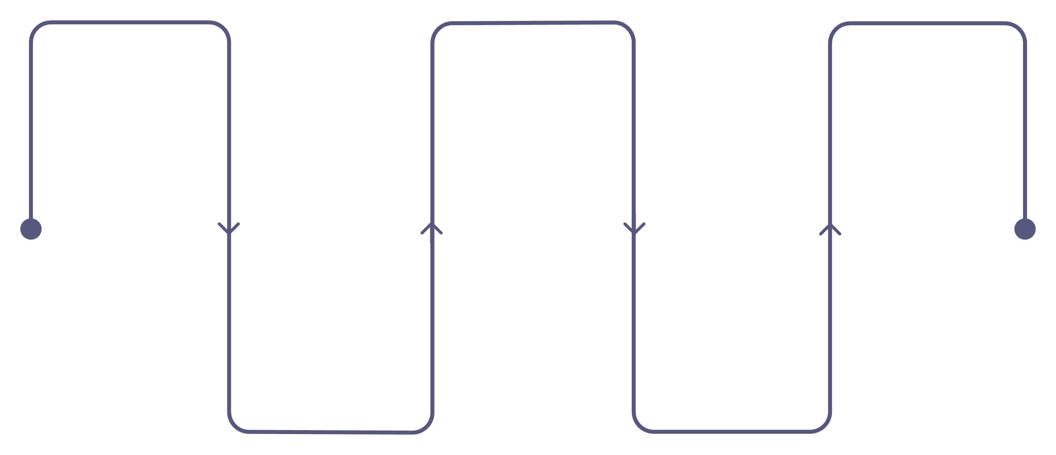
Program Flow
Listen
Send
Act
Python captures voice input
HTTP request dispatched
Relay toggles, appliance responds
Recognize
Receive
Convert speech to command
ESP32 web server handles it

Slide 8
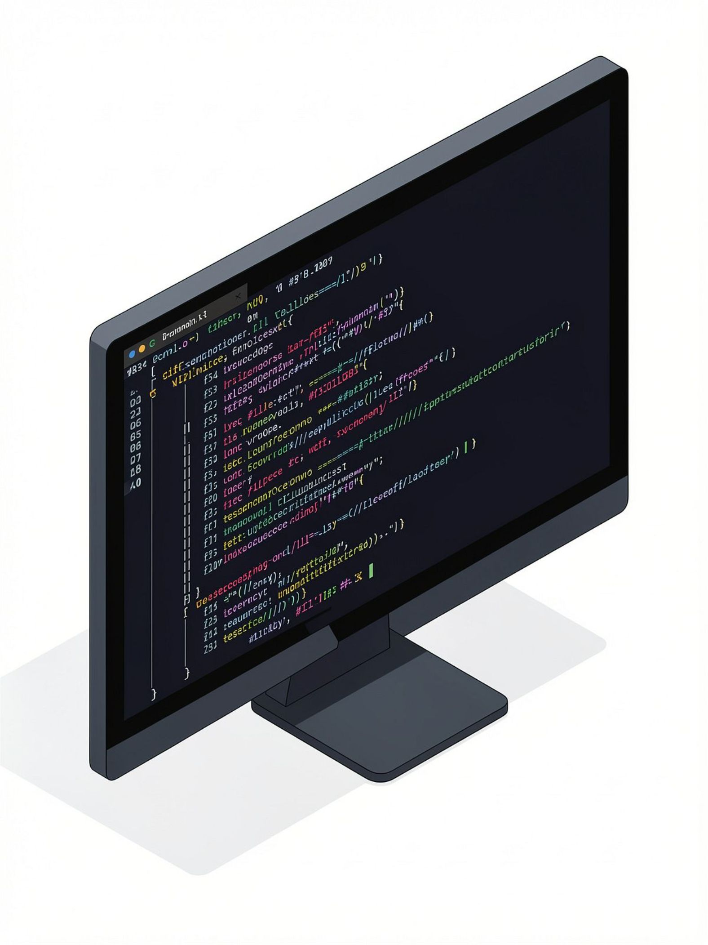
Demo Dashboard
Serial Monitor
Python Terminal
ESP32 IP address displayed on Serial Monitor output
"You said: turn on → Lights ON" printed in terminal output
Live Appliance
Appliance switching ON/OFF in real time via relay

Slide 9
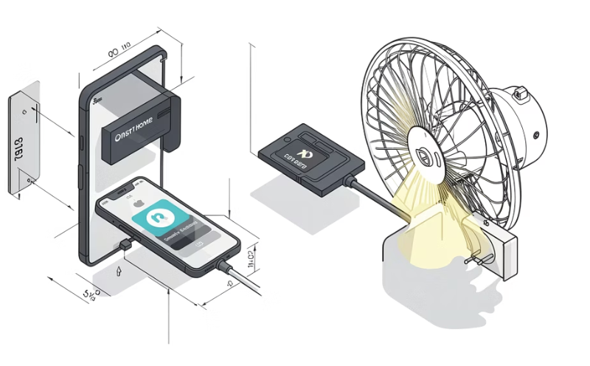
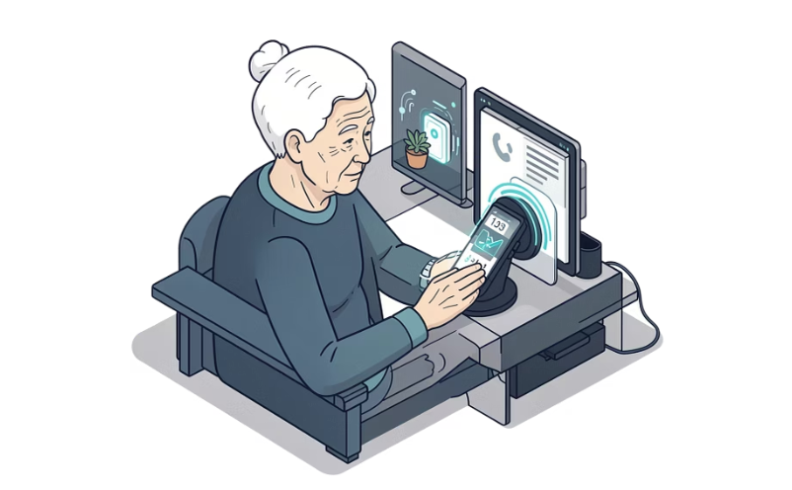
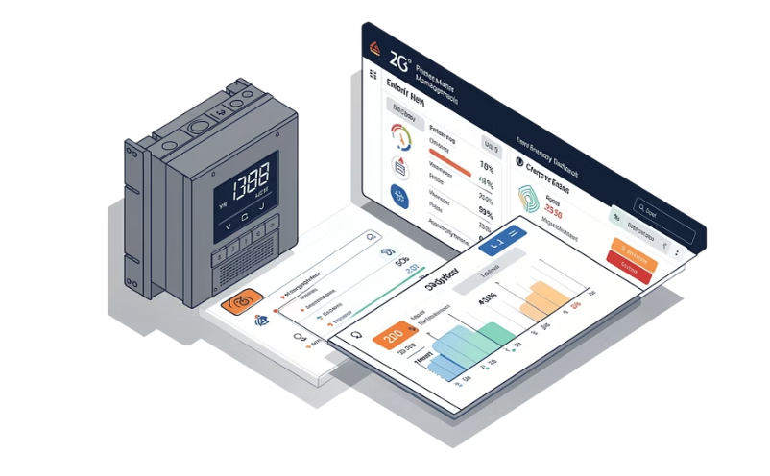
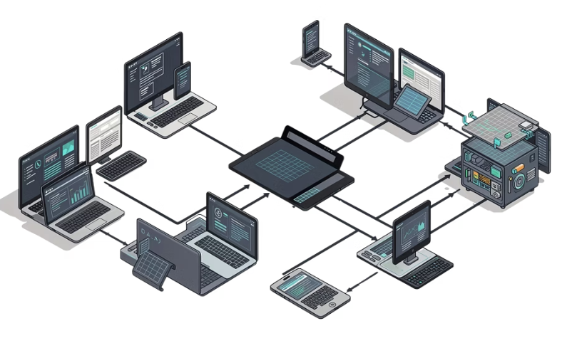
Applications
Smart Home Automation
Accessibility
Energy Management
Scalable Expansion
Voice-controlled access for elderly and disabled users
IoT-based monitoring and energy efficiency
Expandable to multiple relays & devices
Control lights, fans, and appliances hands-free

Slide 10




Benefits
Hands-Free Control
Low-Cost IoT Solution
Operate appliances entirely through voice — no physical interaction needed
Affordable components make smart automation accessible to everyone
Easy Integration
Scalable
Works seamlessly with existing household appliances
Designed to grow — add more relays and devices for smart homes & offices

Slide 11
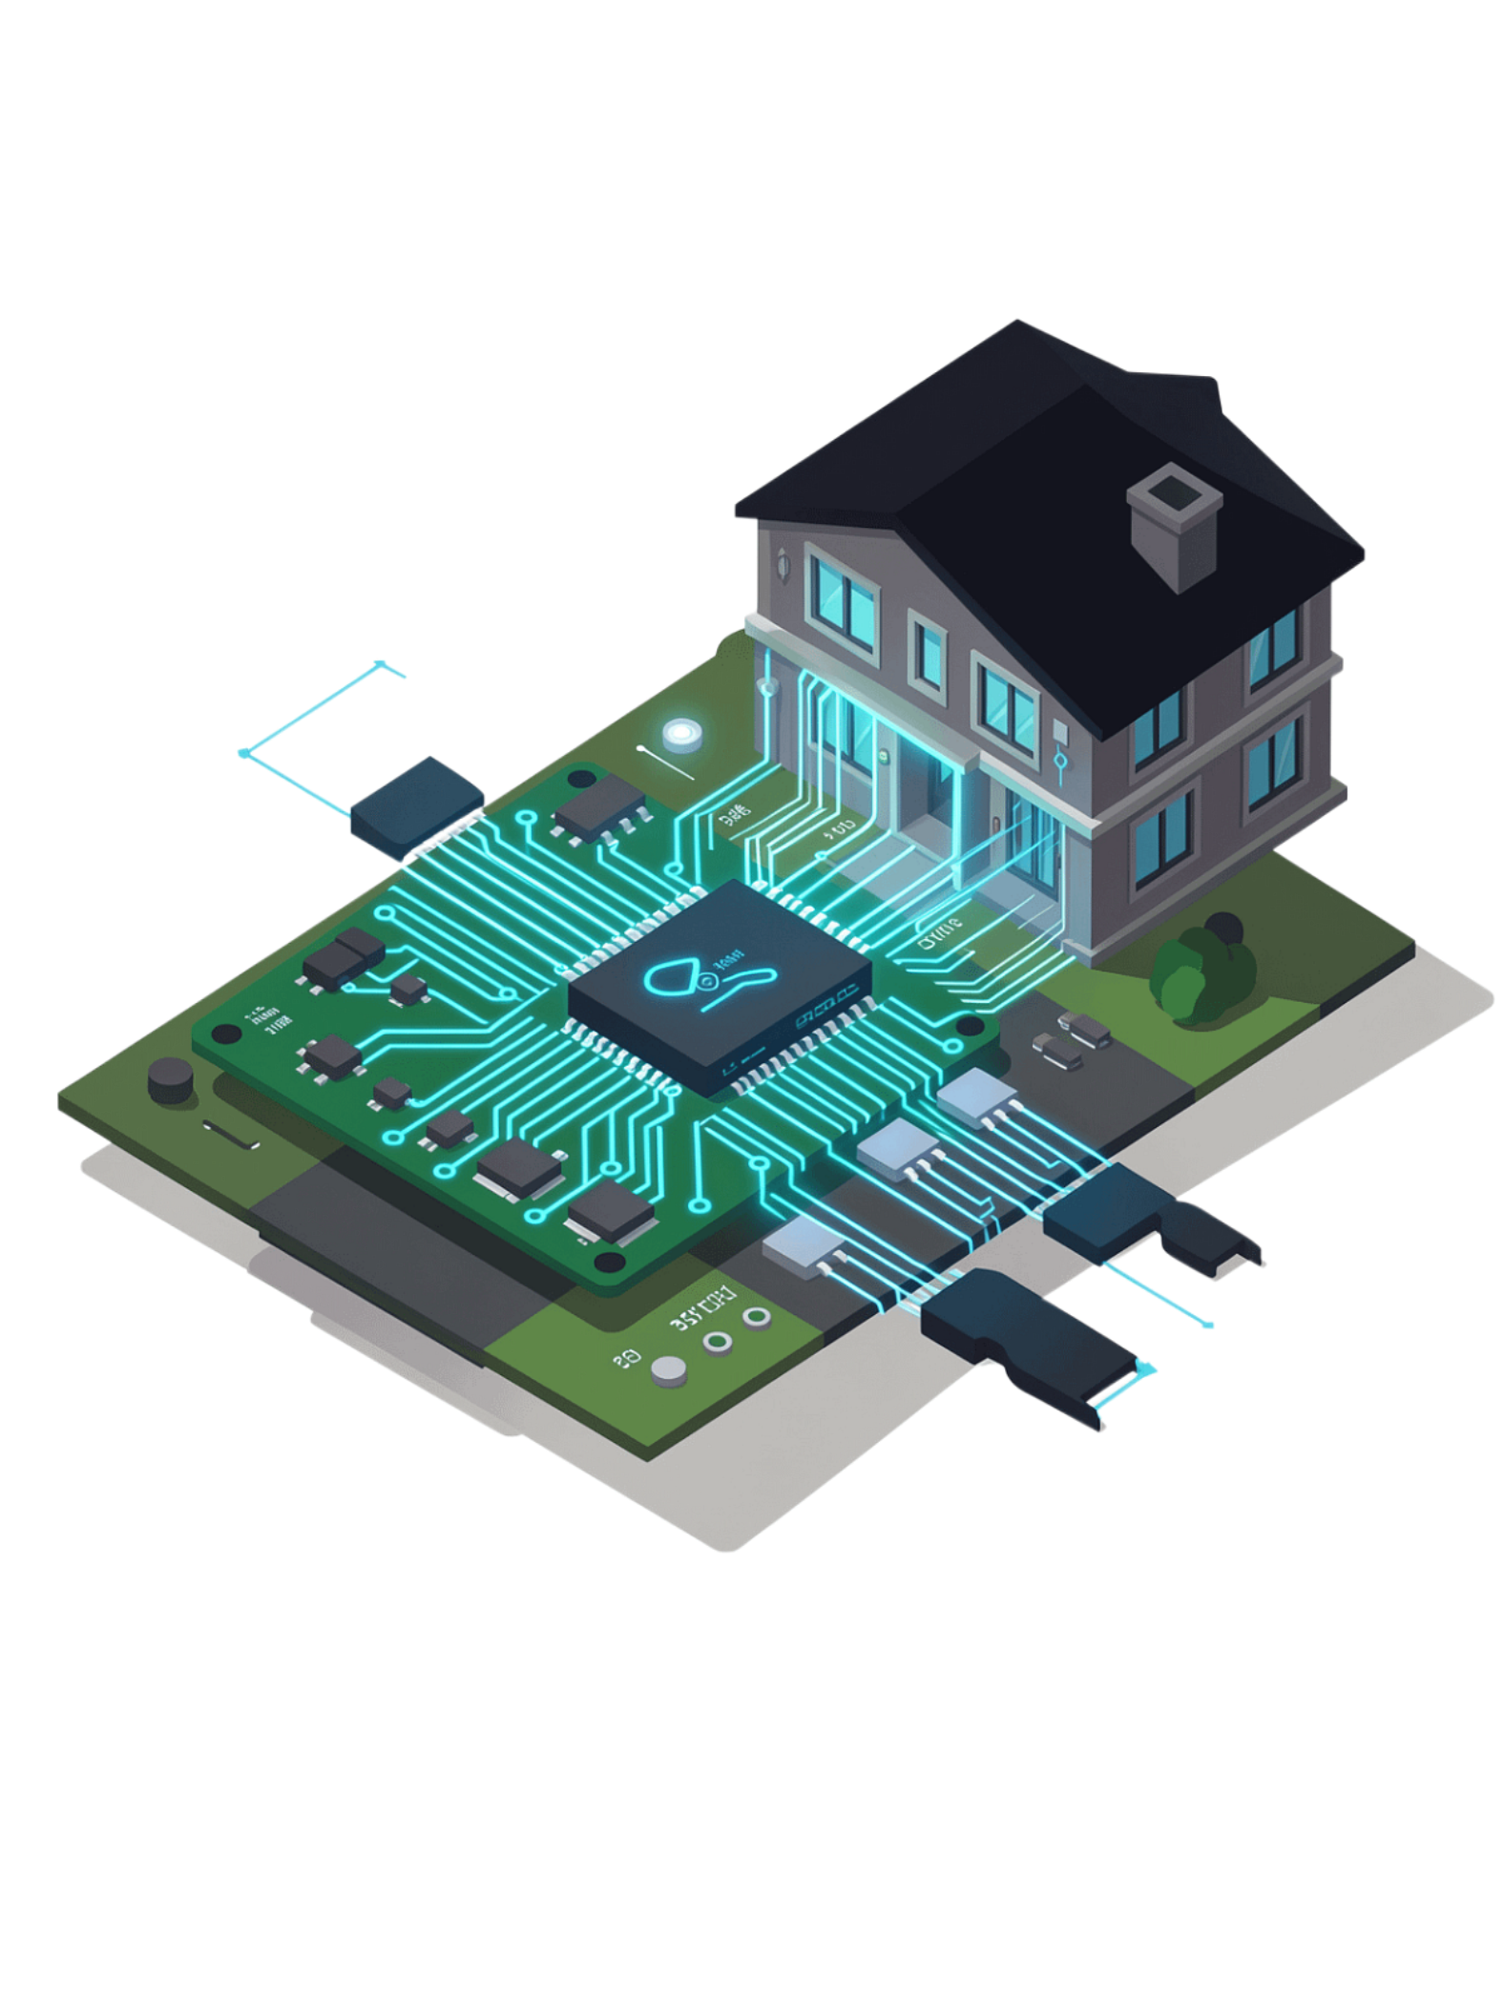




Summary
ESP32 + Relay
Hardware control
Python + SpeechRecognition
Voice interface
Wi-Fi
Seamless communication
Together
A simple, powerful voice-controlled IoT system

