Slide 1
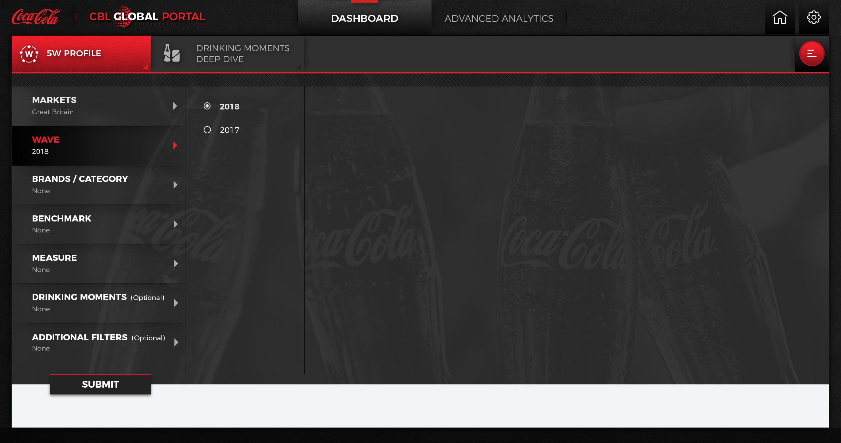
Drinking Moment Deep Dive
Market: Colombia
Wave: 2018
Drinking Moment: Global Drinking Moments
Base: NA RTD
Benchmark: Total Beverage
Measure: Occasion

Slide 2
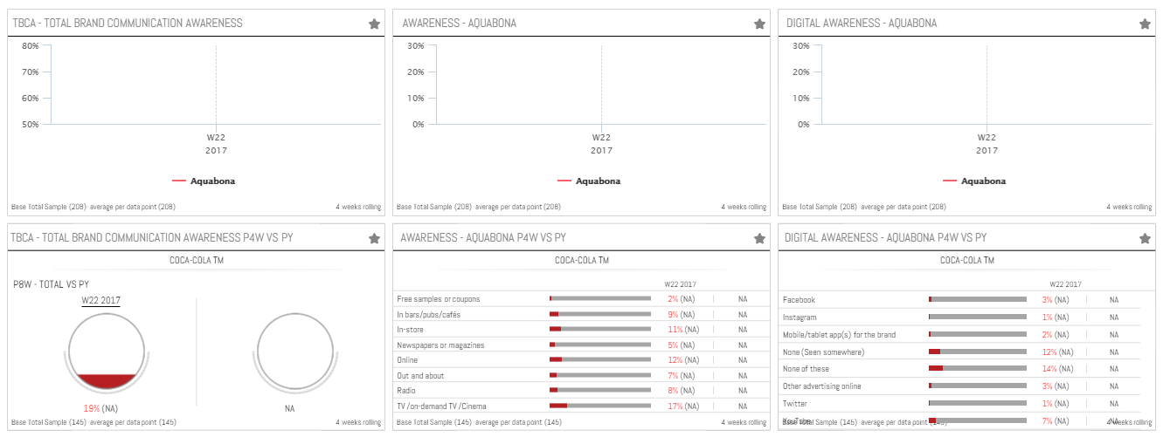
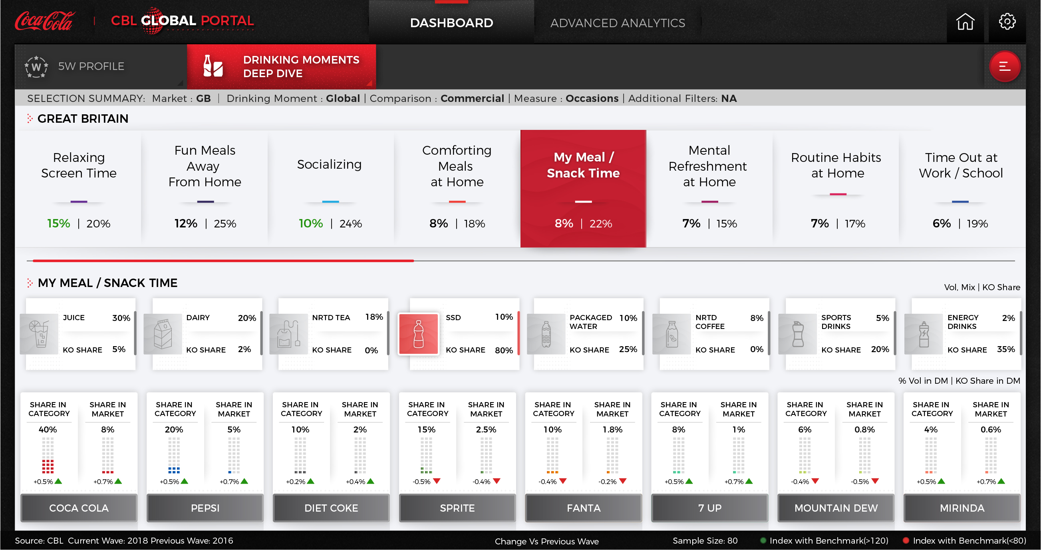
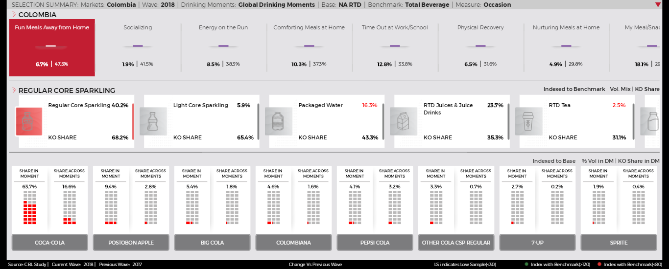
Drinking Moment Deep Dive

