Slide 1



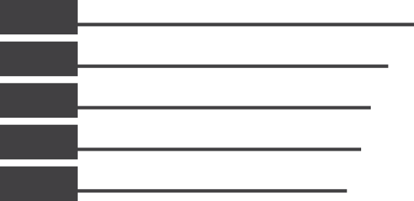











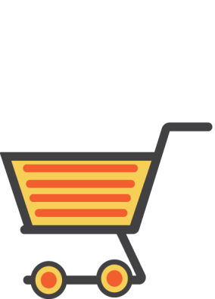
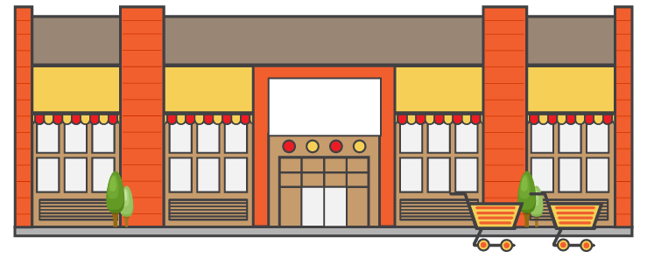




























3MMT
PRE-SHOP
PLANNING
TIME OF DAY
LOCATION PRIOR TO TRIP
-0.0
CONSIDERATION
WEEKDAY OR WEEKEND
23%
MORNING
-0.0
57%
Planned
+0.0
-0.0
8%
Yes
69%
Weekdays
22%
-0.0
-0.0
+0.0
60%
Home
57%
Planned
MID-DAY
24%
-0.0
-0.0
AFTERNOON
32%
Weekend
27%
+0.0
EVENINGS
4%
-0.0
WHO WITH
REASON FOR STORE CHOICE
NIGHT
+0.0
+0.0
72%
Alone
68%
Easily find items I needed
TRIP MISSION
SHOP
Grab and Go Home
DESTINATION ITEM
PURCHASED NARTD
30%
+0.0
+0.0
BASKET SUMMARY
FIILL IN FOOD AND BEV
11%
Fresh Produce
-0.0
TOP ITEMS
28%
+0.0
+0.0
41%
+0.0
7%
Fresh Meat
38%
Fresh Produce
Stock Up
16%
+0.0
+0.0
6%
Milk
+0.0
Other
IMMEDIATE CONSUMPTION
(Consumed Within 1 hour)
26%
Fresh Meat
26%
+0.0
+0.0
38%
-0.0
24%
Milk
POST-SHOP
IC Food/Bev in Basket
NUMBER OF ITEMS
9.5
Average
-0.0
OVERALL SATISFACTION
SATISFACTION DRIVERS
LOCATION AFTER TRIP
-0.0
TIME SPENT
80%
Home
DOLLARS SPENT
-0.0
21-30
38%
-0.0
$34
95%
Satisfied (Top 2 Box)
Average
Product
Selection
92%
Product
Pricing
90%
Service by
Employees
82%
Check-out
Experience
92%
Overall Store
Atmosphere
91%
Ease of
Shopping
93%
-$0.00
+0.0
+0.0
+0.0
+0.0
+0.0
+0.0
Source : ISHOP-,Time Period : JUN 2018 12MMT , Base - Convenience; % Trips, Sorted By: Largest Size Filters: 25-34, 35-49, 50-64
Sample Size – 15,466
* Stat tested at 95% CL against : TOTAL VISIT, Filters: 25-34, 35-49, 50-64
Sample size in chart legend/label; Grey font = Low Sample (30-99)
Classified - Confidential
Significantly Higher
Significantly Lower
1

Slide 2

3MMT
PRE-SHOP
PLANNING
WEEKDAY OR WEEKEND
TIME OF DAY
LOCATION PRIOR TO TRIP
-0.0
CONSIDERATION
23%
MORNING
57%
Planned
-0.0
+0.0
-0.0
8%
Yes
69%
Weekdays
-0.0
-0.0
22%
+0.0
60%
Home
57%
Planned
MID-DAY
24%
-0.0
-0.0
AFTERNOON
32%
Weekend
27%
+0.0
EVENINGS
WHO WITH
REASON FOR STORE CHOICE
4%
NIGHT
-0.0
+0.0
+0.0
72%
Alone
68%
Easily find items I needed
TRIP MISSION
SHOP
Grab and Go Home
DESTINATION ITEM
PURCHASED NARTD
30%
+0.0
BASKET SUMMARY
+0.0
FILL IN FOOD AND BEV
11%
Fresh Produce
TOP ITEMS
28%
+0.0
-0.0
+0.0
41%
+0.0
7%
Fresh Meat
38%
Fresh Produce
Stock Up
16%
+0.0
+0.0
6%
Milk
+0.0
Other
IMMEDIATE CONSUMPTION
(Consumed Within 1 hour)
26%
Fresh Meat
26%
+0.0
+0.0
38%
-0.0
24%
Milk
POST-SHOP
IC Food/Bev in Basket
NUMBER OF ITEMS
9.5
Average
-0.0
OVERALL SATISFACTION
SATISFACTION DRIVERS
LOCATION AFTER TRIP
-0.0
TIME SPENT
80%
Home
DOLLARS SPENT
-0.0
21-30
38%
-0.0
$34
95%
Satisfied (Top 2 Box)
Average
Product
Selection
92%
Product
Pricing
90%
Service by
Employees
82%
Check-out
Experience
92%
Overall Store
Atmosphere
91%
Ease of
Shopping
93%
-$0.00
+0.0
+0.0
+0.0
+0.0
+0.0
+0.0
Source : ISHOP-,Time Period : JUN 2018 12MMT , Base - Convenience; % Trips, Sorted By: Largest Size Filters: 25-34, 35-49, 50-64
Sample Size – 15,466
* Stat tested at 95% CL against : TOTAL VISIT, Filters: 25-34, 35-49, 50-64
Classified - Confidential
2
Sample size in chart legend/label; Grey font = Low Sample (30-99)
Significantly Higher
Significantly Lower
2

