Slide 1
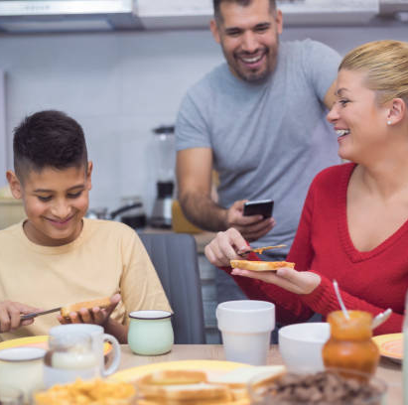
LANDMARK OCCASION VISUALIZER
OCCASION PROFILE
INSERT DATE

Slide 2
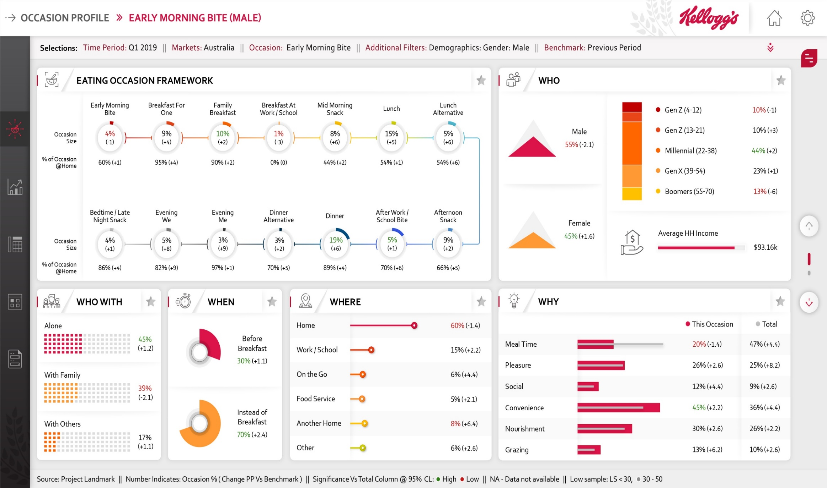

EARLY MORNING BITE
Selection Summary : Time Period : Q1 2019 | Markets : Australia | Occasion : Early Morning Bite | Benchmark : Vs Previous Period
Source: Project Landmark || Number Indicates :Occasion | Item %(Change PP Vs Benchmark) || Significance Vs Total Column@ 95 CL : High Low || NA- Data not available || Low Base Sample : LS<150 , 150-250
Notes:
Shopper Mission Statements :
Healthy Replenishment :To buy a nutritious and healthy food with a specific health benefit or ingredient that I always like to have in stock at home.
Routine Replenishment :To buy food that I always like to have in stock at home.
Grab & Go :To buy food right away, while on the go.
Family Enjoyment :To buy food that the whole family would eat. A food that I know my kids will eat and I can share with others.
Spontaneous Buying :I hadn’t planned to buy this item when I started shopping but while shopping for other food saw something to try.
Spontaneous Deal :Saw this item on special offer / promotion and found such a good deal I decided to buy some.
Planned Deal :To buy a product that I knew was on special offer/deal/sale.
Treat/Reward for Me or my family :To buy an item as a treat/ reward. Something that is indulgent and would cheer me/my family up.
Specific Activity :To buy an item that could be used for a specific activity (e.g., hike/biking, before/after/during exercise, etc.).
Activity Statements:
Getting ready for a day
Thinking about things I need to get done
Watching TV
Watching a movie
Reading
Preparing a meal
Commuting/traveling by car
Commuting/traveling by public transport/other
Walking
Catching up on/reading email
Browsing the internet/Social networking (e.g., Facebook, Twitter)
Talking/texting on the phone with others
Working/studying
Taking a break from work/studying
Relaxing/doing nothing/hanging out
Doing housework/cleaning
Catching up on the news (watching, reading, listening)
Socializing or talking with others, in person
Playing sports/working out
Before sports or physical activity
After sports or physical activity
At a casual gathering with friends
At a celebration/party
Listening to music
Shopping
Running errands
Physical labor
Getting kids ready
Gaming (playing video/online games)
Other

Slide 3
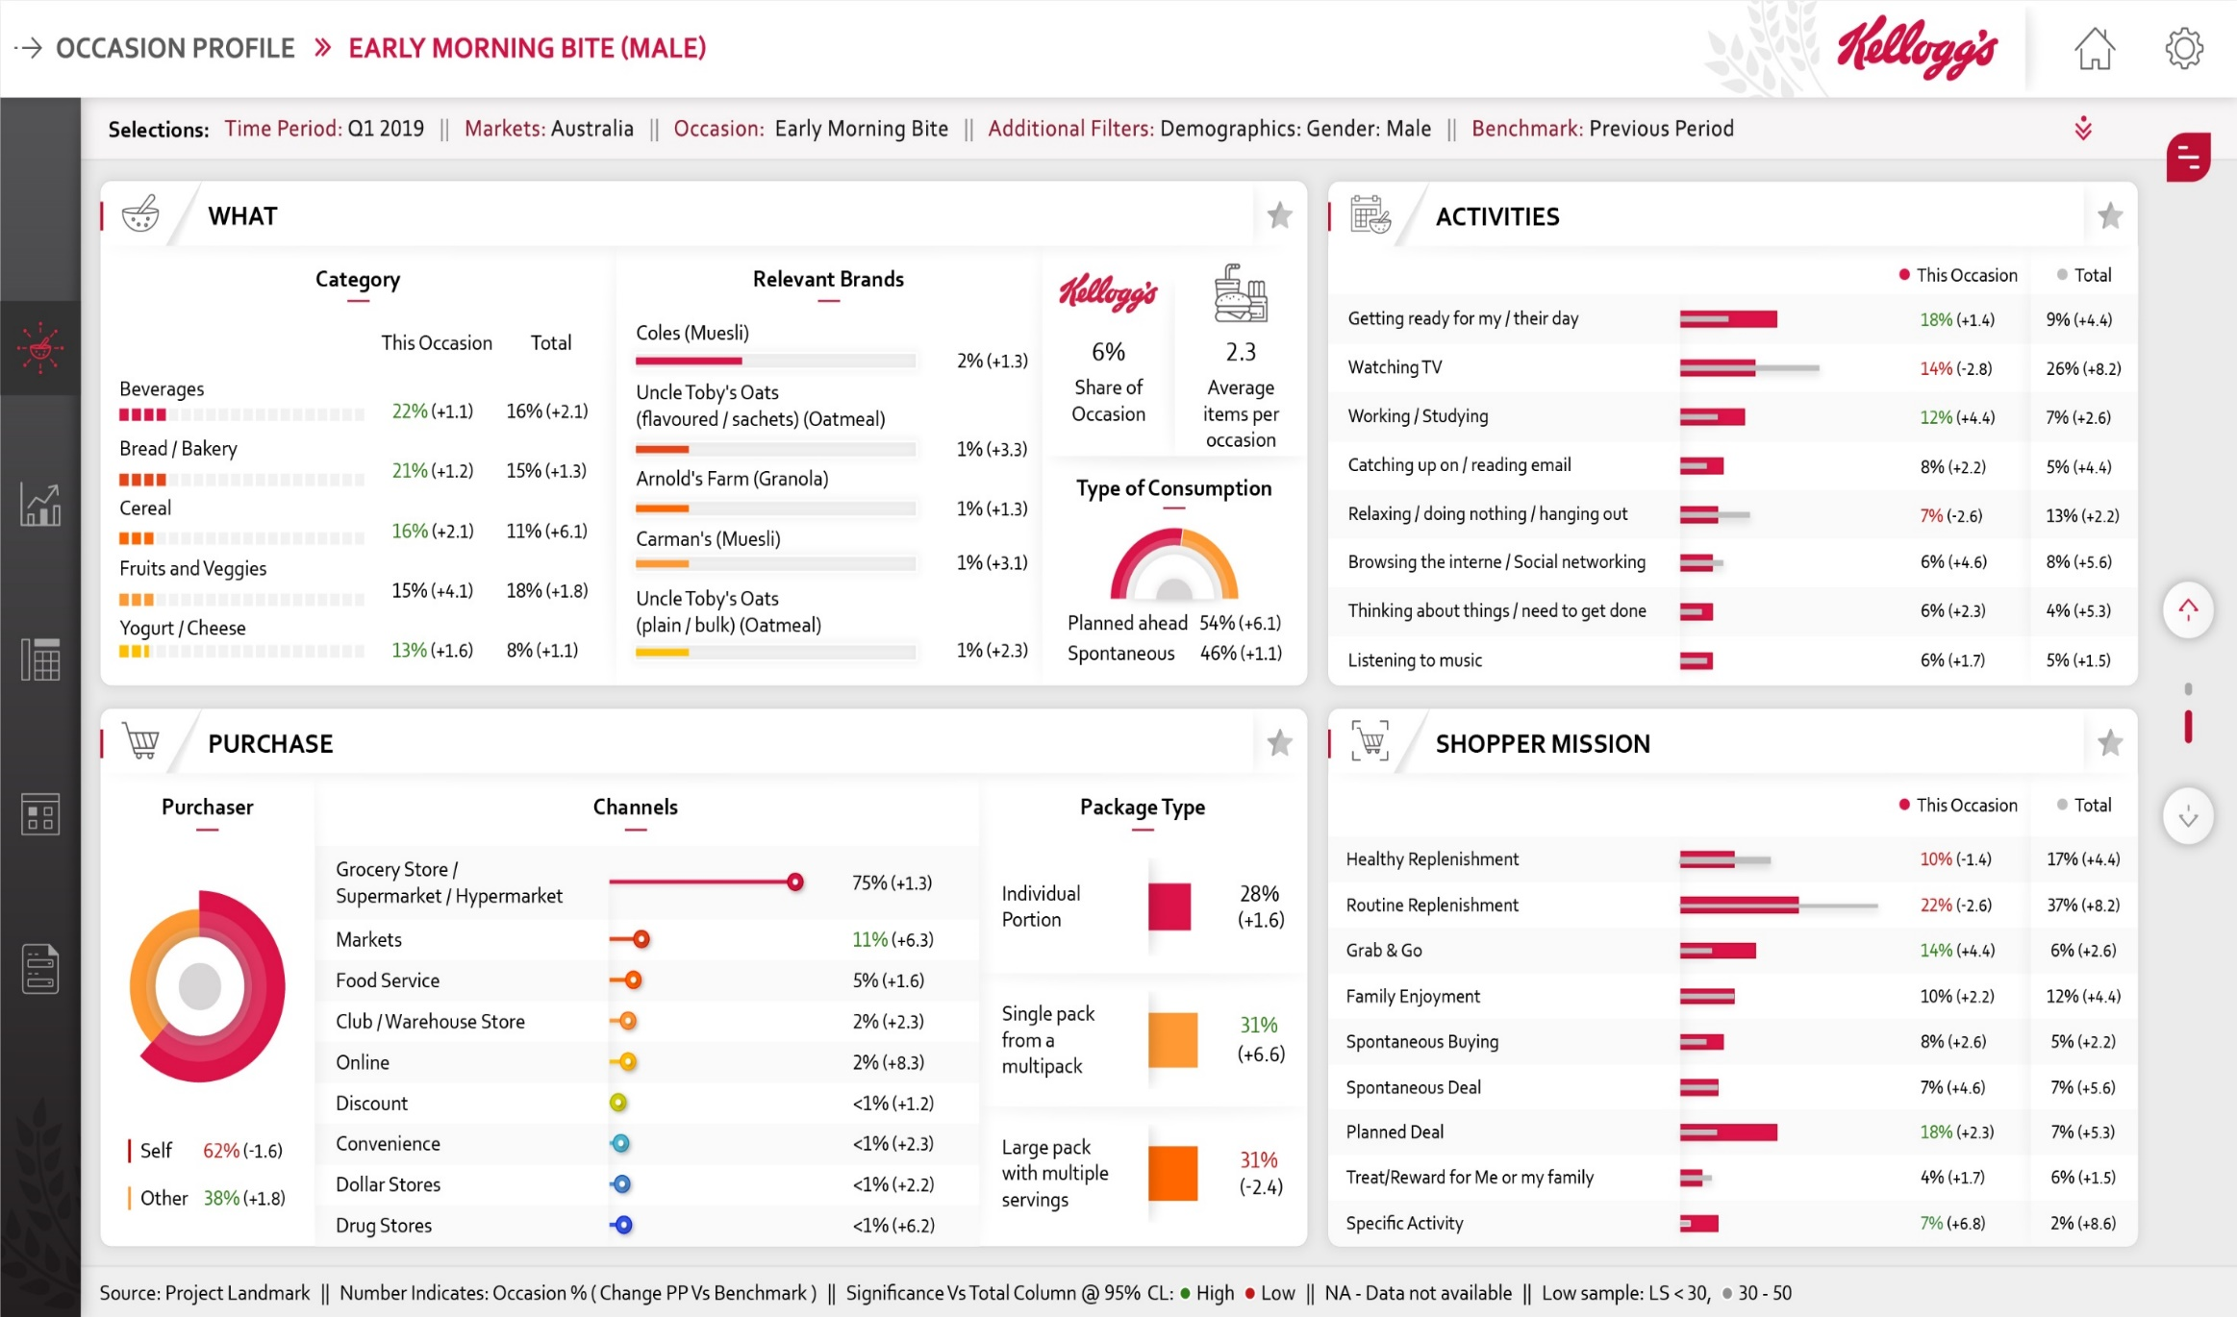
EARLY MORNING BITE
Selection Summary : Time Period : Q1 2019 | Markets : Australia | Occasion : Early Morning Bite | Benchmark : Vs Previous Period
Source: Project Landmark || Number Indicates :Occasion | Item %(Change PP Vs Benchmark) || Significance Vs Total Column@ 95 CL : High Low || NA- Data not available || Low Base Sample : LS<150 , 150-250
Notes:
Shopper Mission Statements :
Healthy Replenishment :To buy a nutritious and healthy food with a specific health benefit or ingredient that I always like to have in stock at home.
Routine Replenishment :To buy food that I always like to have in stock at home.
Grab & Go :To buy food right away, while on the go.
Family Enjoyment :To buy food that the whole family would eat. A food that I know my kids will eat and I can share with others.
Spontaneous Buying :I hadn’t planned to buy this item when I started shopping but while shopping for other food saw something to try.
Spontaneous Deal :Saw this item on special offer / promotion and found such a good deal I decided to buy some.
Planned Deal :To buy a product that I knew was on special offer/deal/sale.
Treat/Reward for Me or my family :To buy an item as a treat/ reward. Something that is indulgent and would cheer me/my family up.
Specific Activity :To buy an item that could be used for a specific activity (e.g., hike/biking, before/after/during exercise, etc.).
Activity Statements:
Getting ready for a day
Thinking about things I need to get done
Watching TV
Watching a movie
Reading
Preparing a meal
Commuting/traveling by car
Commuting/traveling by public transport/other
Walking
Catching up on/reading email
Browsing the internet/Social networking (e.g., Facebook, Twitter)
Talking/texting on the phone with others
Working/studying
Taking a break from work/studying
Relaxing/doing nothing/hanging out
Doing housework/cleaning
Catching up on the news (watching, reading, listening)
Socializing or talking with others, in person
Playing sports/working out
Before sports or physical activity
After sports or physical activity
At a casual gathering with friends
At a celebration/party
Listening to music
Shopping
Running errands
Physical labor
Getting kids ready
Gaming (playing video/online games)
Other

