Slide 1
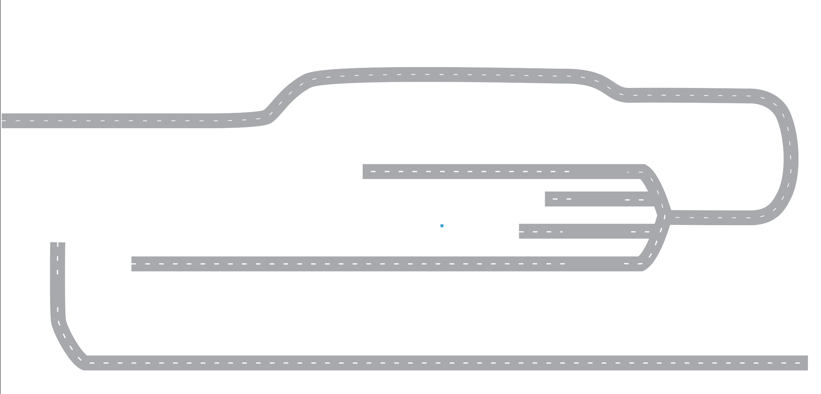



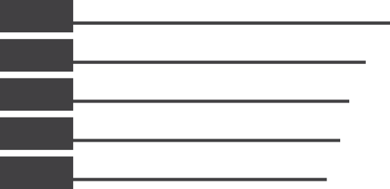












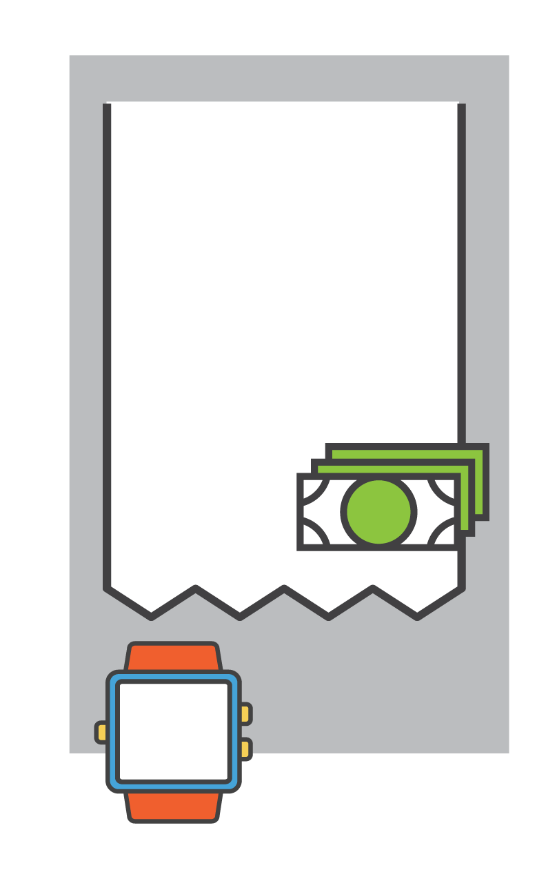

























3MMT
PRE-VISIT
TRIP
AVERAGE DISTANCE
TRAVELLED OUT OF WAY
TIME OF DAY
PLANNING
OCCASION MOTIVATION
TRAVELLED OUT
OF THE WAY
+0.0%
XX%
MIDDLE OF THE NIGHT
-0.0%
LOCATION
PRIOR TO VISIT
-0.0%
XX%
Motivation
XX%
LATE NIGHT
+0.0%
XX%
Somewhat Ahead of time
XX
Miles
XX%
The
OUTLET MOTIVATION
XX%
XX%
EVENING
-0.0%
-0.0%
-0.0%
-0.0%
XX%
Motivation
XX%
AFTERNOON
+0.0%
XX%
MORNING
-0.0%
WHO WITH
OVERALL MOOD
XX%
Alone
+0.0%
XX%
Positive Mood
+0.0%
TRANSPORTATION
XX%
Public Transportation
+0.0%
ORDER SUMMARY
MEAL
TOP FOOD &
BEVERAGE ITEM
RESTAURANT VISIT
OTHER ACTIVITIES
XX%
DELIVERY
XX%
BREAKFAST
+0.0%
XX%
Had Other Activities
Beverage
Only
XX%
-0.0%
-0.0%
-0.0%
XX%
LUNCH
XX%
TAKE OUT
Food
Only
XX%
XX%
-0.0%
-0.0%
-0.0%
DINNER
52%
-0.0%
53%
+0.0%
Food &
Beverage
XX%
+0.0%
DINE IN
XX%
SNACK
Carbonated
Soft Drink
Hamburger/
Cheeseburger
XX%
-0.0%
+0.0%
XX%
-0.1%
JUST A DRINK
DOLLARS
SPENT
-0.0%
DRIVE-THRU
$100
XX%
+0.0%
Average Per
Diner
-$0.00
POST-VISIT
TIME SPENT
DESTINATION
AFTER VISIT
21 - 30
MINUTES
XX%
-0.0%
OVERALL SATISFACTION
SATISFACTION DRIVERS
XX%
Workplace
-0.0%
XX%
Satisfied
(Top 2 Box)
-0.0%
Food
Beverages
Value
Cleanliness
Atmosphere
Service
XX%
XX%
XX%
XX%
XX%
XX%
+0.0%
-0.0%
-0.0%
-0.0%
+0.0%
-0.0%

Slide 2
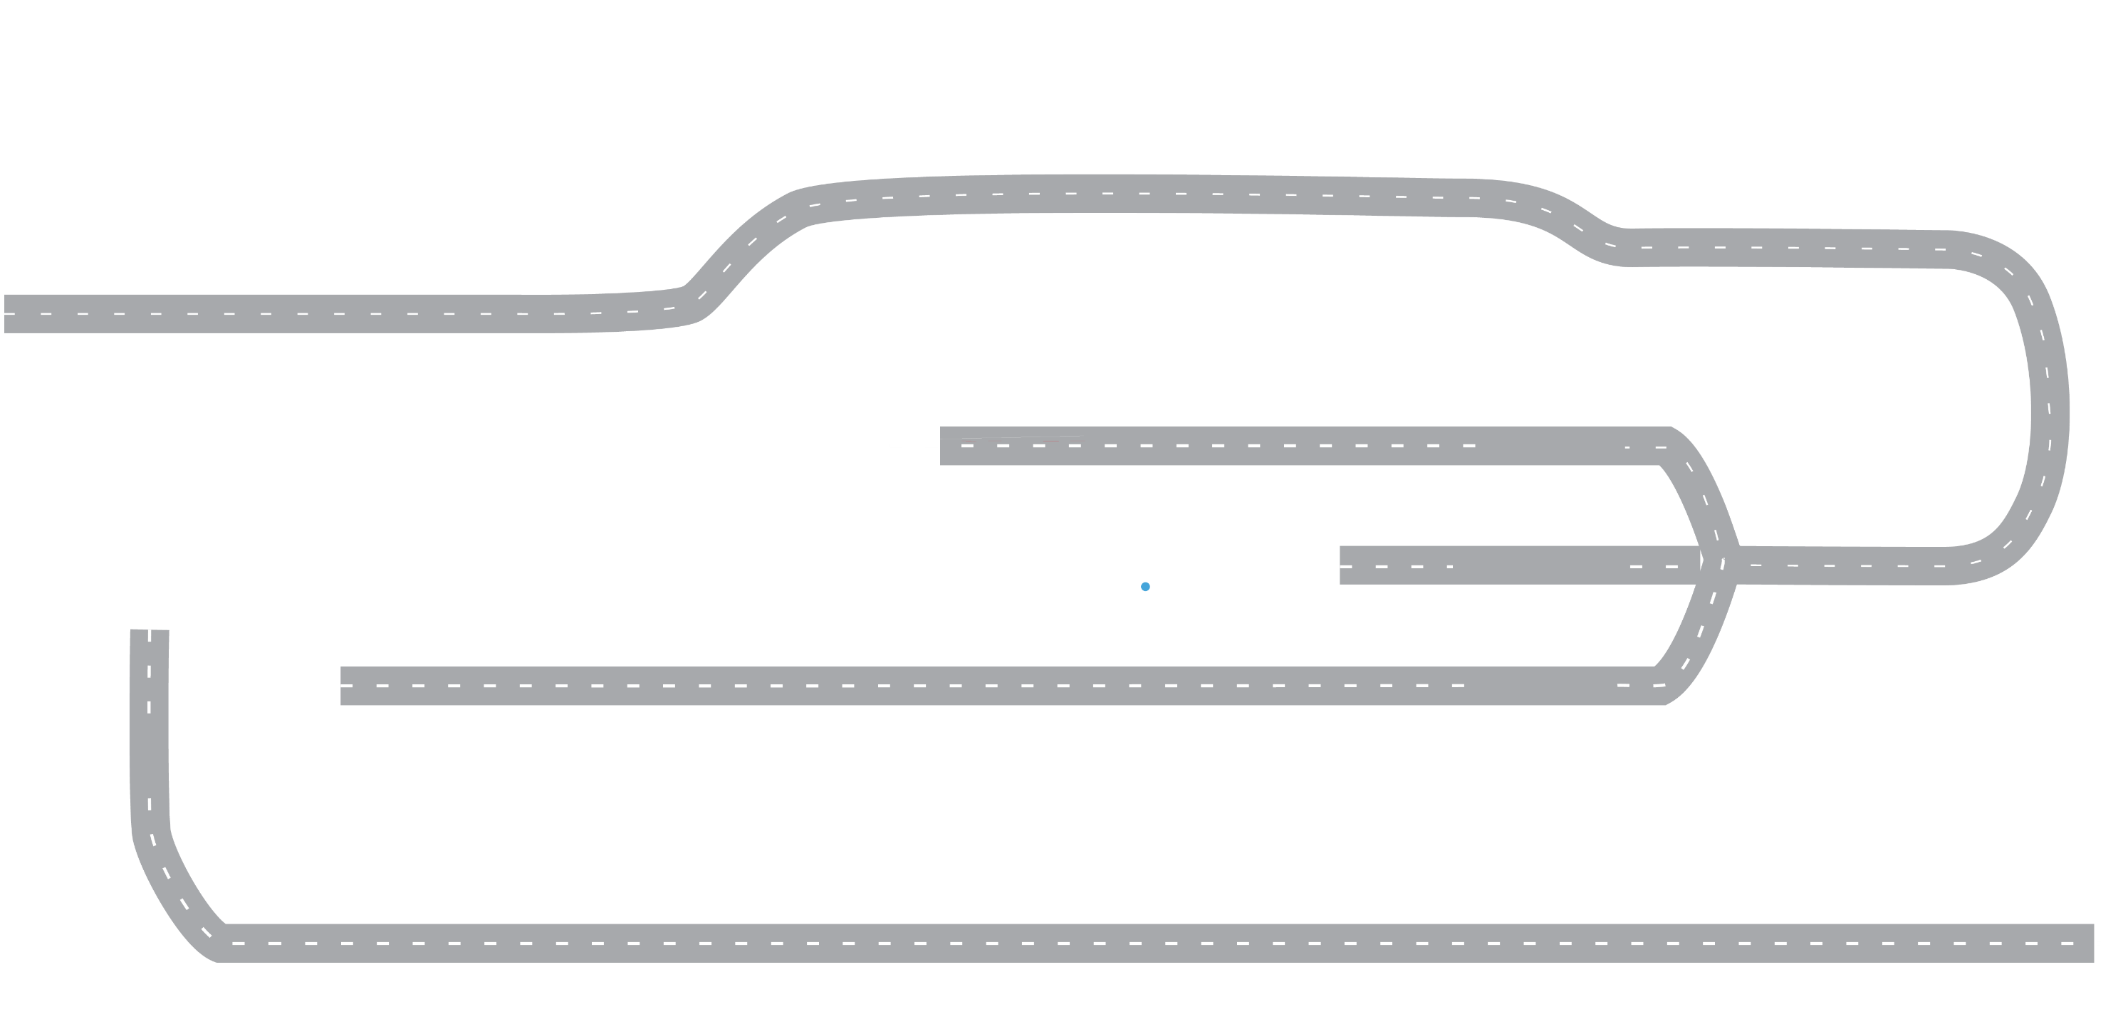
3MMT
PRE-VISIT
TRIP
AVERAGE DISTANCE
TRAVELLED OUT OF WAY
TIME OF DAY
PLANNING
OCCASION MOTIVATION
TRAVELLED OUT
OF THE WAY
+0.0%
XX%
MIDDLE OF THE NIGHT
-0.0%
LOCATION
PRIOR TO VISIT
-0.0%
XX%
Motivation
XX%
LATE NIGHT
+0.0%
XX%
Somewhat Ahead of time
XX
Miles
XX%
The
OUTLET MOTIVATION
XX%
XX%
EVENING
-0.0%
-0.0%
-0.0%
-0.0%
XX%
Motivation
XX%
AFTERNOON
+0.0%
XX%
MORNING
-0.0%
WHO WITH
OVERALL MOOD
XX%
Alone
+0.0%
XX%
Positive Mood
+0.0%
TRANSPORTATION
XX%
Public Transportation
+0.0%
ORDER SUMMARY
MEAL
TOP FOOD &
BEVERAGE ITEM
RESTAURANT VISIT
OTHER ACTIVITIES
XX%
DELIVERY
XX%
BREAKFAST
+0.0%
XX%
Had Other Activities
Beverage
Only
XX%
-0.0%
-0.0%
-0.0%
XX%
LUNCH
Food
Only
XX%
XX%
-0.0%
TAKE OUT
-0.0%
DINNER
52%
-0.0%
53%
+0.0%
XX%
Food &
Beverage
XX%
+0.0%
-0.0%
XX%
SNACK
Carbonated
Soft Drink
Hamburger/
Cheeseburger
+0.0%
XX%
-0.1%
JUST A DRINK
DOLLARS
SPENT
-0.0%
DRIVE-THRU
$100
XX%
+0.0%
Average Per
Diner
-$0.00
POST-VISIT
TIME SPENT
DESTINATION
AFTER VISIT
21 - 30
MINUTES
XX%
-0.0%
OVERALL SATISFACTION
SATISFACTION DRIVERS
XX%
Workplace
-0.0%
XX%
Satisfied
(Top 2 Box)
-0.0%
Food
Beverages
Value
Cleanliness
Atmosphere
Service
XX%
XX%
XX%
XX%
XX%
XX%
+0.0%
-0.0%
-0.0%
-0.0%
+0.0%
-0.0%

Slide 3

3MMT
PRE-VISIT
TRIP
AVERAGE DISTANCE
TRAVELLED OUT OF WAY
TIME OF DAY
PLANNING
OCCASION MOTIVATION
TRAVELLED OUT
OF THE WAY
+0.0%
XX%
MIDDLE OF THE NIGHT
-0.0%
LOCATION
PRIOR TO VISIT
-0.0%
XX%
Motivation
XX%
LATE NIGHT
+0.0%
XX%
Somewhat Ahead of time
XX
Miles
XX%
The
OUTLET MOTIVATION
XX%
XX%
EVENING
-0.0%
-0.0%
-0.0%
-0.0%
XX%
Motivation
XX%
AFTERNOON
+0.0%
XX%
MORNING
-0.0%
WHO WITH
OVERALL MOOD
XX%
Alone
+0.0%
XX%
Positive Mood
+0.0%
TRANSPORTATION
XX%
Public Transportation
+0.0%
ORDER SUMMARY
MEAL
TOP FOOD &
BEVERAGE ITEM
RESTAURANT VISIT
OTHER ACTIVITIES
XX%
DELIVERY
XX%
BREAKFAST
+0.0%
XX%
Had Other Activities
Beverage
Only
XX%
-0.0%
-0.0%
-0.0%
XX%
LUNCH
XX%
TAKE OUT
Food
Only
XX%
XX%
-0.0%
-0.0%
-0.0%
DINNER
52%
-0.0%
53%
+0.0%
Food &
Beverage
XX%
+0.0%
DINE IN
XX%
SNACK
Carbonated
Soft Drink
Hamburger/
Cheeseburger
XX%
-0.0%
+0.0%
XX%
-0.1%
JUST A DRINK
DOLLARS
SPENT
-0.0%
DRIVE-THRU
$100
XX%
+0.0%
Average Perr
Diner
-$0.00
POST-VISIT
TIME SPENT
DESTINATION
AFTER VISIT
21 - 30
MINUTES
XX%
-0.0%
OVERALL SATISFACTION
SATISFACTION DRIVERS
XX%
Workplace
-0.0%
XX%
Satisfied
(Top 2 Box)
-0.0%
Food
Beverages
Value
Cleanliness
Atmosphere
Service
XX%
XX%
XX%
XX%
XX%
XX%
+0.0%
-0.0%
-0.0%
-0.0%
+0.0%
-0.0%

Slide 4
3MMT
PRE-VISIT
TRIP
AVERAGE DISTANCE
TRAVELLED OUT OF WAY
TIME OF DAY
PLANNING
OCCASION MOTIVATION
TRAVELLED OUT
OF THE WAY
+0.0%
XX%
MIDDLE OF THE NIGHT
-0.0%
LOCATION
PRIOR TO VISIT
-0.0%
XX%
Motivation
XX%
LATE NIGHT
+0.0%
XX%
Somewhat Ahead of time
XX
Miles
XX%
The
OUTLET MOTIVATION
XX%
XX%
EVENING
-0.0%
-0.0%
-0.0%
-0.0%
XX%
Motivation
XX%
AFTERNOON
+0.0%
XX%
MORNING
-0.0%
WHO WITH
OVERALL MOOD
XX%
Alone
+0.0%
XX%
Positive Mood
+0.0%
TRANSPORTATION
XX%
Public Transportation
+0.0%
ORDER SUMMARY
MEAL
TOP FOOD &
BEVERAGE ITEM
RESTAURANT VISIT
OTHER ACTIVITIES
XX%
DELIVERY
XX%
BREAKFAST
+0.0%
XX%
Had Other Activities
Beverage
Only
XX%
-0.0%
-0.0%
-0.0%
XX%
LUNCH
Food
Only
XX%
XX%
-0.0%
TAKE OUT
-0.0%
DINNER
52%
-0.0%
53%
+0.0%
XX%
Food &
Beverage
XX%
+0.0%
-0.0%
XX%
SNACK
Carbonated
Soft Drink
Hamburger/
Cheeseburger
+0.0%
XX%
-0.1%
JUST A DRINK
DOLLARS
SPENT
-0.0%
DRIVE-THRU
$100
XX%
+0.0%
Average Per
Diner
-$0.00
POST-VISIT
TIME SPENT
DESTINATION
AFTER VISIT
21 - 30
MINUTES
XX%
-0.0%
OVERALL SATISFACTION
SATISFACTION DRIVERS
XX%
Workplace
-0.0%
XX%
Satisfied
(Top 2 Box)
-0.0%
Food
Beverages
Value
Cleanliness
Atmosphere
Service
XX%
XX%
XX%
XX%
XX%
XX%
+0.0%
-0.0%
-0.0%
-0.0%
+0.0%
-0.0%

