Slide 1
Overview of JavaScript and DOM Instructor: Dr. Fang (Daisy) Tang

Slide 2
Introduction to JavaScript
What is JavaScript?
It is designed to add interactivity to HTML pages
It is a scripting language (a lightweight programming language)
It is an interpreted language (it executes without preliminary compilation)
Usually embedded directly into HTML pages
And, Java and JavaScript are different

Slide 3
What can a JavaScript Do?
JavaScript gives HTML designers a programming tool:
simple syntax
JavaScript can put dynamic text into an HTML page
JavaScript can react to events
JavaScript can read and write HTML elements
JavaScript can be used to validate data
JavaScript can be used to detect the visitor’s browser
JavaScript can be used to create cookies
Store and retrieve information on the visitor’s computer

Slide 4
JavaScript How To
The HTML <script> tag is used to insert a JavaScript into an HTML page
<script type=“text/javascript”>
document.write(“Hello World!”)
</script>
Ending statements with a semicolon?
Optional; required when you want to put multiple statements on a single line
JavaScript can be inserted within the head, the body, or use external JavaScript file
How to handle older browsers?
<script type=“text/javascript”>
<!—
document.write(“Hello World!”)
// -->
</script>

Slide 5
JavaScript Where To
You can include JavaScripts in head, body, or simply use external JavaScript file (.js)
JavaScripts in the body section will be executed while the page loads
JavaScripts in the head section will be executed when called
Examples:
http://www.w3schools.com/js/js_whereto.asp

Slide 6
JavaScript Basics
Variables
If … Else
Switch
Operators
Popup Boxes
Functions
Loops (for, while)
Events
Try … Catch
Throw
onerror
Special Text
Guidelines

Slide 7
Java Objects
String
Date
Array
Boolean
Math
RegExp
HTML DOM

Slide 8
RegExp: Regular Expression
Two ways to define regular expression:
new RegExp(“[xyz]”)
or, /[xyz]/
String object methods that supports regular expressions:
search: search a string for a specified value. Returns the position of the value
match: search a string for a specified value. Returns an array of the found value(s)
replace: replace characters with other characters
split: split a string into an array of strings

Slide 9
JavaScript Regular Expression Examples
Check input for 5 digit number
http://www.javascriptkit.com/javatutors/re.shtml
Different categories of pattern matching:
http://www.javascriptkit.com/javatutors/re2.shtml

Slide 10
More RegExp Examples
Example 1:
var string1="Peter has 8 dollars and Jane has 15"
parsestring1=string1.match(/\d+/g)
returns the array [8,15]
Example 2:
var string2="(304)434-5454"
parsestring2=string2.replace(/[\(\)-]/g, "")
Returns "3044345454" (removes "(", ")", and "-")
Example 3:
var string3="1,2, 3, 4, 5"
parsestring3=string3.split(/\s*,\s*/)
Returns the array ["1","2","3","4","5"]

Slide 11
More RegExp Examples
Valid number: contains only an optional minus sign, followed by digits, followed by an optional dot (.) to signal decimals
Valid date format
2-digit month, date separator, 2-digit day, date separator, and a 4-digit year
e.g., 02/02/2000, 02-02-2000, 02.02.2000
http://www.javascriptkit.com/javatutors/re4.shtml

Slide 12
HTML DOM
What is the DOM?
It stands for Document Object Model
With JavaScript, we can restructure an entire HTML document by adding, removing, changing, or reordering items on a page
JavaScript gains access to all HTML elements through the DOM

Slide 13
Using JavaScript Objects
When you load a document in your web browser, it creates a number of JavaScript objects
These objects exist in a hierarchy that reflects the structure of the HTML page

Slide 14
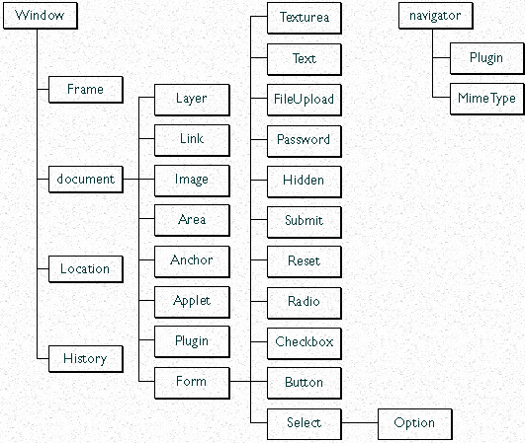
HTML DOM Structure

Slide 15
DOM Resources
Tutorials:
http://www.w3schools.com/htmldom/default.asp
DOM examples:
http://www.w3schools.com/htmldom/dom_examples.asp

Slide 16
Java Advanced
Browser
Cookies
Validation
Animation
Timing
Create your own object

Slide 17
Some Dynamic HTML Examples
http://www.w3schools.com/dhtml/dhtml_examples.asp

Slide 18
Case Study
More Examples:
http://www.pages.org/javascript/index.html
http://www.csupomona.edu/~ftang/www/courses/CS299-S09/examples/changestyle.html
Form validation:
http://www.xs4all.nl/~sbpoley/webmatters/formval.html

