Slide 1

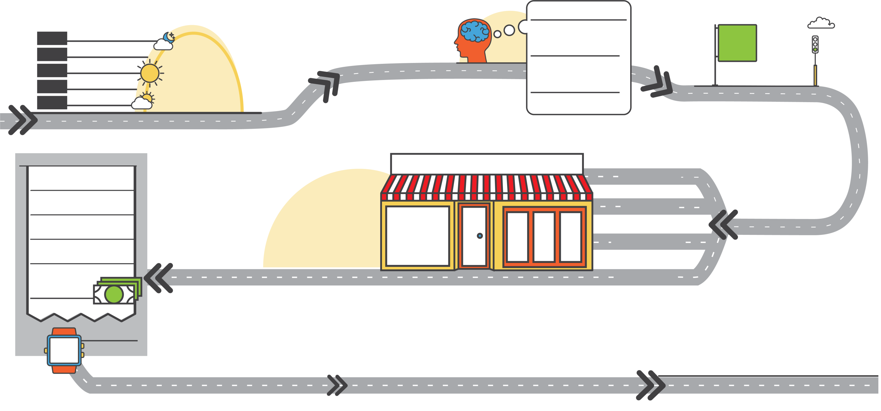









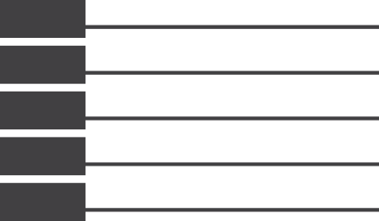





















3MMT
PRE-VISIT
TRIP
AVERAGE DISTANCE
TRAVELLED OUT OF WAY
TIME OF DAY
OCCASION MOTIVATION
TRAVELLED OUT
OF THE WAY
PLANNING
+0.0%
XX%
MIDDLE OF THE NIGHT
-0.0%
LOCATION
PRIOR TO VISIT
XX%
Motivation
-0.0%
XX
Miles
XX%
LATE NIGHT
+0.0%
XX%
Somewhat Ahead of time
OUTLET MOTIVATION
XX%
XX%
The
-0.0%
-0.0%
-0.0%
XX%
EVENING
-0.0%
XX%
Motivation
XX%
AFTERNOON
+0.0%
WHO WITH
OVERALL MOOD
XX%
MORNING
-0.0%
XX%
Alone
+0.0%
+0.0%
XX%
Positive Mood
TRANSPORTATION
XX%
Public Transportation
+0.0%
ORDER SUMMARY
MEAL
TOP FOOD &
BEVERAGE ITEM
RESTAURANT VISIT
OTHER ACTIVITIES
XX%
DELIVERY
Beverage
Only
XX%
+0.0%
XX%
Had Other Activities
XX%
BREAKFAST
-0.0%
-0.0%
XX%
-0.0%
TAKE OUT
Food
Only
XX%
LUNCH
XX%
XX%
-0.0%
-0.0%
-0.0%
DINNER
52
53
Food + In -Outlet Beverage
+0.0%
-0.0%
-0.0%
DINE IN
XX%
XX%
SNACK
XX%
-0.0%
-0.1%
Carbonated
Soft Drink
Hamburger/
Cheeseburger
-0.0%
Food + Beverage Elsewhere
XX%
JUST A DRINK
XX%
-0.0%
DRIVE-THRU
+0.0%
XX%
+0.0%
DOLLARS
SPENT
$100
POST-VISIT
Average Per
Diner
-$0.00
DESTINATION
AFTER VISIT
TIME SPENT
OVERALL SATISFACTION
SATISFACTION DRIVERS
-0.0%
21 - 30
MINUTES
XX%
-0.0%
XX%
Workplace
XX%
Satisfied
(Top 2 Box)
-0.0%
Food
Beverages
Value
Cleanliness
Atmosphere
Service
XX%
XX%
XX%
XX%
XX%
XX%
+0.0%
-0.0%
-0.0%
-0.0%
+0.0%
-0.0%
Source: CCNA DINE₃₆₀ Tracker, Base: Total Visits, Sorted By: Largest Size, Time Period: 12MMT Sep 2018
Filters: 25-34, 35-49, 50-64
* Stat tested at 95% CL against : TOTAL VISIT, Filters: 25-34, 35-49, 50-64
Sample size in chart legend/label; Grey font = Low Sample (30-99)
Classified - Confidential
Significantly Higher
Significantly Lower

Slide 2

3MMT
PRE-VISIT
TRIP
AVERAGE DISTANCE
TRAVELLED OUT OF WAY
TIME OF DAY
OCCASION MOTIVATION
TRAVELLED OUT
OF THE WAY
PLANNING
+0.0%
XX%
MIDDLE OF THE NIGHT
-0.0%
LOCATION
PRIOR TO VISIT
XX%
Motivation
-0.0%
XX
Miles
XX%
LATE NIGHT
+0.0%
XX%
Somewhat Ahead of time
OUTLET MOTIVATION
XX%
XX%
The
-0.0%
-0.0%
-0.0%
XX%
EVENING
-0.0%
XX%
Motivation
XX%
AFTERNOON
+0.0%
WHO WITH
OVERALL MOOD
XX%
MORNING
-0.0%
XX%
Alone
+0.0%
+0.0%
XX%
Positive Mood
TRANSPORTATION
XX%
Public Transportation
+0.0%
ORDER SUMMARY
MEAL
TOP FOOD &
BEVERAGE ITEM
RESTAURANT VISIT
OTHER ACTIVITIES
DELIVERY
Beverage
Only
XX%
XX%
XX%
Had Other Activities
XX%
BREAKFAST
+0.0%
-0.0%
-0.0%c
XX%
-0.0%
Food
Only
XX%
LUNCH
XX%
-0.0%
TAKE OUT
-0.0%
DINNER
52
53
XX%
Food + In -Outlet Beverage
+0.0%
-0.0%c
-0.0%c
-0.0%
XX%
XX%
SNACK
Carbonated
Soft Drink
Hamburger/
Cheeseburger
-0.0%
-0.1%
Food + Beverage Elsewhere
XX%
JUST A DRINK
XX%
-0.0%
DRIVE-THRU
+0.0%
XX%
DOLLARS
SPENT
+0.0%
$100
POST-VISIT
Average Per
Diner
-$0.00
DESTINATION
AFTER VISIT
TIME SPENT
OVERALL SATISFACTION
SATISFACTION DRIVERS
-0.0%
21 - 30
MINUTES
XX%
-0.0%
XX%
Workplace
XX%
Satisfied
(Top 2 Box)
-0.0%
Food
Beverages
Value
Cleanliness
Atmosphere
Service
XX%
XX%
XX%
XX%
XX%
XX%
+0.0%
-0.0%
-0.0%
-0.0%
+0.0%
-0.0%
Source: CCNA DINE₃₆₀ Tracker, Base: Total Visits, Sorted By: Largest Size, Time Period: 12MMT Sep 2018
Filters: 25-34, 35-49, 50-64
* Stat tested at 95% CL against : TOTAL VISIT, Filters: 25-34, 35-49, 50-64
Classified - Confidential
Significantly Higher
Sample size in chart legend/label; Grey font = Low Sample (30-99)
Significantly Higher
Significantly Lower

Slide 3

3MMT
PRE-VISIT
TRIP
AVERAGE DISTANCE
TRAVELLED OUT OF WAY
TIME OF DAY
OCCASION MOTIVATION
TRAVELLED OUT
OF THE WAY
PLANNING
+0.0%
XX%
MIDDLE OF THE NIGHT
-0.0%
LOCATION
PRIOR TO VISIT
XX%
Motivation
-0.0%
XX
Miles
XX%
LATE NIGHT
+0.0%
XX%
Somewhat Ahead of time
OUTLET MOTIVATION
XX%
XX%
The
-0.0%
-0.0%
-0.0%
XX%
EVENING
-0.0%
XX%
Motivation
XX%
AFTERNOON
+0.0%
WHO WITH
OVERALL MOOD
XX%
MORNING
-0.0%
XX%
Alone
+0.0%
+0.0%
XX%
Positive Mood
TRANSPORTATION
XX%
Public Transportation
+0.0%
ORDER SUMMARY
MEAL
TOP FOOD &
BEVERAGE ITEM
RESTAURANT VISIT
OTHER ACTIVITIES
XX%
DELIVERY
Beverage
Only
XX%
+0.0%
XX%
Had Other Activities
XX%
BREAKFAST
-0.0%
-0.0%
XX%
-0.0%
TAKE OUT
Food
Only
XX%
LUNCH
XX%
XX%
-0.0%
-0.0%
-0.0%
DINNER
52
53
Food + In -Outlet Beverage
+0.0%
-0.0%
-0.0%
DINE IN
XX%
XX%
SNACK
Carbonated
Soft Drink
Hamburger/
Cheeseburger
XX%
Food + Beverage Elsewhere
-0.0%
XX%
-0.1%
-0.0%
XX%
JUST A DRINK
+0.0%
-0.0%
DRIVE-THRU
XX%
+0.0%
DOLLARS
SPENT
$100
POST-VISIT
Average Per
Diner
-$0.00
DESTINATION
AFTER VISIT
TIME SPENT
OVERALL SATISFACTION
SATISFACTION DRIVERS
-0.0%
21 - 30
MINUTES
XX%
-0.0%
XX%
Workplace
XX%
Satisfied
(Top 2 Box)
-0.0%
Food
Beverages
Value
Cleanliness
Atmosphere
Service
XX%
XX%
XX%
XX%
XX%
XX%
+0.0%
-0.0%
-0.0%
-0.0%
+0.0%
-0.0%
Source: CCNA DINE₃₆₀ Tracker, Base: Total Visits, Sorted By: Largest Size, Time Period: 12MMT Sep 2018
Filters: 25-34, 35-49, 50-64
* Stat tested at 95% CL against : TOTAL VISIT, Filters: 25-34, 35-49, 50-64
Sample size in chart legend/label; Grey font = Low Sample (30-99)
Classified - Confidential
Significantly Higher
Significantly Lower

Slide 4
3MMT
PRE-VISIT
TRIP
AVERAGE DISTANCE
TRAVELLED OUT OF WAY
TIME OF DAY
OCCASION MOTIVATION
TRAVELLED OUT
OF THE WAY
PLANNING
+0.0%
XX%
MIDDLE OF THE NIGHT
-0.0%
LOCATION
PRIOR TO VISIT
XX%
Motivation
-0.0%
XX
Miles
XX%
LATE NIGHT
+0.0%
XX%
Somewhat Ahead of time
OUTLET MOTIVATION
XX%
XX%
The
-0.0%
-0.0%
-0.0%
XX%
EVENING
-0.0%
XX%
Motivation
XX%
AFTERNOON
+0.0%
WHO WITH
OVERALL MOOD
XX%
MORNING
-0.0%
XX%
Alone
+0.0%
+0.0%
XX%
Positive Mood
TRANSPORTATION
XX%
Public Transportation
+0.0%
ORDER SUMMARY
MEAL
TOP FOOD &
BEVERAGE ITEM
RESTAURANT VISIT
OTHER ACTIVITIES
DELIVERY
Beverage
Only
XX%
XX%
XX%
Had Other Activities
XX%
BREAKFAST
+0.0%
-0.0%
-0.0%
XX%
-0.0%
Food
Only
XX%
LUNCH
XX%
-0.0%
TAKE OUT
-0.0%
DINNER
52
53
XX%
Food + In -Outlet Beverage
+0.0%
-0.0%
-0.0%
-0.0%
XX%
XX%
SNACK
Carbonated
Soft Drink
Hamburger/
Cheeseburger
-0.0%
-0.1%
Food + Beverage Elsewhere
XX%
JUST A DRINK
XX%
-0.0%
DRIVE-THRU
+0.0%
XX%
DOLLARS
SPENT
+0.0%
$100
POST-VISIT
Average Per
Diner
-$0.00
DESTINATION
AFTER VISIT
TIME SPENT
OVERALL SATISFACTION
SATISFACTION DRIVERS
-0.0%
21 - 30
MINUTES
XX%
-0.0%
XX%
Workplace
XX%
Satisfied
(Top 2 Box)
-0.0%
Food
Beverages
Value
Cleanliness
Atmosphere
Service
XX%
XX%
XX%
XX%
XX%
XX%
+0.0%
-0.0%
-0.0%
-0.0%
+0.0%
-0.0%
Source: CCNA DINE₃₆₀ Tracker, Base: Total Visits, Sorted By: Largest Size, Time Period: 12MMT Sep 2018
Filters: 25-34, 35-49, 50-64
* Stat tested at 95% CL against : TOTAL VISIT, Filters: 25-34, 35-49, 50-64
Sample size in chart legend/label; Grey font = Low Sample (30-99)
Classified - Confidential
Significantly Higher
Significantly Lower

Slide 5

3MMT
Sample Sizes
12MMT DEC 2017 | Establishment – KFC | Custom Base – Total Dine
Total | 237 | 2,930
Time Spent | 221 | 2,387
Satisfaction Drivers – Food | 193 | 2,261
Satisfaction Drivers – Beverage | 211 | 2,767
Satisfaction Drivers – Cleanliness | 203 | 1,130
Satisfaction Drivers – Atmosphere | 203 | 1,130
Source: CCNA DINE₃₆₀ Tracker, Base: Total Visits, Sorted By: Largest Size, Time Period: 12MMT Sep 2018
Filters: 25-34, 35-49, 50-64
* Stat tested at 95% CL against : TOTAL VISIT, Filters: 25-34, 35-49, 50-64
Sample size in chart legend/label; Grey font = Low Sample (30-99)
Classified - Confidential
Significantly Higher
Significantly Lower

