Slide 1
Scientific Programming & Visualisation
Steve Crouch
Software Sustainability Institute
s.crouch@software.ac.uk
Notes:
Welcome to the Scientific Programming and Visualisation session,
where we'll look at two tools that can help us manipulate numerical data and generate graphs.
We'll first be looking at how a specialised library called NumPy can help us to perform numerical operations on matrix-based data efficiently and quickly.
We'll also be using another library, Matplotlib, to generate graphs that yield insight into this data.

Slide 2
Why is Python so popular with researchers?
Historically, MathWorks MATLAB very popular
Been around since 1984
Built-in support for efficient numerical matrix analysis, plotting
However, it's proprietary commercial software
Scientific Python trilogy
IPython: foundation of the Notebook, created in 2001 by Fernando Perez
Matplotlib: plotting library, created in 2003 by John D. Hunter
NumPy: fast matrix maths library, created in 2005 by Travis Oliphant
All available as a free and open toolchain
Also get benefits of general Python language
Notes:
So why is Python so popular with researchers?
Historically, a software product called MATLAB has proved very popular with researchers.
Firstly, it's been around for a long time - it's a very mature piece of software with excellent integration between it's many capabilities, and has excellent documentation
Primarily for numerical computing, it support things like numerical matrix analysis and manipulation, plotting of functions and data
However, a big drawback is that it's proprietary commercial software, so you need to buy a licence to use it
But then, a set of three Python packages began surfacing after the turn of the millenium
IPython, foundation for the Jupyter Notebook, created in 2001 by Fernando Perez
Matplotlib, a library for creating graphical plots, created in 2003 by John D. Hunter
And also NumPy, which arrived in 2005. A fast matrix mathematics library, created by Travis Oliphant
Now these are all open source and free, have been developed and supported for over a decade, function well together, and have been gaining traction with the academic community ever since.
And you also get benefits of general Python language - it's flexibility and general purpose nature mean you can make use of features from these packages in larger projects where you need them, and you aren't tied to only the single package, like MATLAB.

Slide 3
Introduction to NumPy
A third-party, non-core Python library
Stands for 'Numerical Python'
The array object in NumPy is called ndarray
Can only contain one type - e.g all integers, floats, text strings, etc.
Fixed size - editing an ndarray deletes and recreates it each time
Similar in some respects to Python, e.g. element slicing
Provides many support functions to work with them
Use additional SciPy package to gain more MATLAB-like functionality
Linear algebra, integration, interpolation, FFT, signal/image processing, etc.
Notes:
So what is NumPy?
It stands for Numerical Python,
And it's a third party Python library, which means it doesn't come as part of Python as it's normally installed.
So we need to install it as a separate Python package.
The core thing NumPy provides you is the ndarray.
The ndarray is an array of objects - an array is a data structure which can store a collection of ordered elements of the same type of data
So all elements in an array, or ndarray, must be of a single type, so all integers, all floats, text strings, and so on
Since ndarrays are of fixed size, unlike Python lists, every time we change the contents of an ndarray we are deleting it and recreating it each time
In some respects, they act like Python lists, for example you slice an ndarray in the same way.
But in other ways they are very different. But these differences give us some key advantages
ndarrays also come with many support functions and capabilities for performing operations on them at a high-level which is very useful
There is also an additional package called SciPy which makes use of NumPy arrays to provide more MATLAB-like functionality
Such as linear algebra

Slide 4
NumPy arrays vs Python lists
Advantages of NumPy arrays
Less memory - data structure has denser, smaller memory footprint
High performance - often orders of magnitude faster
Convenience - supports powerful matrix and scientific operations
Similar to arrays in other languages in concept
Advantages of Python lists
Can contain different data types, unlike NumPy
It's a core data type - don't need to be explicitly declared NumPy arrays trade flexibility for performance, efficiency, and power
Notes:
Let's take a look at the core array object provide by NumPy, in relation to the Python list.
So what are the advantages of NumPy arrays?
Firstly, they consume significantly less memory than Python lists
Because NumPy arrays are of only one type and of fixed size they can be stored in a more densely-packed format which is much more efficient
NumPy arrays are also high performance
Tasks executed in NumPy are around 5 to 100 times faster than lists
This is because parts requiring fast computation are written in C/C++, and also in part, because of how they're stored in memory, it's more efficient to process them
And also, NumPy is optimised to work with the latest CPU architectures
However, it's important to bear in mind that Python lists still have advantages which may steer you in their direction:
They can contain different data types, unlike NumPy, so are far more flexible
They are part of the core library, and don't need to be explicitly declared as a specific type, unlike ndarrays
So in the end, NumPy arrays trade flexibility you have with Python lists for performance, efficiency, and also power - due to how it's designed around the ndarray, you can perform complex and powerful operations on them using very little code.
If you don't need the flexibility offered by Python lists, but are doing a lot of intensive operations over single of type data, and value efficiency and performance, use NumPy arrays.

Slide 5
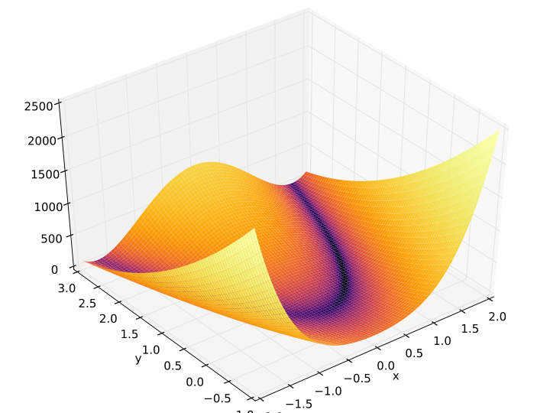
Introduction to Matplotlib
"The purpose of computing is insight, not numbers" - Richard Hamming
Most popular Python data visualisation library
Very powerful, comprehensive
Bar graph, line/pie charts, histograms, box plots, ...
Huge customisation options
Publication quality
Easy to get started, can be complicated
Single line to generate a graph
Example Rosenbrock function
Image author: Adrien F. Vincent, CC-BY-SA
Notes:
The mathematician Richard Hamming once said, “The purpose of computing is insight, not numbers,” and the best way to develop insight is often to visualize data. Visualization deserves an entire lecture of its own, but we can explore a few features of Python’s matplotlib library here. While there is no official plotting library, matplotlib is the de facto standard.
Matplotlib is very powerful and also comprehensive
With it, you can create charts of many types, including basic bar graphs, line or pie charts, histograms, box plots, scatter plots. It also supports 3D graphs, as you can see from the example Rosenbrock function graph on the right
It allows for massive customisation of graphs too - you can add or change graph labels, axis limits, colours, background grid, pretty much anything
You can also generate publication quality graphs, with some work - see the example Rosenbrock function [a popular test problem for gradient-based optimization algorithms]
It's also easy to get started - you can generate a graph of a specific type with a single line.
But you can also go a lot further and produce very complex, tailored graphs using Matplotlib's API
However, it can be confusing - the library itself is around 70,000 lines of code, and there are several different ways of constructing a figure. Also note that it is still evolving, and Matplotlib's own documentation is often out-of-date

Slide 6
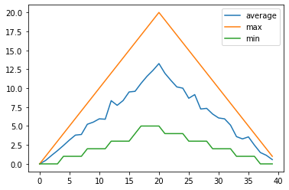
Anatomy of a Matplotlib plot
A plot is a hierarchy of objects
Outermost: Figure object
Can contain multiple Axes objects
Axes object
Actually represents a 'plot' or 'graph'
Contain many smaller object types
Smaller object types
Tick marks, individual lines, legends, text boxes, ...
Figure
Axes
...
Notes:
As we've said, Matplotlib can get a little confusing,
So it's useful to know how Matplotlib puts a graph or plot together.
A plot you generate is made of a hierarchy of objects:
The outermost object is the Figure object. This can contain multiple Axes objects. Which could be side by side, vertical, arranged in a grid, or even on top of each other.
The Axes objects are not actually to do with the axis concept of a graph. These actually represent an individual plot or graph as we would know it
Each Axes object can contain many other smaller object types which make up the graph itself, such as: tick marks, individual lines, legends, text boxes, labels, and so on
So now we have a conceptual overview of what a Matplotlib plot is, let's look at an actual Python example.

Slide 7
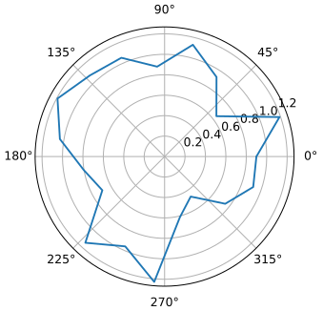
Example: polar curve graph
import numpy as np
import matplotlib.pyplot as plt
theta = np.linspace(0, 2*np.pi, 20)
theta[19] = theta[0]
r = 1 + 0.2*np.random.randn(20)
r[19] = r[0]
plt.polar(theta, r)
plt.savefig("courbe_polaire_rayon_aleatoire.svg",
format="svg")
Example polar curve graph
Image/code author: Cdang, CC-BY-SA
Notes:
Let's put NumPy and Matplotlib together, using some example Python which is used to generate the polar graph on the top right.
For this example
We first import the numpy library as well as Matplotlib
Then we use NumPy to generate a NumPy array filled with evenly spaced numbers over a specified interval (using linspace, a function within NumPy) - these form the polar x coordinates for our graph
We then generate some random numbers with a common coefficient and constant - these form the polar y coordinates for our graph
By passing these x and y values to the polar() function of Matplotlib, we generate a new figure - our polar curve graph
We then save that Figure as a file
An important thing to note is that here, we're making use of hidden Matplotlib PyPlot state.
Whilst plt is what we use to refer to the Matplotlib PyPlot module as a convenient shorthand,
plt.polar() is implicitly creating a new Figure which is held internally by Matplotlib.
And plt.savefig() is referring to that hidden Figure - in order to save it as a file
So - it's good to remember that Plt - or PyPlot - is just a set of wrappers around Matplotlib's lower-level API, and there this hidden Figure state held in the background is what we are creating and changing as we make calls via plt
Which implies there is only ever one Figure that you're manipulating at any given time
So, throughout this introduction, we've taken a look at two key libraries that can greatly help numerical analysis and visualisation, and the reasons to use them.
So the next thing to do is to make a start on the self-learning online materials, which aims to give you some hands-on experience using these libraries, making use of a medical inflammation dataset to introduce you to the features of NumPy and Matplotlib which you can use to analyse data and visualise it, as aids to give you insight to the properties of that data.

Slide 8
Learning objectives
Scientific Programming with NumPy
Explain key similarities and differences between NumPy arrays and Python lists
Select subsets of data from a NumPy array using slicing
Efficiently perform elementwise operations on data
Obtain characteristics of tabular data using NumPy's statistical functions
Data Visualisation with Matplotlib
Generate a heatmap of longitudinal, numerical tabular data
Create graphs of mean, min and max characteristics over time from data
Create graphs showing multiple data characteristics within a single plot and separate plots
Save generated graph to local storage
Write a script to visualise data from multiple data files
Notes:
So what are the learning objectives for this session?
With NumPy, be able to:
Explain the key similarities and differences between NumPy arrays and Python lists
Select subsets of data from a NumPy array using slicing
Efficiently perform elementwise operations on data
And obtain characteristics of tabular data using NumPy's statistical functions
In terms of Matplotlib, be able to:
Firstly generate a heatmap of longitudinal and numerical tabular data
Create graphs of mean, minimum, and maximum characteristics over time from data
Also create graphs to show multiple data characteristics within a single plot and within separate plots
Save a generated graph to local file storage
Write a script to visualise data from multiple data files

