Slide 1
Community and Refactoring
James Graham
Software Sustainability Institute
j.graham@software.ac.uk
Notes:
Hi everyone and welcome to the session on community practices and refactoring.
This one’s a bit of a mix of things that didn’t really fit elsewhere, but continues on from the theme of the last session.
We’re going to look at a few more techniques and tools we can use to improve the quality of our software, most of which are an extension of things we’ve seen previously.
I’d also like to encourage you to think about what Quality actually means, in the context of software engineering.
That’s what I’d like to start with...

Slide 2
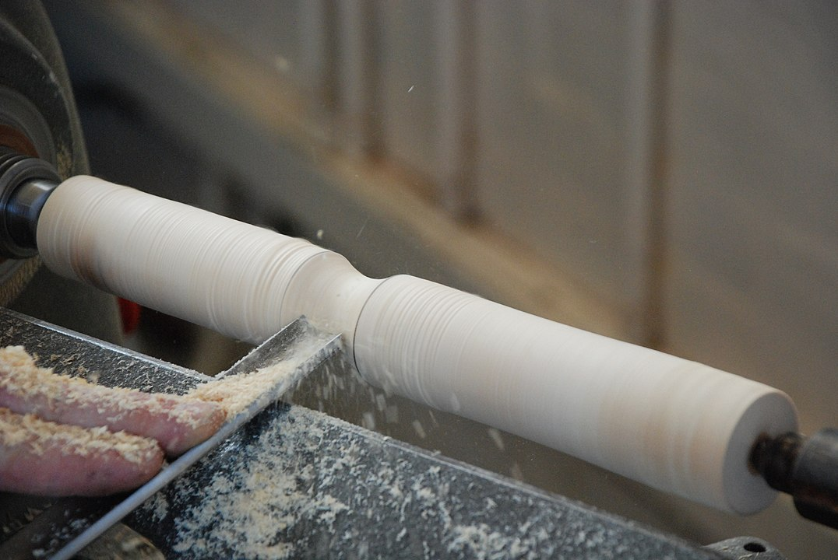
What Makes Good Quality Software / Code?
It works!
It works well!
What does this really mean?
Makes tasks easier
Makes tasks quicker
Makes tasks nicer to do
What if we’re a tool maker? (we are)
Easy to repair
Easy to modify
Woodturning with a Spindle Gouge
CC BY 2.0 - Jordanhill School D&T Dept
https://www.flickr.com/photos/42042252@N02/4113146788
Notes:
To frame our thoughts about the quality of software, we should again remind ourselves of what software actually is.
Most of the time, software is a tool.
Mostly, people use software because they have a task which needs to be performed.
So we can think of software much in the same way we would think about any other tool.
What makes a good quality tool? If we’re doing some woodwork for example.
There’s some things that I think almost everyone would agree on:
a good quality tool works, it allows you to do the task that it’s supposed to help with
a good quality tool helps you do the task quicker than you would without it - the quicker the better
the result should also be better than it would be without the tool
you’d also expect a good quality tool to last a long time, and not break as soon as you try to use it, though it might need to be repaired occasionally
finally, and this can be really hard to quantify, a good quality tool should make the task nicer to do
As makers of tools, we have a few extra things we probably care about as well, which would also apply to the maker of woodworking tools:
we want the tools we make to be easy to repair - people are going to ask us to repair them and we probably should when they do
we want them to be extensible - if someone asks us for a new type of chisel, it would be much easier for us if we can modify one we already made
and all of the same arguments as using the tool - it should be as easy as possible to make, modify and repair, for example
There’s a lot that goes into our experience as makers of tools, some of which we’ll be looking at soon.

Slide 3
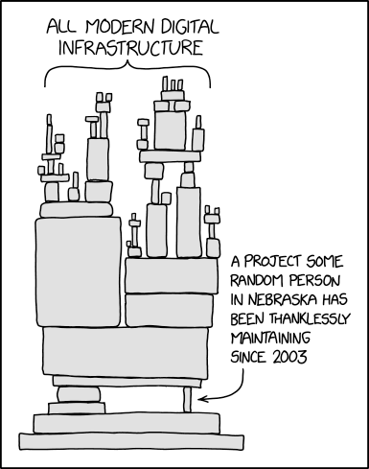
Who is our community?
Us?
People who run our code?
People who contribute to our code?
People who develop code that relies on ours?
People who run their code?
How much responsibility do we have to look after the needs of these people?
XKCD 2347: Dependency
CC BY-NC 2.5 - Randall Munroe
https://xkcd.com/2347/
Notes:
So who are we making these tools for? Who is affected by the quality of the things we produce?
Firstly, us, we’re writing the software, so we get affected first
Have we set everything up to make developing the software as easy as possible, when we come back later, do we have everything we need to jump back in?
Our software also obviously affects the people that use it - and we’ll probably have some interaction with a few of them to talk about what it is that they need.
If we make our project open source, we might find that some of the people who use it want to help us improve it.
Other people contributing to our code have the same sorts of concerns as we do, but they weren’t there when the project started, so they’ll need enough information to make up for that.
Depending on what sort of software we’re producing, it might also end up being a dependency of someone else’s software, so now we have them and the people who use their code to worry about
How much responsibility do we, as software developers, have to each of these groups?
That’s up to you, within the context of each project you’re working on, but I’d like to point out the image on the right - we don’t want to end up in that position, having so much of our essential infrastructure relying on projects that are at risk of disappearing.

Slide 4
Documenting Software
Documentation is where many people will go first
What do the different parts of our community need?
User documentation
Usage docs
Developer documentation
API docs
Architecture docs
Contribution guide
Notes:
One of the best things we can do, to get the most benefit for our community, is to properly document our software.
Documentation is one of the first things that both users and potential developers of software will see, often it’s one of them main indicators we use for whether we should pick this software, or look for another one to use.
Hopefully, we can all agree already that documentation is important. But what sort of documentation, and what should it include?
Well, there’s two main types of documentation:
user documentation, which describes how and why to use the software
and developer documentation, which describes the components and structure of the software, and how a new developer should start contributing to the project
In this session, we’ll look at some recommendations for the contents and format of our documentation, as well as a tool that’s commonly used to build documentation for Python projects.
For our API documentation, the documentation that describes each of the components of our software, we’ll also look at Docstrings, one of the nice features of Python that means we can write a lot of our documentation within the code itself.
This makes it much easier for us to make sure that it’s up to date, and also means that you can refer back to it when you’re developing, without having to find the relevant pages in a manual.
Even in languages without special support for docstrings, there’s often a commonly accepted way of formatting comments that serves the same purpose - for example the JavaDoc format in Java.

Slide 5
Style, Style Guides and Linting
A consistent style is ‘A Good Thing’
Easier to read code if style is familiar
Some languages have official recommendation
e.g. PEP8 in Python
Sometimes a few to choose from
C++ has Google, C++ Core Guidelines, etc.
Sometimes write your own
But usually better not to
“Tabs”
“No, spaces”
“How many? Two?”
“No, four”
“Okay, three spaces, final offer”
Familiar?
Notes:
Another important thing we can do to make our code easier to work with, and to help new developers join the project, is to ensure that our code has a consistent style.
One of the common disagreements is whether we should use spaces or tabs to indent our code.
You may have come across this disagreement already, or you might come across it in the future, but does happen in many projects.
Rather than have disagreements list these on every question of style, we can refer to a style guide.
Style guides are documentation that provides guidelines for style within our code, that everyone in the project should stick to, even if they personally disagree with its advice.
You might have someone who prefers to use tabs to indent with, but if the style guide says to use spaces, then everyone has to use spaces in this project.
Some languages, like Python, have an official style guide - for Python it’s called PEP 8 (PEP for Python Enhancement Proposal).
PEP 8 says we should use four spaces, so we use four spaces.
Other languages might not have a widely accepted official style guide, but a few common ones we can pick from.
C++ has probably two main choices, the Google style guide and the C++ Core Guidelines as well as a few other less common choices.
Both of them are fine and it doesn’t really matter which one you pick, but you should pick one and stick to it.
In more unusual cases, with unusual programming languages, or unusual areas of study, you might not have any common style guides to choose from.
If you find yourself in this position, you might have to write your own, but I wouldn’t recommend this, unless it’s a particularly large project and you’re already having problems keeping a consistent style.
Many languages have tools we can use to check that our code conforms to a style guide, which fit into two main types:
linters are a type of static analysis tool, and check your code for errors, but also for style, and report the results to you
if you’re using a linter, you typically run it over your code, correct some of the errors or warnings and run it again
formatters are tools that actually reformat our code directly - fixing many style issues automatically
some editors, of which VSCode is one, can even be configured to run a formatter every time we save a file

Slide 6
Refactoring
In computer programming and software design, code refactoring is the process of restructuring existing computer code … without changing its external behavior. Refactoring is intended to improve the design, structure, and/or implementation of the software …
-- Wikipedia - Refactoring
Notes:
The other part of our session today is on refactoring.
Refactoring is the process of changing our code, to improve it, without affecting the functionality.
We usually end up doing this because we want to improve the structure of the code, either because we’ve thought of a better way to do something complicated, or because the way we did something originally prevents us from making another change we have planned.
Particularly as you’re learning about new techniques, you might find that something you previously found difficult, has a much simpler solution available.
Refactoring can either be something you do continuously as you notice these issues in your code, or as part of a more formal process.
The Red, Green, Refactor cycle in Test Driven Development refers to writing tests first, which fail, because you haven’t written the code yet.
Next we write the code, until the tests pass, without being too worried about the structure.
Then we refactor the code we just wrote - here we fix any structural issues and make sure it’s nicely integrated into the rest of the project.
One of the most useful tools when refactoring code is a good set of automated tests, which will be coming in a later session, but we’ll be able to cover enough today without tests yet.
We’ll also refer back to our programming paradigms and look at some of the ideas from the Structured Programming paradigm, which we only really covered implicitly before.

