Slide 1
Virtual Environments and Packaging
James Graham
Software Sustainability Institute
j.graham@software.ac.uk
Notes:
Hi everyone and welcome to the session on virtual environments and packaging.
In this session, we’ll be looking at some of the tools we can use to manage the dependencies that our software has and how we make our code usable by others.

Slide 2
Distributing our software
Ideally want to make this as easy as possible
Linux ecosystem uses package managers
Get packages from a package repository
Also a couple available for Windows and OSX
Many programming languages have own package repository
In Python we have the Python Package Index (PyPI)
Also Anaconda - you might come across this later
Notes:
For our intro, we’ll start at the end, with distributing our software.
This is ultimately what we’re trying to do, to get the software that researchers need to the researchers who need that software.
That might be our own research group, it might be our collaborators from another university, or it might be people we’ve never met in a lab on the other side of the world.
Getting hold of and installing our software, is often the first interaction that our users will have with our software, so the easier we can make this, the better first impression we have.
Many of us will have had the experience of trying to install some software, find out how complicated the install process is, give up and go and find something else instead.
In the Linux ecosystem, we tend to install most software using a package manager.
If you’ve not come across package managers before, they’re a tool which allows us to search for and install software from a central store, usually known as a package repository, or repo.
Each Linux distribution has a recommended package manager, on Ubuntu it’s called apt.
There’s also a couple of package managers available for macs and windows, but they’re something you have to setup yourself.
Many modern programming languages have their own package repository that contains usually software written in that language.
In Python, we have the Python Package Index and Anaconda.
You might also have heard of similar tools from other languages, such as NPM, which is very commonly used when developing in JavaScript.
By adding our software to one of these package repositories, we can make sure it’s easy to find and install, for anyone who wants to use it.

Slide 3
What is a package?
Should be everything you need to install the software!
The software itself
Source code? Compiled binaries?
Any necessary data files
e.g. Config files, common parameter sets
Metadata
Name, version number, author, license, etc.
Dependencies, versions
Documentation?
Notes:
So what’s actually in a package?
Really, a package should contain everything you need to install and get ready start using the software.
This means:
the software itself
this might be the source code, or it could be a compiled version, depending on the language and packaging tools you’re using
it should include any necessary data files
this might include config files, or any common parameter sets that you expect people to need
and it should include a set of metadata, again depending on what packaging tools you’re using
this typically includes things like the name of the software, a version number, author details, that people can use to search for and identify the software
it also includes a list of other packages on which your software depends, sometimes with specific version details
and finally, it may include some form of documentation, anything from a short README, to a full manual
In the second part of our session today, we’ll be using a tool called Poetry to work through the process of creating a package and uploading it to a package repository, that’s specifically used for testing.
That will include a look at some of the metadata that’s useful to add to your packages and how to organise it, building on some of the points in the previous community practices session.

Slide 4
Dependency Hell
Most software depends on other software ‘libraries’
e.g. Our numerical modelling probably depends on NumPy
Need particular features?
Okay, let’s pin a particular version
But some other software needs a different version
Dependency chains
Dependency conflicts
Circular dependencies
Notes:
Most software we write will use components, or libraries, that other people have written and made available to us in one of these package repositories.
If we’re writing some numerical modelling code, for example, we’ll almost certainly be using NumPy and maybe SciPy, so we don’t have to write all of the underlying numerical operations ourselves.
NumPy has been around since 2005, so it’s well tested and has had a lot of effort put into making it as fast as possible.
If we were to try to implement it from scratch ourselves, it’s likely we’d end up with something slower and with a few bugs.
The disadvantages of using other people’s code in this way, is when we rely on a particular set of features to be present.
As that person or group of people develops their own project, they will add features and often also remove features.
They might remove a feature because not many people are using it, or maybe because it has bugs that can’t be fixed.
Hopefully, they’ve been using a sensible version numbering system, that we can use to tell which versions of their project support the features that we need.
We’ll look at a common version numbering system shortly.
But what happens when this goes wrong?
Our dependencies have their own dependencies, which can quickly result in way more than you’d think is necessary.
It’s quite unusual in Python to have more than 100 total dependencies, but for a large JavaScript project, you could have thousands.
What if there’s other software we use that has some of the same dependencies - but requires a different version?
This is a dependency conflict and would be very common if we don’t do something to prevent it
Finally, we can end up in a position where we have a circular dependency, where A depends on B, but B also depends on A.
These are much rarer, but can occur if we’re not careful about what dependencies we bring in - the best way to avoid this is to keep our list of dependencies as short as possible, and check them as part of our automated testing.
This situation of having to manage all of these dependencies ourselves is commonly known as Dependency Hell

Slide 5
Resolving Dependency Hell
Install multiple versions at the same time?
Separate groups of dependencies from each other?
Version pinning?
How strict? When / how to update?
Separate groups is wasteful duplication
Notes:
So what can we do to avoid Dependency Hell?
The first and probably most obvious solution is to minimise the number of dependencies our software has.
This is something we should always keep in mind, but not be too strict with - if a dependency provides enough value to be worth the increased risk, include it.
And obviously it won’t help with any software that you didn’t write.
On a larger scale, there’s two main strategies that can be used.
The first is to allow multiple versions of each dependency to be installed in parallel, so each piece of software can find whatever version it needs.
This is a common solution for this at the Operating System scale, and is how Windows addresses the problem.
The main downside of this approach is that it’s not always obvious when an old version of a library is or should be no longer used, so we often end up with old versions lying around that we don’t need any more.
The other approach is for each application to keep its own dependencies, separate from the dependencies of all of the other installed software.
This means that we always have only the required versions installed, but passes on the responsibility for managing these to the application or user.
Either of these approaches can result in multiple versions of a dependency installed across the system, which could be considered wasteful, but it’s usually better than trying to handle conflicts yourself.

Slide 6
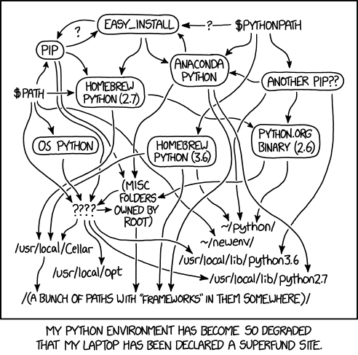
Virtual Environments
Python has been a bit of a mess here
venv, virtualenv, pyenv, pipenv, conda, poetry, pew, virtualenvwrapper, docker, …
But venv is official since Python 3.3
Use venv unless you prefer another one
Gives us a completely separate environment
Generally store environment with project
XKCD 1987 - Python Environment https://xkcd.com/1987/
Notes:
In Python, we usually opt for the second strategy, keeping all of the dependencies of an application separate from the rest of the system.
We call this a ‘Virtual Environment’.
Historically, this has been a bit of a mess, with many competing tools and methods for solving the same fundamental problem.
However, since Python 3.3, a tool called ‘venv’ has been the official recommendation.
This is part of the Python core specification, so should either be already present, or easily installable on all platforms that have access to Python.
Venv is the tool we’ve been using so far and we’ll be looking at in a bit more detail in this session, and I’d recommend that as your default virtual environment tool, unless you need features from one of the others that venv doesn’t provide.
For example, pyenv can change the version of Python you’re using, or Conda sometimes works a bit better with complex libraries using multiple different languages.

