Slide 1

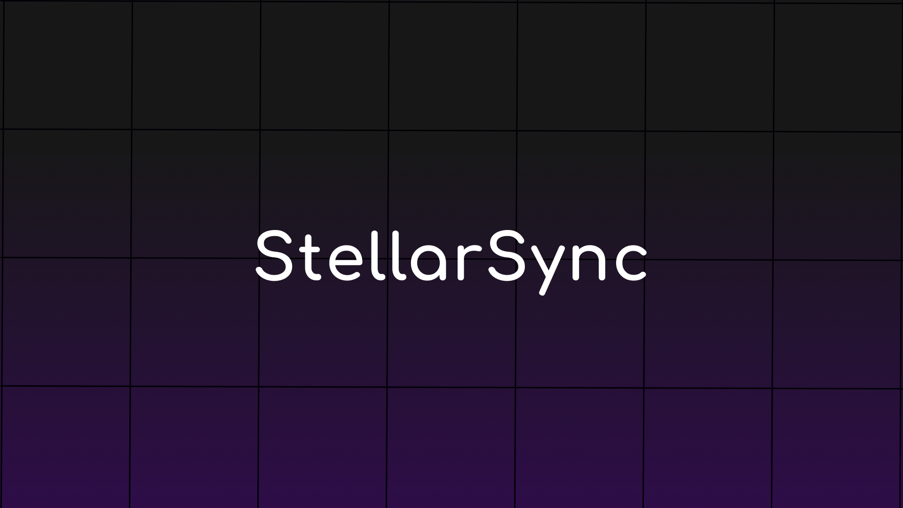


StellarSync

Slide 2
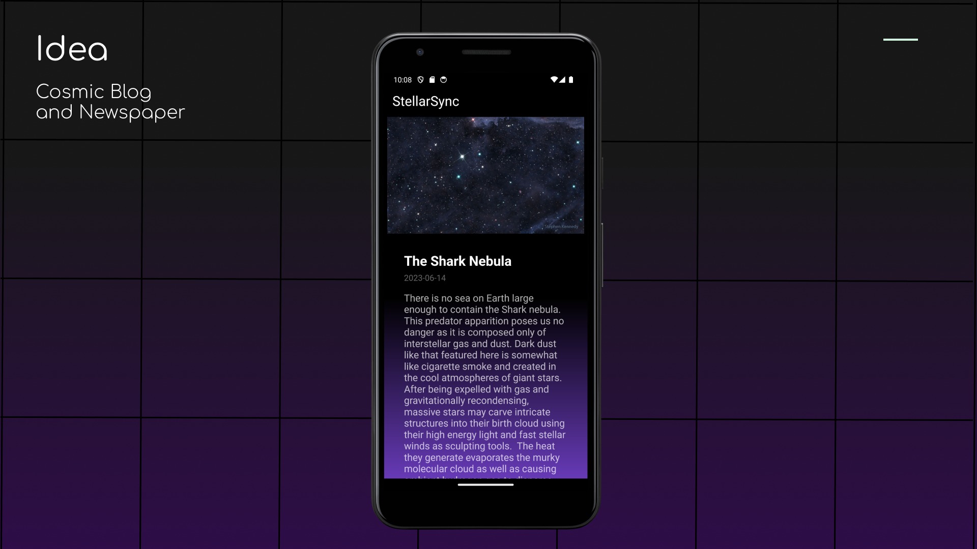


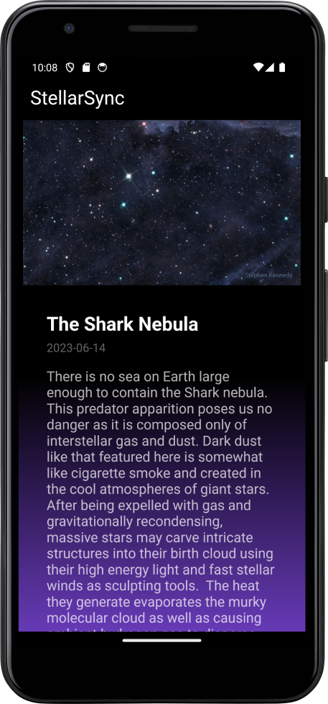
Idea
Cosmic Blog and Newspaper

Slide 3
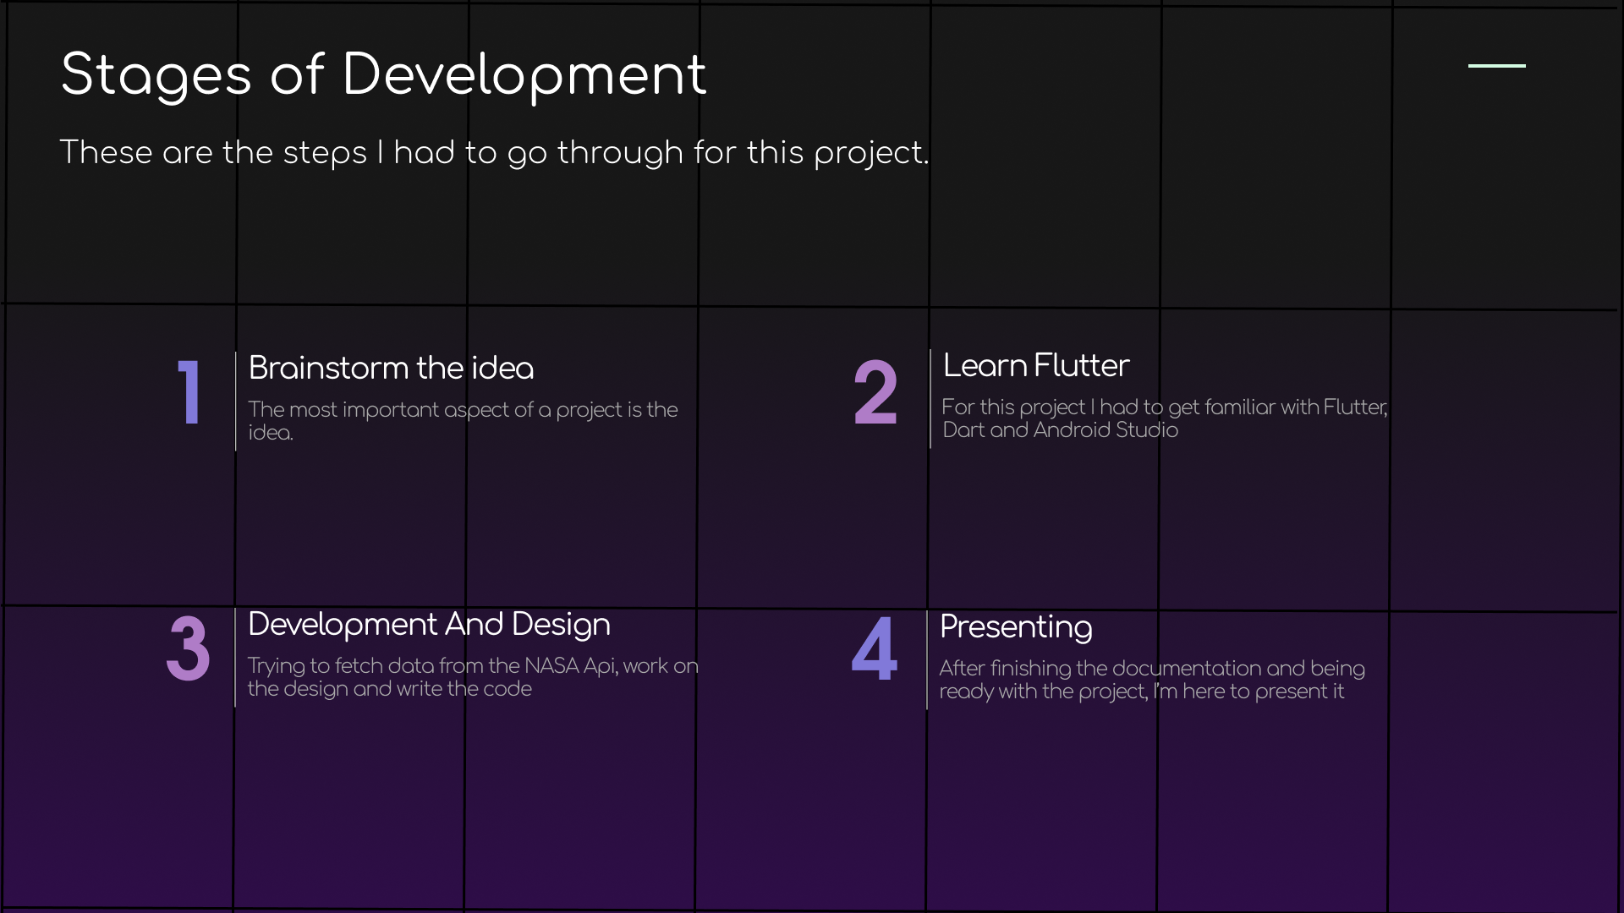


Stages of Development
These are the steps I had to go through for this project.
1
2
Brainstorm the idea
Learn Flutter
The most important aspect of a project is the idea.
For this project I had to get familiar with Flutter, Dart and Android Studio
3
4
Development And Design
Presenting
Trying to fetch data from the NASA Api, work on the design and write the code
After finishing the documentation and being ready with the project, I’m here to present it

Slide 4
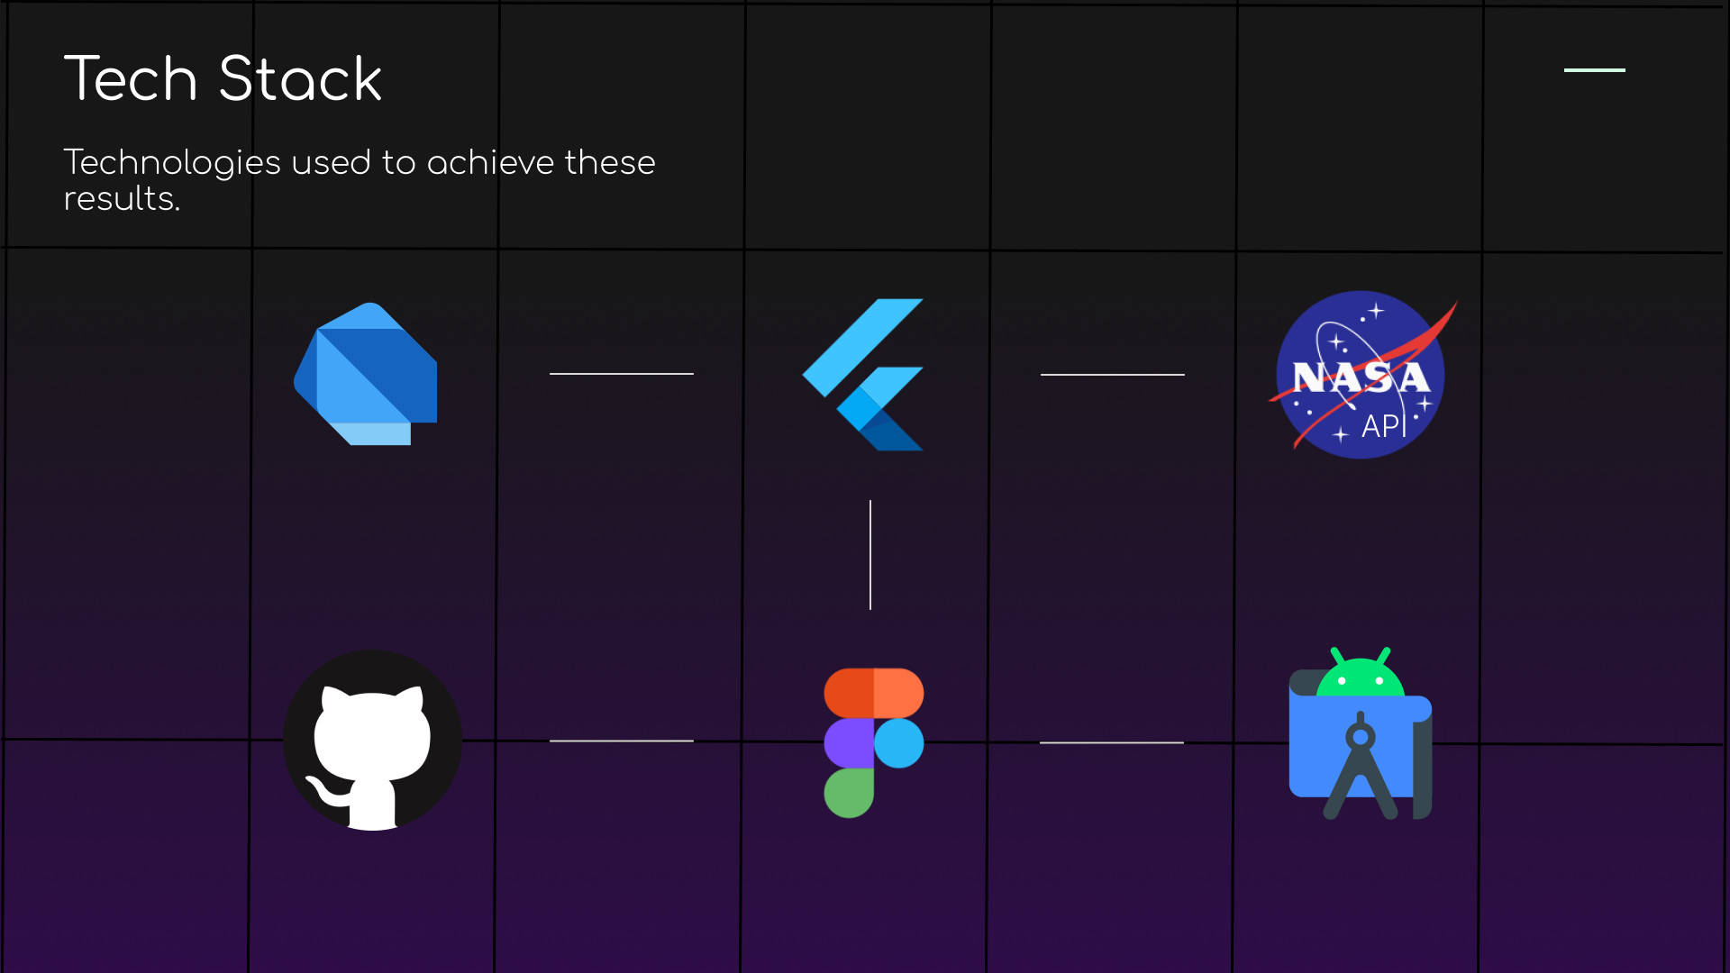







Tech Stack
Technologies used to achieve these results.
API

Slide 5
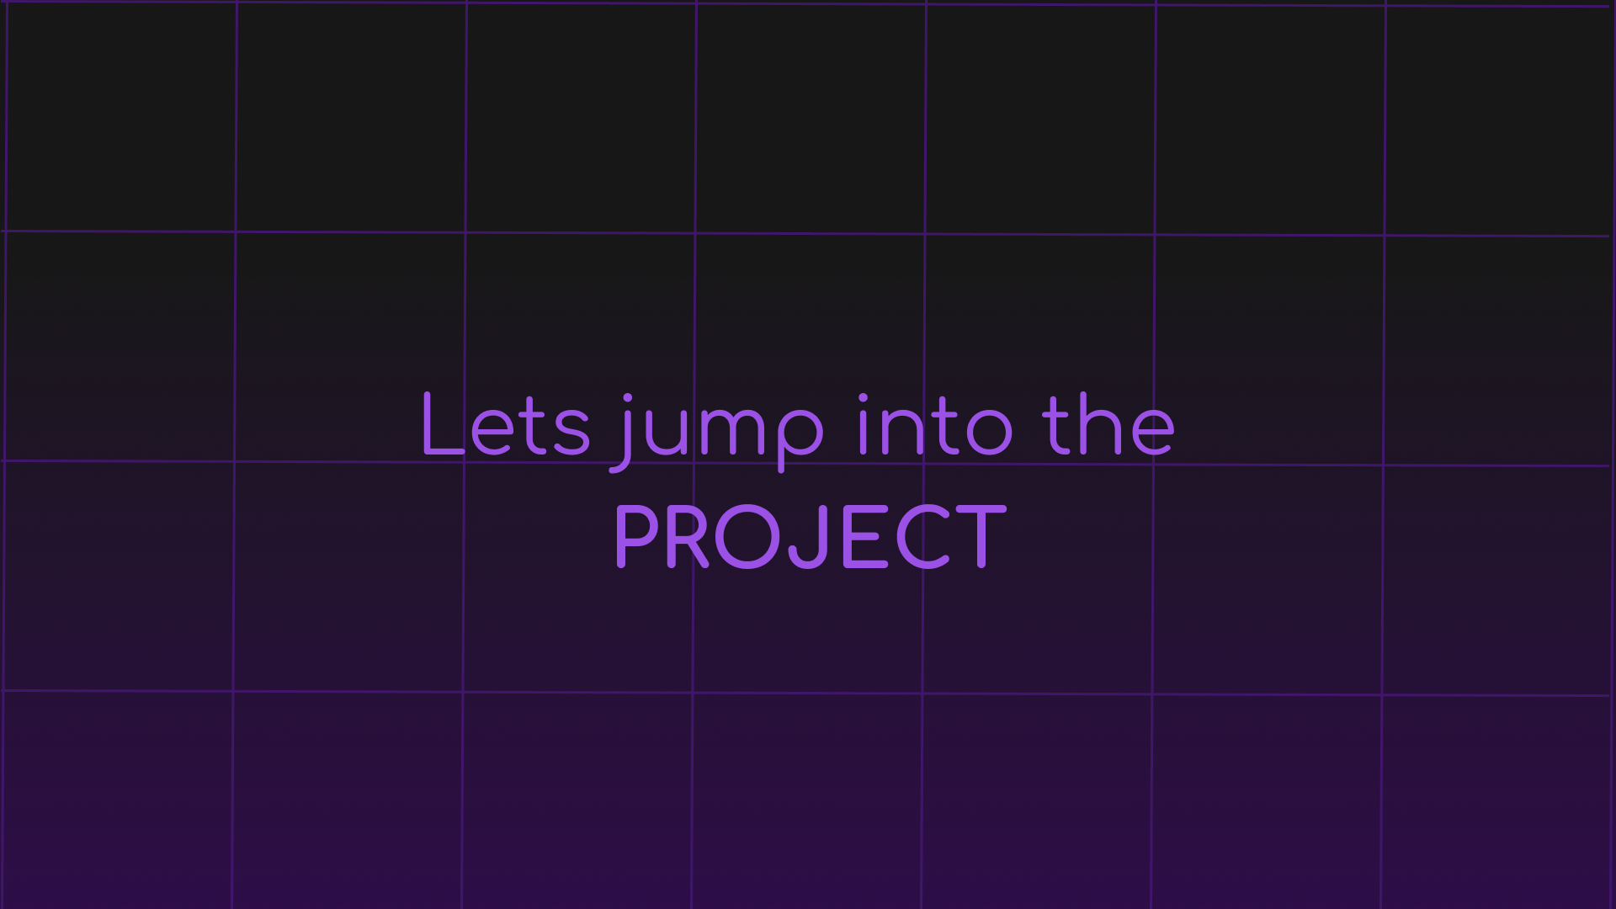


Lets jump into the PROJECT

