Slide 1
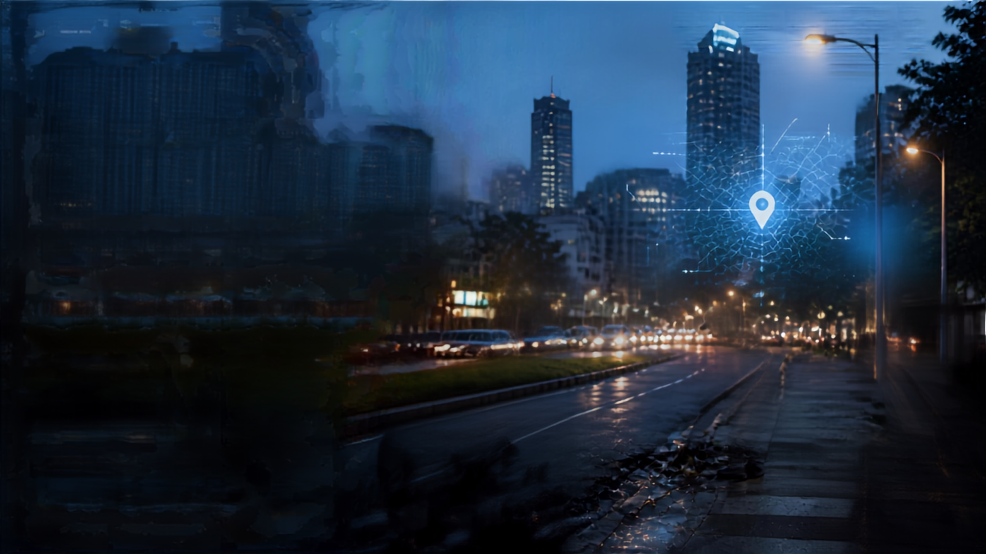








CIVIC GUARDIAN
AI-Powered Community Problem Solving Platform
Report. Solve. Improve Our City Together.
R Anbuselvan
G A Sethupathi
P Pon madasamy
CSE(AIML)
Sri Sairam Engineering College

Slide 2

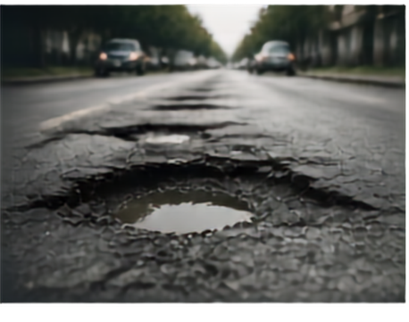
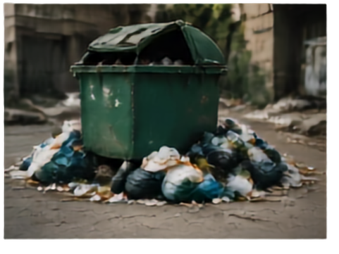



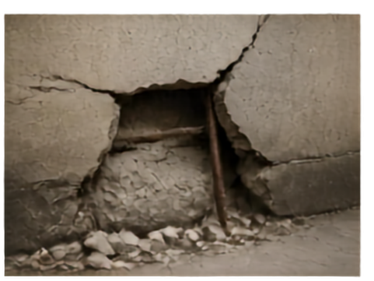
PROBLEM
STATEMENT
Civic problems are everywhere and impact daily life.
Reporting and coordination are slow and inefficient.
Issues remain unresolved due to gaps in reporting, tracking, verification and communication.
Communities need a smart platform that connects citizens, AI and authorities to identify and resolve problems efficiently.

Slide 3
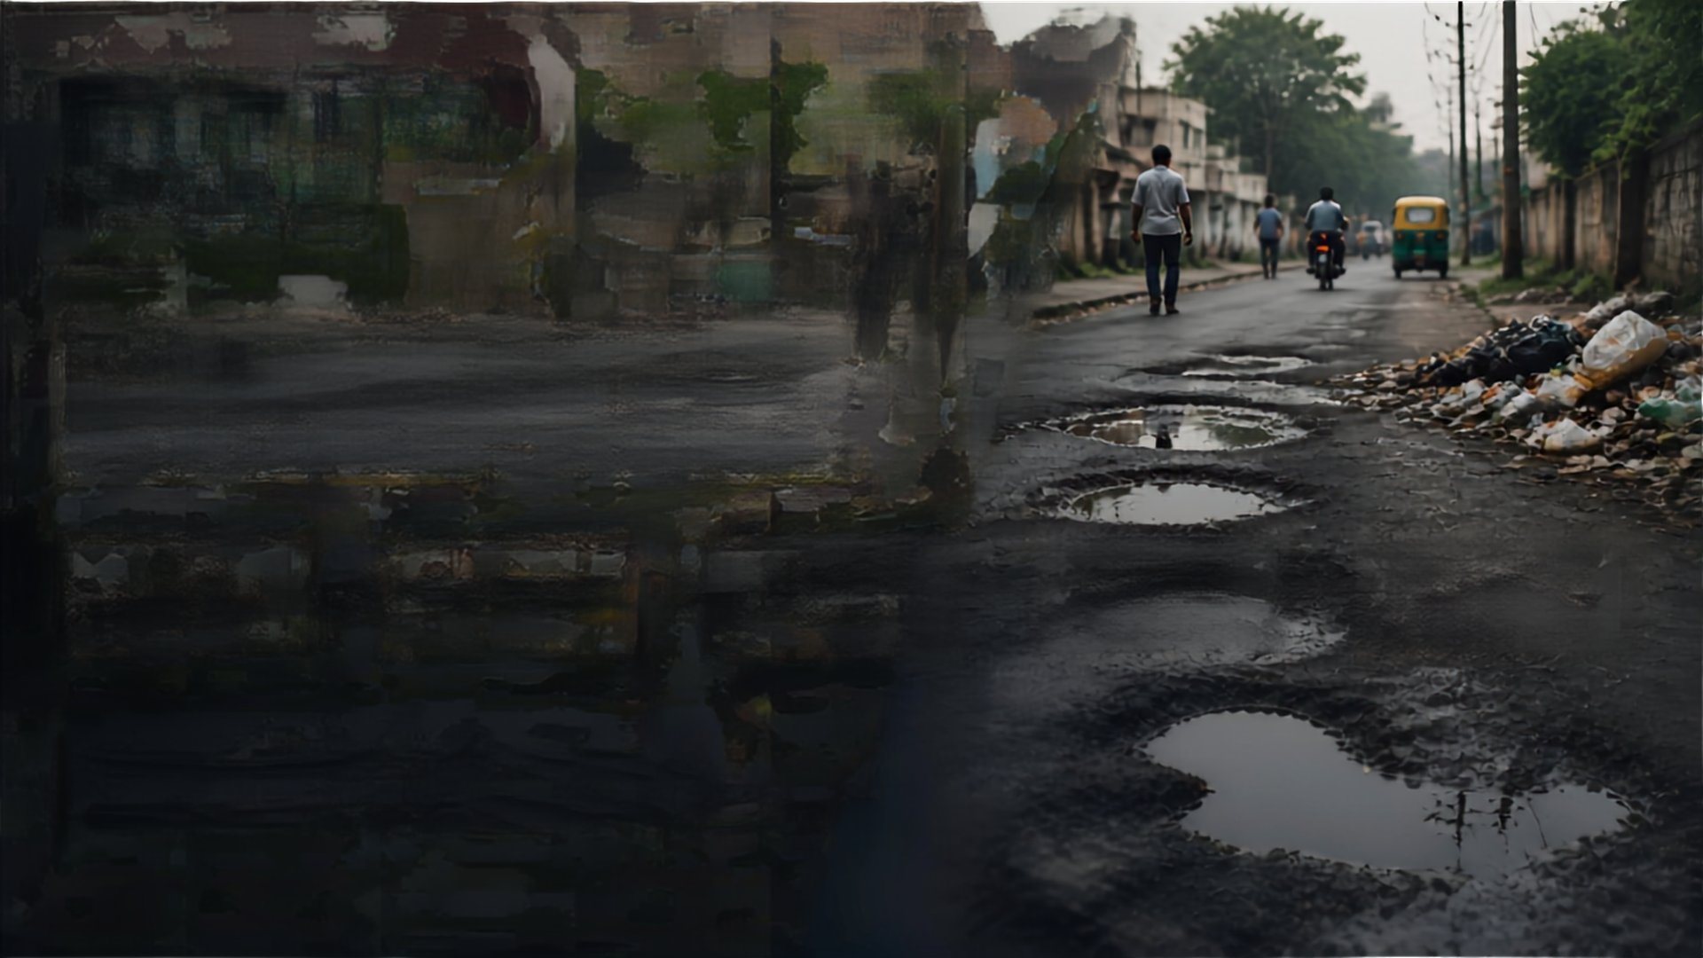










EFFECT ON
PEOPLE
Everyday civic problems disrupt daily life and impact everyone. They lead to inconvenience, safety risks, and waste of resources. Ignored issues make our city less livable and more stressful. Small problems today can become bigger challenges tomorrow.
CIVIC PROBLEMS
SAFETY RISKS
RESOURCE WASTAGE
POOR URBAN ENVIRONMENT
INCONVENIENCE
“A small civic issue, when ignored,
can become a major problem for the community.”

Slide 4





















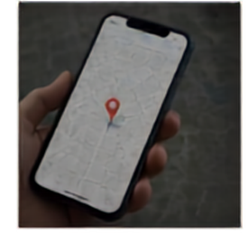

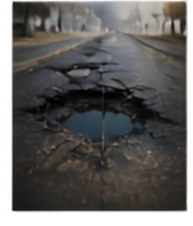
PROPOSED
SOLUTION
Civic Guardian is an AI-powered civic issue reporting and community problem-solving platform that connects citizens, communities and local authorities.
01
02
03
04
05
06
07
08
REPORT
GPS LOCATION
AI DETECTION
DUPLICATE & PRIORITY DETECTION
COMMUNITY RESOLUTION
PROOF OF RESOLUTION
AI VERIFICATION
REWARDS & RECOGNITION
CIVIC IMPACT SCORE
ranks contributors based on verified resolutions, problem severity and community impact.

Slide 5
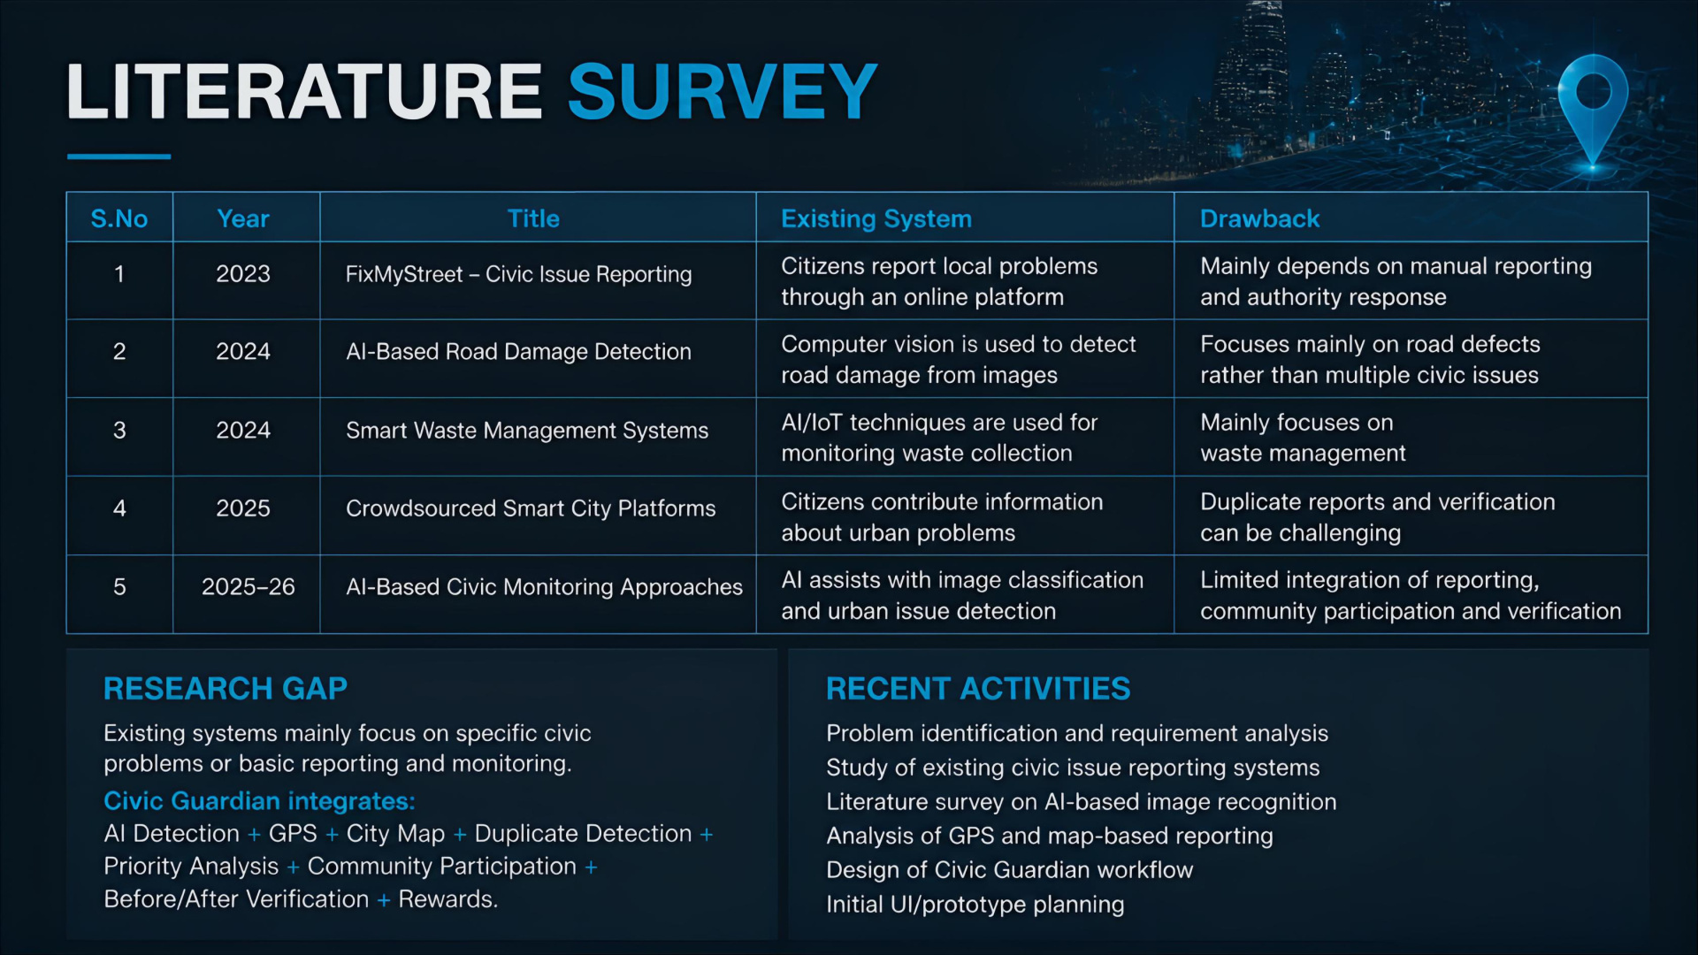

Slide 6









THANK YOU
Report. Solve. Improve Our City Together.
Smarter communities start with every report
AI-powered solutions for faster results
Stronger coordination for lasting change
Let’s build safer, cleaner, and more responsive cities.
Let’s continue the conversation.

