Slide 1

Objectives
In this session, you will learn to:
  Create and manage indexes
Notes:
Begin the session by sharing the objectives with the students.

Slide 2
Identifying Type of Indexes
Flash presentation: Implementing Indexes
Index:
  Is a data structure associated with a table
  Enables quick access to data
  Accelerates queries that join tables, and perform sorting and grouping
  Can be used to enforce uniqueness of rows
  Contains a collection of keys and pointers stored in B-Tree in the memory
Notes:
In this topic, you need to explain the concept of indexes to the students. While teaching the topic, you need to stress on the following points:
Importance of naming conventions while creating indexes.
Advantages of using indexes.
Creating appropriate indexes for appropriate columns.
Mention that indexes are used to speed up queries and are created on columns that are used in joins, the WHERE clause, the ORDER BY clause, or the GROUP BY clause.
Additional Inputs
If a primary key constraint is not created, then a unique clustered index can be used to implement the primary key and entity integrity. However, a foreign key constraint cannot reference such a column since a primary key constraint is not defined. However, in such cases, referential integrity can be implemented from the child table by using a trigger.
Creating multiple indexes on a column is not a good practice.
Indexes created by creation of constraints like the Primary key or Unique cannot be dropped by using the DROP INDEX statement. To drop these indexes, you need to drop the constraint.
In a SELECT statement without a WHERE clause, indexes belonging to the column mentioned first in the select list are used.
A unique index enforces uniqueness on the column for which it is mentioned. If nulls are allowed, it will allow only one NULL. A second null value will become a duplicate. A unique index can be clustered or non-clustered, the default is clustered.
While creating an index, the FILLFACTOR can be mentioned. The FILLFACTOR is a percentage to which the leaf level pages of the index are filled up. Similarly, PAD INDEX can be used to mention the number of non-leaf level pages that are filled. PAD INDEX cannot be used without fillfactor. A separate percentage value cannot be mentioned for PAD INDEX as it takes the fillfactor value only.

Slide 3
Identifying Type of Indexes (Contd.)
Indexes are of two types:
  Clustered index: Sorts and stores the data rows in the table based on their key values.
  Nonclustered index: Contains the index key values and row locators that point to the storage location of the data but the physical order of rows is different.
Notes:
In this slide, you need to explain to the students about a clustered index and a nonclustered index. Do not provide details on the type of indexes as they will be discussed later in the slides.

Slide 4
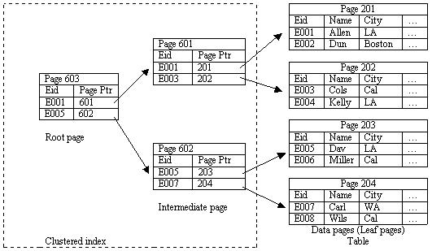
Identifying Type of Indexes (Contd.)
Working of a Clustered Index:
Notes:
In this slide, you need to explain how a clustered index searches for a particular string. You can refer to the Student Guide to explain the steps.

Slide 5
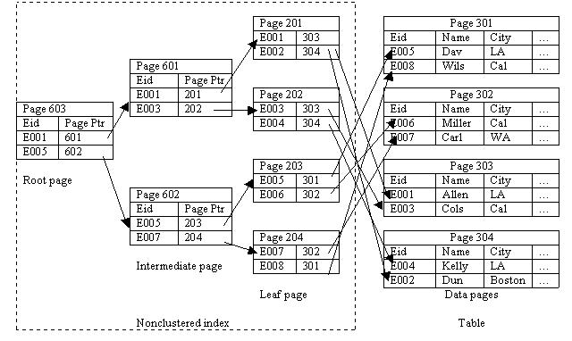
Identifying Type of Indexes (Contd.)
Working of a NonClustered Index:
Notes:
In this slide, you need to explain how a nonclustered index searches for a particular string. You can refer to the Student Guide to explain the steps.

Slide 6
Creating Indexes
Index:
  Is created on the most frequently queried column in tables or views
  Based on two or more columns is called a composite index
  Can be created by using the CREATE INDEX statement
Notes:
In this slide, you need to explain the guidelines to be followed while creating an index.

Slide 7
Creating Indexes (Contd.)
Syntax:
  CREATE [UNIQUE][CLUSTERED | NONCLUSTERED] INDEX
  index_name
  ON [{database_name.[schema_name]. | schema_name.}]
  {table_or_view_name}(column [ASC | DESC][,...n])
  [INCLUDE (column_name [,...n])]
  [WITH(<relational_index_option>[,...n])]
  [ON {partition_scheme_name(column_name[,...n])
  | filegroup_name | DEFAULT}]
Notes:
In this slide, you need to explain the syntax of the CREATE INDEX statement. In addition, you need to describe the various parameters of the CREATE INDEX statement.
In this session, you will not teach the topic on creating XML indexes (given in the book). However, you can ask the students to read the topic at home. The concept will not be tested in the MT.
CG Input: Before creating any index, please log on by using sa and execute the CreateTable.sql data file present in the Chapter 6\Instep Demo folder.

Slide 8
Creating Indexes (Contd.)
  <relation_index_option>::= {PAD_INDEX = {ON | OFF}
  | FILLFACTOR = fillfactor | SORT_IN_TEMPDB = {ON | OFF}
  | IGNORE_DUP_KEY = {ON | OFF}
  |STATISTICS_NO_RECOMPUTE = {ON | OFF}
  | DROP_EXISTING = {ON | OFF} | ONLINE = {ON | OFF}
Let’s see how…
Notes:
You can use the examples given in the Student Guide to clarify the concept to the students. Further, you can execute the following statements to explain the concept:
Example: CLUSTERED INDEX
CREATE CLUSTERED INDEX IX_EmployeeID
ON Employee (EmployeeID)
WITH FILLFACTOR = 10
Example: NONCLUSTERED INDEX
CREATE NONCLUSTERED INDEX IDX_Employee_ManagerID
ON Employee (ManagerID)

Slide 9
Creating XML Indexes
XML Index:
  Can be created on columns storing XML data values
  Supports indexing only on a single XML column
  Is of two types:
    Primary XML index
    Secondary XML index
Notes:
In this slide, you need to explain the concept the XML Indexes to the students.

Slide 10
Just a minute
Which type of index implements physical sorting of data?
Answer:
  Clustered index
Notes:
Reiterate the concepts taught earlier by asking the given question.

Slide 11
Just a minute
Which type of an XML index is created first on the table?
Answer:
  Primary XML index
Notes:
Reiterate the concepts taught earlier by asking the given question.

Slide 12
Just a minute
Which of the following is used to specify the percentage of space to be used for each index page?
  1. Fill Factor
  2. Pad Index
  3. Path Index
  4. Value Index
Answer:
  1. Fill Factor
Notes:
Reiterate the concepts taught earlier by asking the given question.

Slide 13
Managing Indexes
Involves:
  Disabling indexes
  Enabling indexes
  Renaming indexes
  Dropping indexes
  Optimizing indexes
Let’s see how…
Notes:
In this slide, you will explain how to disable, enable, rename, delete, and optimize indexes. You can use the examples given in the Student Guide to clarify the concept to the students. Further, you can execute the following statements to explain the concept:
Example: (Disabling indexes)
The following statement disables a nonclustered index, IdX_Employee_LoginID, on the Employee table:
ALTER INDEX IdX_Employee_LoginID
ON HumanResources.Employee DISABLE
Example: (Enabling indexes)
You can enable a disabled index by rebuilding it by using one of the following methods:
ALTER INDEX statement with the REBUILD clause
CREATE INDEX with the DROP_EXISTING clause
DBCC DBREINDEX
Example: (Renaming indexes)
The following statement renames the IX_JobCandidate_EmployeeID index in the JobCandidate table to IX_EmployeeID:
EXEC sp_rename 'HumanResources.JobCandidate.IX_JobCandidate_EmployeeID',
'IX_EmployeeID','index'
Example: (Dropping indexes)
The following statement drops the IX_JobCandidate_EmployeeID index in the JobCandidate table:
DROP INDEX IX_JobCandidate_EmployeeID
ON HumanResources.JobCandidate;
Example: (Optimizing indexes)
The following statement helps you identify an index that contains a high level of fragmentation in the Employee table:
SELECT a.index_id AS IndexID, name AS IndexName,
avg_fragmentation_in_percent AS Fragmentation
FROM sys.dm_db_index_physical_stats (DB_ID (N'AdventureWorks'),
OBJECT_ID ('HumanResources.Employee'), NULL, NULL, NULL) AS a
JOIN sys.indexes AS b on a.object_id = b.object_id and a.index_id = b.index_id ORDER BY Fragmentation DESC

Slide 14
Demo: Creating Indexes
Problem Statement:
  The production manager of the AdventureWorks, Inc. needs to frequently view data from the Product table in the Production schema. He needs to frequently search for data based on the product number.
  The Product table contains a large volume of data, and therefore the query takes time to execute. To reduce the time taken in the execution of the query, you need to suggest a solution to improve performance. For this, you need to check the performance of the query before and after applying the suggested solution.
Notes:
You need to ensure that after the end of this demo, the students are able to implement indexes in the tables.
To perform this demo, you need to provide the SHOWPLAN permissions to the user account that you are using to perform the demo.
CG Input: The table already contains an index on the ProductNumber column. The name of the index is AK_Product_ProductNumber. Therefore, before performing this demo, you need to ensure that you drop the existing index by executing the following statement:
DROP INDEX [AK_Product_ProductNumber] ON [Production].Product] WITH ( ONLINE = OFF )
In the task 3 of the demo, the execution plan will display an icon of a clustered index scan. You can inform the students that this index is applied on the ProductID column. However, an index is to be applied on the ProductNumber column.

Slide 15
Demo: Creating Indexes (Contd.)
Solution:
  To solve the preceding problem, you can apply an index on the column on which data is frequently searched. To apply an index, you need to perform the following tasks:
    1. Identify the column to be indexed.
    2. Enable the display of query execution plan.
    3. Check the I/O cost of the query.
    4. Create an index to improve performance.
    5. Verify the improvement in query execution.

Slide 16
Summary
In this session, you learned that:
  Indexes are created to enhance the performance of queries.
  There are two types of indexes, clustered and nonclustered.
  Indexes are created by using the CREATE INDEX statement
  Clustered indexes should be built on an attribute whose values are unique and do not change often. Data is physically sorted in a clustered index.
  In a nonclustered index, the physical order of rows is not the same as that of the index order.
  A nonclustered index is the default index that is created with the CREATE INDEX command.
Notes:
You can summarize the session with the help of the Summary given in the Student Guide.
In addition, you can ask the students to summarize what they have learned in this session.

Slide 17
Summary
  An XML index is built on columns with the XML data type.
  The common index maintenance tasks include disabling, enabling, renaming, and dropping an index.
Notes:
You can summarize the session with the help of the Summary given in the Student Guide.
In addition, you can ask the students to summarize what they have learned in this session.

