Slide 1

Rationale
A user interface is the means by which a user interacts with an application.
User interaction in a windows-based application is accomplished through Windows Forms and controls.
The purpose of GUI Applications Development Using .NET Framework is to provide the student with a hands-on environment in which they will learn the core skills of Microsoft Windows Forms application development.
Notes:
Share the rationale of the module with the students.

Slide 2
Objectives
In this session, you will learn to:
  Appreciate the graphical user interface
  Identify the controls of graphical user interface
  Identify the features of .NET Framework
  Use Visual Studio .NET integrated development environment to create and execute Windows projects
Notes:
Start the session by sharing the session objectives with the students.

Slide 3
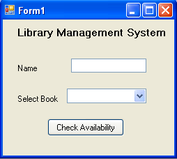
Introducing the GUI Environment
The two ways of interacting with an application are:
  By using Character User Interface (CUI)
  By using Graphical User Interface (GUI)
In CUI, the user interacts with a system by keying in commands.
The following figure shows the sample output of a CUI application.
A GUI provides a picture-oriented or graphical way of interacting with the system.
The following figure shows a sample output of a GUI application.
Enter your name: John
Enter a book name: Famous Five
Sorry, The book is not available.
Do you want to check for another book (y/n):
Notes:
Start the session by discussing the features of CUI based application. Ask the students to list down the possible disadvantages of CUI applications. Collate the answers given by the students and list down the following points:
The user needs to enter the data.
The user needs to remember the commands.
Lengthy code has to be written for simple tasks.
The display area is restricted to 25 rows and 80 columns.
Now take the discussion towards the GUI . Discuss the advantages of GUI as being WYSIWYG (What you see is what you get).
Discuss with the students that there are several controls available in GUI that can be used to take input from the user. This input can be validated easily.

Slide 4
Introducing the GUI Environment (Contd.)
Advantages of GUI applications are:
  They are easy to learn and use.
  Users need not remember the lines of syntax.
  Most of the commands can be executed using the mouse.
Notes:
Discuss the advantages of GUI applications listed here.

Slide 5
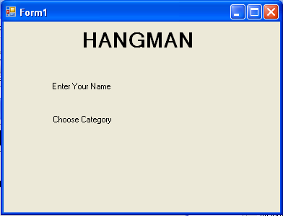
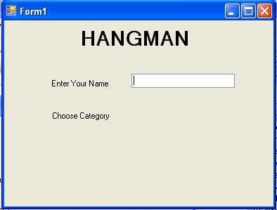
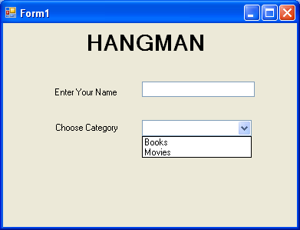
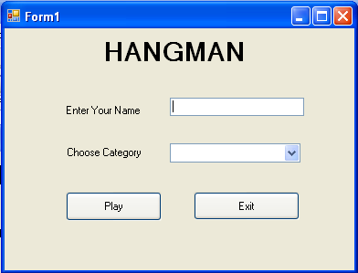
Identifying Controls of GUI Interface
A typical application screen contains components such as buttons and text boxes.
These components enable you to enter information and customize other parameters. These components are called controls.
The following figure shows a GUI application with various controls such as label, button, textbox, and combo box.
Label Controls
TextBox Control
ComboBox Control
Button Control
Notes:
Some of controls that appear in the dialog box are explained in the following list.
Label: Displays text that users cannot directly edit.
TextBox: Accepts input from the user.
Combo Box: Displays items in a drop-down list. It is a combination of a text box in which a user types something, and a drop-down list from which the user selects an item.
Button: Provides options such as OK, Cancel etc.
Discuss with the students that there are 2 types of components, visual and non-visual components. Visual components are the ones which the users can see. They are also called as controls.

Slide 6
Just a minute
A ____________ is a control that consists of other controls.
Answer:
  Container
Notes:
Reiterate the concepts taught earlier by asking the given question.

Slide 7
Identifying Controls of GUI Interface (Contd.)
Windows provides the following types of dialog boxes:
  Modal
  System modal
  Modeless
Notes:
Discuss all the three types of dialog boxes with the students with appropriate examples.
Example of:
Modal: Save As Dialog Box, that does not allow to move the control else where unless the user selects some option or closes the dialog box
System Modal : Windows Log On Dialog Box, that takes control of the entire Windows Environment.
Modeless: Find and Replace Dialog Box, that stays on screen and is available for use at any time.

Slide 8
Just a minute
Which dialog box allows users to switch to another area of the application?
Answer:
  Modeless Dialog Box
Notes:
Reiterate the concepts taught earlier by asking the given question.

Slide 9
Just a minute
A __________ acts as a container for a group of related controls.
Answer:
  Dialog box
Notes:
Reiterate the concepts taught earlier by asking the given question.

Slide 10
Identifying the Features of the Windows Environment
Two of the most important features of the Windows environment that enable applications to interact effectively with the user are:
  Event-Driven Programming:
    Based on user’s input, an event gets generated and the corresponding code is executed.
  Dynamic Linking:
    Windows application is linked to the existing library functions at run time.
Notes:
Using this slide, discuss with the students that all windows based applications accept the input and process the input on the basis of an event. Take a simple example of adding two numbers. For this application, the user enters two numbers in the text boxes. Only when he clicks on the button, will he be able to see the results of addition. Here, clicking of a button is an example of an event being generated.
Now proceed the discussion towards another example of Student’s Data Entry form. After entering all the values in the required fields, the user needs to ensure the data is transferred into the database. The code to transfer the database will be written on the click event of the button. Therefore, after entering the data, the user needs to click on the button to transfer the data to the database.
In addition, also discuss with the students that Windows Applications allow to link the application to the existing library function. For example, there is a library function to connect to the desired database where the user needs to just specify the name and location of database. Therefore, instead of writing the code again and again, the user can use the in-built function and connect to the database quickly.

Slide 11
The .NET Framework
The .NET offers a complete suite for developing and deploying applications.
This suite consists of the:
  .NET Products
  .NET Services
  .NET Framework
Microsoft has introduced Visual Studio .NET, which is a tool for developing .NET applications by using programming languages such as Visual Basic, Visual C#, and Visual C++.
These products aim at allowing developers to create numerous applications.
Notes:
Discuss with the students that .NET is a product that developers can use to easily build, debug, and deploy powerful applications. Visual Studio .NET includes a range of new features and enhancements for every type of developer, and offers key improvements directed at mobile device developers and enterprise developers.
The advantages of using Visual Studio .NET are:
It helps create powerful applications quickly and effectively.
Applications can span any platform or device.

Slide 12
The .NET Framework (Contd.)
The .NET offers a complete suite for developing and deploying applications.
This suite consists of the:
  .NET Products
  .NET Services
  .NET Framework
Microsoft has come up with its own set of Web services, known as My Services. These services are based on the Microsoft Passport Authentication service, which is used in Web applications such as Hotmail.
This service allows users to access data by linking calendars, phonebooks, address books, and personal references to the passport authentication service.

Slide 13
The .NET Framework (Contd.)
The .NET offers a complete suite for developing and deploying applications.
This suite consists of the:
  .NET Products
  .NET Services
  .NET Framework
It is the foundation on which you design, develop, and deploy applications.
It is a consistent and simplified programming model that helps you to easily build robust applications.

Slide 14



Components of the .NET Framework
The following figure shows the different components of the .NET Framework.
CLR is the environment where all programs using .NET technologies are executed.
The CLR allows the execution of code across different platforms by translating code into Intermediate Language (IL).
IL is a low-level language that the CLR understands.
At the presentation layer, .NET provides three types of user interfaces. They are Windows Forms, Web Forms, and Console Applications.
The .NET Framework class library works with any .NET language, such as VB.NET, VC++ .NET, and VC#.
The .NET Framework class library comprises namespaces, which are contained within assemblies.
Notes:
Using this slide, discuss with the students that .NET Framework consists of 3 different components. Discuss each of the components one by one. Try to give an example of the components.

Slide 15
Components of the .NET Framework (Contd.)
Some of the advantages offered by the .NET Framework are:
  Consistent programming model
  Multi-platform applications
  Multi-language integration
  Automatic resource management
  Ease of deployment
Notes:
Using this slide discuss the advantages of .NET framework

Slide 16
Using Visual Studio .NET IDE
The Visual Studio .NET IDE provides you with a common interface for developing various kinds of applications.
The IDE also provides you with a centralized location for designing the user interface for an application, writing code, and compiling and debugging the application.
Let us see the various components of .NET IDE.
Notes:
Using this slide discuss the .NET IDE with the students. An effective way of explaining the IDE to the students will be to open the .NET windows application project and discuss each of the components including:
Windows Form Designer
Code Window
Toolbox
Properties Window
Solution Explorer Window
Error-view Window
Output Window
And the menu and toolbars available within the IDE.
The faculty should also discuss the following templates in .NET:
Windows Application
Class Library
Windows Control Library
Console Application
Device Application
Crystal Reports Application

Slide 17
Just a minute
Which template creates a .NET Compact Framework 2.0 forms application for Pocket PC 2003 and later?
  1. Windows Control Library
  2. Class Library
  3. Device Application
  4. Web Control Library
Answer:
  3. Device Application
Notes:
Reiterate the concepts taught earlier by asking the given question.

Slide 18
Just a minute
Which window displays messages for the status of various features provided in the Visual Studio .NET IDE?
Answer:
  The Output Window
Notes:
Reiterate the concepts taught earlier by asking the given question.

Slide 19
Just a minute
Which window allows to view the resources of the servers, such as services, processes, and the event log.
Answer:
  The Server Explorer window
Notes:
Reiterate the concepts taught earlier by asking the given question.

Slide 20
Navigational Features in Visual Studio .Net IDE
In addition to various windows, the Visual Studio .NET IDE also provides three navigational features.
These are:
  Docking
  Tabbed Navigation
  Auto Hide
Let us see these navigational features in the Visual Studio .NET IDE.
Notes:
While discussing the IDE, the faculty must also explain that .NET also provides three navigational features with almost all the windows. Demonstrate each of them for a better understanding of the features.

Slide 21
Creating Projects and Solutions
In Visual Studio .NET, an application can be made up of several files and folders.
To organize these files and folders efficiently, Visual Studio .NET has provided two types of containers:
  Projects
  Solutions
Let’s see how to create projects and solutions.
Notes:
The faculty must demonstrate the steps to create projects and solutions.

Slide 22
Compiling and Executing a Project
To compile and execute the application, you need to perform the following steps:
  1. Select Build→Build Solution or press F6 to compile the application.
  Select Debug→Start Debugging or press F5 to execute the application.
Notes:
While discussing the IDE, create a small form to demonstrate the IDE and at the same time build and execute the project so that the students are able to understand and remember the steps to do so.

Slide 23
Summary
In this session, you learned that:
  Windows provides a GUI, which enables a user to interact with the application by using graphical components.
  Windows provides three types of dialog boxes:
    Modal Dialog Box
    System Modal Dialog Box
    Modeless Dialog Box
  The .NET Framework consists of three main components:
    Common Language Runtime (CLR)
    The .NET Framework Class Library
    User and Program Interfaces
Notes:
You can summarize the session by using the summary given in the slides.
In addition, you can also ask students summarize what they have learnt in this session.

Slide 24
Summary (Contd.)
  The Visual Studio .NET IDE provides you with a common interface for developing various kinds of projects for the .NET Framework.
  In Visual Studio .NET, an application can be made up of one or more items, such as files and folders.
  To organize these items efficiently, Visual Studio .NET has provided two types of containers, projects and solutions.
  In addition to various windows, the Visual Studio .NET IDE also provides three navigational features. These are:
    Docking
    Tabbed Navigation
    Auto Hide

