Slide 1

Objectives
In this session, you will learn to:
  Work with Windows Forms
  Work with the Windows forms controls
  Perform drag-and-drop operations using clipboard
Notes:
Students have already learnt the basic syntax and program structure in C#. They have already designed console based application. Now the students will be familiarized with windows based applications.
Start the session by sharing the session objectives with the students.

Slide 2
Introducing Windows Forms
Windows Forms is a representation of any window displayed in an application.
A form is used to accept input from a user and display the information entered.
When you create a new project for a Windows application, a form is automatically added to the project. This form has the default name Form1.cs.
Every form in Windows is a class derived from the Form class of the System.Windows.Forms namespace.
Notes:
The students have already understood the difference in CUI and GUI applications. Also, they are aware of the advantages of the GUI applications as being more user friendly. Therefore, the faculty should start the session with the same concept of designing GUI applications. In order to design these applications the students require Windows Form. This is a container that can contain other controls such as a label, textbox, button, list box etc.
Explain the concept of form by taking a real life example. Compare this with the Admissions form to be filled by students to take admission in a university. Discuss with the students, that each students is handed over a similar form to be filled. This reduces the ambiguity, as otherwise each student will write details at their own will. This will make it difficult for the Admissions department to extract the required information.
Explain to the students that a form is added by default when a new windows application project is opened. The students can customize this form according to their requirements.

Slide 3
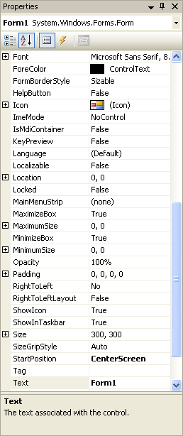
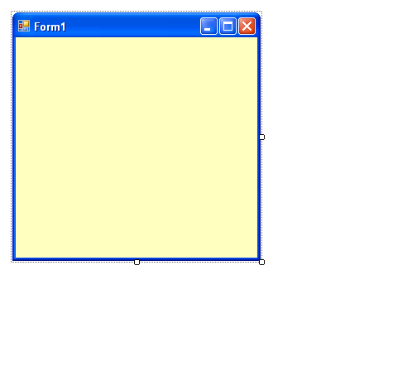
Windows Forms Properties
Windows Forms properties are used to determine its appearance at run time.
Font property specifies the style, size, and type of font for the text to be displayed on various controls in a form.
Backcolor property specifies the background color of the form.
Size property is used to specify the height and width of a form.
StartPosition property is used to specify the position of the form on the screen.
Text property is used to specify the caption to be displayed in the title bar of a form.
Notes:
To customize the form, the students can use several properties of the forms. Some of these properties have been displayed here.

Slide 4
Windows Forms Methods
Windows Forms methods enable you to perform various tasks, such as opening, activating, and closing the form.
Some of the methods are:
Form1 frmObj = new Form1();
frmObj.show();
frmObj.hide();
frmObj.Activate();
frmObj.Close();
// Is used to display a form.
Notes:
Besides properties, a Form control also has various methods that can be used to customize an application according to customer’s requirements. Here the faculty must display a demo form that helps the students to understand the way properties, methods, and events can be attached to a form.
The faculty can also display the purpose of the methods such as show(), hide(), close(), activate().

Slide 5
Windows Forms Methods (Contd.)
Windows Forms methods enable you to perform various tasks, such as opening, activating, and closing the form.
Some of the methods are:
Form1 frmObj = new Form1();
frmObj.show();
frmObj.hide();
frmObj.Activate();
frmObj.Close();
// Is used to hide a form.

Slide 6
Windows Forms Methods (Contd.)
Windows Forms methods enable you to perform various tasks, such as opening, activating, and closing the form.
Some of the methods are:
Form1 frmObj = new Form1();
frmObj.show();
frmObj.hide();
frmObj.Activate();
frmObj.Close();
// Is used to activate a form and set the focus on it.

Slide 7
Windows Forms Methods (Contd.)
Windows Forms methods enable you to perform various tasks, such as opening, activating, and closing the form.
Some of the methods are:
Form1 frmObj = new Form1();
frmObj.show();
frmObj.hide();
frmObj.Activate();
frmObj.Close();
// Is used to close a form.

Slide 8
Windows Forms Events
An event is generated when a user performs an action, such as clicking the mouse or pressing a key.
You can specify the action to be performed on the occurrence of an event within a special method called, event handler.
While the user needs to call the methods explicitly, the code within the event handler method gets executed as soon as the event gets generated.
The common events used in a form are:
  Click
  FormClosed
  Deactivate
  Load
  MouseMove
Notes:
In GUI programming, the most important thing is an event. Events can be used to perform an action. The faculties must explain to the students that all the controls have various events attached to them. For example, display a simple form to the students that is being to add two numbers. While creating this form do not insert any buttons. Insert only 3 labels and 3 textboxes ( to accept 1st number, 2nd number, display result).
Now insert numbers in the 1st and 2nd textbox.
After this ask the students, how will they be able to see the result. Collate the answers from the students.
Now add a button to the form and create code in the click event of the button.
With this example, you can discuss the importance of the events in a GUI application.

Slide 9
Working with Windows Forms Controls
A control is a component used to accept input from a user or display some information on a form.
Each control has its own set of properties, methods, and events that make it suitable for a particular task.
You can set the properties of a control during design time by using the Properties window.
You can also set the properties of a control at run time by writing code.

Slide 10
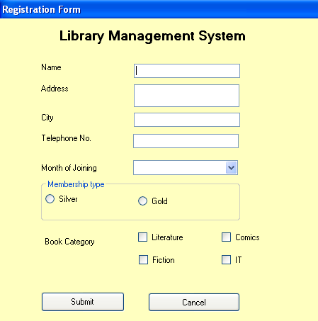
Working with Windows Forms Controls (Contd.)
Let us identify the various controls on a form.
Label Controls
TextBox Controls
ComboBox Control
RadioButton Control
GroupBox Control
CheckBox Controls
Button Control
Notes:
The faculty must demonstrate all the commonly used controls with the help of a form. These have been shown in the given figure.

Slide 11
Just a minute
Which of the following control serves as a repository for images?
  1. PictureBox
  2. ListView
  3. ImageList
  4. ListBox
Answer:
  3. ImageList

Slide 12
Control Events
The events associated with various controls are as follows:
  Keyboard events
  Mouse events
  Control-specific events
For example, KeyDown, KeyUp, KeyPress
For example MouseUP, MouseDown, MouseMove
For example Resized, VisibleChanged
Notes:
Explain to the students that there are three basic categories of events. These are keyboard, mouse, and control-specific events. The keyboard events are generated when the keyboard keys are pressed or released. The mouse events are generated when the mouse keys are pressed or released. Mouse events are also generated when the mouse is rolled over a control. The control-specific events are associated to a particular control.
You can write the following code to demonstrate one of the keyboard events:
Create a text box on the form n then write the following code in the KeyPress event of the form:
private void textBox1_KeyPress(object sender, KeyPressEventArgs e)
{
MessageBox.Show("keypressed");
}
You can write the following code to demonstrate one of the mouse events. This code needs to be written in the MouseUp event of the form.
private void Form1_MouseUp(object sender, MouseEventArgs e)
{
MessageBox.Show("MouseUp");
}

Slide 13
Dynamically Loading Controls in Windows Forms
The loading of controls at run time is called dynamic loading of controls.
Every control is a class derived from the System.Windows.Forms.Control class.
To add a control at run time:
  Create an instance of the control to be added.
  Set the properties of the control.
  Add the new control to the Controls collection of the parent control.
Let us see how a control is added at run time.
Notes:
Explain the concept of loading controls dynamically with the help of the following example:
The controls need to be dynamically loaded in an Order Detail Entry form. This is because one of the customer may have purchased five items while the other may have purchased 15 items. Now if the form contains only 10 text box controls to accept input, the user will not be able to enter details for all the items for the second customer in a single bill. He might have to create two bills. Therefore, to overcome such a problem, the user must have the flexibility to add as many text boxes as the number of items purchased by the customers at the run time.
In addition, the faculty must demonstrate an application that loads controls dynamically to the form.

Slide 14
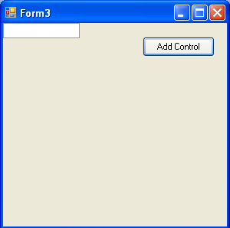
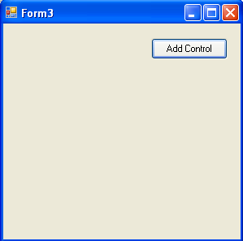
Dynamically Loading Controls in Windows Forms (Contd.)
For example, following code should be written to dynamically load a textbox control at the click of a button:
private void button1_Click(object sender, EventArgs e)
{
TextBox t1 = new TextBox();
this.Controls.Add(t1);
}

Slide 15
Just a minute
Write the steps, which need to be taken, while adding a control dynamically to a form.
Answer:
  1. Create an instance of the control to be added
  2. Set the properties of the control
  3. Add the control to the Controls collection of the parent control

Slide 16
Creating Event Handlers at Run Time
Creation of event handlers at run time is required if a control is added to a form at run time.
When you create an event handler at run time, you must first create a method that has the same parameters as the event that you want to handle.
You must then connect the event with code that specifies the handler for the event involved.

Slide 17
Demo: Working with Windows Forms Controls
Problem Statement:
  Create an application to accept a user name and a password through a startup screen. The application should check whether the login name is “sa” and the password is “callcenter”. The user should be provided with three login attempts. After three unsuccessful login attempts, the application should display an error message and close the screen.
Notes:
Use this and the next slide to create an application containing Windows Forms Controls. Discuss with the students the various controls, methods, and events that are added within the form application.

Slide 18
Demo: Working with Windows Forms Controls (Contd.)
Solution:
  To create a Login Form, you need to perform the following tasks:
    1. Create a new VC# application.
    2. Design the application form.
    3. Add code to validate the user input.
    4. Execute the application and verify the output.

Slide 19
Performing Drag-and-Drop Operation Using Clipboard
The drag-and-drop function enables you to drag an item from one location to another in an application.
Notes:
Before discussing this topic with the students, the faculty must demonstrate the drag-and-drop operation using any of the Windows based application such as wordpad or notepad.
Although the students would have already worked with the clipboard while working with MS-Word or MS-Exccel, the faculty should also discuss the features of clipboard with the students.
Using this and the next two slides, explain to the students that they can use a clipboard in their VC# applications with the help of Clipboard functions.

Slide 20
The Drag-and-Drop Operation Events
The events that need to be handled by the Windows Forms application to perform drag-and-drop operation are as follows:
  ItemDrag
  DragEnter
  DragOver
  DragDrop
  DragLeave
  GiveFeedback
Notes:
The faculty must also discuss these Drag-and-Drop operation events with the students.

Slide 21
The Drag-and-Drop Operation Phases
To perform the drag-and-drop operation, the user has to perform a series of steps. These steps are:
  1. Initiate the drag-and-drop operation for a control by calling the DoDragDrop() method from the MouseDown or the ItemDrag event of the control.
  2. Handle the events to provide information about the
  drag-and-drop operation to the user. These events include DragEnter, DragLeave, and GiveFeedback.
  3. To enable the destination control to accept the dropped data, set its AllowDrop property to true.
  4. Write code in the DragDrop event of the destination control specifying how the dropped data should be handled.
Notes:
Before discussing this topic with the students, the faculty must demonstrate the drag-and-drop operation using any of the Windows based application such as wordpad or notepad.
Although the students would have already worked with the clipboard while working with MS-Word or MS-Exccel, the faculty should also discuss the features of clipboard with the students.
Using this and the next two slides, explain to the students that they can use a clipboard in their VC# applications with the help of Clipboard functions.

Slide 22
Providing Clipboard Support in a Windows Form Application
Clipboard acts as a temporary storage area for any application running on Windows operating system.
The Clipboard function can be incorporated in a VC# application by using the methods provided by the System.Windows.Forms.Clipboard class.
The three different operations associated with the clipboard are:
  Storing data on clipboard
  Identifying the type of data on clipboard
  Retrieving data from clipboard
To do so, use methods such as SetAudio(), SetData(), SetImage()
To do so, use methods like ContainsAudio(), ContainsData(), ContainsImage()
To do so, use methods like GetAudioStream(), GetData(), GetImage()

Slide 23
Just a minute
Which event occurs when a user drags an item in a TreeView or ListView control?
  1. DragEnter event
  2. DragOver event
  3. GiveFeedback event
  4. ItemDrag event
Answer:
  4. ItemDrag event

Slide 24
Performing Drag-and-Drop Operation Between Applications
The following code will help the user to enter text in a WordPad file and drag the text in the TextBox control on his form:
private void textBox1_DragEnter(object sender,DragEventArgs e)
{
if(e.Data.GetDataPresent(DataFormats.Text))
e.Effect = DragDropEffects.Copy;
else
e.Effect = DragDropEffects.None; }
Notes:
For the following example to be functional, you need to add a text box control named textBox1 to the form and write the given code in the corresponding textbox events

Slide 25
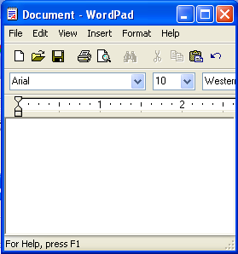
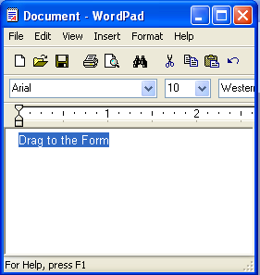
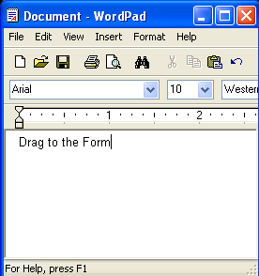
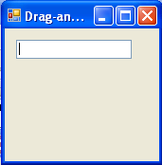
Performing Drag-and-Drop Operation Between Applications (Contd.)
private void textBox1_DragDrop(object sender, DragEventArgs e)
{
textBox1.Text = e.Data.GetData(DataFormats.Text).ToString();
}
Drag to the Form

Slide 26
Demo: Performing the Drag-and-Drop Operation
Problem Statement:
  Create an application to use the drag-and-drop feature of VC#. Use the TextBox and TreeView controls as the source of data and the ListBox control as the destination.
  How will you create the application?
Notes:
Use this and the next slide to discuss the concept of drag-and-drop operations. Ask students to provide examples of different applications where these drag-and-drop operations can be used.

Slide 27
Demo: Performing the Drag-and-Drop Operation (Contd.)
Solution:
  To create an application to demonstrate the drag-and-drop operation, you need to perform the following tasks:
    1. Create a new VC# application.
    2. Design the application form.
    3. Add code to perform the drag-and-drop operation.
    4. Execute the application and verify the output.

Slide 28
Summary
In this session, you learned that:
  A form is used to accept input from a user and present information to the user.
  A form has many properties, methods, and events.
  An event gets generated on performing an action such as clicking the mouse or pressing a key from the keyboard.
  When an event is raised, code within the event handler is executed.
  Controls can be added to a form to accept input from the user or display some information on the form.
  Some commonly used controls are the TextBox, Label, CheckBox, RadioButton, and Button controls.
  Controls can be added either at design time or at runtime.
  The drag-and-drop function enables the user to move an item on a form from one location to another.
Notes:
You can summarize the session by using the summary given in the slides.
In addition, you can also ask students to summarize what they have learnt in this session.

Slide 29
Summary (Contd.)
  There are various events that need to be handled to support the drag-and-drop operation in an application. These events are:
    ItemDrag event
    DragEnter event
    DragOver event
    DragDrop event
    DragLeave event
    GiveFeedback event
  Clipboard is the temporary repository of data.
  The Clipboard function can be incorporated in the application by using the methods provided by the System.Windows.Forms.Clipboard class.

