Slide 1


Dev 03
TRI-NIT Hackathon
Development track: All things Green
Team name: 594092-U2JVL824
College name: Thiagarajar college of engineering, Madurai

Slide 2
Introduction
Team Info
Table of Contents
Problem Statement
Objective
Solution
Details of Product Demo
Understanding Market
Resources
Conclusion

Slide 3

Tech Farming
Introduction
Humans in this world are dedicated to promote sustainability and eco-friendly activities.
Farmers play an important part in maintaining the balance.
Turning things into green to reduce environmental issues.
Farming with latest technologies will improve this world.
It includes use of machineries to increase the productivity.

Slide 4

Sachin Kamaraj K
2nd yr B.Tech CSBS
Coding & Presentation
sachink@student.tce.edu
Vaseekaran M
2nd yr B.Tech CSBS
Team Info
Coding & Presentation
vaseekaran@student.tce.edu
Shrinivas S
2nd yr B.Tech CSBS
Coding & Presentation
shrinivass@student.tce.edu

Slide 5
Problem Statement
Build a one-stop solution for all gardening aspirations and the country’s farmers.
The government of India sends millions of dollars to provide schemes and educate the country's farmers
Similarly, many nature enthusiasts want to start gardening in many metropolitan cities but need more experience.
We intend to provide a solution for everyone interested in getting to know plants.

Slide 6
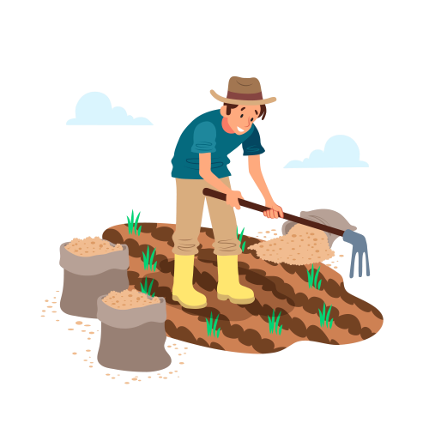
Objective
Create a central platform that connects farmers from all over India with the latest advancements in agricultural technology.
Utilise GPS location to suggest crops for farmers to grow based on their specific field and family information.
Provide information on available schemes and programs from the central and state governments.
Educate farmers on various hybrid farming methods and technology.
Include a chat system for farmers to communicate with each other and with experts in the field.

Slide 7
