Slide 1


Department of Computer Science and Engineering
REAL-TIME SERVER FAILURE PREDICTION USING RANDOM FOREST AND MACHINE LEARNING TECHNIQUES
Mrs. M. Divya M.E.
SUPERVISOR
Assistant Professor
Department of Computer Science and Engineering.
Done By:
SADHANA A
(220701235)

Slide 2
Problem Statement and Motivation
Traditional IT systems detect server failures only after they occur, causing downtime and inefficiencies. Current monitoring tools are reactive, lacking predictive capabilities. This project aims to bridge that gap by creating a real-time dashboard that uses machine learning (Random Forest) to predict server failures from live performance data, enabling proactive maintenance and reducing disruptions. The solution enhances infrastructure resilience by enabling timely risk mitigation and smarter decision-making.

Slide 3
Existing System
Most current server monitoring systems operate on a reactive model, where issues are identified and addressed only after performance degradation or failures occur.
These tools typically rely on threshold-based alerts and manual log analysis, lacking the ability to predict future failures.
While they may display real-time metrics, they do not leverage machine learning to analyze trends or assess risk levels, resulting in delayed responses and increased downtime.

Slide 4
Objectives
Design a real-time web dashboard to monitor and display server performance metrics.
Train and integrate machine learning models (Random Forest) to predict server failure risks.
Simulate live data input using a time-updating CSV to mimic real-world server conditions.
Visualize prediction results with interactive and user-friendly charts using Chart.js.

Slide 5
Abstract
The Real-Time Server Failure Prediction Dashboard is a smart monitoring system that uses machine learning to predict potential server failures before they occur. By analyzing live server performance metrics from a simulated CSV source, the system employs trained Random Forest model to assess failure risks. Built with a Flask backend and a Bootstrap/JavaScript frontend, it features interactive visualizations using Chart.js, including real-time risk rankings and diagnostics. The dashboard provides up-to-date insights to support proactive maintenance. This project demonstrates the practical use of predictive analytics in IT infrastructure, aiming to reduce downtime and enhance operational efficiency.

Slide 6
Proposed System
Real-time Monitoring: A web-based dashboard displays server performance metrics using data from a simulated CSV source.
Failure Prediction: Machine learning models (Random Forest) analyze server metrics to predict potential failures.
Interactive Visualization: Chart.js is used to visualize risk levels, top high-risk servers, and diagnostic trends in a user-friendly way.
Timely Insights: The system provides regularly updated insights to support proactive server maintenance and risk management.

Slide 7
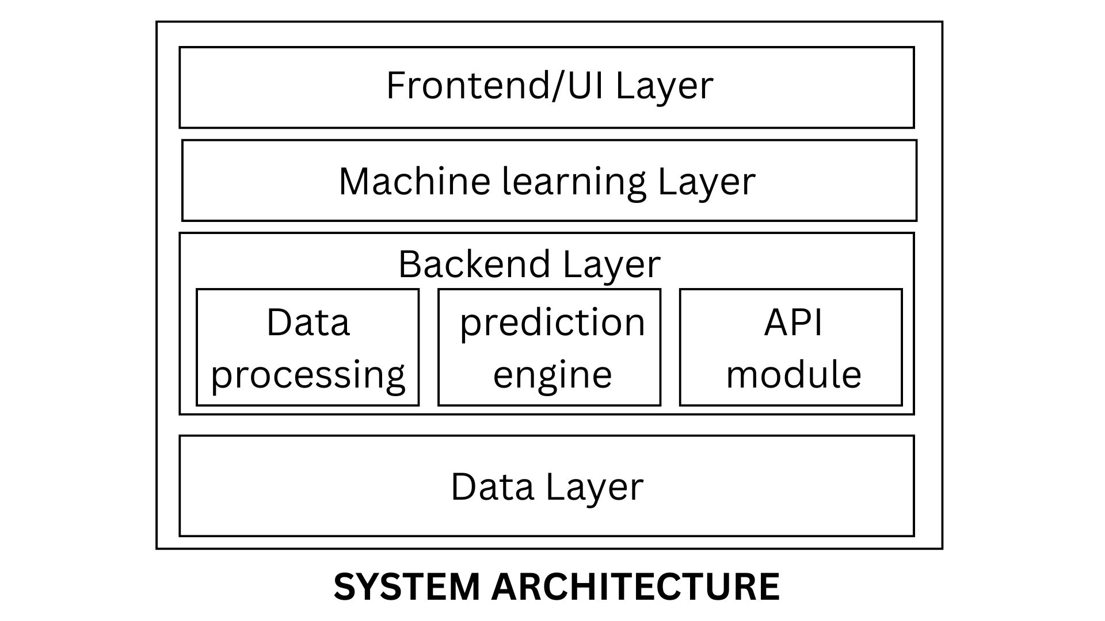
System Architecture

Slide 8
List of Modules
Data Handling Module
Ingests and preprocesses server performance data from a simulated CSV or API source.
Machine Learning Module
Loads trained Random Forest models.
Backend & API Module
Built with Flask to handle data routing, API endpoints, and communication between ML and frontend.
Visualization & UI Module
Displays interactive charts using Chart.js and a Bootstrap-based interface.

Slide 9
Functional Description for each modules with DFD and Activity Diagram
1. Data Handling Module
Functionality:
Cleans raw data, fills missing values, and performs feature extraction (e.g., CPU load, memory usage).
Prepares the data in the correct format for the ML model.
2. Machine Learning Module
Functionality:
Loads a pre-trained model (Random Forest/XGBoost).
Accepts preprocessed data and returns failure probability scores for each server.

Slide 10
Functional Description for each modules with DFD and Activity Diagram
3. Backend & API Module
Functionality:
Uses Flask to route data between frontend and backend.
Provides RESTful API endpoints to serve predictions and processed server data.
Manages model inference requests and response handling.
4. Visualization & UI Module
Functionality:
Uses Bootstrap and JavaScript (Chart.js) to create an interactive dashboard.
Displays top risky servers, server failure probability rankings, and search-based diagnostics.

Slide 11
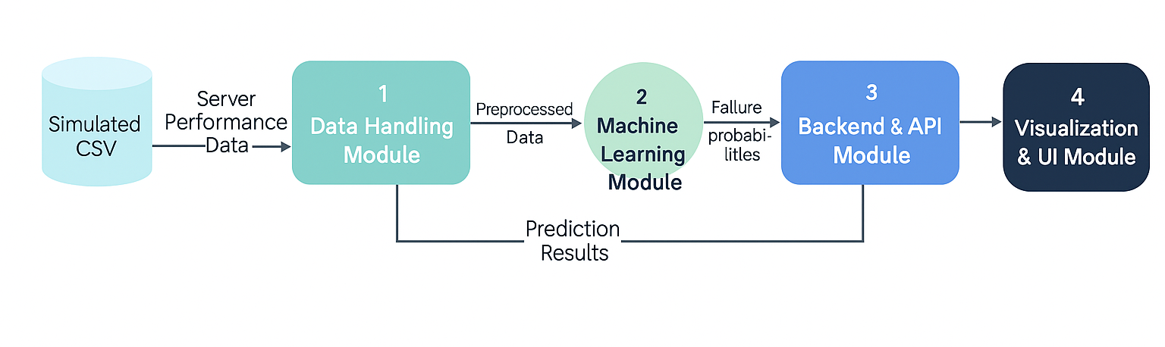
Functional Description for each modules with DFD and Activity Diagram

Slide 12
Implementation & Results of Module
Data Handling Module
Clean and consistent dataset generated for model input.
2. Machine Learning Module
Risk probabilities successfully assigned to each server.
3. Backend & API Module
Stable performance under simulated loads.
4. Visualization & UI Module
Displayed high-risk servers and ranked failure probabilities effectively.

Slide 13
Conclusion & Future Work
CONCLUSION:
The dashboard successfully predicts potential server failures using machine learning, enabling proactive IT maintenance and reducing unexpected downtime.
Its modular and scalable design ensures flexibility for future integration with real-time systems and larger server clusters.
FUTURE WORK:
Integrate live server APIs and real-time alert systems for fully automated monitoring and notifications.

Slide 14
References
REFERENCES
1. Gawali, M., Lalwani, M., Chetwani, M., Suryavanshi, P., & Anala, H. (2024). Predictive Maintenance of Server using Machine Learning and Artificial Intelligence. Journal of Electrical Systems, 20(5s), 2828–2833. Journal of Electrical Systems
2. Alhudhaif, A., Almaslukh, B., Aseeri, A. O., Guler, O., & Polat, K. (2023). A novel nonlinear automated multi-class skin lesion detection system using soft-attention based convolutional neural networks. Chaos, Solitons & Fractals, 170, 113409.

Slide 15
Thank You

