Slide 1
Predicting Seasonal Vaccines and H1N1
Vaccines Using Machine Learning Techniques
Sourav P. Adi – ASE - Accenture Solutions Pvt. Ltd.
Vivek B A – Strukton BHEL
Keshav V Bharadwaj – Mad Street Den

Slide 2
Need of Data Science in Medical Field
Medical Imaging – Helps in detecting Cancer, Tumor etc.
Pharmaceutical – Development of better drugs.
Predicting health conditions of individuals and act on the same.
and many more……
Sourav P. Adi, ASE

Slide 3
Problem Statement
To Predict whether people got H1N1 and seasonal flu vaccines based on their backgrounds, opinions, health behaviors etc.
The dataset was provided by US National Center for Health Statistics.
The data was collected through a telephonic survey jointly by NCIRD, NCHS, and CDC.
Each row in the dataset represents information about one individual participated in the survey.
Sourav P. Adi, ASE

Slide 4
EDA
Sourav P. Adi, ASE

Slide 5
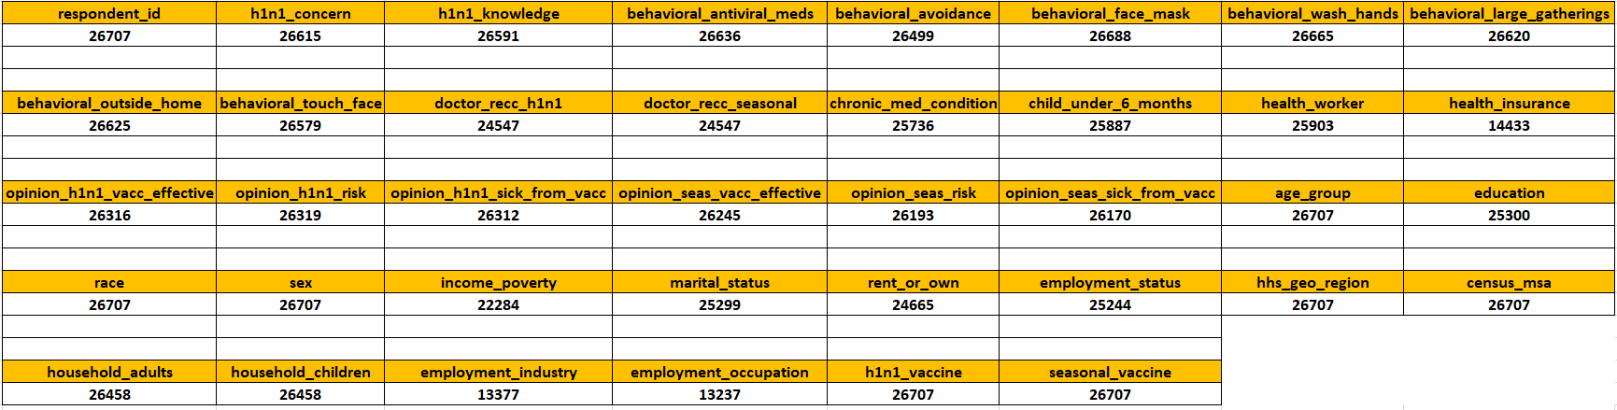
Data at a Glance
Sourav P. Adi, ASE

Slide 6
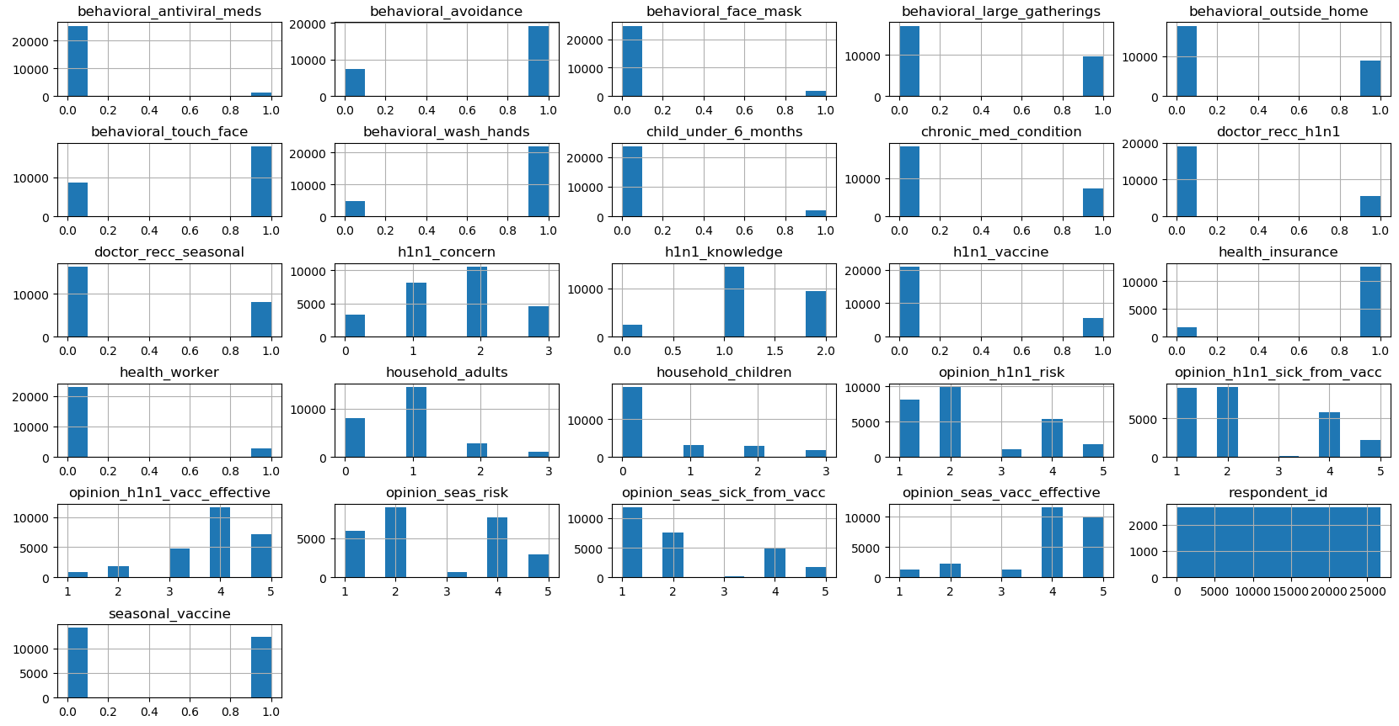
Data with plots
Sourav P. Adi, ASE

Slide 7
Correlation in Data
Click the button to view heatmap
Sourav P. Adi, ASE

Slide 8
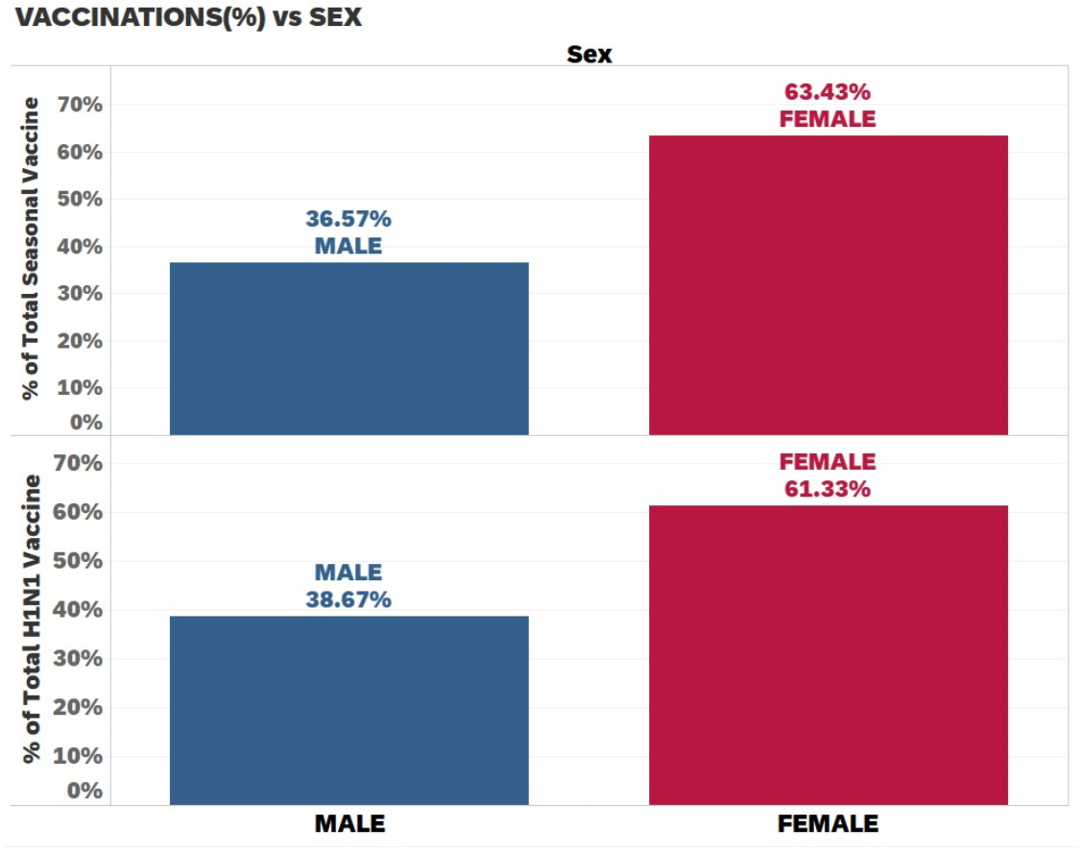
Who got Vaccinated more?
Females are more vaccinated than males.
A research article reveals that the virus infected more Men than women hence, females were vaccinated to prevent the infection spread
Sourav P. Adi, ASE

Slide 9
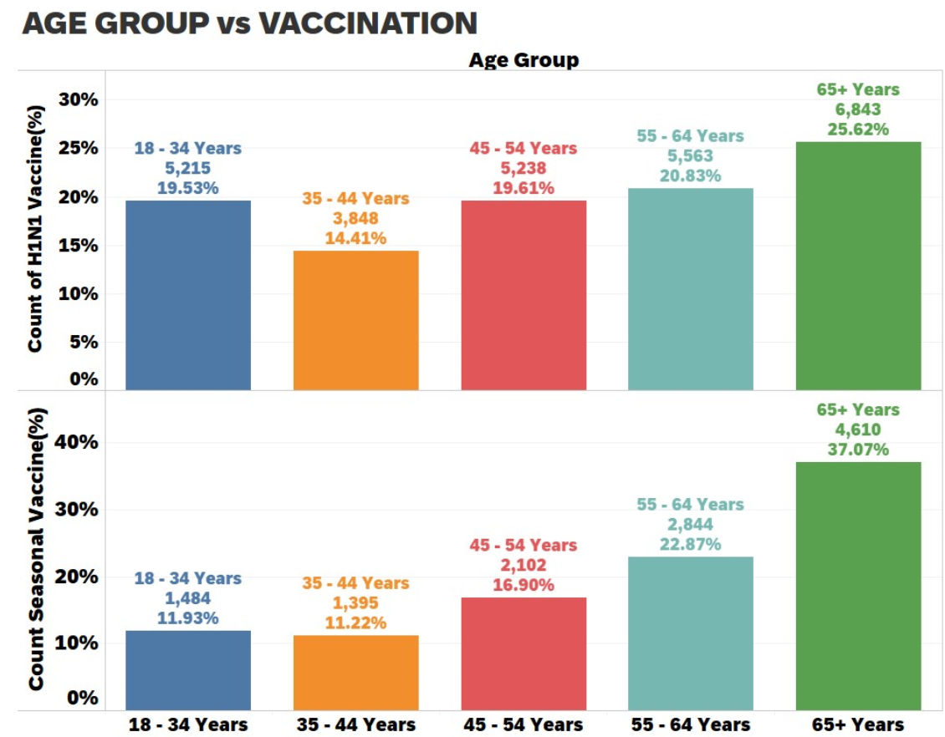
Who got Vaccinated more?
Aged people are more prone to get vaccinated.
Sourav P. Adi, ASE

Slide 10
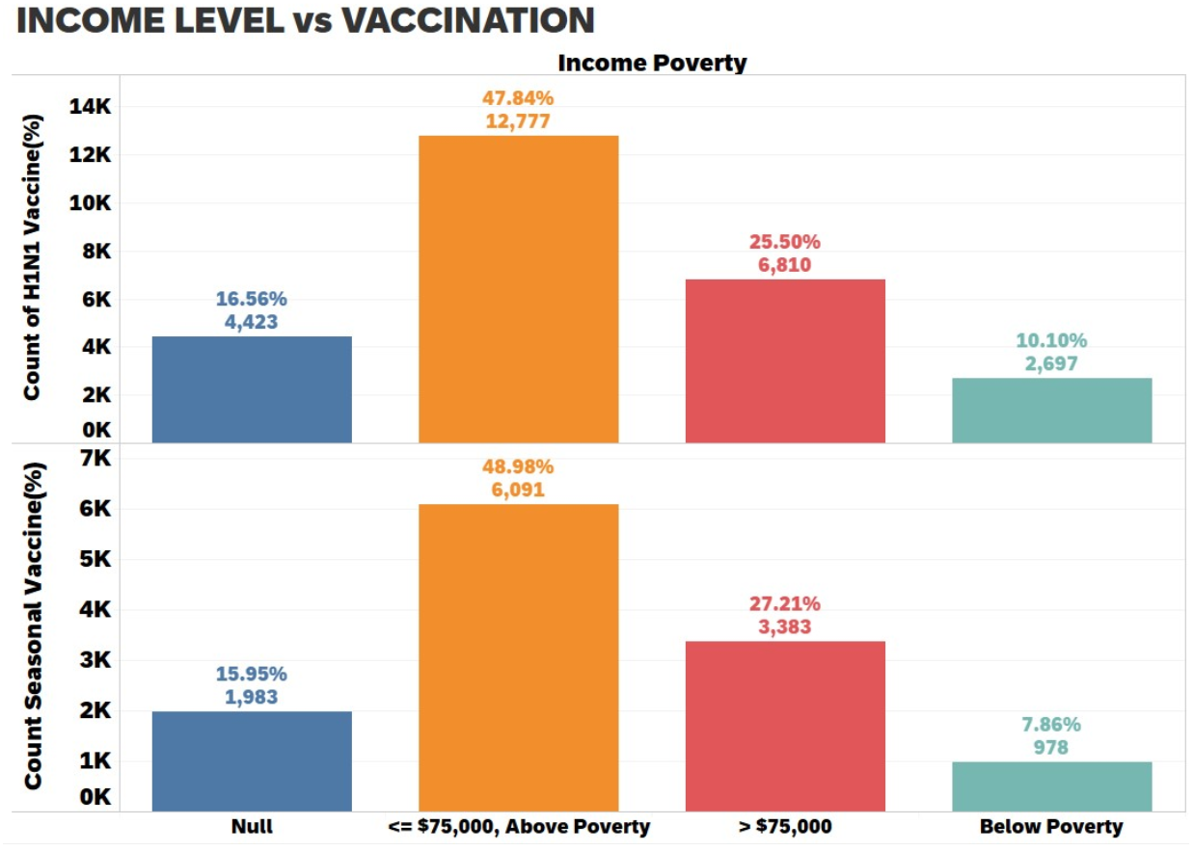
Who got Vaccinated more?
Above poverty line people can afford vaccination.
Need to take necessary actions to vaccinate others also.
Sourav P. Adi, ASE

Slide 11
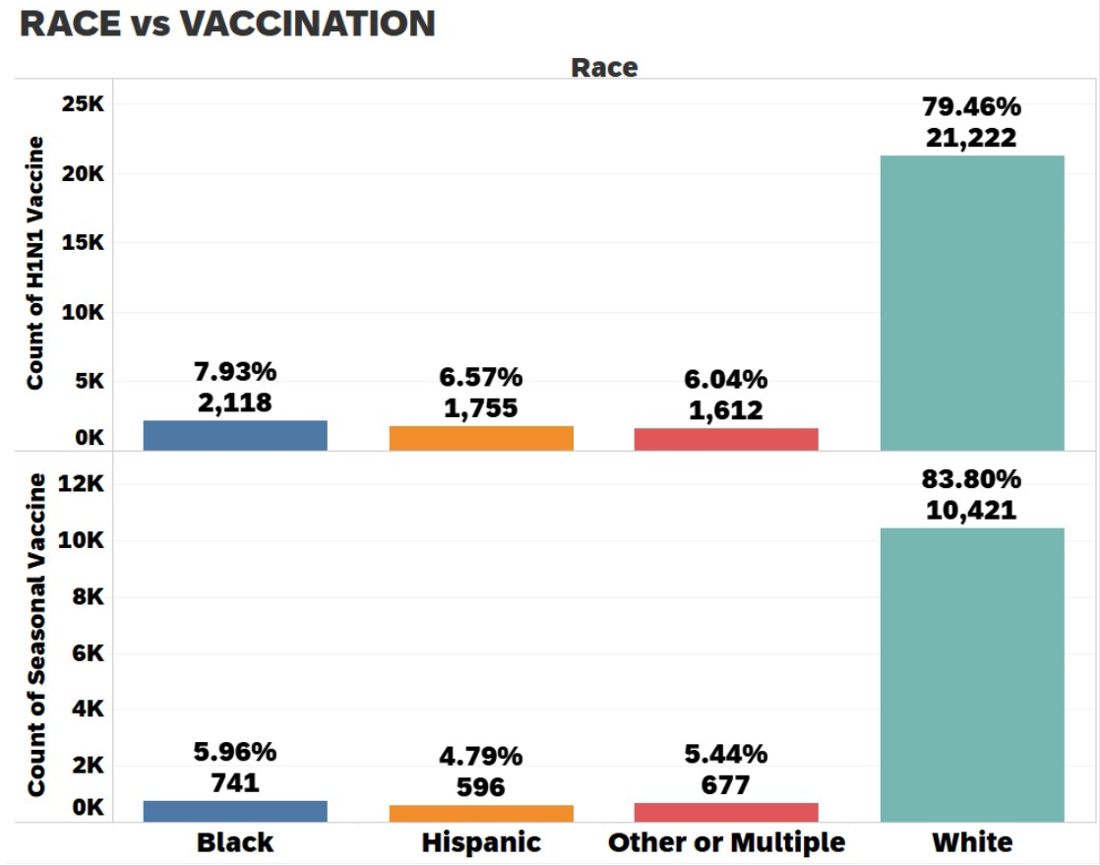
Who got Vaccinated more?
There is a need of vaccination for Blacks, Hispanics, other and multiple race people than Whites as they are least vaccinated
Sourav P. Adi, ASE

Slide 12
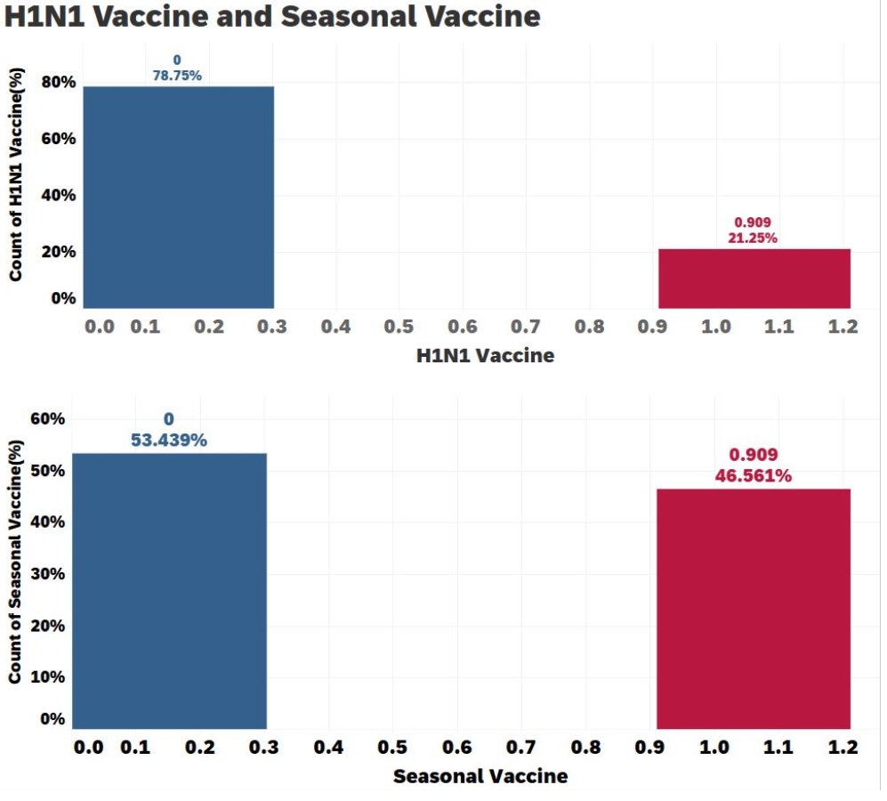
Which Vaccine was given more?
More residents have received seasonal vaccination as compared to H1N1 vaccination.
Sourav P. Adi, ASE

Slide 13
Actions taken
doctor_recc_seasonal and doctor_recc_h1n1 are correlated by 60%, hence one of the column is dropped.
opinion_seas_risk and opinion_h1n1_risk also are correlated by 56% hence only one column is kept.
behavioral_large_gatherings and behavioral_outside home are related by 60% hence one column is eliminated.
Sourav P. Adi, ASE

Slide 14
Ground work before applying Algorithm
employment_industry, and employment_occupation have more than 13000 values missing, hence both the columns are removed.
The imbalance in the H1N1 target column is handled by using ensemble methods.
Missing data in other columns are handled using imputation techniques.
All categorical columns are encoded using One-Hot-Encoding.
Sourav P. Adi, ASE

Slide 15
Flowchart
Import data
EDA
One-Hot-Encoding
Separate Target Feature from other features
OneVsRest
Predict on test data
Make 80-20 split
AUC
Gradient Boosting
Sourav P. Adi, ASE

Slide 16
Gradient Boosting Algorithm
Ensemble Technique.
Works well with imbalanced data
Doesn’t require scaling.
Rebuilds models using residuals.
Disadvantages
More time consuming with increased trees.
Larger grid search during tuning
Sourav P. Adi, ASE

Slide 17
Model Building
Two models are used( To predict H1N1 and Seasonal Vaccines ).
AUC score is used to measure performance of the model.
Model 1(H1N1 Vaccine) | Model 2(Seasonal Vaccine)
Estimators = 250 Depth = 6 Minimum Samples per split = 500 Minimum Leaf Node Samples = 500 Subsample = 0.8 | Estimators = 300 Depth = 4 Minimum Samples per split = 550 Minimum Leaf Node Samples = 600 Subsample = 0.8
Sourav P. Adi, ASE

Slide 18
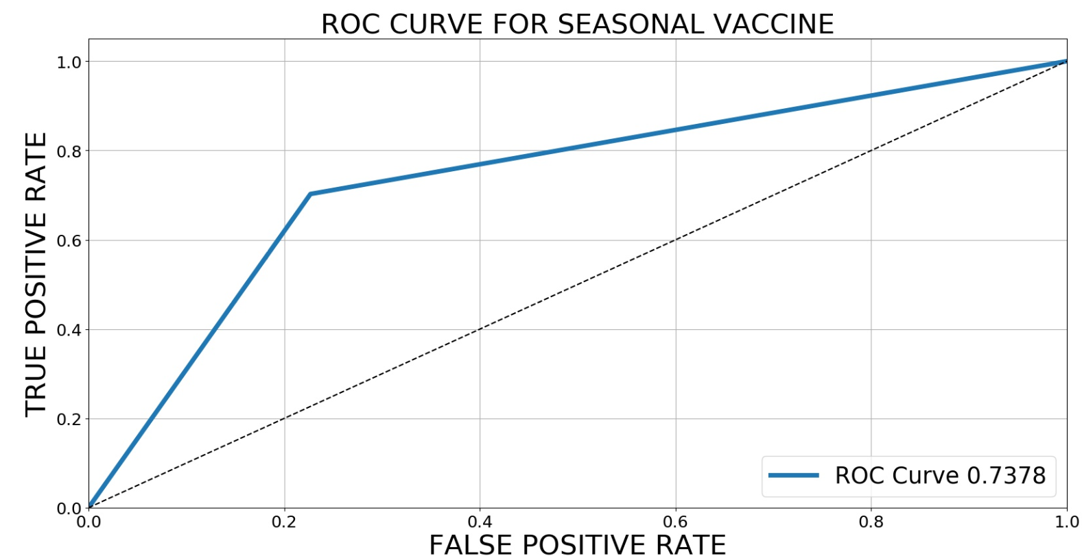
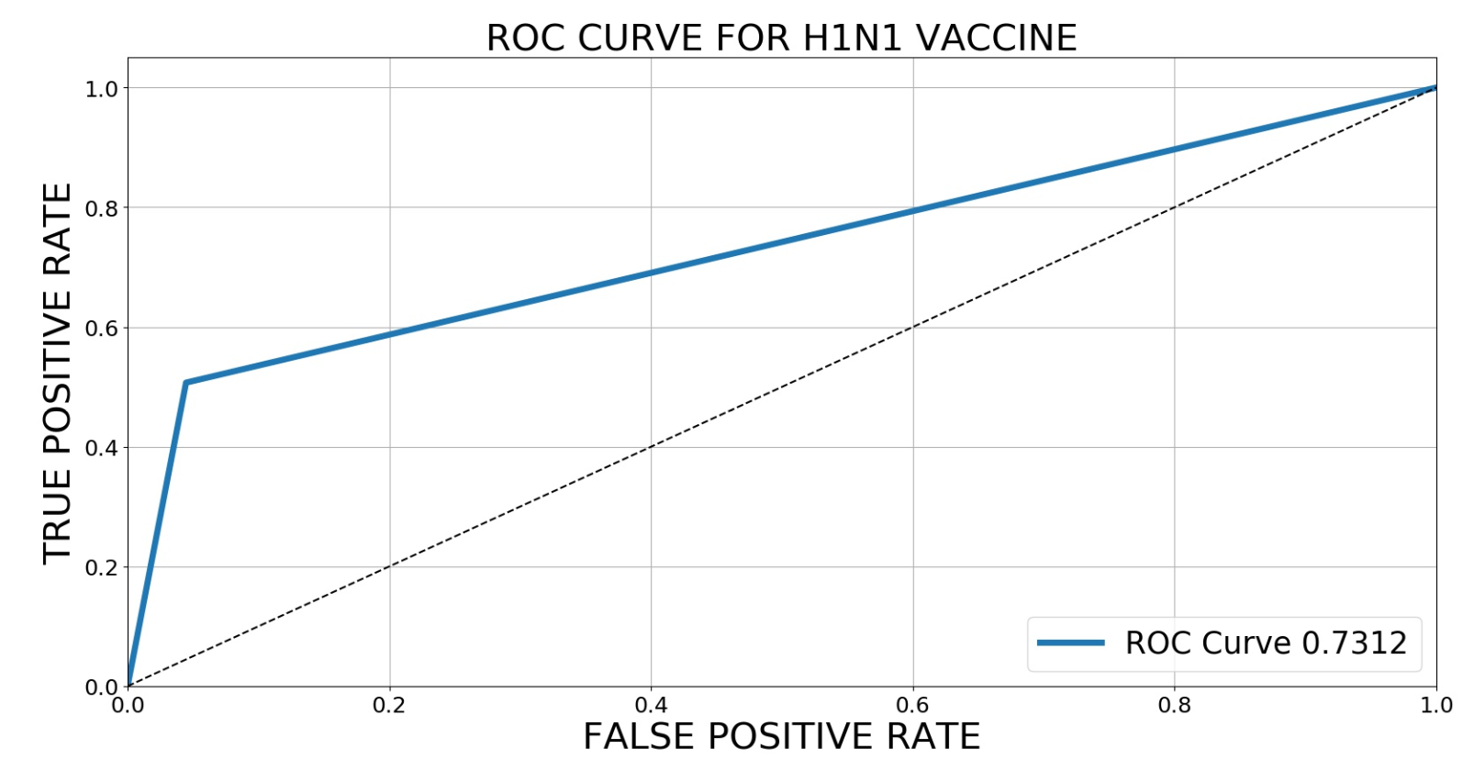
ROC Curve
Sourav P. Adi, ASE

Slide 19

OneVsRest Classifier
N models for N classes.
Used for multiclass and multilabel classification problems.
Predict probability from each model and allot the class with highest probability.
Sourav P. Adi, ASE

Slide 20
OneVsRest Classifier Working
Shape | Size | Color | Class
Round | Small | Red | Apple
Round | Small | Green | Apple
Round | Large | Green | Sweet Lemon
Round | Small | Yellow | Lemon
Model 1 - Apple
OVR
Model 2 – Sweet Lemon
Model 3 - Lemon
<Round, Large, Orange> = ?
Sourav P. Adi, ASE

Slide 21
OneVsRest Classifier Working
Model 1 - Apple
P(Apple) = x
<Round, Large, Orange>
Model 2 – Sweet Lemon
P(Sweet Lemon) = y
Model 3 - Lemon
P(Lemon) = z
<Round, Large, Orange> = Max(x,y,z)
Sourav P. Adi, ASE

Slide 22
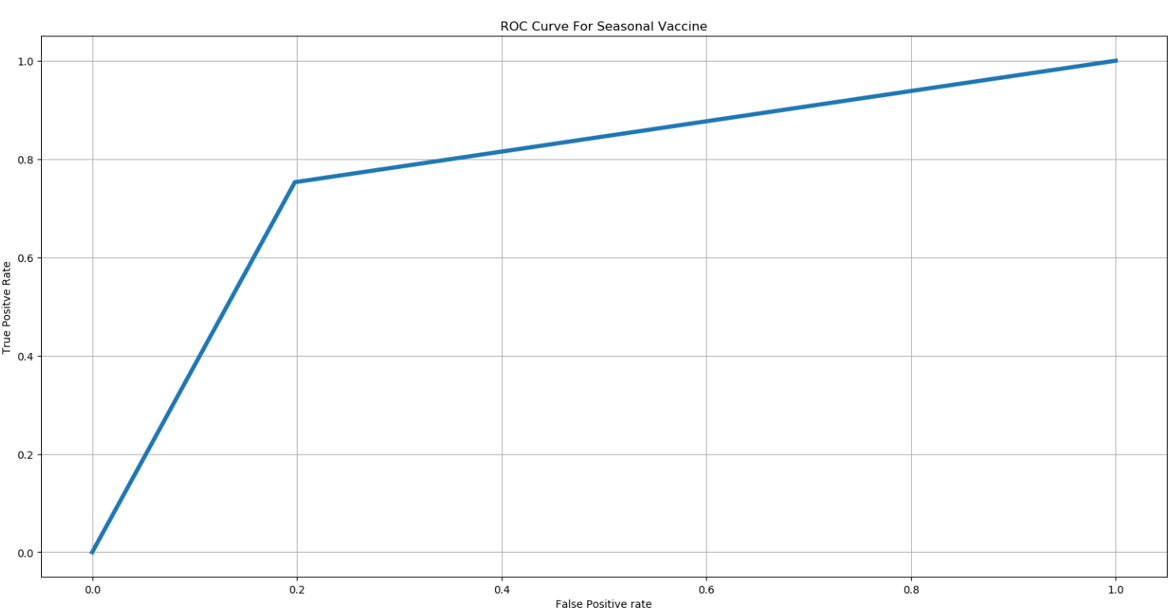
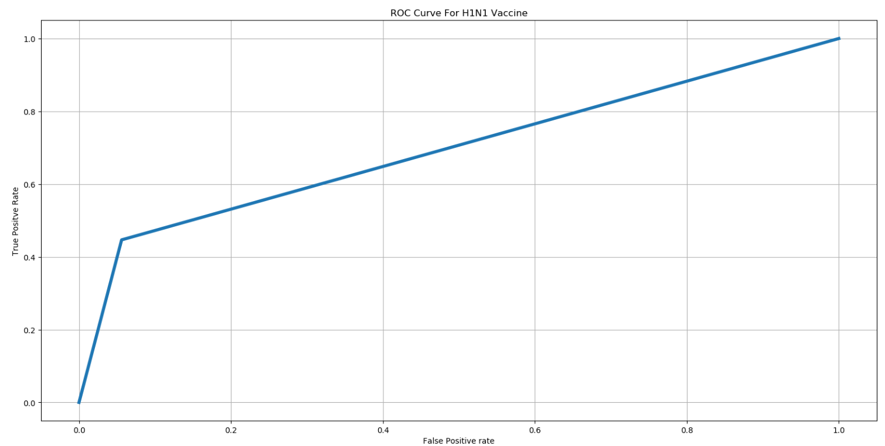


OneVsRest ROC Curve
ROC for Seasonal Vaccine
ROC for H1N1 Vaccine
TPR
FPR
FPR
Sourav P. Adi, ASE

Slide 23
AUC Score on Test Data
Test data was provided by the research team itself and was validated online.
OneVsRest = 0.8362
Gradient Boosting = 0.8368
Sourav P. Adi, ASE

Slide 24
Conclusions
Both the models performed well.
Gradient Boosting outperformed OVR by a little amount.
Time consumed by gradient boosting classifier was a bit more than OVR.
The presence of imbalance in the H1N1 Vaccine target variable made the AUC score a bit lower than that of Seasonal vaccine.
Sourav P. Adi, ASE

Slide 25
Application and Future Work
Same model can be tried applying on any Vaccination related problems(COVID-19).
Dealing with the imbalance.
Time issue wrt Gradient Boosting.
More Feature Engineering to improve model performance.
Sourav P. Adi, ASE

