Slide 1





Reduced Order Modelling and Physics-informed Neural Networks
RomApplication Tutorial

Slide 2
Content
Overview of ROMs in Kratos
Setup a FOM (StructuralMechanics)
Setup a ROM (StructuralMechanics)
ROM Example 2 (FluidDynamics)
ROM Advanced Options

Slide 3
Content
Overview of ROMs in Kratos
Setup a FOM (StructuralMechanics)
Setup a ROM (StructuralMechanics)
ROM Example 2 (FluidDynamics)
ROM Advanced Options

Slide 4


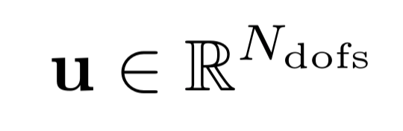


Overview of ROMs in Kratos
INPUT
Full Order Model (FOM)
OUTPUT
u
StructuralMechanicsApplication
Parameters
Main Variable

Slide 5



Overview of ROMs in Kratos
INPUT
Full Order Model (FOM)
OUTPUT
u
StructuralMechanicsApplication
Parameters
Main Variable
INPUT
Surrogate Model
Approximated output
ũ
Parameters
Main Variable

Slide 6
Overview of ROMs in Kratos
INPUT
Full Order Model (FOM)
OUTPUT
u
StructuralMechanicsApplication
Parameters
Main Variable
INPUT
Surrogate Model
Approximated output
ũ
Parameters
Main Variable

Slide 7


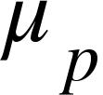
Overview of ROMs in Kratos
training parameters
FOM

Slide 8
Overview of ROMs in Kratos
training parameters
FOM
Optimize
Data for ROM

Slide 9
Overview of ROMs in Kratos
training parameters
FOM
Optimize
Data for ROM
ROM

Slide 10
Overview of ROMs in Kratos
training parameters
FOM
Optimize
Data for ROM
ROM
Validate

Slide 11
Overview of ROMs in Kratos
training parameters
FOM
Optimize
Data for ROM
ROM
Validate
RomManager

