Slide 1





Reduced Order Modelling and Physics-informed Neural Networks
RomApplication Tutorial

Slide 2
Content
Overview of ROMs in Kratos
Setup a FOM (StructuralMechanics)
Setup a ROM (StructuralMechanics)
ROM Example 2 (FluidDynamics)
ROM Advanced Options

Slide 3
ROM Advanced Options

Slide 4
ROM Advanced Options
Requirements:
GiD or Paraview (For postprocessing)
Kratos:
StructuralMechanicsApplication
ConstitutiveLawsApplication
RomApplication

Slide 5
ROM Advanced Options
Rom Database
Analysis Stage (More specific customizations)
Using nonconverged solutions
Linear or Nonlinear decoder
Different Projection strategies (Galerkin, LSPG, PG)
HROM

Slide 6



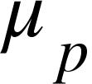
HROM
training parameters
FOM
SVD ( + NN )
Data for ROM
ROM
Validate
rom_stages_to_train:[“ROM”]
RomManager.Fit(mu_train)

Slide 7

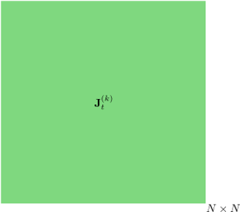
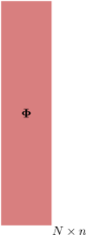





HROM
j
=
r

Slide 8
HROM
j
=
r
Global
Elemental

Slide 9
HROM
j
=
r
Global
Elemental

Slide 10
HROM
training parameters
FOM
SVD ( + NN )
Data for ROM
ROM
Data for HROM
SVD+ECM
HROM
rom_stages_to_train:[“ROM”, “HROM”]
RomManager.Fit(mu_train)

Slide 11
HROM
j
=
r
=
w
Global
Elemental

Slide 12
HROM
j
=
r
=
w
Global
Elemental

Slide 13
HROM
HROM
RomManager.RunHROM(mu_run,use_full_model_part=True)

