Slide 1





Reduced Order Modelling and Physics-informed Neural Networks
RomApplication Tutorial

Slide 2
Content
Overview of ROMs in Kratos
Setup a FOM (StructuralMechanics)
Setup a ROM (StructuralMechanics)
ROM Example 2 (FluidDynamics)
ROM Advanced Options

Slide 3
Setup a ROM (StructuralMechanics)

Slide 4
Setup a ROM (StructuralMechanics)
Requirements:
GiD or Paraview (For post processing)
Kratos:
StructuralMechanicsApplication
ConstitutiveLawsApplication
RomApplication

Slide 5
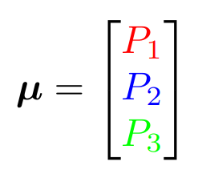
Setup a ROM (StructuralMechanics)
P1
P2
P3

