Slide 1





Reduced Order Modelling and Physics-informed Neural Networks
RomApplication Tutorial

Slide 2
Content
Overview of ROMs in Kratos
Setup a FOM (StructuralMechanics)
Setup a ROM (StructuralMechanics)
ROM Example 2 (FluidDynamics)
ROM Advanced Options

Slide 3
Setup a ROM (StructuralMechanics)

Slide 4
Setup a ROM (StructuralMechanics)
Requirements:
GiD or Paraview (For post processing)
Kratos:
StructuralMechanicsApplication
ConstitutiveLawsApplication
RomApplication

Slide 5
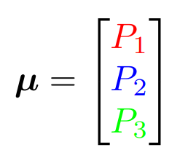
Setup a ROM (StructuralMechanics)
P1
P2
P3

Slide 6
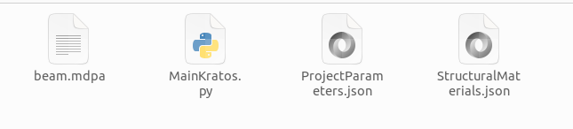
Setup a ROM (StructuralMechanics)

Slide 7

RomManager
general_rom_manager_parameters
Fit()
Test()
RunFOM()
RunROM()
PrintErrors()

Slide 9


training parameters
FOM
Optimize
Data for ROM
ROM
mu = [10,10,10]
Validate
RomManager.Fit()

Slide 11
Passing Parameters
ProjectParameters.json (Boundary conditions, Loads)
Materials.json (Material Properties)
Analysis Stage (More specific customizations)

Slide 12

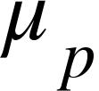
training parameters
FOM
Optimize
Data for ROM
ROM
Validate
RomManager.Fit(mu_train)

Slide 13
testing parameters
FOM
ROM
Validate
RomManager.Test(mu_test)

Slide 14
FOM
RomManager.RunFOM(mu_run)

Slide 15
ROM
RomManager.RunROM(mu_run)

