Slide 1





Reduced Order Modelling and Physics-informed Neural Networks
RomApplication Tutorial

Slide 2
Content
Overview of ROMs in Kratos
Setup a FOM (StructuralMechanics)
Setup a ROM (StructuralMechanics)
ROM Example 2 (FluidDynamics)
ROM Advanced Options

Slide 3
ROM Advanced Options

Slide 4
ROM Advanced Options
Requirements:
GiD or Paraview (For postprocessing)
Kratos:
StructuralMechanicsApplication
ConstitutiveLawsApplication
RomApplication

Slide 5
ROM Advanced Options
Rom Database
Analysis Stage (More specific customizations)
Using nonconverged solutions
Linear or Nonlinear decoder
Different Projection strategies (Galerkin, LSPG, PG)
HROM

Slide 6
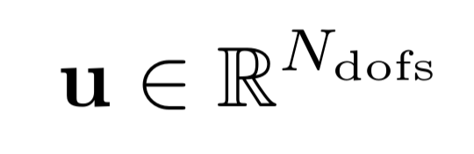




Using nonconverged solutions
INPUT
Full Order Model (FOM)
OUTPUT
u
Parameters
Main Variable
u
u
u
u
…
nonconverged solutions

Slide 7


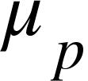
Using nonconverged solutions
training parameters
FOM
Optimize
Data for ROM
converged + nonconverged solutions
ROM

