Slide 1





Reduced Order Modelling and Physics-informed Neural Networks
RomApplication Tutorial

Slide 2
Content
Overview of ROMs in Kratos
Setup a FOM (StructuralMechanics)
Setup a ROM (StructuralMechanics)
ROM Example 2 (FluidDynamics)
ROM Advanced Options

Slide 3
ROM Advanced Options

Slide 4
ROM Advanced Options
Requirements:
GiD or Paraview (For postprocessing)
Kratos:
StructuralMechanicsApplication
ConstitutiveLawsApplication
RomApplication

Slide 5
ROM Advanced Options
Rom Database
Analysis Stage (More specific customizations)
Using nonconverged solutions
Linear or Nonlinear decoder
Different Projection strategies (Galerkin, LSPG, PG)
HROM

Slide 6
Linear or Nonlinear decoder
converged
Nonconverged
Basis
N=1000
Ndofs
S
Φ = SVD( S, ϵ=0)
Φ
Ndofs

Slide 7
Linear or Nonlinear decoder
Linear or Nonlinear decoder
converged
Nonconverged
Basis
Ninf
Nsup
Ndofs
S
Φ = SVD( S, ϵ )
Φ
Ndofs

Slide 8

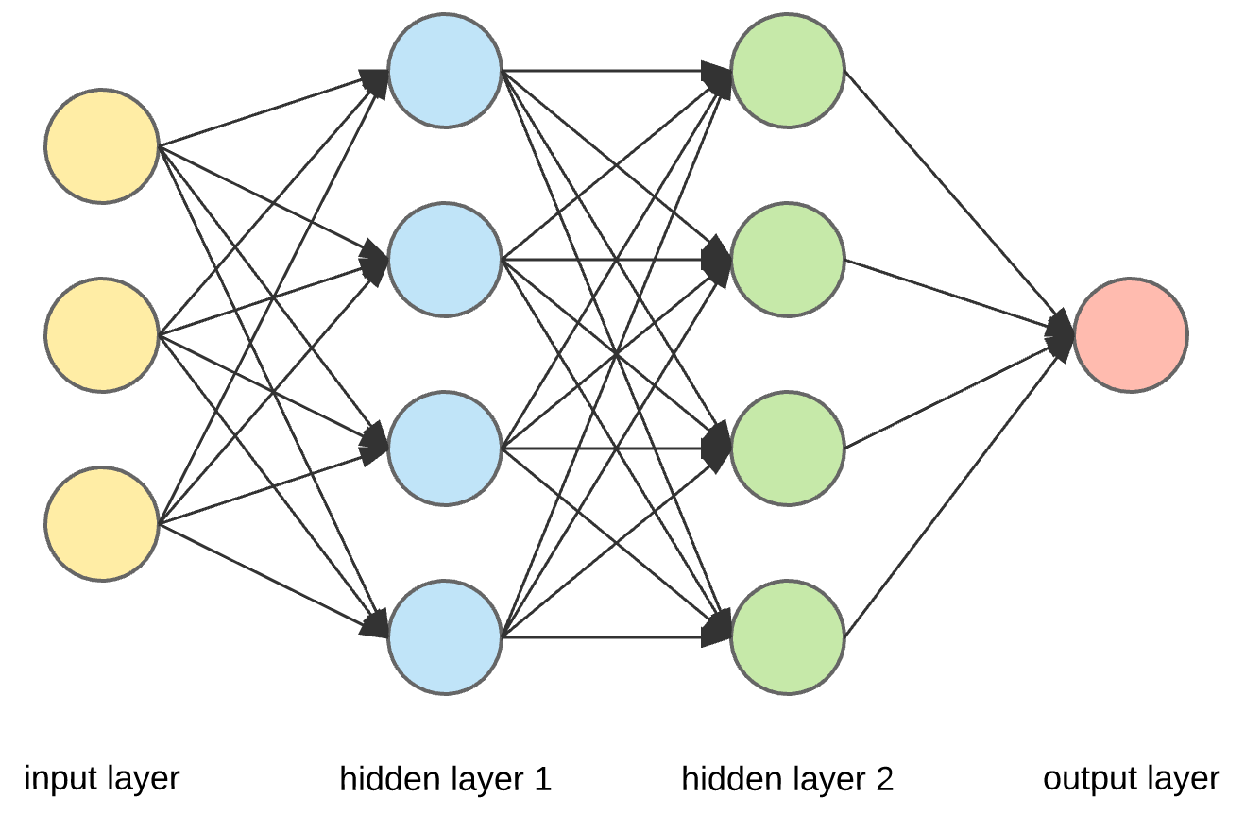
Linear or Nonlinear decoder
Basis + ANN
Nsup
converged
Nonconverged
Basis
Ninf
Ndofs
S
Φ = SVD( S, ϵ )
Φ
+

Slide 9
Linear or Nonlinear decoder
N
Ndofs

Slide 10
Linear or Nonlinear decoder
N
N
Φ
≈ =
Ndofs

Slide 11
Linear or Nonlinear decoder
N
Ninf
Nsup
N
Ninf
NN( )
+
Φ
≈ =
≈ =
Φ
Ndofs

