Slide 1





Reduced Order Modelling and Physics-informed Neural Networks
RomApplication Tutorial

Slide 2
Content
Overview of ROMs in Kratos
Setup a FOM (StructuralMechanics)
Setup a ROM (StructuralMechanics)
ROM Example 2 (FluidDynamics)
ROM Advanced Options

Slide 3
ROM Advanced Options

Slide 4
ROM Advanced Options
Requirements:
GiD (For postprocessing)
Kratos:
FluidDynamicsApplication
RomApplication

Slide 5
ROM Advanced Options
Rom Database
Analysis Stage (More specific customizations)
Using nonconverged solutions
Linear or Nonlinear decoder
Different Projection strategies (Galerkin, LSPG, PG)
HROM

Slide 6
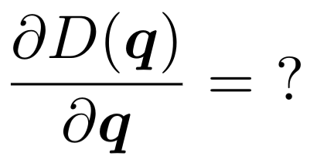
Different Projection strategies (Galerkin, LSPG, PG)
N
Ninf
Nsup
N
Ninf
NN( )
+
Φ
≈ =
≈ =
Φ
Ndofs

Slide 7
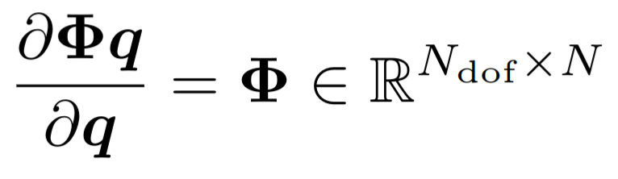
Different Projection strategies (Galerkin, LSPG, PG)
N
Ninf
Nsup
N
Ninf
NN( )
+
Φ
≈ =
≈ =
Φ
Ndofs

Slide 8
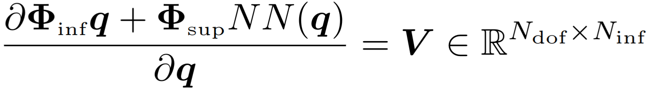
Different Projection strategies (Galerkin, LSPG, PG)
N
Ninf
Nsup
N
Ninf
NN( )
+
Φ
≈ =
≈ =
Φ
Ndofs

Slide 9
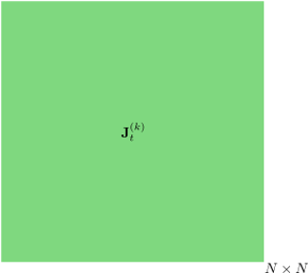



Different Projection strategies (Galerkin, LSPG, PG)

Slide 10

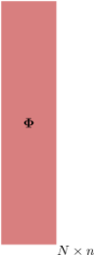



Different Projection strategies (Galerkin, LSPG, PG)

Slide 11
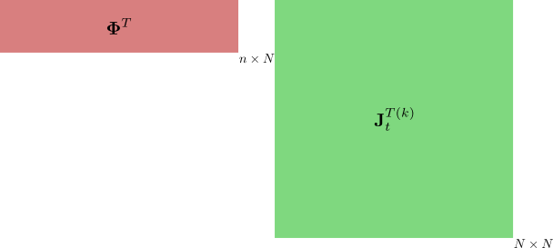

Different Projection strategies (Galerkin, LSPG, PG)

Slide 12
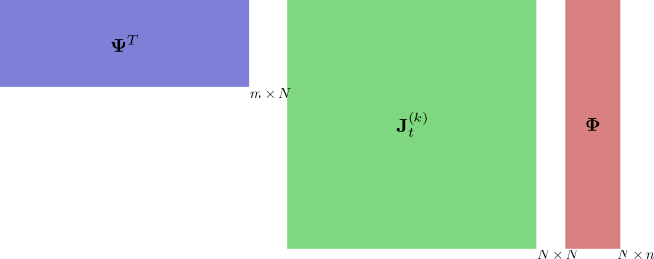
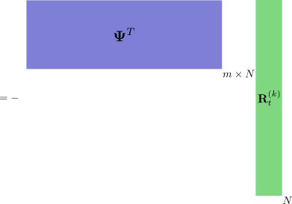


Different Projection strategies (Galerkin, LSPG, PG)

