Slide 1
Information Systems in Digital Age Module-I

Slide 2
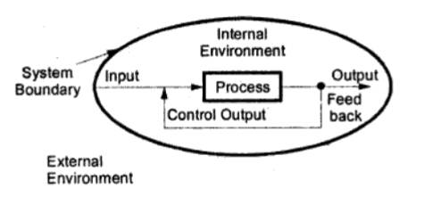
System-Concept
A System consists of a number of interrelated components, only few of them can be seen easily. (For e.g. Human Body, Refinery System)
A System is defined as a group of interrelated components organized with a purpose.

Slide 3
System-Characteristics
A System can be either probabilistic or deterministic in nature.
System often have multiple goals.
System often consists of subsystems
Subsystems send and receive data from each other
Subsystems may be open or closed
A System always exists and functions within an environment.

Slide 4
Components of a System
Input
Inputs of a system are data, elements or raw materials that are to be transformed.
Process
System transforms input into output i.e. changing the state of input is known as process. It is also called as transformation.
Output
A system transforms input into output. It is the final product of the system. A system communicates with its environment in terms of inputs to and outputs from the system.

Slide 5
Open Vs Close System
An open system operate in external environment and exchange information with environment.
Not self sufficient
Exchanges information to exist environment i.e. output does not determine
Close system does not exchanges information with its environment
Self contained
Output may deteriorate

Slide 6
“Information systems are interrelated components working together to collect, process, store, and disseminate information to support decision making, coordination, control, analysis, and viualization in an organization.”

Slide 7
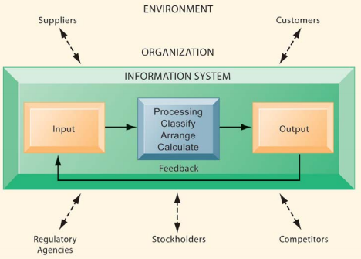

Slide 8
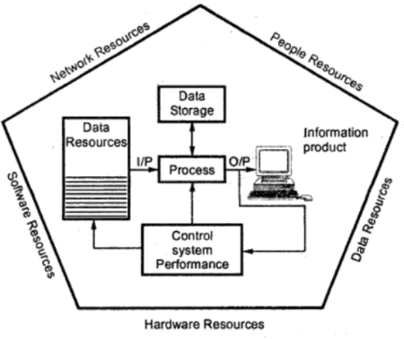
Information Systems- Components

Slide 9
Information Systems- Components
An Information system has following components:
Hardware
Software
Data
Network
People
All five components are arranged and interrelated to perform input, process, output, feedback and control that converts data resources into information.

Slide 10
Hardware Resources: | Computer Systems | Personal computer, Mini-computer, Mainframe Computer
 | Computer Peripherals | Keyboard mouse, Monitor, Printer etc
Software Resources | System Software | Operating System
 | Application Software | MS office, Tally
Date Resources |  | Different types of data: Alphanumeric, text, audio, video, imager etc
Network Resources | Communication Media | Twisted Pair, Fiber-Optic cable,
 | Network support | Technicians, hardware ,software
People Resources | End Users: | People who uses Information System
 | Specialists | System analysis, Programmer, system administrators

Slide 11
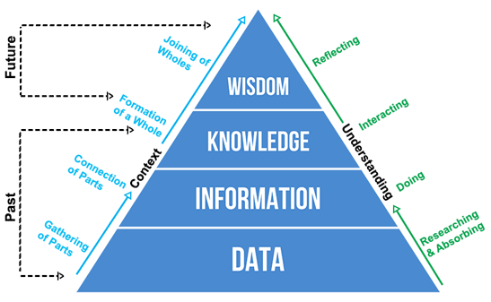
Data-Information-Knowledge-Wisdom

Slide 12
Data-Information-Knowledge-Wisdom
DIKW framework describes a hierarchical relationship between data, information, knowledge, and wisdom.
Data comes in the form of signs and signals, such as numbers, words or other signs that represent discrete facts about an objective reality.
Information comes from providing context to data. It is data that has been endowed with meaning and purpose.
Knowledge is the synthesis of multiple sources of information over time, to create conceptual frameworks, theories, and axioms. As Einstein said “knowledge comes from experience, everything else is information.”
Wisdom is the ability to use knowledge to make correct judgments in response to a unique context, without the aid of facts. Wisdom involves knowing the right things to do, for the greater good. It requires a sense of what is right and wrong, ethical and unethical. It is most uniquely human.

Slide 13
There is a limit to the number of people Disney World can handle at one time. In order to keep increasing revenue, Disney needs to find more efficient and productive ways to utilize its existing facilities. In Disney’s case, this means encouraging customers to spend more time on the premises and also to make repeat visits.
To increase revenue, Disney management chose to use information technology to improve the customer experience. Disney uses video cameras, television displays, and specialized computer software to calculate visitor capacity, identify gridlock, and launch activities that will help re-flow crowds. In addition to reducing wait times, Disney uses information technology to provide new interactive services, such as video games to guests waiting in line, and mobile applications to help visitors navigate the theme park more efficiently.
It is also important to note that using information technology for crowd control has changed the way Disney World runs its business. Disney World’s systems for managing people in lines changed procedures for ticketing, crowd management, and ordering food from restaurants. These changes had to be carefully planned to make sure they enhanced service, efficiency, and profitability.
Information Systems in Business-Case

Slide 14
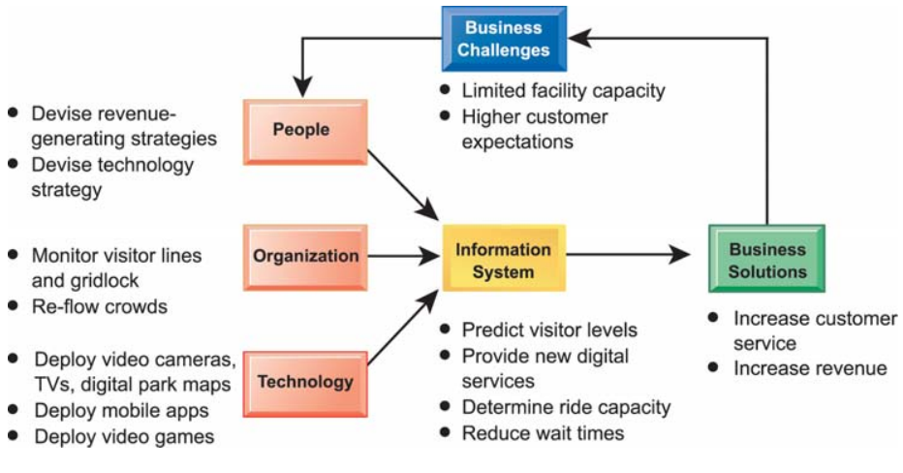
Information Systems in Business-Case

Slide 15
Organizations As Systems
Katz and Kahn (1978), in their classic book “The Social Psychology of Organizations”, advocate for thinking about organizations as systems, social systems that are alive, organic, dynamic, and complex.
As systems, organizations make choices—for example, to expand business or hold steady for another year.

Slide 16
Organizations As Systems
The systems perspective was introduced by Ludwig von Bertalanffy (1956, 1968), who proposed that all systems—physical, biological, or social—have predictable tendencies or behaviors:
Open/closed exchange: high or low attention and responsiveness to information about the system that is internal or external to the system
Interdependence: members (subsystems) of the system influence each other simultaneously, and each part is affected by the actions of the other parts
Homeostasis: participation in maintaining system stability; parts of the system adjust their communications and other behaviors to achieve or retain equilibrium
Non - summative: the whole system equals more (is greater than) the sum of its parts

Slide 17
Hierarchical and Matrix Organizational Structure
Hierarchical organizational structure is an organizational structure in which all the people associated with a project are grouped into functional departments that report directly within the vertical line of command of the organization.
Matrix organizational structure is an organizational structure in which people are grouped based on the functions they perform. These people may not report directly within the vertical line of command of the organization.

Slide 18
The hierarchical structure of an organization as represented in an organization chart, is characterized by:
The vertical division of labour (with the creation of departments) and
The horizontal division of labour (with the creation of administrative levels).
The horizontal division of an organization can be assumed that it divides the management at three levels:
The senior managers who form the strategic level of the organization
The middle managers who form the tactical level
The low level executives who form the functional level
The vertical division of labour defines the various activities that are necessary for the operation of the business (production, sales, research and development etc.)
Hierarchical Organizational Structure

Slide 19
A matrix structure is developed to give equal emphasis and attention to product and function, or product and geography.
The main objective of matrix organization is to secure a higher degree of coordination than what is possible from the conventional organizational structures such as – the line and staff.
Some of the merits of Matrix structure are;
It offers operational freedom and flexibility.
It seeks to optimize the utilization of resources.
It focuses on end results.
Matrix organization is a two dimensional structure, a combination of pure project structure and the traditional functional departments. Members of a particular project team are drawn from the functional departments and are placed under the direction of the project manager.
Matrix Organizational
Structure

Slide 20
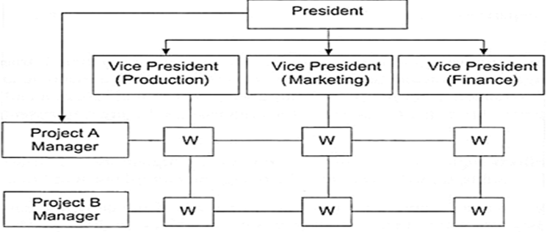
Matrix Organizational Structure

Slide 21
Business Process
A Business Process as a collection of inter-related events, activities and decision points that involve a number of actors and objects, which collectively lead to an outcome that is of value to at least one customer

Slide 22
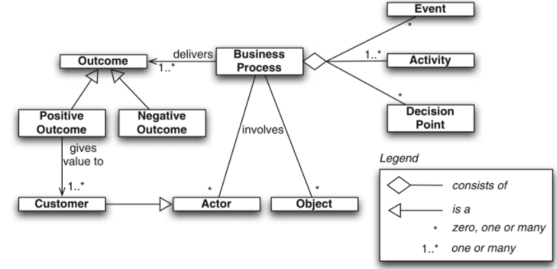
Business Process

Slide 23
Business Process - Essential Attributes
There are 4 essential attributes that constitute an ideal business process:
Finite – A good business process has a well-defined starting point and ending point. It also has a finite number of steps.
Repeatable – A good business process can be run an indefinite number of times.
Creates value – It ultimately aims at translating creation of value into executable tasks and does not have any step in the process just for the sake of it.
Flexibility – It has an in-built nature to be flexible to change and is not rigid

Slide 24
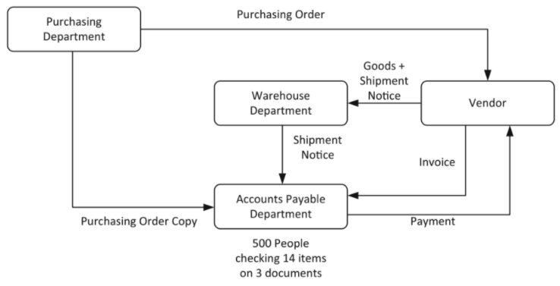
Business Process-Ford

Slide 25
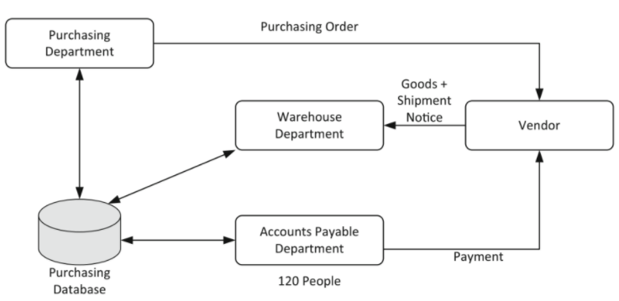
Redesigned Business Process-Ford

Slide 27
Business Process-Management(BPM)
BPM includes concepts, methods and techniques to support the design, administration, configuration enactment and analysis of business processes

Slide 28
Business Process-Management(BPM)
BPM includes concepts, methods and techniques to support the design, administration, configuration enactment and analysis of business processes
The basis of BPM is the explicit representation of business processes with their activities and the execution constraints between them.
Once business processes are defined, they can be subject to analysis, improvement and enactment.

Slide 29
BPM is never concluded because continuous improvement requires continual change. Companies practicing business process management need to go through the following steps:
Identify processes for change: One of the most important strategic decisions that a firm can make is not deciding how to use computers to improve business processes, but rather understanding what business processes need improvement.
Analyze existing processes: Existing business processes should be modeled and documented, noting inputs, outputs, resources, and the sequence of activities. The process design team identifies redundant steps, paper-intensive tasks, bottlenecks, and other inefficiencies.
Design the new process: Once the existing process is mapped and measured in terms of time and cost, the process design team will try to improve the process by designing a new one. A new streamlined “to-be” process will be documented and modeled for comparison with the old process.
Implement the new process: Once the new process has been thoroughly modeled and analyzed, it must be translated into a new set of procedures and work rules.
Continuous measurement: Once a process has been implemented and optimized, it needs to be continually measured.

Slide 30
Planning & strategic alignment:
Organization profiling
Identifying primary, management, and support processes
Noting key performance indicators (KPIs)
Preparing for process analysis
Process analysis
In this stage, one needs to observe the process as it is currently practiced in order to get a complete picture.
Based on the nature of the processes, the method of analysis chosen may be qualitative / quantitative.
Process design
Observations from process analysis are put to use in the design stage.
Continuous process improvement
Redesign
Implementing the process
Process monitoring
Systemic and non-systemic implementation
The choice between the two types depends on the nature of the business process and resources available to the organization.
In this stage, previously identified KPIs are monitored to ensure that the process is aligning with the organization’s overarching goals.
Process refinement
In the refinement stage, one makes the effort to close the gap between current performance and the modeled process with carefully measured changes.
BPM Life Cycle……

Slide 31
An analysis of the Case
Flipped classroom

