Slide 1
Network gameplay and AI in Assassins Creed Unity
Samuel Styles – SAE Institute Geneva
12.10.2022

Slide 2
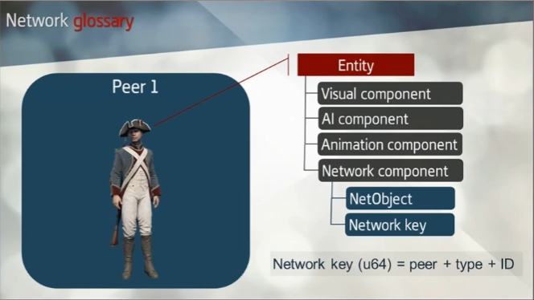
The Key principle : Architecture
Billions of lines of code !
Massive time loss to rewrite !
Network architecture is built on top of the existing libraries.

Slide 3
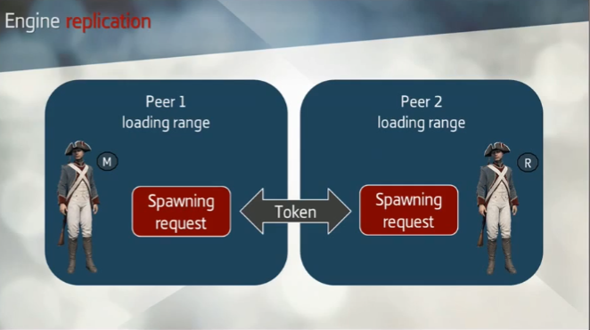
The Key principle : Replication
The NetTokens help to Decide who is the “Master” and who is the Replica.

Slide 4
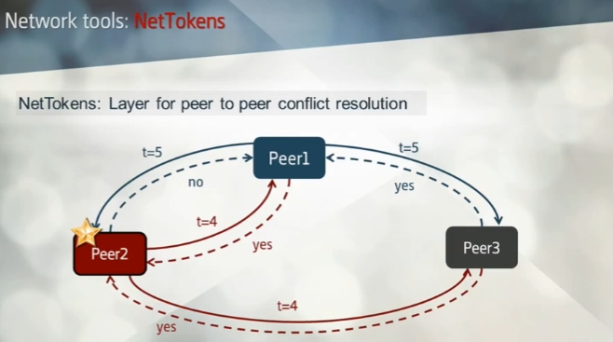
The Key principle : NetTokens
Token given to the Peer who asks first (lower “t” is the Token holder)

Slide 5
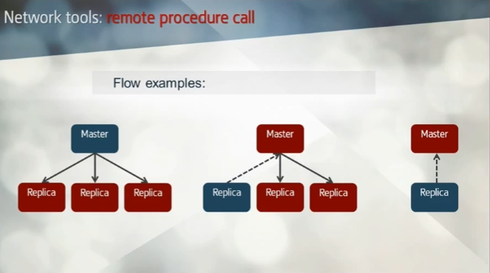
The Key principle : Flow
The flow of data is unidirectional but can go from Master to Replica(s) or Replica(s) to Master.

Slide 6
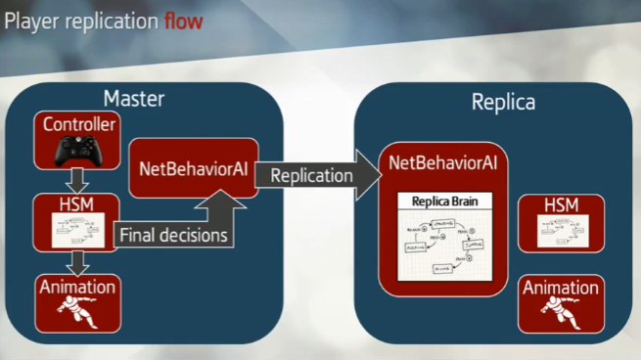
The Player Replication
Replication of player behaviour done through the Human State Machine (HSM)

Slide 7
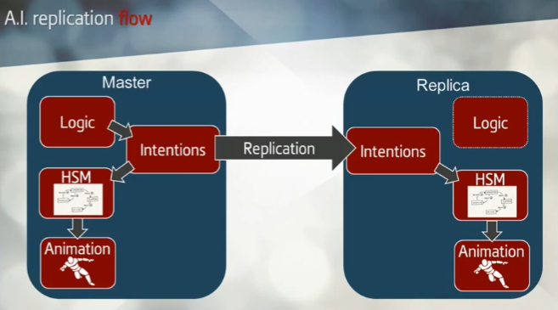
The AI Replication
Replication of AI behaviour is done through an intermediate “Interpreter” called “Intentions”.
The Human State Machines (HSM) then apply states accordingly on Master and on Replica.

Slide 8
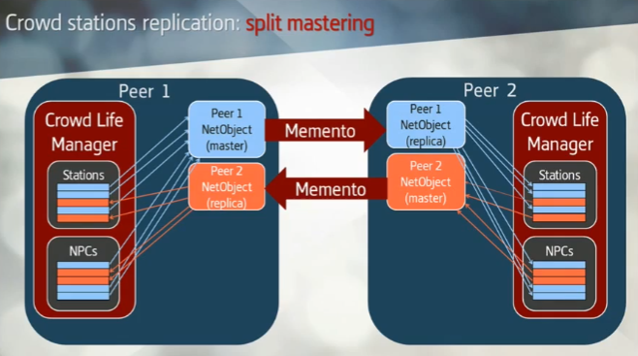
The Crowd Replication
The replication is the same as AI except for “group” behaviour (here called Crowd stations).
If group behaviour is broken, the Crowd station is discarded, entities return to normal AI behaviour.

Slide 9
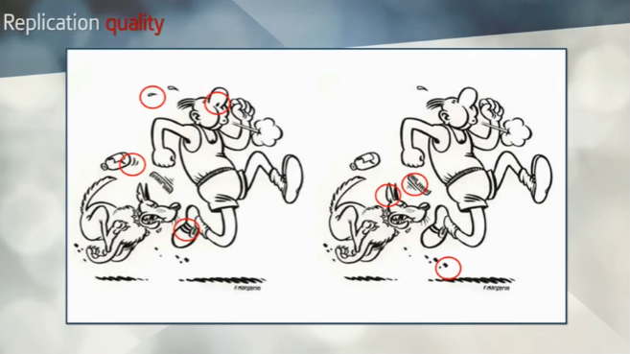
Optimisation
The idea behind this replication was to keep it simple and send the less data possible.
Does not need to be perfect but give the illusion that it is.

Slide 10
Thank you for listening

