Slide 1
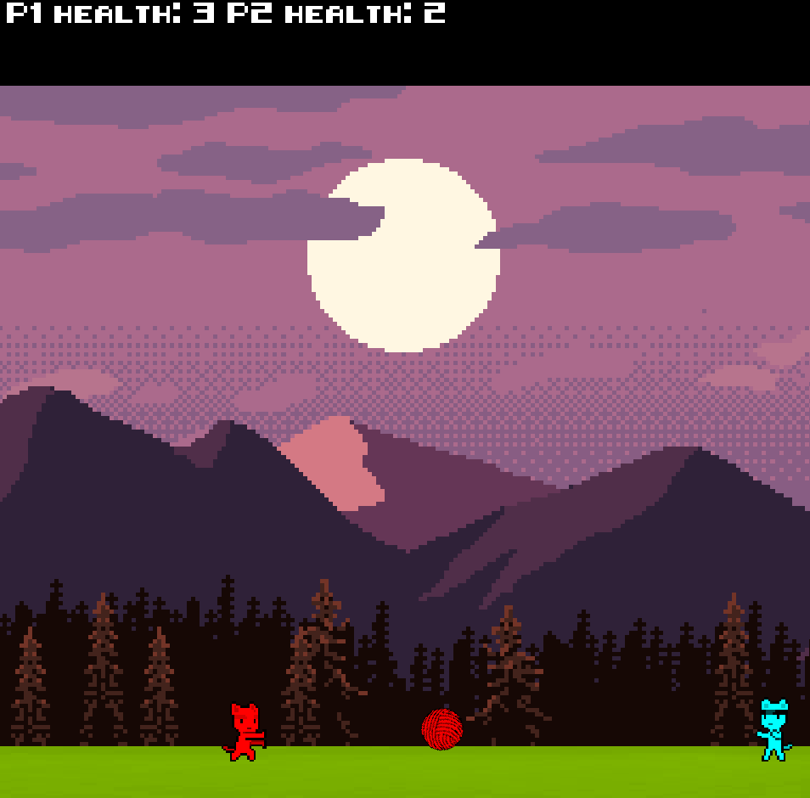
CatFight Project modifications and Animation System
Samuel Styles – GPR5100 - Rollback

Slide 2
What is CatFight ?
Multiplayer online game (goes up to 4 players)
Ninja cats !
Super wool projectiles !

Slide 3
The Modifications

Slide 4
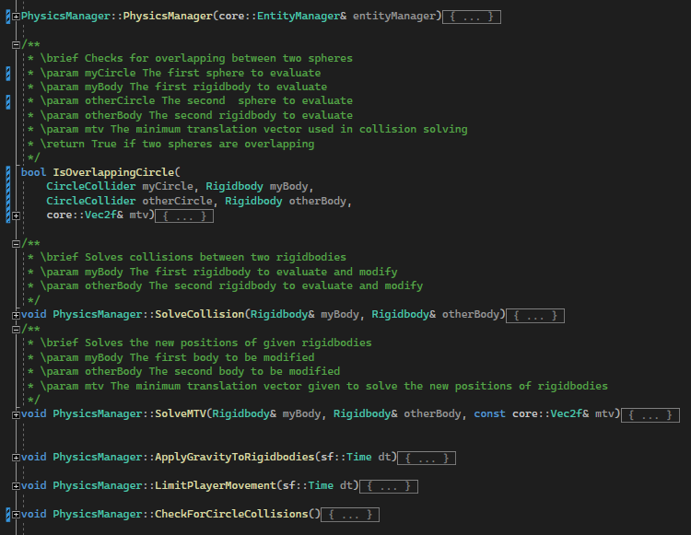
Physics Manager
Addition of methods:
From BoxColliders to CircleColliders

Slide 5
Physics Manager
Addition of methods:
From BoxColliders to CircleColliders
SolveCollision()

Slide 6
Physics Manager
Addition of methods:
From BoxColliders to CircleColliders
SolveCollision()
SolveMTV()

Slide 7
Physics Manager
Addition of methods:
From BoxColliders to CircleColliders
SolveCollision()
SolveMTV()
ApplyGravityToRigidbodies()

Slide 8
Physics Manager
Addition of methods:
From BoxColliders to CircleColliders
SolveCollision()
SolveMTV()
ApplyGravityToRigidbodies()
LimitPlayerMovement()

Slide 9
Physics Manager
Addition of methods:
From BoxColliders to CircleColliders
SolveCollision()
SolveMTV()
ApplyGravityToRigidbodies()
LimitPlayerMovement()
CheckForCircleCollisions()

Slide 10
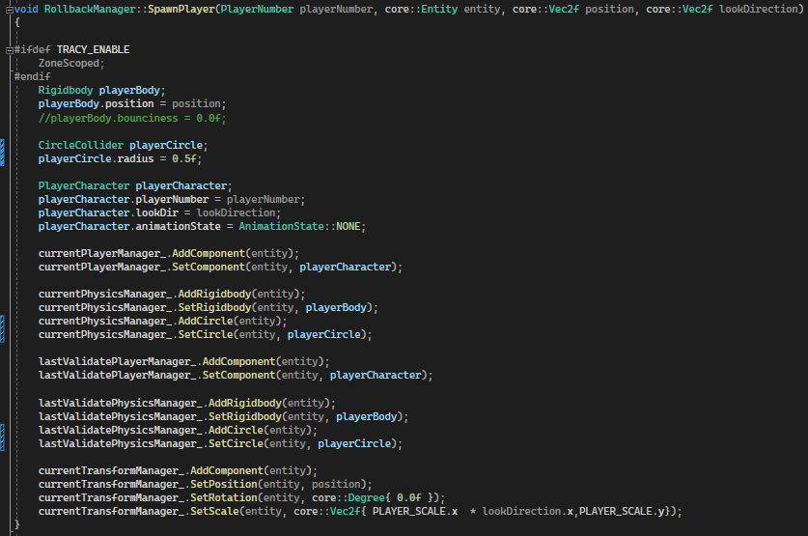
Rollback Manager
Modification of:
SpawnPlayer() with CircleCollider

Slide 11
Rollback Manager
Modification of:
SpawnPlayer() with CircleCollider, lookDirection

Slide 12
Rollback Manager
Modification of:
SpawnPlayer() with CircleCollider, lookDirection and AnimationState

Slide 13
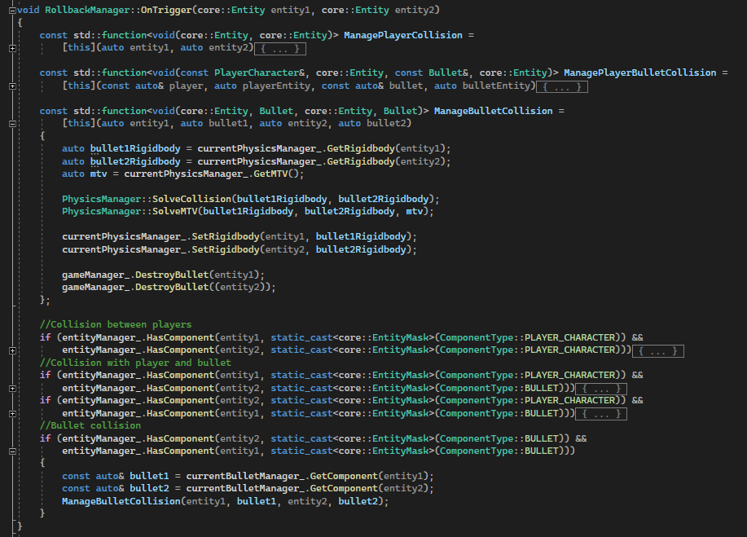
Rollback Manager
Modification of:
SpawnPlayer() with CircleCollider, lookDirection and AnimationState
Addition of Collision resolution to OnTrigger()

Slide 14
Game Manager
Modifications on:
Begin method (with Texture loading)
Sound Loading
Background creation (from stars to sprites)

Slide 15
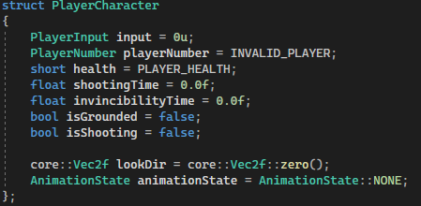
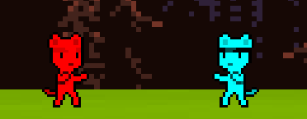
Player Character
Addition to the PlayerCharacter struct:
isGrounded & isShooting “state”.
“lookDir”
animationState

Slide 16
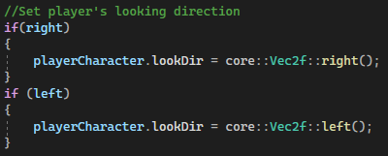
Player Character
Addition to the PlayerCharacter logic (FixedUpdate) :
LookDirection according to input

Slide 17
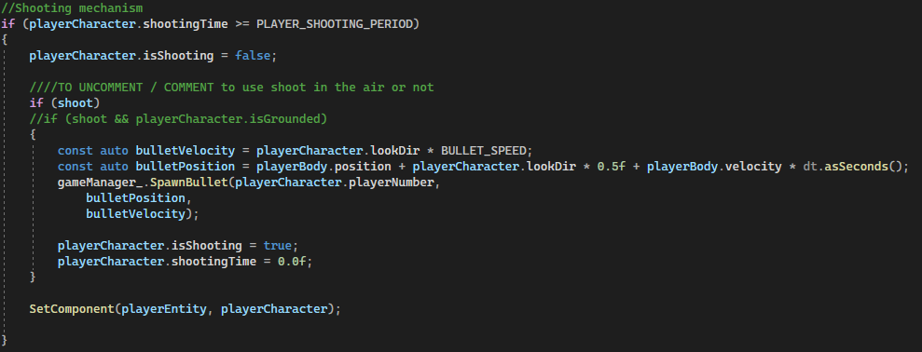
Player Character
Addition to the PlayerCharacter logic (FixedUpdate) :
LookDirection according to input
Modification of shooting logic

Slide 18
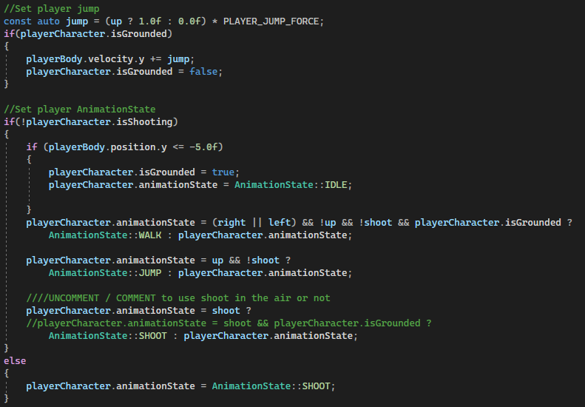
Player Character
Addition to the PlayerCharacter logic (FixedUpdate) :
LookDirection according to input
Modification of shooting logic
AnimationState logic

Slide 19
The Animation System

Slide 20
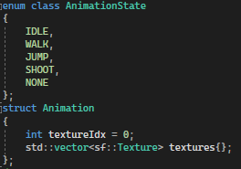
The Animation System
Creation of an animation_manager !
Enum class “AnimationState”

Slide 21
The Animation System
Creation of an animation_manager !
Enum class “AnimationState”
Struct “Animation” holding an index and textures

Slide 22
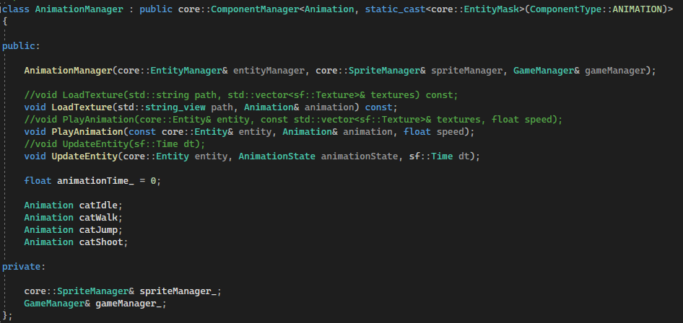
The Animation System
Creation of an animation_manager !
Enum class “AnimationState”
Struct “Animation” holding an index and textures
AnimationManager class with a Constructor, references to sprite/game Managers

Slide 23
The Animation System
Creation of an animation_manager !
Enum class “AnimationState”
Struct “Animation” holding an index and textures
AnimationManager class with a Constructor, references to sprite/game Managers, a timer, Animations

Slide 24
The Animation System
Creation of an animation_manager !
Enum class “AnimationState”
Struct “Animation” holding an index and textures
AnimationManager class with a Constructor, references to sprite/game Managers, a timer, Animations and Methods,

Slide 25
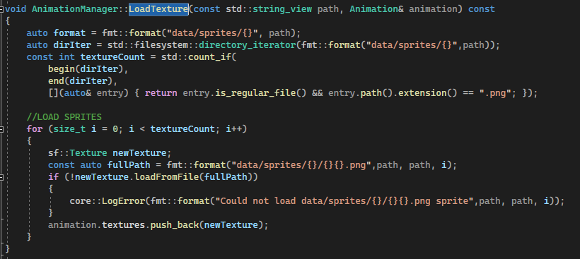

The Animation System
The AnimationManager methods are :
LoadTextures()

Slide 26
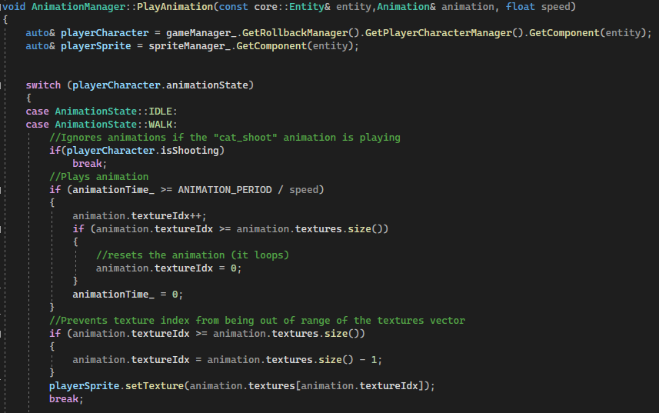
The Animation System
The AnimationManager methods are :
LoadTextures()
PlayAnimation()

Slide 27
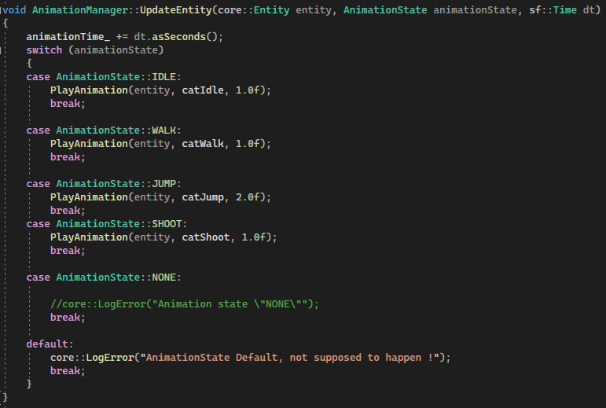
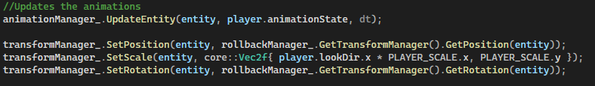
The Animation System
The AnimationManager methods are :
LoadTextures()
PlayAnimation()
UpdateEntity()

Slide 28
The Animation System Usage
Adding animations to the AnimationManager became easier:
Adding an Animation to the AnimationManager

Slide 29
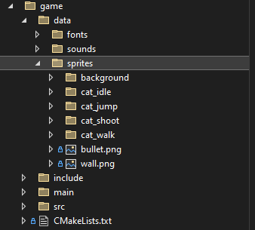
The Animation System Usage
Adding animations to the AnimationManager became easier:
Adding an Animation to the AnimationManager
Creating a folder and copy sprites in it

Slide 30
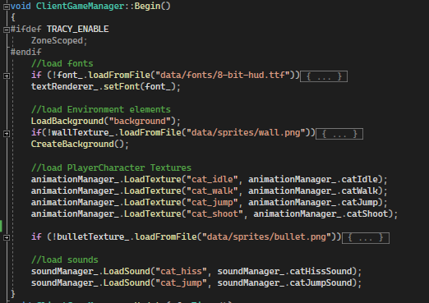
The Animation System Usage
Adding animations to the AnimationManager became easier:
Adding an Animation to the AnimationManager
Creating a folder and copy sprites in it
Calling the “LoadTextures()” with the name of the folder and the Animation name

Slide 31
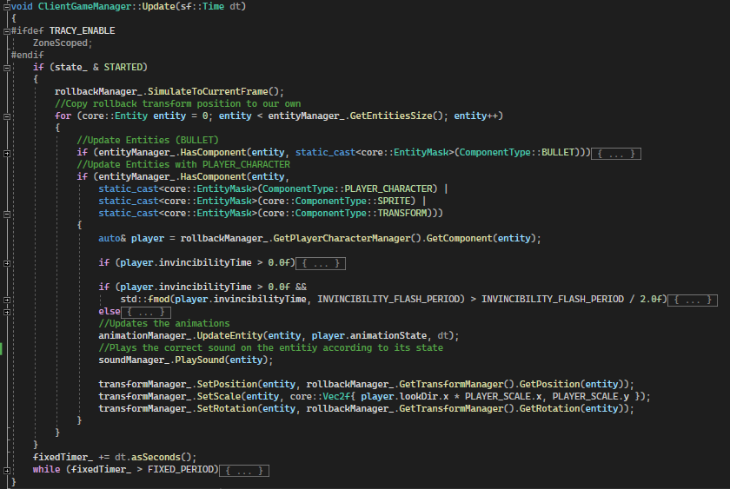
The Animation System Usage
Adding animations to the AnimationManager became easier:
Adding an Animation to the AnimationManager
Creating a folder and copy sprites in it
Calling the “LoadTextures()” with the name of the folder and the Animation name
Updating the Entity on the ClientGameManager

Slide 32
The Animation System Usage
The most complicated part of it is to implement States in the
“PlayAnimation()” Switch
and
PlayerCharacter FixesUpdate

Slide 33
Conclusion
I had to:
Update the PhysicsManager
Update the RollbackManager accordingly
Modify the PlayerCharacter
Create an Animation System
Add conditions to the PlayerCharacter
Implement it in the GameClientManager

Slide 34
Thank you for listening

