Slide 1
Ideas and propositions to improve « mass voting system » design

Slide 2
Why do we need improves ?
The « mass voting » system design shows clearly high benefits, but shows serious weaknesses too :
If we consider a faulty software, and a calculator fails due to this faulty software, one of the others « healthy » calculators can (and often will) reconfigure to this faulty software, because of the software dissimetry wanted policy. This would results in potential loss, by domino effect, of all remaining calculators : the original objective of avoiding common faults modes would results in the complete opposite effect!

Slide 3
In the current proposed design, the actuators are the only deciders and calculators are the only ones to process command : it is a potential wasting in efficiency as both components can assume either roles.
The faulty components can hardly recovers, particularly from temporary faults.
Data history is not used in trying to perform any fault diagnostis.

Slide 4
Functional safety
Definition from Jean-Claude Laprie :
« la propriété qui permet aux utilisateurs du système de placer une confiance justifiée dans le service qu'il leur délivre »
Trust based system behavior

Slide 5

More information generally means
better decision !

Slide 6
C1
(hw1,sw1)
A1
C2
(hw2,sw1)
A2
C3
(hw1,sw2)
A3
C4
(hw2,sw2)
A4
C5
(hw1,sw3)
A5
C6
(hw2,sw3)
A6
TOTAL POPULATION
New « massive voting » system design,
making use of all population do discriminate « healthy » components from « faulty » ones.

Slide 7
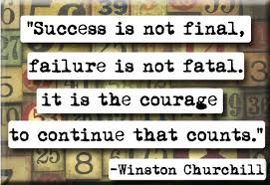

Never definitively kick out faulty components because they can recover from failures

Slide 8

Keep components history.

Slide 9


Slow trust increase, fast trust decrease.
Trust lost implies maximum/cap value decrease.

Slide 10

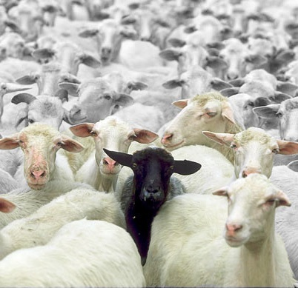


Anomaly detection ?
?
?
?
Decisions are still possible thanks to trusting system.

Slide 11
Possible opinions :
this guy is often right : trust him !
this guy is sometimes right, sometimes wrong : I can’t decide !
this guy is often wrong : don’t trust him !
Anomaly detection
Send and keep own opinion
Gather other components opinions
How to define an opinion ?
An opinion is defined by taking in account all valid/wrong results with a time window.
A valid/wrong results is defined with anomaly detection, taking in account results and trust associated in it.
Rebalance trust in others

Slide 12
Trust balancing processus
Validation
Trust (personal)
Trust rebalancing
DATA
Social proof validation
OTHERS CALCULATORS VALIDATION

Slide 14
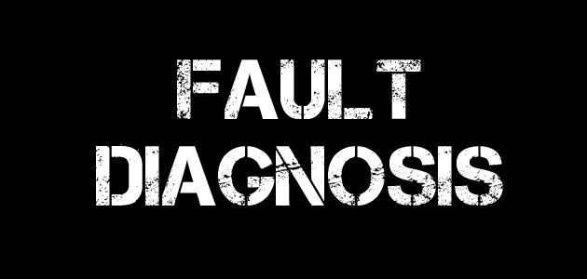
Hypothesis : it’s extremely improbable that different causes implies same errors (nearly) simultaneously.

Slide 15
2 errors appearing (nearly) simultaneously
Cause identified ?
Try a random solution (reset, configuration, rest…)
Try removing the cause
Problem vanished ?
Cause correctly identified : remember it and prevent it to occurring other faults later

