Slide 1
Filling Cloud Gaps in Satellite Chlorophyll with a U-Net
Building the pieces to scale gap-filling toward global PACE
Troy · SAFS-Varanasi Internship · Summer 2026

Slide 2
The problem: clouds hide the ocean
• Chlorophyll-a from ocean-color satellites is a key measure of ocean productivity and the carbon cycle.
• But clouds block the sensor, leaving large gaps in the daily maps.
• Those gaps limit our ability to track blooms and productivity day to day.
• Goal: produce gap-free daily maps, and build tools that scale from one region toward global PACE.

Slide 3
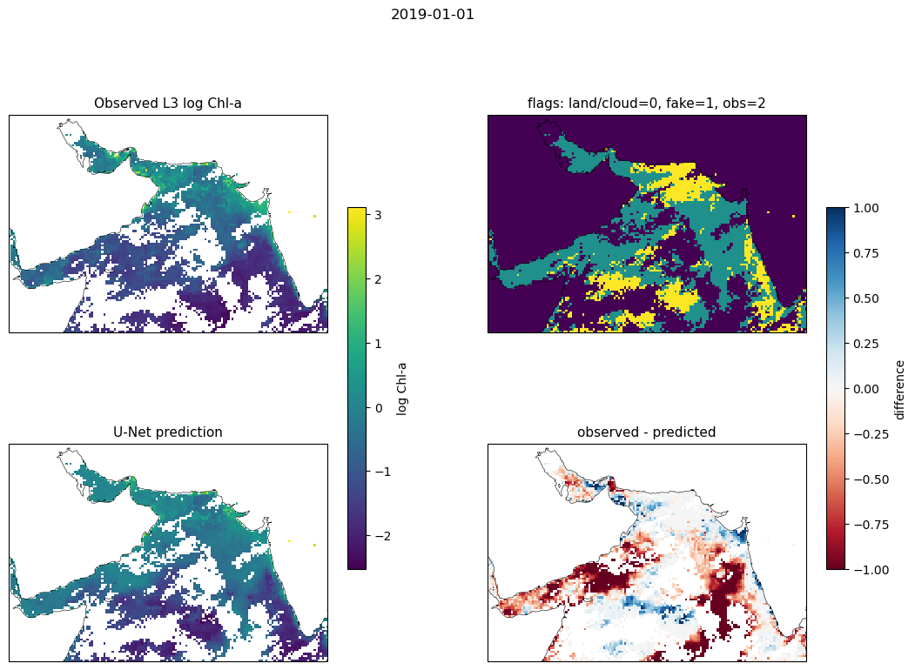
The approach: a gap-filling U-Net
• A U-Net learns to fill cloud gaps from the surrounding pixels, the days before and after, and CHL-derived channels.
• Trained and scored "self-supervised": hide some pixels we DID observe ("fake clouds"), predict them, and compare.
• No hand labels needed — the satellite's own observations are the answer key.
One day: observed (white = cloud gaps) -> U-Net prediction (filled) -> error where truth was hidden

Slide 4
What I built: the mindthegap toolkit
• Streaming data pipeline — standardize and build model inputs on the fly, never loading the whole data cube (memory-safe).
– build_standardized_lazy, make_tf_gen
• Spatial patching — tile a region into pieces so training scales to large areas.
– make_xbatcher
• The gap-filling U-Net.
– UNet
• Evaluation and visualization tools.
– overall_perf, spatial_perf, plot_prediction_observed
• All reusable functions committed to the shared mindthegap package.

Slide 5
How we measure it: the fake-cloud metric
• There is no gap-free "truth" map for the target — and PACE won't have one either.
• So we hide pixels the satellite actually observed, predict them, and score the reconstruction (MAE) only there.
• This is honest: it grades the model exactly where it had to guess.
• And it transfers directly to PACE, where a supervised comparison isn't possible.

Slide 6
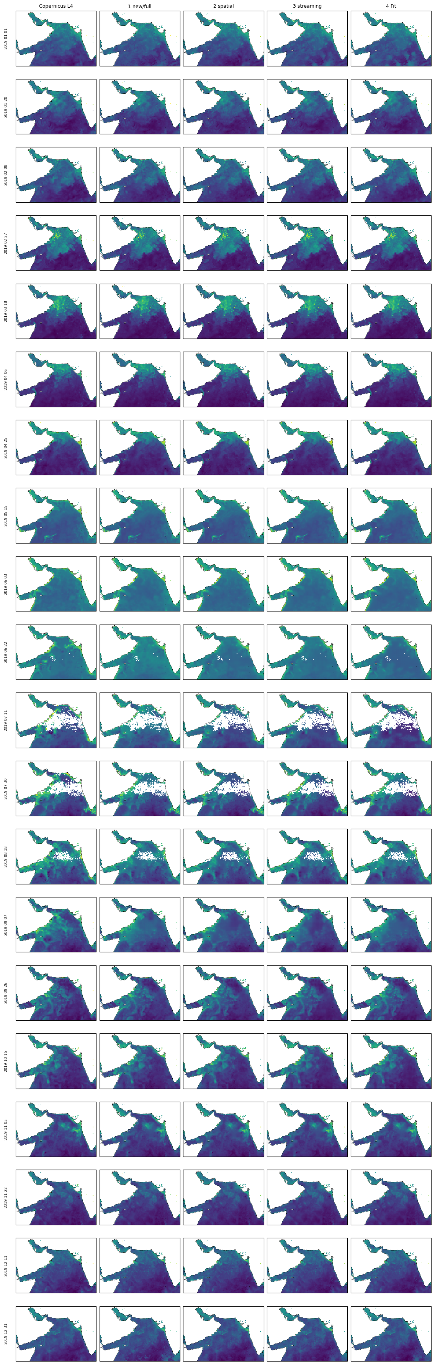
Result 1: the pipeline is sound
• Compared four ways of producing the maps: whole-domain, spatial patches, streaming, and non-streaming.
• Per-day error agrees within ~1%, and the maps are visually identical (vs. the Copernicus reference).
• Takeaway: spatial-patch and streaming training match the whole-domain baseline — the scalable approach is valid.
20 days x 5 methods (Copernicus reference + 4 pipelines) — columns look identical

Slide 7
Result 2: the rechunked data is lossless
• Re-saved the data chunked for fast spatial-patch reads (needed at scale).
• Verified byte-identical to the original — maximum difference = 0.
• A 5-seed test showed model-to-model differences are training noise (~5%), not the data source.
• Statistically indistinguishable (paired t-test, p ~ 0.98) — so the rechunk is safe to build on.

Slide 8
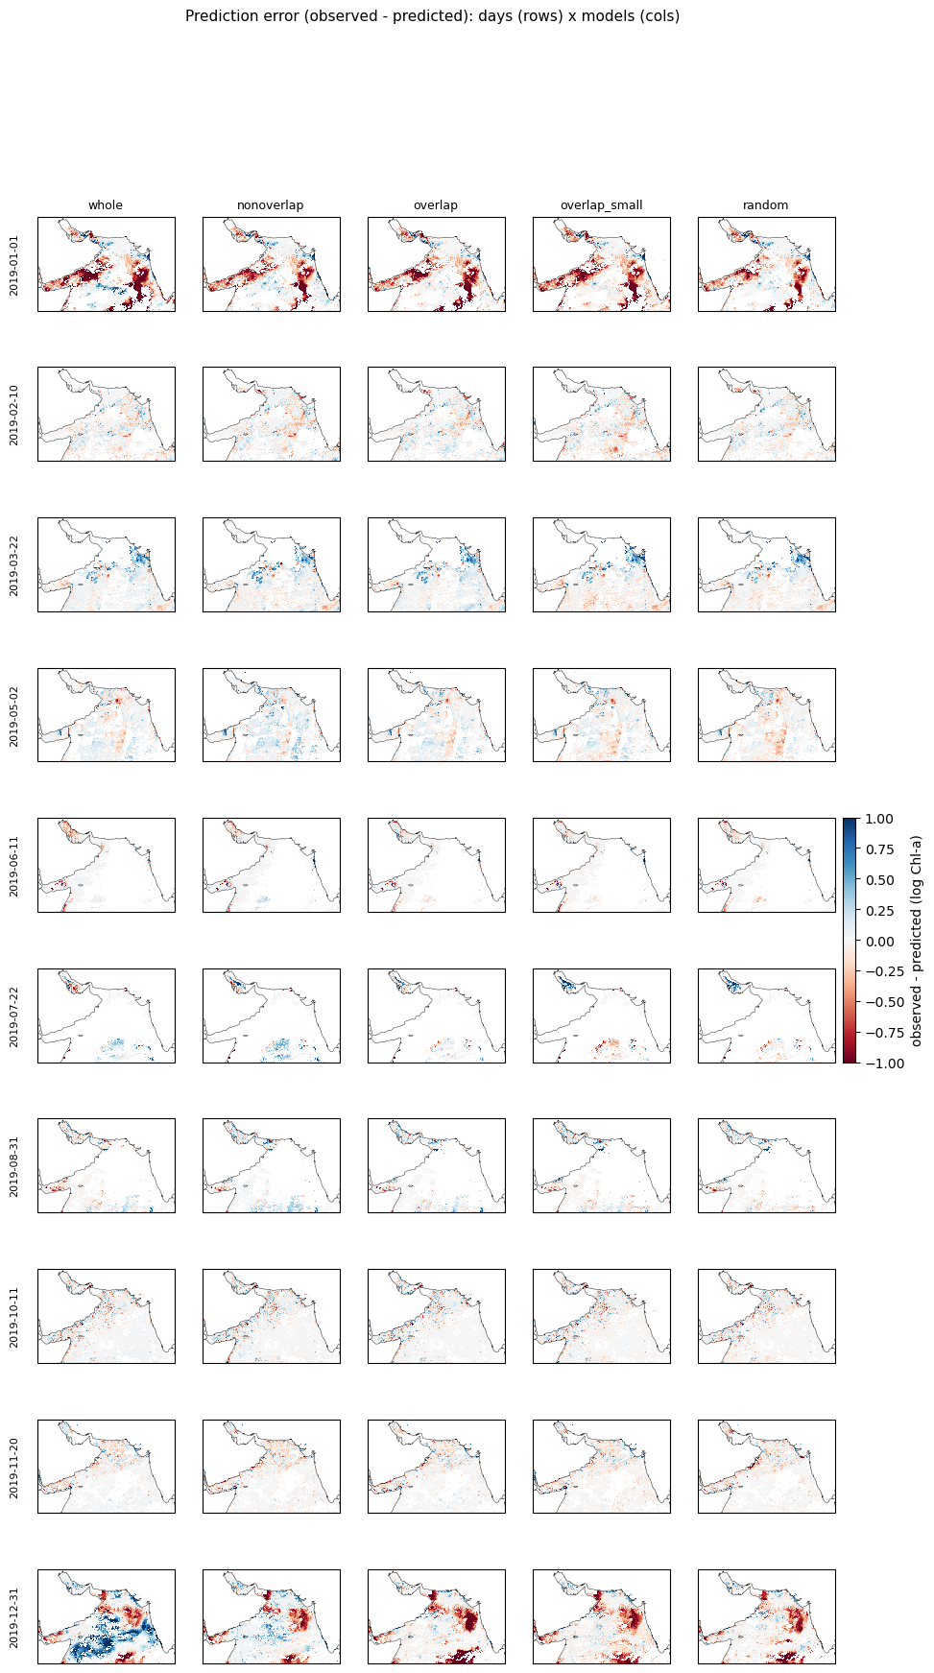
Result 3: comparing patch strategies
• Trained whole / non-overlap / overlap / small-overlap / random-crop tiles; scored with fake-cloud MAE.
• Random-crop augmentation did best (MAE 0.22 vs ~0.27 for whole-domain).
• Found non-overlapping tiles cover only ~57% of the region, and some tile shapes crash the GPU (cuDNN).
• Single-seed so far — confirming the ranking with a 5-seed run.
Prediction error (obs - pred): 10 days (rows) x 5 strategies (cols). Red = under, blue = over

Slide 9
Tools: where and when does it struggle?
• overall_perf — error over time with the training years marked: shows the train-vs-test gap and seasonal swings.
• spatial_perf — a per-pixel (and per-month) error map: the model struggles most along the coast and in high-chlorophyll blooms.
• Both added to the mindthegap package so the whole team can use them.
• These turn a single MAE number into "when" and "where" the model is weak.

Slide 10
What's next: global PACE
• Scale from one region (104 x 152) to global PACE (1800 x 3600).
• PACE has no gap-free truth -> the self-supervised evaluation I built is exactly what's needed.
• Global extent needs tiling -> the spatial-patch strategies I compared feed straight into that.
• Open questions: banded (orbital-swath) gaps, fewer input variables, and telling the model where each tile sits.

