Slide 1


CGB1201 – JAVA PROGRAMMING PROJECT REVIEW-2
Department of Computer Science and Engineering
Academic Year: 2024 – 2025 (Odd Semester)
Register Number : 2303811710422134
Name : SAGANA S
Year : II
Semester : III
Section : C
Date : 6/12/2024

Slide 2
TITLE OF THE PROJECT
PASSWORD GENERATOR

Slide 3
AGENDA
Abstract
Introduction
Java Programming – Concepts Used
Proposed Architecture
Module Description
Result and Discussion
Conclusion

Slide 4
ABSTRACT
This project presents a Custom Password Generator application that empowers users to create passwords of desired complexity by specifying the number of uppercase letters, lowercase letters, numbers, and symbols. The application leverages Secure random for cryptographically strong randomization, ensuring password unpredictability. By integrating principles of object-oriented programming (OOP), the application achieves modularity, reusability, and robustness. The graphical interface, built with Java AWT, ensures ease of use, catering to a wide audience. This system showcases the application of secure coding practices and design.

Slide 5
INTRODUCTION
Password security is a cornerstone of digital safety. With the proliferation of online services, users are required to manage numerous passwords. A strong password with a mix of uppercase, lowercase, numbers, and symbols provides better protection against unauthorized access. The Custom Password Generator application aims to simplify the process of creating secure and custom passwords tailored to user preferences. Built using Java AWT, this user-friendly desktop application combines robust password.

Slide 6
JAVA PROGRAMMING - CONCEPTS USED
1.Encapsulation
2.Abstraction
3.Inheritance
4.Polymorphism

Slide 7
PROPOSED ARCHITECTURE
UperrCase
&
LowerCase
User Input
Number
Cobain All Inputs
Symbols
Gendered
Password

Slide 8
MODULE DESCRIPTION
1.java.awt:
Provides classes for creating a graphical user interface (GUI).Used here for components like Frame, Label, Button, Text Field, Flow Layout, and Color.
2.java.awt.event:
Provides classes and interfaces for event handling in GUI applications . Used here for ActionListener and Window adapter to handle button click events and window closing events.
3.java.security:
Provides classes for secure random number generation and other cryptographic operation . Secure random is used here to ensure randomness while generating characters for the password.

Slide 9
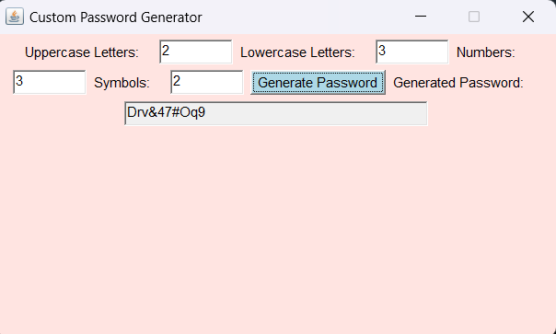
RESULTS AND DISCUSSION

Slide 10
CONCLUSION
The Custom Password Generator simplifies the creation of secure, custom passwords for a variety of applications. By combining Java AWT for a dynamic user interface and strong password generation techniques, this project demonstrates the importance of secure coding and user-centric design in software applications. The use of OOP concepts enhances the application’s maintainability and scalability.

Slide 11
THANK YOU

