Slide 1

Object Oriented Analysis and Design
CRC for a case study
Dr. Sudeepa Roy Dey
Department of Computer Science and Engineering

Slide 2
Object Oriented Analysis and Design
CRC for a case study
Dr. Sudeepa Roy Dey
With grateful thanks for contribution of slides to:
Prof. Ruby D, Asst Professor at the Department of CSE, PESU-EC
Department of Computer Science and Engineering

Slide 3
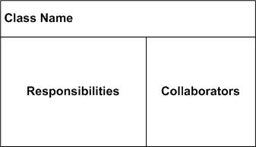
CRC (Class-Responsibility-Collaborators)
CRC cards are tool used for brainstorming in OO design and agile methodologies
CRC cards are created from Index cards
Each member of the project team write one CRC card for each relevant class/object of their design
Objects need to interact with other objects (Collaborators) in order to fulfill their responsibilities
Since the cards are small, prevents to get into details and give too many responsibilities to a class
They can be easily placed on the table and rearranged to describe and evolve the design

Slide 4
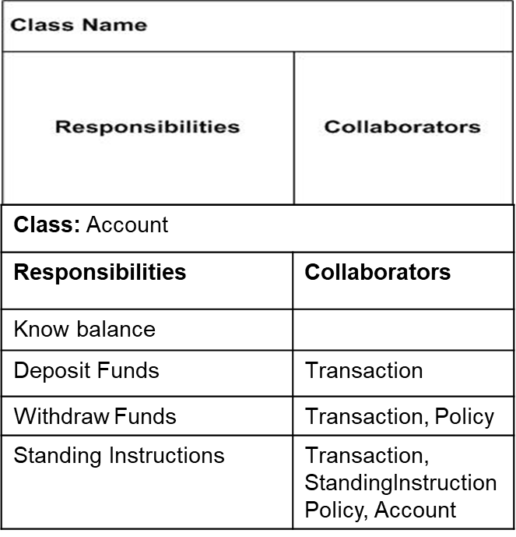
What is a CRC Card?
CRC stands for Class, Responsibility and Collaboration.
Class
An object-oriented class name
Include information about super- and sub-classes
Responsibility
What information this class stores
What this class does
The behavior for which an object is accountable
Collaboration
Relationship to other classes
Which other classes this class uses
Ex: CRC card

Slide 5
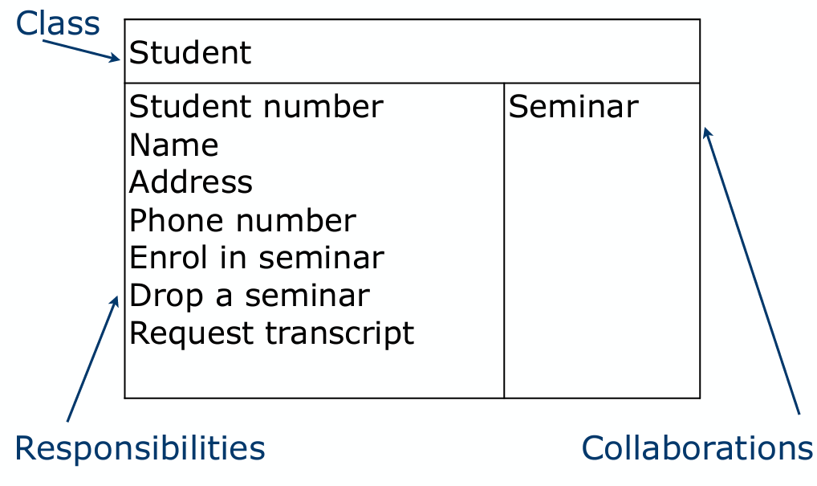
Example: Student CRC card.
A responsibility is anything that a class knows or does. The things a class knows and does constitute its responsibilities.
For example, students have names, addresses, and phone numbers. These are the things a student knows.
Students also enroll in seminars, drop seminars, and request transcripts. These are the things a student does.
Students only have information about themselves (their names and so forth), and not about seminars. What the student needs to do is collaborate/interact with the card labeled Seminar to sign up for a seminar. Therefore, Seminar is included in the list of collaborators of Student.
Refer to link : https://agilemodeling.com/artifacts/crcmodel.htm for details

Slide 6
CRC Card
CRC cards are an aid to a group role-playing activity.
Index cards are used in preference to pieces of paper due to their robustness and to the limitations that their size (approx. 15cm x 8cm) imposes on the number of responsibilities and collaborations that can be effectively allocated to each class.
A class name is entered at the top of each card and responsibilities and collaborations are listed underneath as they become apparent.
For the sake of clarity, each collaboration is normally listed next to the corresponding responsibility.
From a UML perspective, use of CRC cards is in analyzing the object interaction that is triggered by a particular use case scenario.
The process of using CRC cards is usually structured as follows.
1.Conduct a session to identify which objects are involved in the use case.
2. Allocate each object to a team member who will play the role of that object.
3. Act out the use case.
4. Identify and record any missing or redundant objects.

Slide 7
References
[1] “Applying UML and Patterns: An Introduction to Object-Oriented Analysis and Design and Iterative Development”, by Craig Larman, 3rd Edition, Pearson 2015.
[2] "Object-Oriented Software Engineering: Practical Software Development using UML and Java", Timothy C. Lethbridge, Robert Laganière, Second edition, Mc Gram Hill,2016
[3] “Object-Oriented Modelling and Design with UML”, Michael R Blaha and James R Rumbaugh, 2nd Edition, Pearson 2007.
[4] https://agilemodeling.com/artifacts/crcmodel.htm

Slide 8

THANK YOU
Dr. Sudeepa Roy Dey
Department of Computer Science and Engineering
sudeepar@pes.edu

