Slide 1
Battery Health State Classification
Objective: Documenting the complete modelling pipeline, explain the improvement from 78.5% to 89.5% test accuracy, and interpretation of the two multiclass confusion matrices.
Dataset: Kaggle-hosted NASA battery cycling dataset Final evaluation set: 600 discharge-cycle samples Classes: Healthy, Degrading, Critical
NAME - SAGNIK BHATTACHARYYA
ENROLLMENT NUMBER - 12023052003048 A-47
ELECTRONICS AND COMMUNICATION ENGINEERING INSTITUTE OF ENGINEERING AND MANAGEMENT

Slide 2
1. Executive Summary
The project builds a supervised machine-learning system that classifies a battery discharge cycle into three health states: Healthy, Degrading, or Critical. The target is derived from State of Health (SOH), where SOH is calculated relative to the battery's own initial capacity. The supplied baseline experiment produced 78.5% test accuracy. The improved pipeline produced 89.5% test accuracy on the same 600-sample test size.
The improvement was not caused by one isolated change. It came from a combination of (1) richer discharge-curve features, (2) per-battery relative features that normalize a cycle against the battery's own early-life behavior, (3) capacity/energy proxy features derived directly from the discharge curve, (4) battery-grouped train/test separation, and (5) hyperparameter tuning/model selection, with the final supplied 89.5% matrix corresponding to a Decision Tree.
The most important interpretation is that the improved model does not merely predict 'Healthy' more often. The Degrading class becomes much easier to identify: its true positives rise from 89 to 132 and its recall rises from 49.2% to 72.9%.
Critical detection also improves from 5 to 25 true positives, with zero false negatives in the supplied test matrix.
Important correction: the supplied confusion matrices do not show a decrease in true positives. True positives increase for all three classes: Healthy 377→380, Degrading 89→132, and Critical 5→25. What changes is the distribution of errors, especially the large reduction in Degrading and Critical samples being incorrectly predicted as Healthy.
 | Measure | Baseline | Improved | Change
 | Test samples | 600 | 600 | Same evaluation size
 | Accuracy | 78.5% | 89.5% | +11.0 percentage points
 | Correct predictions | 471 | 537 | +66
 | Incorrect predictions | 129 | 63 | −66
 | Macro F1 | 0.582 | 0.910 | +0.328

Slide 3
Why This Dataset Was Chosen
The project uses a Kaggle-hosted version of the NASA battery dataset. The notebook identifies 7,565 metadata records covering charge, discharge, and impedance tests. The modelling pipeline focuses specifically on discharge records because discharge behavior directly exposes capacity, voltage, current, temperature and time characteristics associated with battery aging.
This dataset is appropriate for the task for several practical reasons:
  Repeated cycling: each battery is observed over multiple cycles, allowing degradation to be studied as a progression rather than as isolated observations.
  Battery identity is available: the model can preserve battery-level grouping during evaluation, which is important because cycles from the same physical battery are not independent experiments.
  Measured electrical and thermal signals: voltage, current, temperature and time are available at the discharge-curve level and can be converted into meaningful cycle-level features.
  Capacity information: the metadata contains discharge capacity, which allows SOH to be calculated and converted into supervised health classes.
  Real experimental variation: ambient temperature, load behavior and battery-to-battery differences create a more realistic classification problem than a perfectly clean synthetic dataset.
In the executed baseline notebook, 2,794 discharge records were found across 34 batteries. After removing invalid rows, duplicates and implausible records, the modelling table contained 2,562 cycle-level samples.
 | Dataset stage | Count
 | All metadata records | 7,565
 | Discharge records | 2,794
 | Batteries represented in discharge data | 34
 | Final cleaned cycle-level samples | 2,562
Why this matters: the final model is not learning from a single measurement such as voltage. It learns a health state from a compact representation of the entire discharge behavior of each cycle.

Slide 4
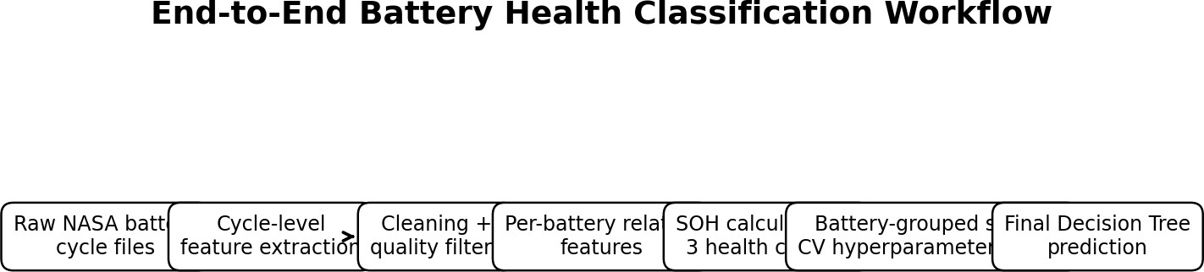
3. From Raw Battery Files to a Machine-Learning Table
Figure 1. End-to-end workflow used to convert raw battery-cycle files into health predictions.
Each discharge CSV contains time-series measurements. The feature-extraction function reads Voltage_measured, Current_measured, Temperature_measured and Time. Instead of feeding every raw time point into the classifier, the project summarizes each discharge cycle into physically interpretable statistics.
The resulting modelling row represents one discharge cycle of one battery. It contains cycle number, ambient temperature, voltage statistics, current statistics, temperature statistics and time-based discharge indicators. In the improved pipeline, two additional curve-derived quantities are also computed: coulomb-counted estimated capacity and delivered energy.
This conversion is important because tree-based classifiers operate on a tabular feature matrix. It also reduces the dimensionality of the raw time series while retaining information that is relevant to battery degradation.
Feature family | Examples | What it captures
Voltage | v_mean, v_min, v_max, v_std | Operating voltage level and discharge-curve spread
Current | i_mean | Typical discharge load
Temperature | temp_mean, temp_max, temp_rise | Thermal behavior during discharge
Time | discharge_time_s, time_to_3_5V_s | How long the battery sustains discharge / reaches a voltage thr
Operating context | cycle, ambient_temperature | Age and environmental conditions
Curve-derived | cap_est_ah, energy_wh | Approximate charge throughput and delivered energy
eshold

Slide 5
Data Cleaning and Preprocessing
The baseline notebook first constructs the cycle-level table and then applies quality filters. Infinite values are replaced with missing values, missing rows are removed, duplicates are removed, capacity is restricted to a physically plausible interval, and extremely short discharge records are excluded.
The final cleaning rules used for the modelling table were:
  Replace positive/negative infinity with missing values and drop rows containing missing values.
  Remove duplicate cycle-level rows.
  Keep capacity values greater than 0.2 Ah and less than 2.5 Ah.
  Keep discharge records longer than 60 seconds.
  Sort observations by battery ID and cycle number before calculating battery-specific baselines.
The improved notebook then adds an important normalization step. For each battery, the first three valid discharge cycles are treated as an approximate 'as-new' reference. Several features are divided by the median of those first three cycles. This creates relative features such as cap_est_ah_rel, energy_wh_rel, discharge_time_s_rel, time_to_3_5V_s_rel and v_mean_rel.
This matters because absolute measurements can differ between batteries for reasons unrelated to aging. A raw discharge time of 3,000 seconds may mean something different for two batteries with different starting characteristics. A ratio such as current-cycle discharge time divided by that battery's early-life discharge time asks a more useful question: how much has this battery changed relative to itself?
The separate full-dataset preprocessing section also demonstrates missing-value imputation, IQR-based clipping, power calculation, time differences, categorical encoding, standardization and min-max normalization. These operations document a broader cleaned dataset, while the final classification experiment relies on its explicitly defined cycle-level feature set.

Slide 6
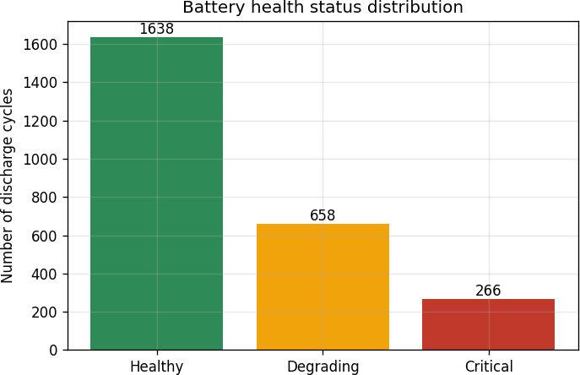
5. Defining State of Health and the Three Classes
State of Health is computed per battery rather than using one universal starting capacity. The notebook calculates the median capacity of the first three discharge cycles and defines:
SOH = current discharge capacity / median capacity of the first three discharge cycles
The resulting SOH is then converted to three discrete health states:
SOH range | Class | Interpretation used in the project
SOH ≥ 0.85 | Healthy | Capacity remains at or above 85% of the battery's initial reference level.
0.75 ≤ SOH < 0.85 | Degrading | The battery has crossed the first degradation threshold but has not reached
SOH < 0.75 | Critical | The battery is below 75% of its initial reference capacity.
the critical thres
The cleaned dataset contains 1,638 Healthy cycles, 658 Degrading cycles and 266 Critical cycles. Therefore, the classes are imbalanced: Healthy is the largest class and Critical is the smallest. This imbalance is one reason the modelling code uses class_weight='balanced' in the baseline Random Forest and in the tuned Decision Tree/SVM candidates.
Figure 2. Distribution of the three battery-health classes in the cleaned modelling data.

Slide 7
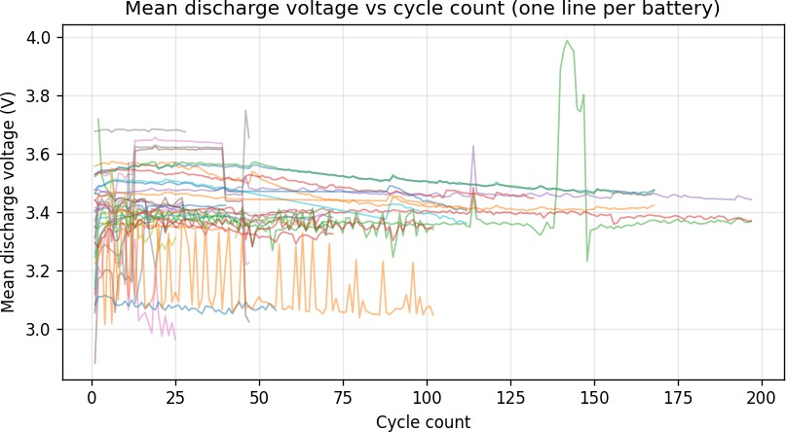
6. Exploratory Analysis: Mean Discharge Voltage
Figure 3. Mean discharge voltage versus cycle count, with one line per battery.
The voltage plot shows that battery behavior is not identical from one battery to another. Most trajectories occupy a relatively narrow band, while some batteries show lower values, abrupt changes or irregular sections. This is exactly why relying on one raw voltage threshold would be insufficient for health classification.
The model instead receives several voltage descriptors: mean, minimum, maximum and standard deviation. Together these describe both the overall voltage level and the variability of the discharge curve.
The baseline Random Forest's recorded feature-importance output ranked i_mean, time_to_3_5V_s, v_std, cycle and temp_rise among its top five features. This supports the modelling decision to use multiple physical signals rather than a single voltage statistic.
A useful interpretation is that degradation is expressed through a combination of electrical and temporal behavior. A battery that reaches 3.5 V unusually early, changes its voltage profile, heats differently, or behaves differently under load can provide information about its health state even when its average voltage alone looks normal.

Slide 8
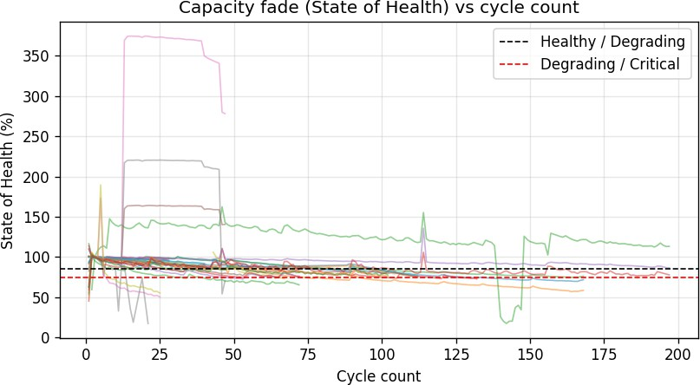
7. Exploratory Analysis: Capacity Fade and Health Boundaries
Figure 4. State of Health versus cycle count. Dashed lines indicate the 85% and 75% class boundaries.
The capacity-fade plot is central to the problem because the class label is derived from SOH. The 85% line separates Healthy from Degrading, while the 75% line separates Degrading from Critical.
The trajectories are not perfectly smooth. Some batteries remain at high SOH for many cycles and then fall rapidly; others show fluctuations or unusual values. This explains why cycle count is informative but not sufficient. Two cycles with similar cycle numbers can belong to different health states if the batteries have different starting characteristics or degradation trajectories.
The improved feature engineering attempts to address this variation by adding relative-to-baseline measurements. These features encode the direction and magnitude of change for each individual battery, making the classifier less dependent on absolute scale.
Class imbalance is visible in the distribution: 1,638 Healthy, 658 Degrading and 266 Critical cycles. Because Critical is the smallest class, a model that simply favors the majority class could achieve a deceptively respectable accuracy while missing critical batteries. Therefore the confusion matrix and class-level recall are more informative than accuracy alone.

Slide 9
8. Baseline Model: Why Random Forest Was Used First
The first modelling experiment uses a Random Forest Classifier with 300 trees, maximum depth 12, balanced class weights, a fixed random seed and parallel execution. The choice is technically reasonable for a first baseline because Random Forests are strong tabular-data models and can capture nonlinear interactions without requiring feature scaling.
Random Forest was particularly suitable as a starting point because the feature table mixes quantities with very different units: volts, seconds, amperes, degrees Celsius and cycle counts. A tree ensemble does not require these variables to be standardized before splitting. It can also model threshold-like relationships naturally, for example a change in discharge time or temperature becoming more informative after a certain point.
The baseline experiment uses GroupShuffleSplit by battery ID. The test set contains nine batteries: B0007, B0031, B0032, B0039, B0040, B0043, B0048, B0049 and B0054. The baseline therefore evaluates generalization to batteries that were not used for training, rather than randomly mixing cycles from the same battery between train and test.
 | Baseline setting | Value
 | Model | RandomForestClassifier
 | Number of trees | 300
 | Maximum depth | 12
 | Class weighting | balanced
 | Random state | 42
 | Train samples | 1,962
 | Test samples | 600
 | Evaluation grouping | Battery ID
The baseline achieved 78.5% accuracy: 471 of 600 test cycles were classified correctly.

Slide 10
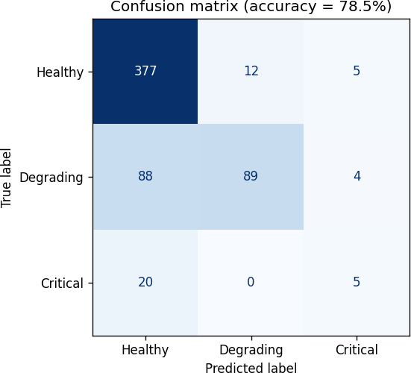
9. Baseline Confusion Matrix: Where the 78.5% Model Fails
Figure 5. Baseline confusion matrix, accuracy = 78.5%. Rows are true labels; columns are predicted labels.
The diagonal entries are correct predictions: 377 Healthy, 89 Degrading and 5 Critical, for a total of 471 correct predictions. The off-diagonal cells show the errors.
True class | Predicted Healthy | Predicted Degrading | Predicted Critical | Total
Healthy | 377 | 12 | 5 | 394
Degrading | 88 | 89 | 4 | 181
Critical | 20 | 0 | 5 | 25
The main weakness is Degrading recall: only 89 of 181 Degrading cycles are correctly detected, while 88 are incorrectly labelled Healthy. Critical recall is also low: 5 of 25 Critical cycles are detected, while 20 are incorrectly labelled Healthy.
In other words, the baseline has a strong tendency to confuse degraded batteries with Healthy batteries. This is more consequential than the small number of Healthy→Critical errors because the largest error block is the failure to recognize degradation.
Class | Precision | Recall | F1
Healthy | 77.7% | 95.7% | 85.8%
Degrading | 88.1% | 49.2% | 63.1%
Critical | 35.7% | 20.0% | 25.6%

Slide 11
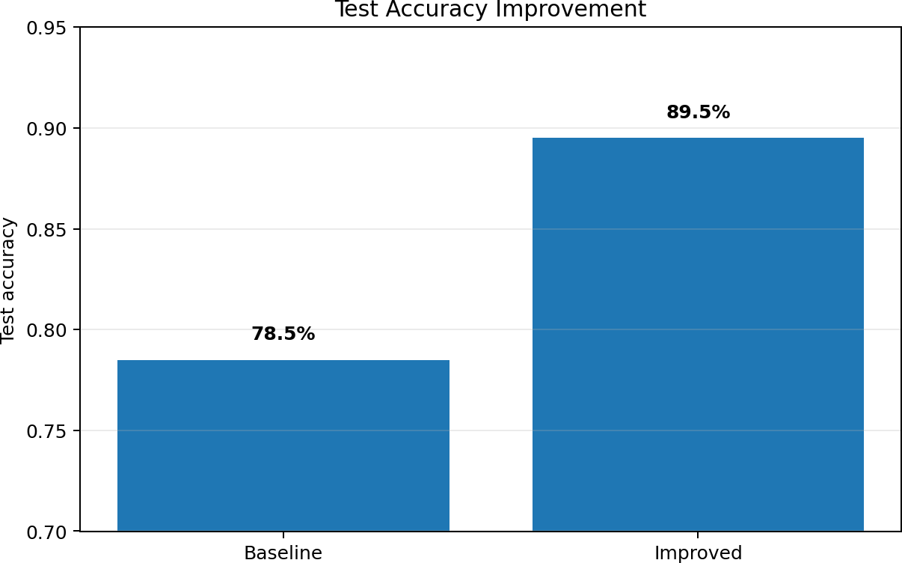
What Was Changed to Improve the Model
The improved experiment changes the representation of each battery cycle before asking the classifier to make a decision. This is the most important part of the improvement story.
  Added coulomb-counted capacity estimate. The improved feature extractor integrates |current| over time to estimate discharge capacity in Ah. This is derived from the raw discharge curve rather than inserted as a label.
  Added delivered energy. The integral of |current × voltage| over time provides an energy estimate in Wh. This gives the model another summary of how much useful electrical output the battery delivered during the cycle.
  Added battery-relative features. For capacity estimate, energy, discharge duration, time to 3.5 V and mean voltage, the current value is divided by the median of that battery's first three cycles. This makes the feature express degradation relative to that battery's own baseline.
  Retained raw physical features. Cycle number, ambient temperature, voltage statistics, current, temperature and discharge-time features are retained. The model therefore has both absolute and relative descriptions.
  Kept battery-grouped evaluation. The improved notebook again uses battery ID as the grouping variable. This prevents cycles from the same battery from being deliberately scattered between training and testing during the primary evaluation.
  Tuned candidate models. The improved notebook evaluates an RBF SVM and a Decision Tree using 5-fold GroupKFold on the training batteries only. The test set is not used to choose hyperparameters. The final supplied 89.5% confusion matrix is from the selected Decision Tree.
Figure 6. Test accuracy changed from 78.5% to 89.5%, an absolute gain of 11.0 percentage points.

Slide 12
11. Why the Decision Tree Became the Final Model
The project did not simply replace Random Forest with a Decision Tree because a tree is inherently 'better'. The improved notebook introduces a model-selection stage. It defines an RBF SVM and a Decision Tree as candidates and tunes them with GroupKFold using only the training batteries. The model with the best cross-validated accuracy is selected.
For the Decision Tree, the search varies max_depth, min_samples_leaf and criterion (Gini or entropy), while balanced class weights are retained. This allows the tree complexity to be chosen from the data instead of relying on a single arbitrary depth.
A Decision Tree is also attractive for this particular application because battery health classes are defined by thresholds and combinations of physical variables. A tree can express rules of the form 'if a relative feature has crossed a certain boundary and another discharge feature is in a certain range, move toward a degraded class'. This structure is easy to explain to a teacher and can be inspected after training.
The accuracy increase should therefore be attributed to the combined pipeline change: improved features + battery-relative normalization + tuned model selection. It would be misleading to say that changing Random Forest to Decision Tree alone mathematically caused the entire 11-point improvement.
There is also an important modelling caveat. The notebook explicitly notes that the capacity-based proxy features are close to the quantity used to construct the SOH label. Although they are calculated from the raw discharge curve rather than directly copied from the label, they provide a much more direct signal of the target. Their use should be described transparently and tested in a follow-up ablation experiment.

Slide 13
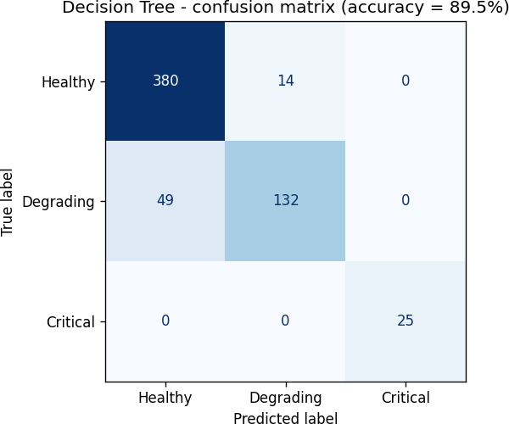
12. Improved Confusion Matrix: 89.5% Accuracy
Figure 7. Improved Decision Tree confusion matrix, accuracy = 89.5%.
The improved matrix contains 537 correct predictions and 63 incorrect predictions. Compared with the baseline, correct classifications increase by 66 while errors decrease by 66.
True class | Predicted Healthy | Predicted Degrading | Predicted Critical | Total
Healthy | 380 | 14 | 0 | 394
Degrading | 49 | 132 | 0 | 181
Critical | 0 | 0 | 25 | 25
The most striking change is the Degrading row: the baseline had 88 Degrading→Healthy errors, whereas the improved model has 49. That is a reduction of 39 such errors. Critical→Healthy errors fall from 20 to 0, and Healthy→Critical errors fall from 5 to 0.
The improved model still makes 14 Healthy→Degrading errors and 49 Degrading→Healthy errors. Therefore the model is not perfect: the main remaining ambiguity is between Healthy and Degrading, which is reasonable because these states lie next to one another at the 85% SOH boundary.

Slide 14
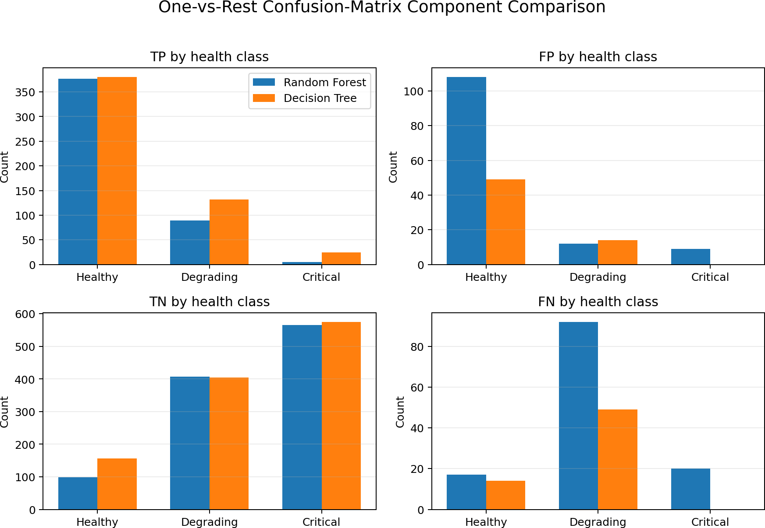
13. Detailed TP / FP / TN / FN Comparison
For a three-class problem, TP, FP, TN and FN are calculated in a one-vs-rest manner for each class. For example, when evaluating 'Degrading', Degrading is treated as the positive class and Healthy + Critical are treated as the negative class.
Model | Class | TP | FP | TN | FN
Random Forest | Healthy | 377 | 108 | 98 | 17
Random Forest | Degrading | 89 | 12 | 407 | 92
Random Forest | Critical | 5 | 9 | 566 | 20
Decision Tree | Healthy | 380 | 49 | 157 | 14
Decision Tree | Degrading | 132 | 14 | 405 | 49
Decision Tree | Critical | 25 | 0 | 575 | 0
Figure 8. One-vs-rest comparison of true positives, false positives, true negatives and false negatives.
True positives: all three classes increase. Healthy +3, Degrading +43, Critical +20. Therefore the supplied matrices do not support the statement that true positives decreased.
False negatives: these fall for every class: Healthy 17→14, Degrading 92→49, Critical 20→0. This is a major reason recall improves.
False positives: Healthy FP falls sharply from 108 to 49; Degrading FP rises slightly from 12 to 14; Critical FP falls from 9 to 0. The overall pattern is a much cleaner separation, especially for the Critical class.

Slide 15
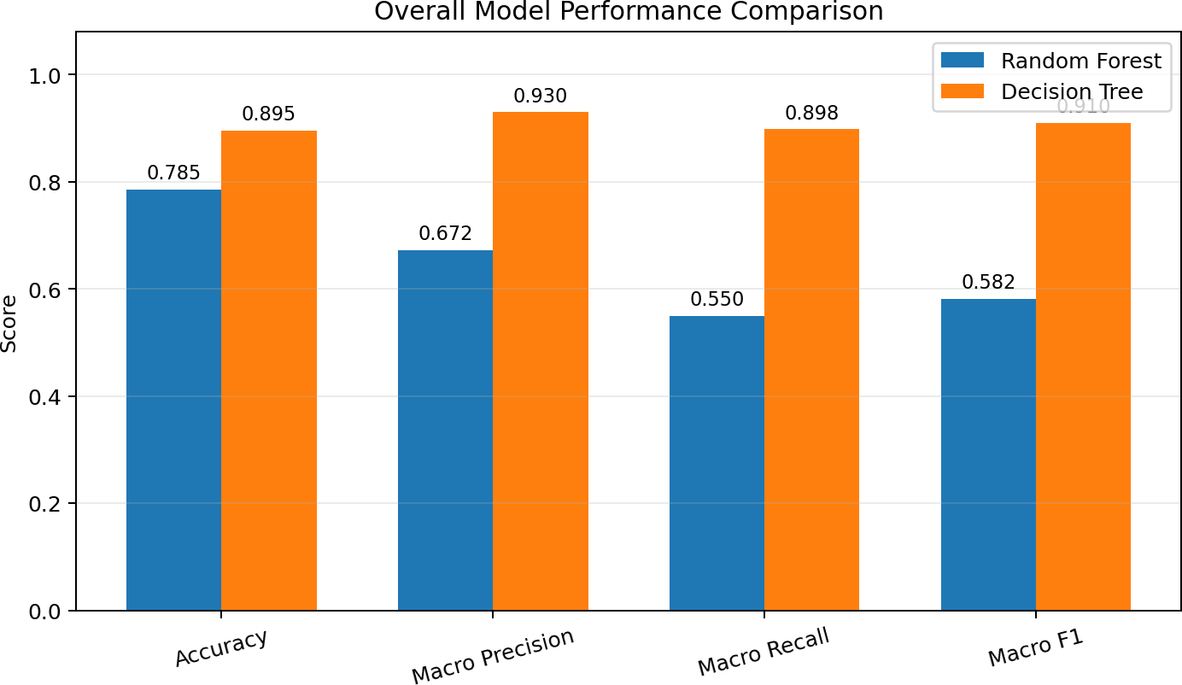
14. Quantitative Comparison of Model Performance
Figure 9. Accuracy, macro precision, macro recall and macro F1 comparison.
Metric | Random Forest | Decision Tree | Interpretation
Accuracy | 78.5% | 89.5% | 537/600 correct versus 471/600
Macro precision | 67.2% | 92.7% | Improved balance of class-wise precision
Macro recall | 55.0% | 89.8% | Much better detection across classes
Macro F1 | 58.2% | 91.0% | Strong improvement in balanced class performance
The accuracy gain is 11.0 percentage points, equivalent to 66 additional correct predictions out of the same 600 test samples. The error count is cut almost in half, from 129 to 63.
The most meaningful class-level improvement is recall. Healthy recall rises from 95.7% to 96.4%, Degrading recall rises from 49.2% to 72.9%, and Critical recall rises from 20.0% to 100.0%. Thus the accuracy increase is not simply caused by predicting the majority Healthy class more aggressively; the model actually detects more Degrading and Critical cases.
At the same time, the result should not be treated as universal proof that a Decision Tree will always outperform a Random Forest. It is a result for this particular feature engineering process, split, tuning configuration and test set. A stronger validation study would repeat grouped evaluation over multiple battery partitions.

Slide 16
Final Interpretation, Limitations and Future Work
What was achieved. The project transformed raw battery discharge files into a supervised health-classification problem, cleaned 2,794 discharge records down to 2,562 usable cycle-level observations, created three SOH-based classes, and established a battery-grouped evaluation. The baseline Random Forest reached 78.5% accuracy. The improved feature/model-selection pipeline produced the supplied Decision Tree result of 89.5%.
Why accuracy increased. The strongest explanation supported by the notebooks is that the improved model receives more informative information about degradation. Coulomb-counted capacity and energy describe the discharge curve more directly; relative features compare each cycle with the battery's own early-life baseline; and tuning lets the final tree use an appropriate complexity. These changes reduce the major baseline failure mode: degraded batteries being labelled Healthy.
What the confusion matrices prove. The improved model makes 537 correct predictions versus 471 for the baseline. Degrading TP rises from 89 to 132, Critical TP rises from 5 to 25, and all class false negatives decrease. Therefore, the statement 'accuracy increased but true positives decreased' is not supported by the supplied matrices.
Important limitations.
  The dataset is relatively imbalanced, with far fewer Critical samples than Healthy samples.
  The target label is derived from capacity, and some new features are also capacity/energy proxies. This can make the classification easier and creates a potential target-proxy/leakage concern that should be investigated.
  Only one held-out grouped test partition is shown in the supplied results. Repeated GroupKFold or leave-one-battery-out evaluation would provide a stronger estimate of generalization.
  The model predicts a discrete health state rather than a continuous remaining useful life (RUL) estimate.
  The supplied improved notebook contains the tuning procedure but does not preserve the printed candidate-model CV table in its stored outputs; therefore this report does not invent exact cross-validation scores.
Recommended next experiments. Run an ablation study removing the capacity proxy features, compare the tuned tree against Random Forest, Gradient Boosting and SVM under identical grouped folds, report mean ± standard deviation across folds, and evaluate calibration/confidence for Critical predictions. A continuous SOH regression model can also be developed alongside the three-class classifier.
Overall, the project demonstrates a clear engineering progression: raw measurements → physically meaningful features → battery-relative normalization → controlled grouped evaluation → tuned classifier → detailed error analysis. The 89.5% result is best understood as the outcome of that complete pipeline rather than a single algorithm swap.

