Slide 1

Gender-Differentiated Price Index and Inflation
Forecast for High Female-Consumption Products in Mexico
December 2, 2025
Arthur Beltrao
(Brazil/IBGE)
Itzel Sanchez
(Mexico/INEGI)

Slide 2
G-CPI Forecast for High Female-Consumption Products in Mexico
Project Purpose
ANALYTICAL SCOPE

Slide 3

The project aims to evaluate whether inflation affects women differently than men by constructing a gender-differentiated price index for Mexico.
Consumption patterns will be analyzed using ENIGH expenditure microdata, distinguishing female-headed and male-headed households.
Products with high female-consumption intensity (e.g., personal care, childcare, healthcare, education) will be identified and grouped for focused measurement.
Price dynamics from the CPI (INPC in Spanish) will be combined with gender-specific expenditure weights to compute a gender-sensitive inflation series.
The study will also produce a forecast for female-consumption product inflation, generating insights relevant to economic vulnerability and public policy.

Slide 4
GOALS SET WITH THE MENTOR (16-WEEK PROGRAMME)
Identify and classify high female-consumption products using ENIGH.
Compute gender-specific expenditure weights for consumption baskets.
Replicate 2022 inflation behaviour of those product groups using INPC.
Train forecasting models to predict future inflation pressures.
Deliver a complete analytical report and presentation summarising findings.

Slide 5
G-CPI FORECAST FOR HIGH FEMALE-CONSUMPTION PRODUCTS IN MEXICO
TIMELINE
STAGE 1
Weeks 1-4
STAGE 2
Weeks 5-8
STAGE 3
Weeks 9-12
STAGE 4
Weeks 13-16
Data preparation + Inflation replication
Identify high female-consumption products +Weighting model
Price index construction + Forecastig
Interpretation + Reporting
CPI inlfation replication for 2022
Gender-specific expenditure weights
Gender-differentiated inlfation + Forecast
Interpretation +Reporting

Slide 6
MILESTONES COMPLETED
Python/Jupyter workflow established for CPI replication and inflation forecasting.
ENIGH methodology clarified for CPI weighting:
    Traditional ENIGH (biennial) historically used for CPI weights.
    Seasonal ENIGH 2022 incorporated in the latest CPI update to better capture year-round consumption.
Analysis conducted to determine the most appropriate series to work with.
Key household and expenditure variables evaluated for G-CPI construction.
Changes in CPI methodology over time were reviewed.
Differences between Traditional and Seasonal ENIGH datasets analyzed to guide variable selection.
Methodological roadmap established for G-CPI development.

Slide 7
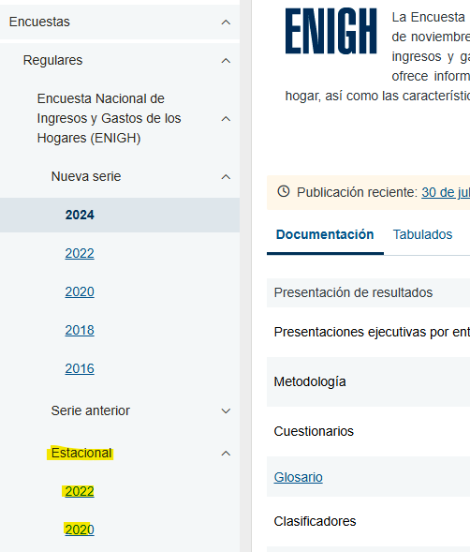
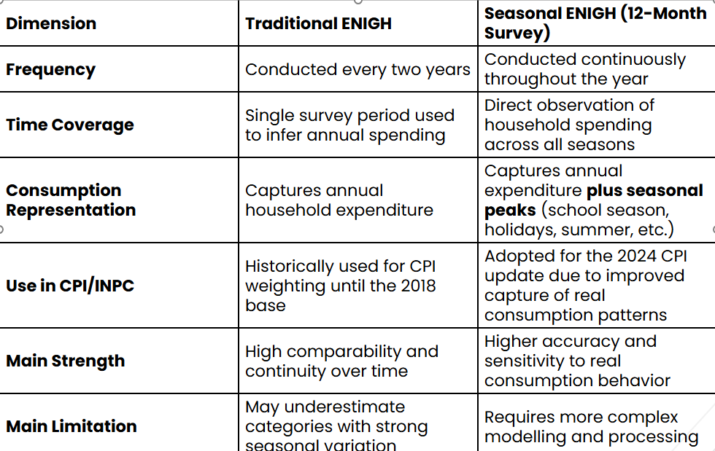
National Survey of Household Income and Expenditures (ENIGH)
Survey | Households surveyed
Traditional ENIGH 2022 | 105,525 households
Seasonal ENIGH 2022 (ENIGH Estacional) | 50,968 households

Slide 8
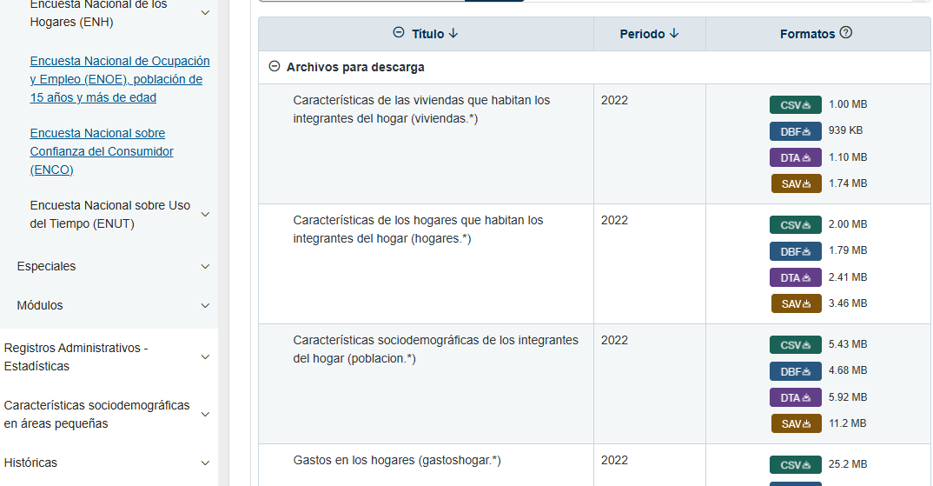

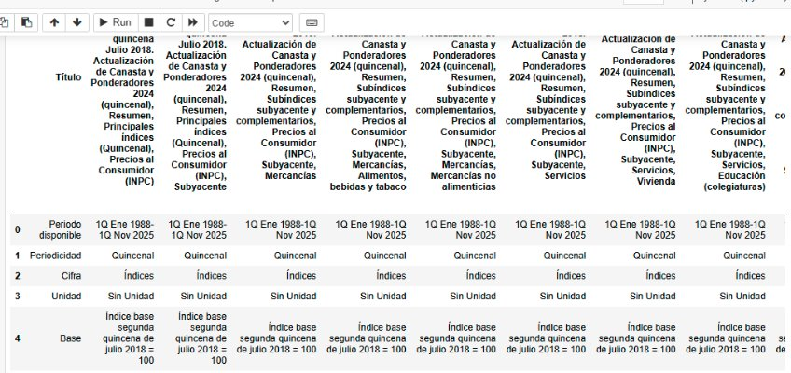
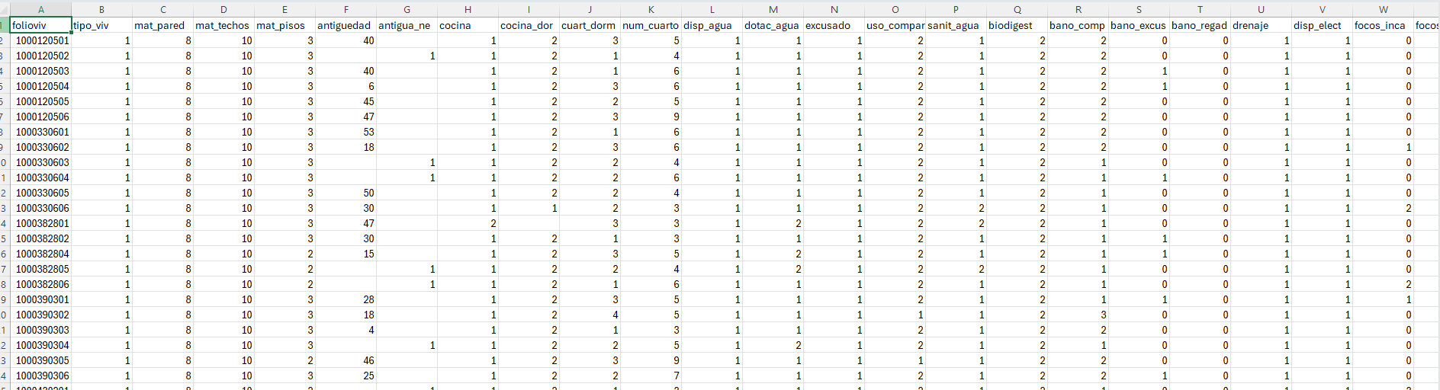
The viviendas.csv file from the ENIGH Estacional 2022 survey contains approximately 90 to 100 variables, covering housing characteristics such as construction materials, access to basic services, tenure status, household equipment, and geographic identifiers.

Slide 9
Key Contribution of the Project
Technical Contribution
Develops a gender-differentiated measure of inflation
Based on real expenditure evidence, not assumptions
Social & Policy Contribution
Reveals whether inflation disproportionately affects women
Supports:
• Gender-aware poverty and vulnerability analysis
• More precise targeting of social programmes
• Improved policy design around cost of living
TEXTO DE EJEMPLO

Slide 10

¡GRACIAS!

