Slide 1
G-CPI
Gender-Differentiated Consumer Price Index for Mexico
Measuring inflation by household headship type using ENIGH 2022 × CPI CCIF 2018 price indices
Itzel Sanchez | INEGI — Mexico Mentor: Arthur Beltrao | IBGE — Brazil International Data Science Accelerator — Cohort VI | March 11, 2026

Slide 2

The Research Question
What the official CPI cannot tell us — and why it matters
Does the inflation rate differ across households depending on the sex and partnership status of the head of household?
📊 Official CPI = one basket for everyone
🏠 Household structure shapes spending
⚖️ The hypothesis to test
Mexico's CPI assigns a single national basket to all 130 million residents. It does not account for differences in how different types of households actually spend their income.
A single-person household eats out more. A household with children spends more on education. These structural differences translate directly into different inflation exposure.
Female-headed households — especially female-alone (FWoP) — were hypothesised to face higher inflation due to income constraints and consumption patterns. The data was expected to confirm this.

Slide 3
Study Overview
16-week IBGE/INEGI collaboration — six analytical components
Data
G-CPI vs CPI
01
ENIGH 2022 seasonal · 50,968 households · CPI CCIF 2018 price indices
04
Counterfactual: official weights applied to G-CPI groups · Bias quantification
Methodology
Forecast 2026
02
4 household headship groups · Laspeyres-type G-CPI formula · 13 divisions
05
SARIMA(1,0,1)(1,0,1,12) · ADF stationarity · Ljung-Box validation
Results
Generics deep-dive
03
Inflation series 2022–2025 · Vulnerability ranking · Gap decomposition
06
292 INPC generic products · 35 gender/age-tagged · next-step roadmap

Slide 4
Section 1
Data Sources

Slide 5
Mexico's Consumer Price Index (CPI / INPC)
Published by INEGI — bi-monthly, national coverage, base July 2018 = 100
CCIF 2018 classification
Uses the international COICOP standard (13 divisions). Enables comparison with Brazil, UK ONS, and other G-CPI programs.
292 generic products
The basket is built from 292 genéricos updated in 2024. The G-CPI maps its 13 division weights directly to these price series.
Study window: 2022–2025
G-CPI is computed for all 48 months. Analysis focuses on Jan 2023–Dec 2025 (36 months) after the 2022 high-volatility period.
Why the 2022 peak matters
The post-COVID inflation spike validates the G-CPI approach: macro shocks hit groups differently depending on their basket composition.

Slide 6
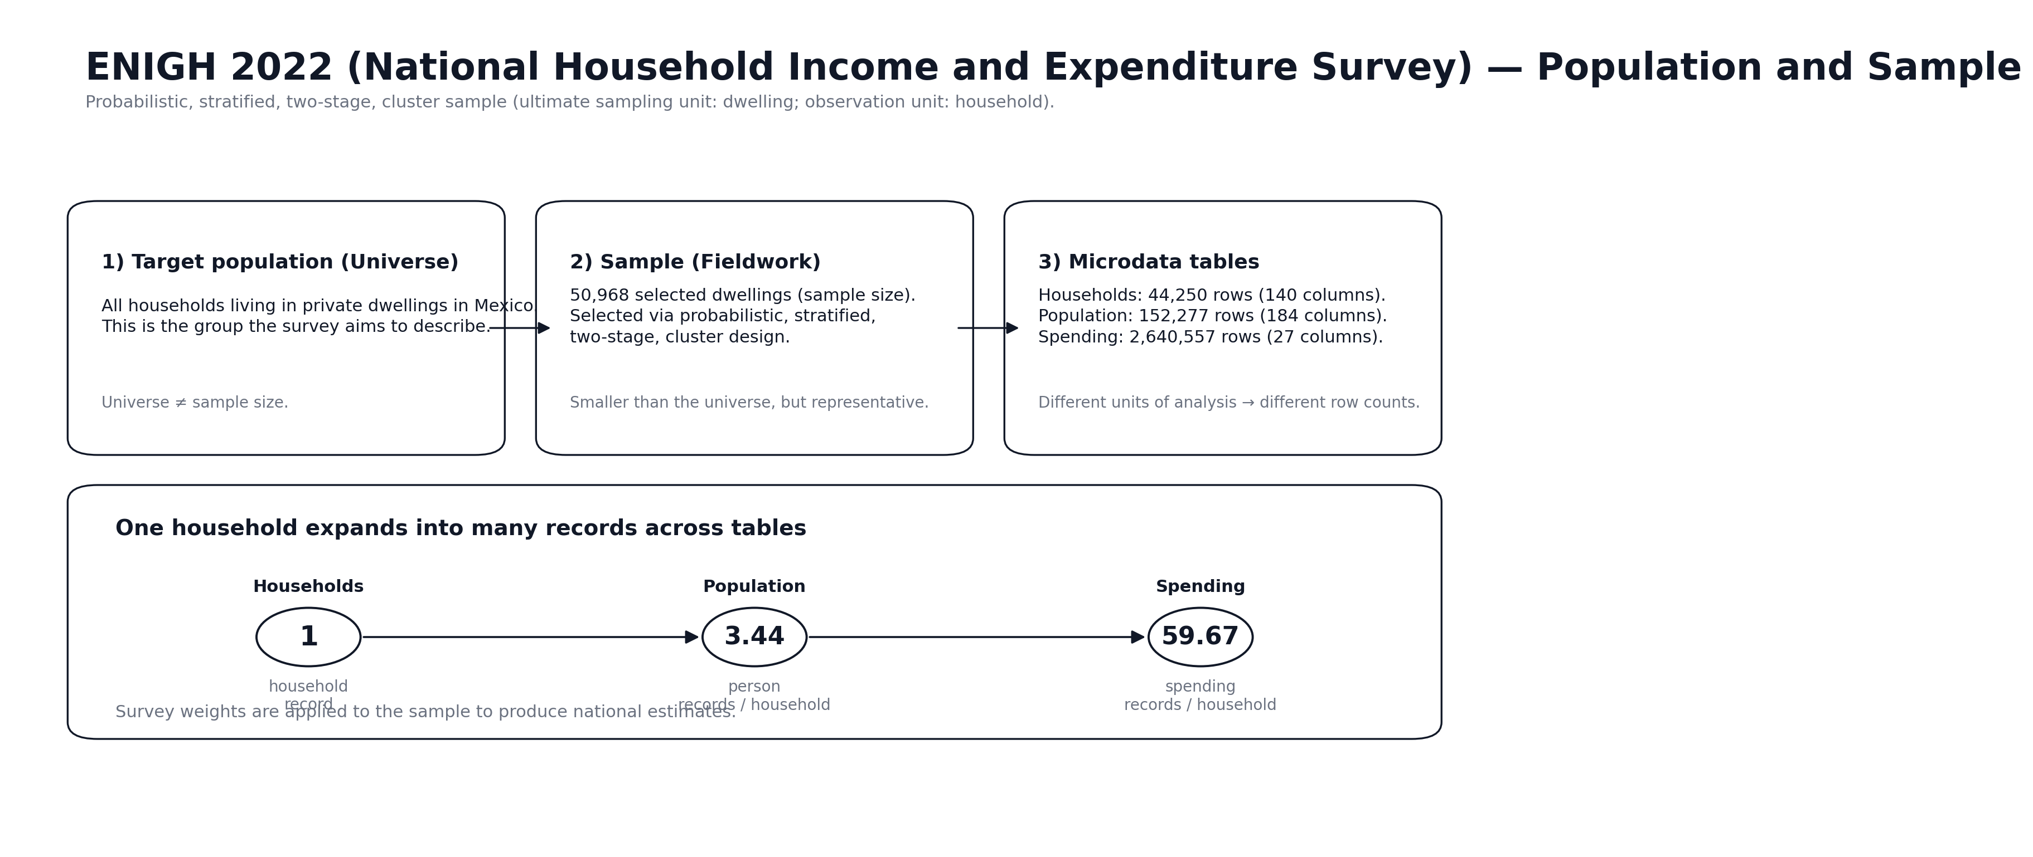
ENIGH: National Household Income and Expenditure Survey
ENIGH Estacional 2022 — base for both G-CPI and the official INPC 2024 update
50,968
households surveyed
4
household headship groups identified
13
CCIF expenditure divisions
2022
seasonal edition — same source as official CPI 2024 weights

Slide 7
Why ENIGH Estacional 2022 and CCIF 2018?
Two official sources — one crosswalk enables the G-CPI construction
Official source — no assumptions needed
Crosswalk: ENIGH categories → CCIF divisions
1
ENIGH is produced by INEGI, the same agency that publishes the CPI. Both the G-CPI expenditure weights AND the official CPI 2024 update use ENIGH 2022. This guarantees methodological coherence.
3
A mapping file (crosswalk_ENIGH_CCIF2018.csv) links each ENIGH expenditure category to its CCIF division. This translation is the methodological backbone of the G-CPI construction.
CCIF 2018 enables international comparison
Seasonal edition = actual quarterly expenditure
2
The CPI Classification of Individual Consumption by Purpose (CCIF/COICOP) is the same standard used by IBGE (Brazil), ONS (UK), and INE (Spain). G-CPI results are directly comparable across G-CPI programs.
4
The 'Estacional' (seasonal) edition captures spending patterns by quarter, making it more representative of real-time consumption than the standard biennial ENIGH. Critical for capturing within-year variation.

Slide 8
Section 2
Methodology

Slide 9
Four Household Headship Groups
Defined by sex of head of household × presence of a partner
MWP
FWoP
MWoP
FWP
Male With Partner
Female Without Partner
Male Without Partner
Female With Partner
24,648
11,531
5,076
2,995
households (48.4%)
households (22.6%)
households (10.0%)
households (5.9%)
Largest group. Two-income potential. Higher transport & education spending. Typically family households with children.
Second largest group. Female-led single-person or lone-parent households. Higher food share, lower transport spending.
Male-led single-person or lone-male households. Highest Restaurants and Personal care weight. Key finding: MOST exposed to inflation.
Smallest group. Female-headed but with partner present. Most stable spending profile. Key finding: LEAST exposed to inflation.
Note: Groups are identified from ENIGH's 'jefatura de hogar' variable. The remaining ~13% of households have mixed or unclassified headship and are excluded from the analysis.

Slide 10
The G-CPI Formula
A Laspeyres-type price index with group-specific expenditure weights
G-CPI(g,t) = Σ w(g,d) × I(d,t) / I(d,0)
where g = group | d = CCIF division | t = month | 0 = base period (2nd fortnight July 2018)
w(g,d)
I(d,t)
Inflation
Group-specific weight
Division price index
Annual inflation rate
Share of total consumption that group g allocates to division d. Computed from ENIGH Estacional 2022. This is what differentiates the G-CPI from the official CPI — each group gets its own basket.
Official INPC index for division d at time t. From INDICE_2022_2025.csv — 48 monthly observations per division, base = July 2018. Published by INEGI, no estimation required.
Computed as [G-CPI(g,t) / G-CPI(g,t-12) − 1] × 100. This gives the 12-month rolling inflation for each group — directly comparable to the official headline CPI rate.

Slide 11
Section 3
Results

Slide 12
Expenditure Weights by Group
Compared to official CPI 2024 national weights — four very different baskets from the same survey
Division | MWP Male+partner | MWoP Male alone | FWP Female+partner | FWoP Female alone | Official CPI 2024
01 Food & beverages | 18.8% | 13.7% | 18.4% | 19.0% | 22.1%
03 Clothing & footwear | 3.1% | 3.7% | 3.1% | 3.1% | 4.3%
04 Housing & utilities | 4.9% | 7.4% | 6.5% | 6.4% | 20.9%
05 Furniture & home | 6.0% | 4.9% | 5.9% | 6.3% | 5.3%
06 Health | 0.8% | 0.8% | 0.8% | 0.8% | 4.1%
07 Transport | 20.9% | 19.1% | 18.4% | 15.7% | 13.5%
08 Communication | 12.6% | 11.5% | 13.6% | 13.9% | 4.7%
09 Recreation & culture | 8.9% | 7.2% | 8.1% | 9.4% | 2.5%
10 Education | 8.9% | 3.9% | 8.8% | 8.0% | 2.5%
11 Restaurants | 10.1% | 15.7% | 11.1% | 10.3% | 11.6%
13 Personal care | 4.6% | 11.1% | 4.9% | 6.4% | 6.0%
🔶 Housing: official CPI 20.9% vs G-CPI groups 4.9–7.4% | 🔴 MWoP outlier: 15.7% Restaurants + 11.1% Personal care (both high-inflation categories)

Slide 13
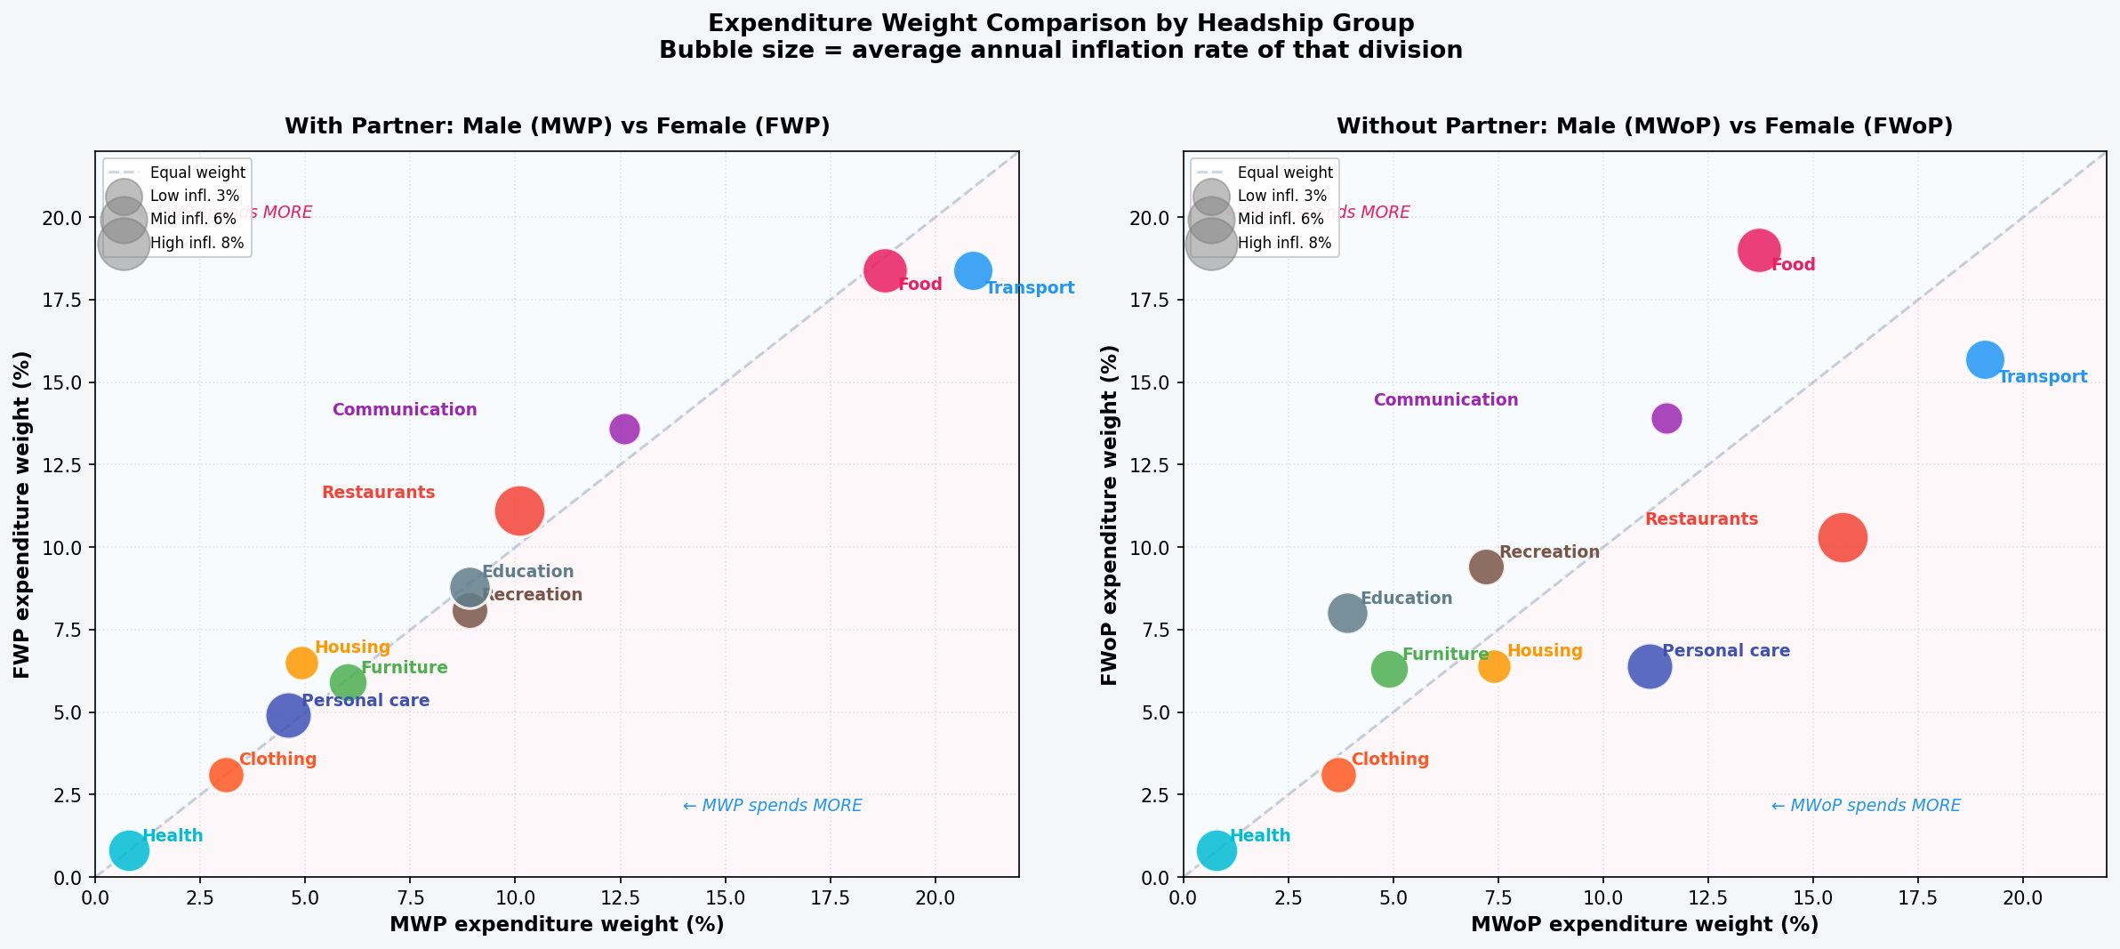
Where Do Groups Spend Differently? — Scatter View
Each bubble = one CCIF division. Position shows male vs female weight. Size = inflation rate of that division.
Bubbles above the diagonal → female-headed households spend proportionally MORE on that division. Bubbles below → male-headed spend more. Larger bubbles = higher inflation → bigger weight on the G-CPI gap.

Slide 14
The 292 CPI Generic Products — What They Are
Official INEGI basket update 2024 — same ENIGH 2022 source as G-CPI
What is a 'genérico'? The CPI basket is built from 292 generic product categories (genéricos) — e.g. 'Tortilla de maíz', 'Gasolina de alto octanaje', 'Sala de belleza y masajes'. Each has a single national weight. The G-CPI currently uses the 13 division aggregates. The next step is to work at the generic level.
Basket composition
Changes 2018 → 2024
35 gender/age-tagged generics
• 99 generics — Food & beverages (Div 01)
• 2018 basket: 299 generics → 2024: 292
• 👩 10 female-specific: shoes, blouses, skirts, makeup, salon, sanitary pads…
• 28 generics — Clothing & footwear (Div 03)
• 261 generics (89.4%) — unchanged
• 👨 10 male-specific: shirts, suits, razors, barbershop, barbacoa…
• 37 generics — Furniture & home (Div 05)
• 25 disaggregated: Streaming added, Bebidas energéticas split, Cilantro separate
• 👶 11 child-specific: school uniforms, baby food, daycare, school fees…
• 23 generics — Transport (Div 07)
• 6 merged: Camarón + Otros mariscos combined
• 4 mixed: children+female clothing, school transport
• 22 generics — Health (Div 06)
• Captures new consumption: streaming, plant-based milk, energy drinks
• Official CPI assigns ONE national weight to each
• 15 generics — Personal care (Div 13)
• Same ENIGH 2022 source → directly comparable to G-CPI
• G-CPI reveals different exposure by headship type
• 8 generics — Restaurants (Div 11)

Slide 15
Gender-Tagged Generics: What the Official CPI Misses
35 of 292 generics have explicit female, male or child profile — all with a single national weight in the official CPI
Generic | Division | Profile | Why it matters for G-CPI
Sala de belleza y masajes | 13 Personal care | 👩 Female | MWoP spends 11.1% on Div 13 vs FWoP 6.4% — but both households buy this product
Toallas sanitarias | 13 Personal care | 👩 Female | Female-headed households buy more — official CPI assigns identical weight to all groups
Navajas / máquinas de afeitar | 13 Personal care | 👨 Male | Higher in male-headed households — contributes to MWoP's elevated personal care weight
Barbacoa o birria | 11 Restaurants | 👨 Male | MWoP spends 15.7% on Restaurants — male-coded consumption drives the gap
Corte de cabello | 13 Personal care | 👨 Male | Systematically higher in male-headed households — a structural, not incidental, pattern
Leche maternizada | 01 Food | 👶 Child | Higher in households with children — linked to MWP and FWP (partner-present groups)
Guarderías e estancias | 10 Education | 👶 Child | MWP and FWP (with partner) spend ~9% on education; MWoP only 3.9%
Connection to G-CPI — and the road ahead
Current G-CPI uses 13 division-level price indices. The official CPI publishes national weights for all 292 generics — but applies them uniformly. Next step (Priority 1): rebuild G-CPI at the generic level. This will reveal whether female-alone households pay more for personal care even within Division 13 — because they buy more salon services and fewer razors.

Slide 16
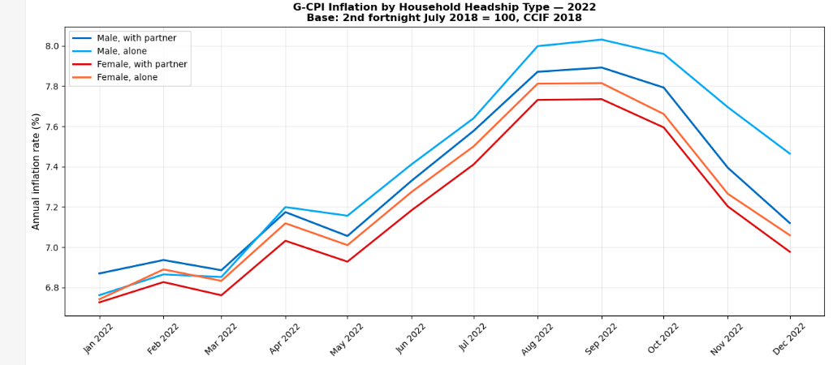
G-CPI Inflation Series — 2022 to 2025
Annual rate (%) by headship group | Base: 2nd fortnight July 2018 = 100, CCIF 2018
All groups follow the same macroeconomic cycle — MWoP (Male Without Partner) is consistently ABOVE all others. The gap is structural and persistent across all phases: shock (2022), moderation (2023–2024), and stabilisation (2025).

Slide 17
Vulnerability Ranking: An Unexpected Result
Mean annual inflation rate — Jan 2023 to Dec 2025 (36 months)
MWoP ranks #1 — male-alone households face the HIGHEST inflation. Restaurants (15.7%) and Personal care (11.1%) are both high-inflation categories (8.0% and 6.2% avg). This combination mechanically produces a higher G-CPI.
FWoP ranks #3 — female-alone households pay LESS than both male groups. The initial hypothesis is rejected. Higher food spending (a mid-inflation category at 5.8%) provides relative protection.
Composition, not sex, determines the ranking. Household structure — alone vs with partner — is the stronger predictor of inflation exposure. The gender framing alone is insufficient.
MWoP − FWP gap: +0.2723 pp — positive in 100% of the 36 months

Slide 18
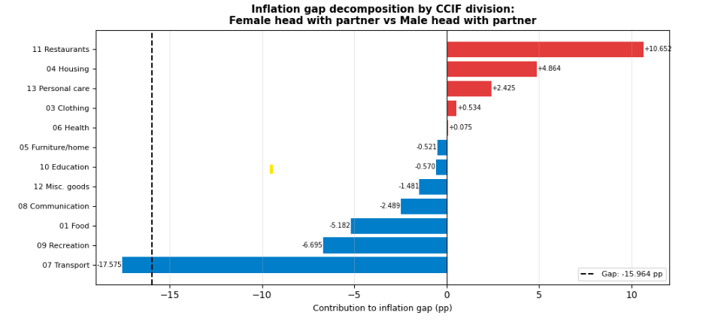
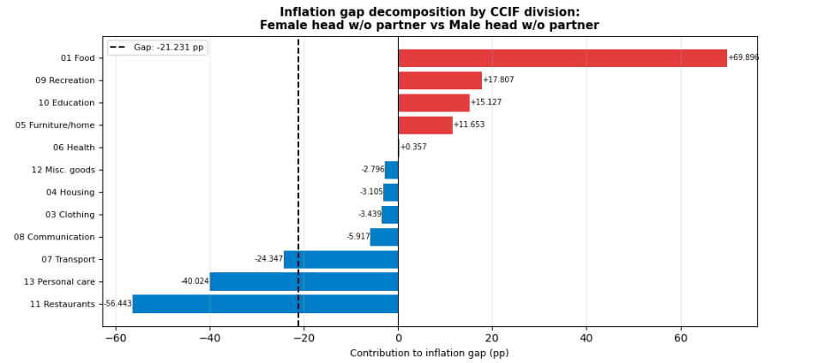
What Drives the Inflation Gap?
Decomposition: contribution(d) = [w(female,d) − w(male,d)] × π(d) | where π(d) = avg annual inflation rate of division d
With partner: FWP vs MWP
Without partner: FWoP vs MWoP
Red = female-headed households spend proportionally MORE on that division (pushes their inflation up). Blue = male-headed spend more (explains why male-alone has higher G-CPI — higher weight on high-inflation Restaurants and Personal care).

Slide 19
Section 4
G-CPI vs. Official CPI
Quantifying the Measurement Bias

Slide 20
G-CPI vs. Official CPI: The Counterfactual
What if we applied the national CPI weights to each group instead of their own basket?
The bias
All groups experience LOWER inflation than the official CPI suggests. Bias (G-CPI minus CPI): MWoP: −0.05 pp MWP: −0.29 pp FWoP: −0.32 pp FWP: −0.34 pp Root cause: Official CPI assigns 20.9% weight to Housing — its lowest-inflation division (2.6% avg). G-CPI groups only spend 5–7% on Housing. This is the single largest source of measurement divergence.

Slide 21
Section 5
Inflation Forecast 2026
G-CPI by Household Headship Type

Slide 22
Forecasting Model: SARIMA(1,0,1)(1,0,1,12)
Fitted independently for each headship group using the G-CPI inflation series 2023–2025 (36 months)
1
Stationarity — Augmented Dickey-Fuller (ADF) Test
All 4 G-CPI inflation series are stationary (p < 0.05) → no differencing required → d = 0, D = 0. The series oscillate around a stable mean — they do not drift permanently in one direction.
2
Model Selection — SARIMA(1,0,1)(1,0,1,12)
AR(1) + MA(1) captures short-term momentum. SAR(1) + SMA(1) captures annual seasonality (12-month cycle). Fitted using statsmodels SARIMAX. AIC: MWP 26.4 | MWoP 17.2 | FWP 25.0 | FWoP 26.5
3
Validation — Ljung-Box Test (white noise check)
Residuals show NO autocorrelation in any of the 4 groups (Ljung-Box p = 1.0 at lag 12). Residuals are white noise → the model has captured all systematic structure in the data. No remaining predictable signal.
4
Forecast — 12-month ahead: January to December 2026
Point forecast + 95% confidence intervals from the model's prediction variance. The vulnerability ranking (MWoP > MWP > FWoP > FWP) is preserved in every month of the 2026 forecast — a structural pattern, not a coincidence.

Slide 23
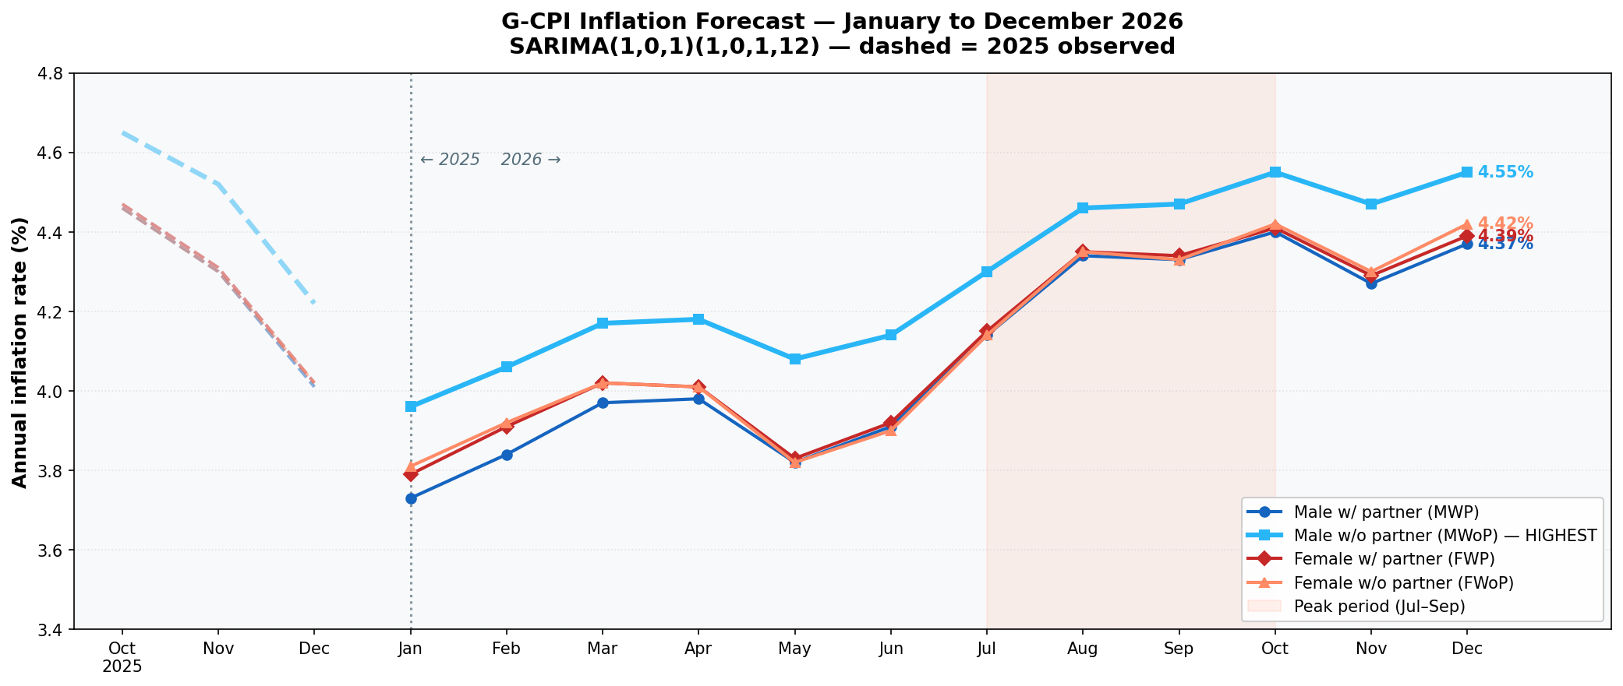
G-CPI Inflation Forecast — Visual Projection 2026
SARIMA(1,0,1)(1,0,1,12) — dashed lines = observed 2025 data for continuity context
MWoP remains the most vulnerable group every single month of 2026. All groups follow a seasonal V-shape: dip in Q1, rebound in Q3. Forecast range: 3.7% (Jan) to 4.6% (Oct). Moderate inflation consistent with Banco de México convergence path.

Slide 24
G-CPI Inflation Forecast — Monthly Values 2026
SARIMA(1,0,1)(1,0,1,12) — point forecasts (%)
Month | MWP Male+partner | MWoP Male alone | FWP Female+partner | FWoP Female alone
Jan 2026 | 3.73% | 3.96% | 3.79% | 3.81%
Feb 2026 | 3.84% | 4.06% | 3.91% | 3.92%
Mar 2026 | 3.97% | 4.17% | 4.02% | 4.02%
Apr 2026 | 3.98% | 4.18% | 4.01% | 4.01%
May 2026 | 3.82% | 4.08% | 3.83% | 3.82%
Jun 2026 | 3.91% | 4.14% | 3.92% | 3.90%
Jul 2026 | 4.14% | 4.30% | 4.15% | 4.14%
Aug 2026 | 4.34% | 4.46% | 4.35% | 4.35%
Sep 2026 | 4.33% | 4.47% | 4.34% | 4.33%
Oct 2026 | 4.40% | 4.55% | 4.41% | 4.42%
Nov 2026 | 4.27% | 4.47% | 4.29% | 4.30%
Dec 2026 | 4.37% | 4.55% | 4.39% | 4.42%
Key patterns
MWoP highest in every single month of 2026
All groups: dip in Q1, rise in Q3 — persistent seasonal cycle
Gradual moderation continues — peak ~4.6% vs 2022 peak ~8%
The vulnerability ranking is structurally preserved
Bold = Jul–Oct 2026 peak period

Slide 25
Conclusions &
Next Steps

Slide 26
Conclusions
Revisiting the hypothesis — what the data actually shows
"The inflation gap in Mexico is not a gender story — it is a household composition story."
01
Hypothesis partially confirmed — but reversed
03
Vulnerability gap is persistent and forecastable
Female-alone households (FWoP) do NOT pay the most inflation. Male-alone (MWoP) does. The initial gender assumption was wrong — household structure matters more than the sex of the head.
MWoP leads every month in 2022–2025 and in the 2026 forecast. The +0.27 pp gap is structural, not cyclical — driven by stable consumption patterns, not temporary shocks.
02
Official CPI overestimates for all groups
04
G-CPI is a replicable, updatable official framework
By 0.05–0.34 pp. Root cause: 20.9% national weight on Housing (2.6% inflation) vs 5–7% in G-CPI groups. The official basket systematically under-represents how G-CPI households actually spend.
Built entirely on INEGI official data. Python workflow is documented and ready to update with each new ENIGH wave or CPI revision. Designed to be institutionalised, not just researched.

Slide 27
Limitations & Robustness
Honest assessment of what the G-CPI can and cannot claim
Division-level aggregation
SARIMA forecast: 36 observations
L1
G-CPI uses 13 CCIF division indices, not 292 generic-level prices. Within-division price variation is invisible — the model assumes each group faces the same price for, say, 'personal care' even when they buy different products within that division.
L3
The model is fitted on 36 monthly data points — a short series for time-series modelling. Wide confidence intervals (not shown for readability) reflect this uncertainty. The forecast is directionally informative, not precise.
Base period weights (2022)
Robustness: ranking is consistent across periods
L2
Expenditure weights are fixed at 2022 levels. They do not update as prices change or as households adapt their consumption. This is standard Laspeyres methodology, but it means G-CPI does not capture substitution effects.
R1
MWoP > MWP > FWoP > FWP in 2022 (shock), 2023 (moderation), 2024 (stabilisation), and 2026 (forecast). The ranking does not depend on the choice of period — it is structurally stable.

Slide 28
Next Steps
Three lines of development identified with mentor Arthur Beltrao (IBGE)
Generic-level G-CPI (292 products)
Infrastructure
ready
1
Rebuild G-CPI using individual product price series instead of 13 division indices. Enables matching specific female-consumption products and eliminates within-division aggregation bias. All infrastructure is ready — crosswalk, inventory, price series.
Specialised male and female consumption baskets
Conceptually
defined
2
Identify products where female-headed spending share > 60% and build a focused sub-index. Answers: is inflation higher specifically for products women buy more of? This tests the gender hypothesis at the most granular level possible.
Extend and refine the SARIMA forecast
3
Incorporate new CPI data as published (quincenal), update the model quarterly, and explore Vector Autoregression (VAR) to capture cross-group inflation dynamics and potential spillover effects.
Model fitted
& validated

Slide 29
Thank you!
Itzel Sanchez INEGI — Mexico Mentor: Arthur Beltrao | IBGE — Brazil
International Data Science Accelerator — Cohort VI | March 11, 2026

