Slide 1
EDUBRIDGE INDIA
NAME: SAHANA M
BATCH: 2021-6138
ENROLLMENT NUMBER: EBEON0921438529
COURSE: JAVA FULL STACK DEVELOPMENT

Slide 2

HOTEL MANAGEMENT TOOL

Slide 3
FEATURES:
Storing customer details
Booking rooms of four different types.
Ordering food for particular rooms.
Unbooking rooms.
Showing the bill.
It can also be used to see different room features and room availability.

Slide 4
WORKING TECHNICS:
It is a menu driven program.
File handling has been used to store the current status.
The program uses thread for reads and writing of file.
User defined exception and Exception handling is used to throw the necessary exceptions.

Slide 5
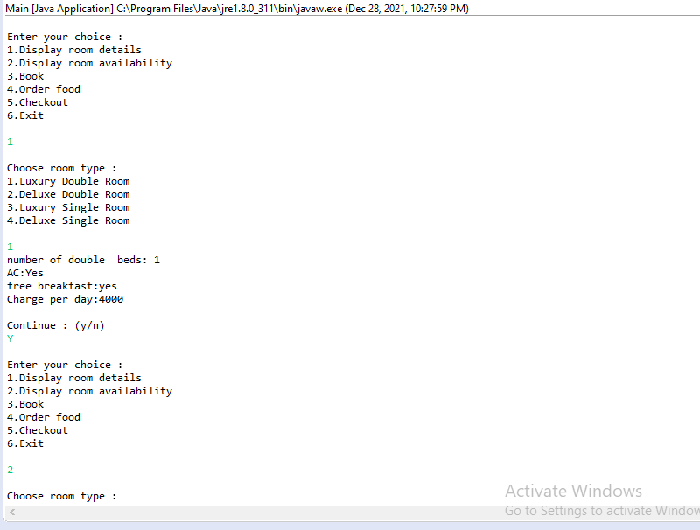
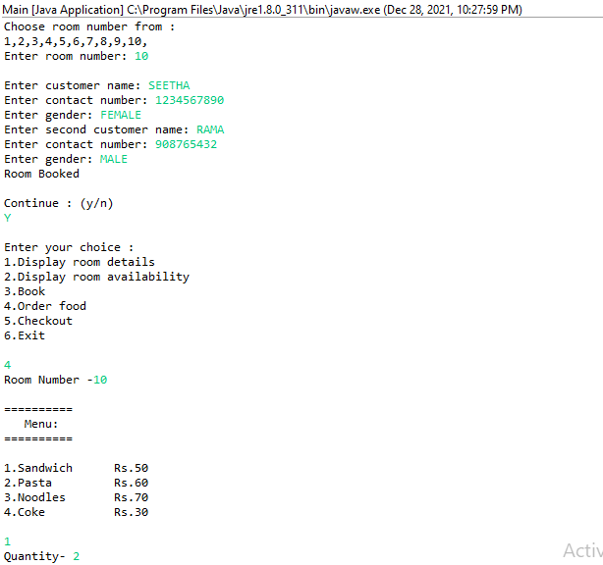
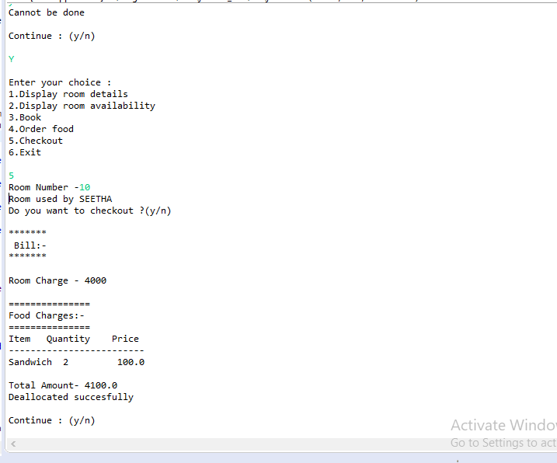
OUTPUT

Slide 6
THANK YOU

