Slide 1
Predictive analysis of ambient conditions for crop growth using Internet of Things
S A Hariprasad 18BCE0868
Nikhil K 18BCE2321

Slide 2
Abstract
In a rapidly developing country like India, which has the world’s highest growing GDP Urbanization is being seen in every nuke and corner of the country. The difference between the population density of the cities and rural areas are very high. The population of the cities are growing exponentially every year, because of which the agricultural farms in and around the cities are being converted into residential sky scrapers. The need and demand for crops and food is growing up but the area to grow is going down. Due to this alarming scenario, hydropic agriculture has risen in popularity and practice. It is a form of agriculture in which the plants are grown with restricted water supply. In this work, we are growing coriander plant in a controlled environment with constant monitoring, the controlled environment being restricted water supply I,e Hydroponic farming. Various parameters like Soil pH, Moisture levels etc. are recorded on daily basis and made into a data set. This data set, then with the help of Supervised Machine Learning algorithms we are going to Co-Relate the data collected via IOT by the help of Regression Models ,find the trends within the taken parameters and give an idea as to which conditions give a better yield.
Keywords: Supervised Machine Learning Algorithms, Regression Models, Controlled Environment, Hydroponic, Urbanization

Slide 3
Objective
The main objective of our work is to find and show the correlation between various parameters take into account while growing a crop through hydroponic agriculture and predict the range of parameters which result in the best growth of the crops.

Slide 4
Problem Statement
In this fast paced world the population in metropolitan Cities is growing exponentially. This is due to both ecological factors and also migration into the cities because of urbanization for a better lifestyle which is directly proportional to the rise in population density. With increasing urbanization and depleting natural resources, it is getting very difficult to satisfy the very basic needs of the population. With cities expanding, Once agricultural land is now being made into real estate for development which in turn is leading to scarcity of staple foods.
This is the main reason why there is a rise in demand for hydropic and other forms of sustainable agriculture.

Slide 5
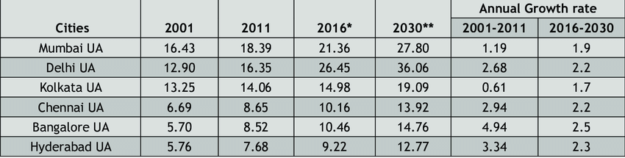
Exponential growth in metropolitan cities in India

Slide 6
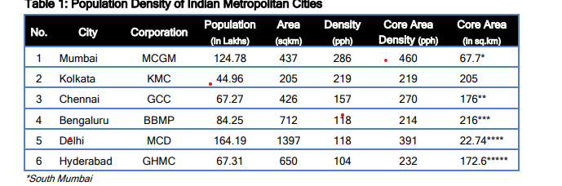
The population density in Indian metropolitan cities

Slide 7
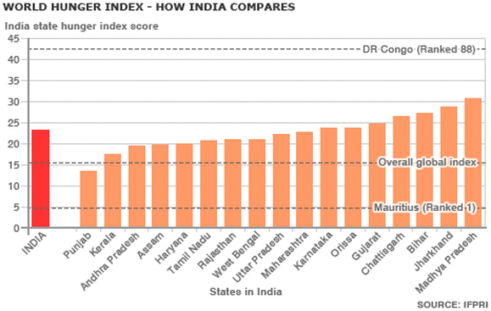
World Hunger Index in India

Slide 8
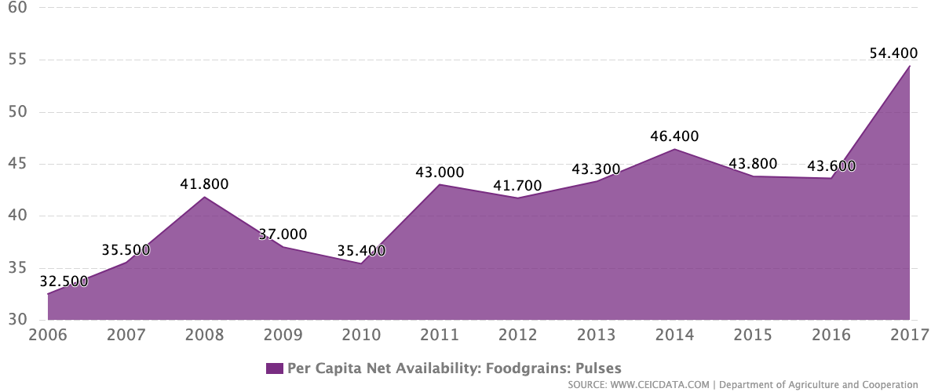
Per capita Net Availability in India

Slide 9
Introduction
Agriculture is the primary occupation in India and is the backbone of Indian economic system. Agriculture provides employment opportunities to rural people on a large scale in underdeveloped and developing countries in addition to providing food. It is the process of producing food, fibre and many other desired products by the cultivation and raising of domestic animals. Agriculture is the primary source of livelihood for about more than 58% of India’s population.
As the population of the city grows significantly the need to feed the city heavily lays on the need of agricultural land. As most of the agriculture lands are dried up due to lack of water the need for starvation increases. Hence cities have to start cultivating crops and the need for automated farming in cities becomes crucial.

Slide 10
Climate changes will have a significant impact on agriculture by increasing water demand and limiting crop productivity in areas where irrigation is most needed. Irrigation system, rain fed agriculture, groundwater irrigation are some of the methods introduced to produce healthier crops which may not use water efficiently. In order to use water efficiently a smart system is designed. In the system farmers need not make the water flow into fields manually, but the system automatically does that efficiently.
The traditional methods practiced by people may result in huge wastage of water. Hence, the concept of robotized farming with a mix of IoT has been developed. The technological advancements began to increase the efficiency of production remarkably thus, making it a reliable system. The knowledge of properties of soil determines the water supply to be driven in a smart way. The practice of agriculture in a smart way helps to acquire knowledge of soil and temperature conditions. Developing the smart agriculture using IoT based systems not only increases the production but also avoids wastage of water

Slide 11
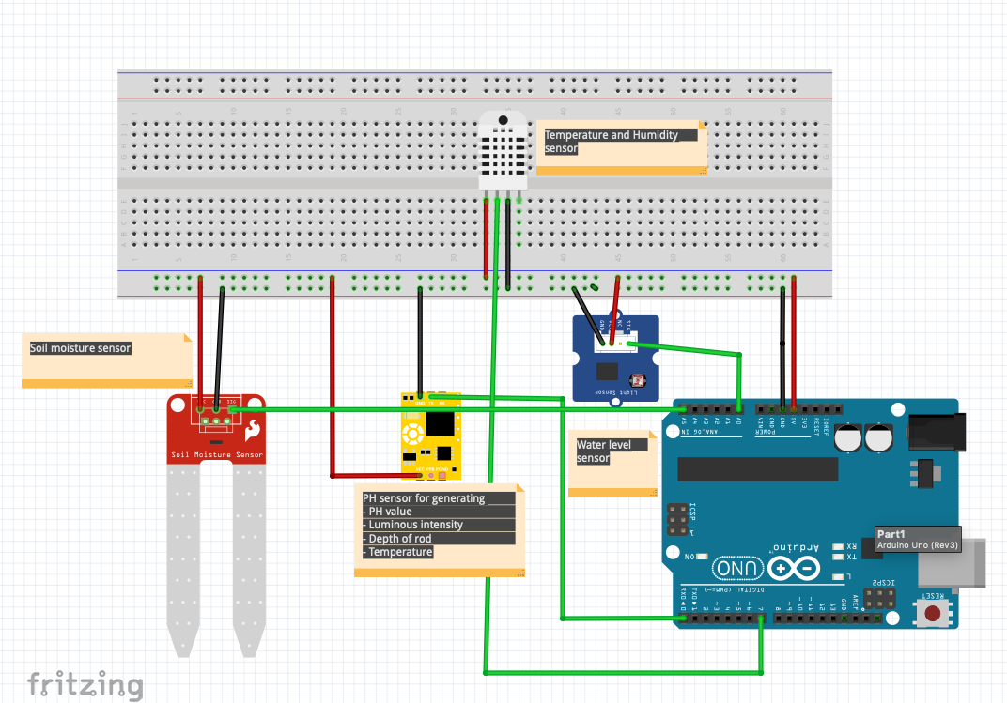
Circuit Diagram

Slide 12
Sensor connection from Arduino
SENSOR | FROM | TO
PH SENSOR | TX | RX
 | VCC | VCC
 | GND | GND
DHT 22
 | VCC | VCC
 | GND | GND
SOIL MOISTURE | DATA | A1
 | VCC | VCC
 | GND | GND
WATER LEVEL SENSOR | DATA | A2
 | VCC | VCC
 | GND | GND

Slide 13
Conclusion
In the current stage of our project we have implemented a hydroponic system to cultivate coriander crop where we are collecting data parameters such as ph value, temperature, humidity, soil moisture, and water level in the system. We are planning to collect data till the plant reaches its full growth and we will be analysing the trends in data using regression model and data analysis. After analysing the data we will be able to implement a prototype that can help people grow crops in cities through automation and improve more cultivation in urban areas. Hydroponic systems are going to become the future of agriculture in urban areas and help farmers to reduce the burden to provide food to urban regions.

